Slide 1
McStasScript, a McStas python API
Mads Bertelsen
Mads.Bertelsen@esss.se
Post Doc, Funding from PaNOSC and HighNESS
European Spallation Source ERIC
4/6/2021 @ PNPI

Slide 2
McStasScript
McStas situation and usability
Instrument file (meta language)
Instrument definition
Declare section
Initialize section
Trace section
Finally section
Code spread out instead of collected
Think of a chopper: code in 1, 2, 3, 4
Large files can become difficult
Component library
Instrument file
c file
Executable
McStas
compiler
Users
c - compiler
This project has received funding from the European Union’s Horizon 2020 research and innovation programme under grant agreement No. 823852

Slide 3
McStasScript
Overview
McStasScript
Python API
Python API that manages instrument file
Traditional Python advantages
Jupyter Notebook
More choice in code placement
Import instrument
Generate instrument file
Instrument file
c file
Executable
McStas
compiler
Users
c - compiler
This project has received funding from the European Union’s Horizon 2020 research and innovation programme under grant agreement No. 823852

Slide 4
McStasScript
Overview
McStasScript
Python API
Python API that manages instrument file
Traditional Python advantages
Jupyter Notebook
More choice in code placement
Local components
Produced data
Generate instrument file
Instrument file
c file
Executable
Reads the local components
Handles compilation / execution
Handles import of data
McStas
compiler
Users
c - compiler
This project has received funding from the European Union’s Horizon 2020 research and innovation programme under grant agreement No. 823852

Slide 5
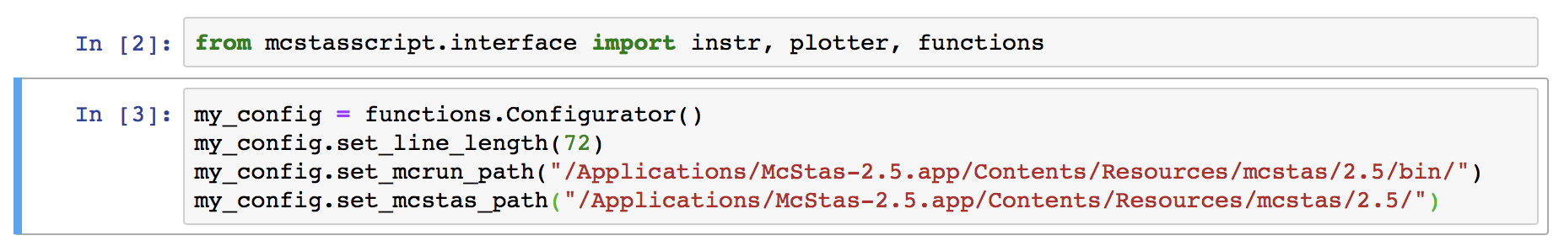
McStasScript
Syntax walkthrough
Installation
Python –m pip install McStasScript
Configuration
Set path to mcrun utility
Set path to components
This project has received funding from the European Union’s Horizon 2020 research and innovation programme under grant agreement No. 823852

Slide 6
McStasScript
Syntax walkthrough
Create a new instrument object
This project has received funding from the European Union’s Horizon 2020 research and innovation programme under grant agreement No. 823852

Slide 7
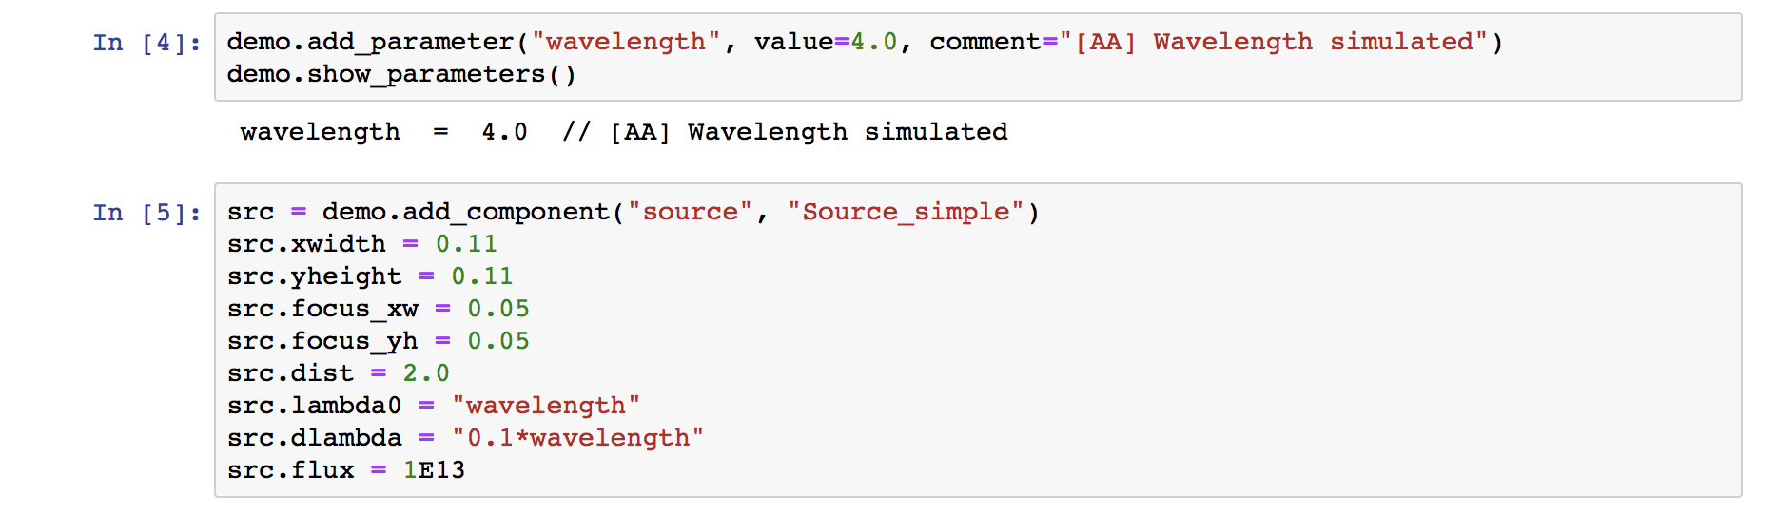
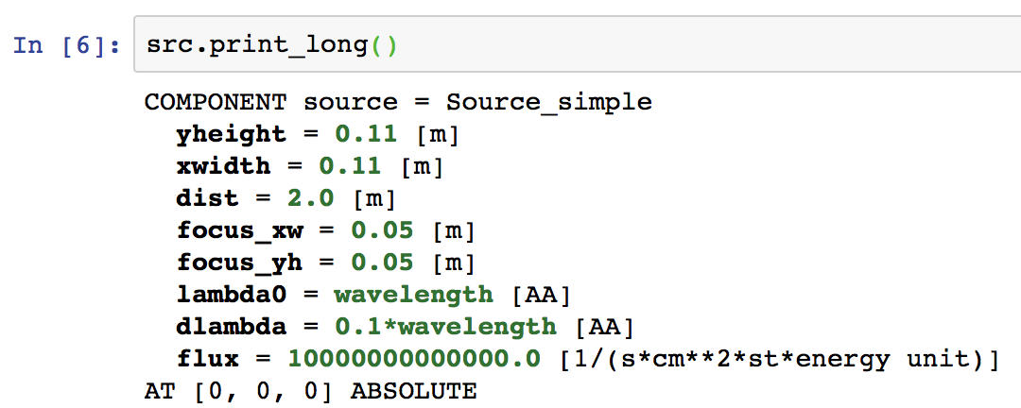
McStasScript
Syntax walkthrough
Add instrument parameter
Add a component
Print component state
This project has received funding from the European Union’s Horizon 2020 research and innovation programme under grant agreement No. 823852

Slide 8
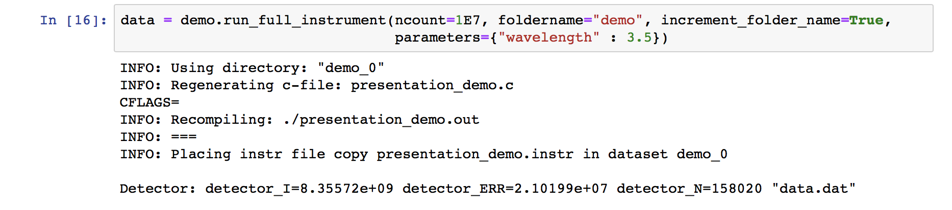
McStasScript
Syntax walkthrough
Run the simulation from python
Data returned as simple object with numpy data arrays
This project has received funding from the European Union’s Horizon 2020 research and innovation programme under grant agreement No. 823852

Slide 9
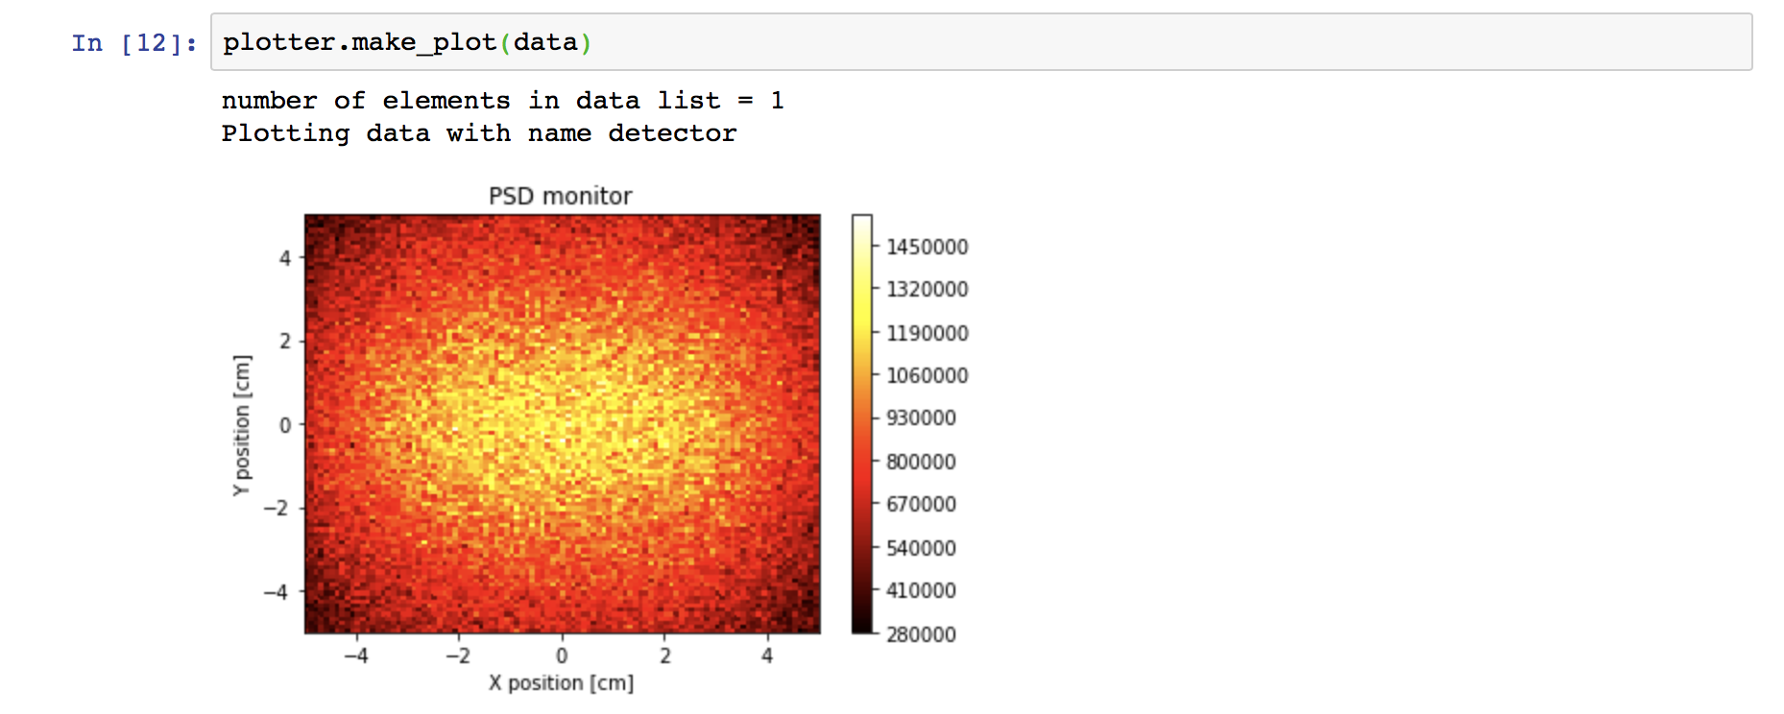
McStasScript
Syntax walkthrough
Running simulation
Getting the data
This project has received funding from the European Union’s Horizon 2020 research and innovation programme under grant agreement No. 823852

Slide 10
McStasScript
Status of the project
On github, open source, happy to collaborate
Documentation both in pdf document and docstrings
199 unit tests (plotting and reader not yet tested)
Integration tests
Still work to do on API, may rename some methods / functions / keywords
Improvements planned on plotting and data handling
This project has received funding from the European Union’s Horizon 2020 research and innovation programme under grant agreement No. 823852

Slide 11
McStasScript
Demo
Try it out yourself right now!
Follow link to login page
Ask for a user in chat, we provide username and password
Select IKON python course and start Jupyter Hub
Select McStas container at start up
Navigate to python-course-ikon/notebooks/5_McStas
Here you will find McStasScript tutorial and McStas Union tutorial
Would recommend McStasScript_tutorial_1 and Union_tutorial_2
This project has received funding from the European Union’s Horizon 2020 research and innovation programme under grant agreement No. 823852

Slide 12
Thanks for your attention!
Mads Bertelsen
Mads.Bertelsen@esss.se
Post Doc, Funding from PaNOSC and HighNESS
European Spallation Source ERIC

