Slide 1
guide_bot
Mads Bertelsen
Post Doc at DMSC in DRAM group led by Thomas Holm Rod
European Spallation Source ERIC
4/6 2021 @ PNPI

Slide 2
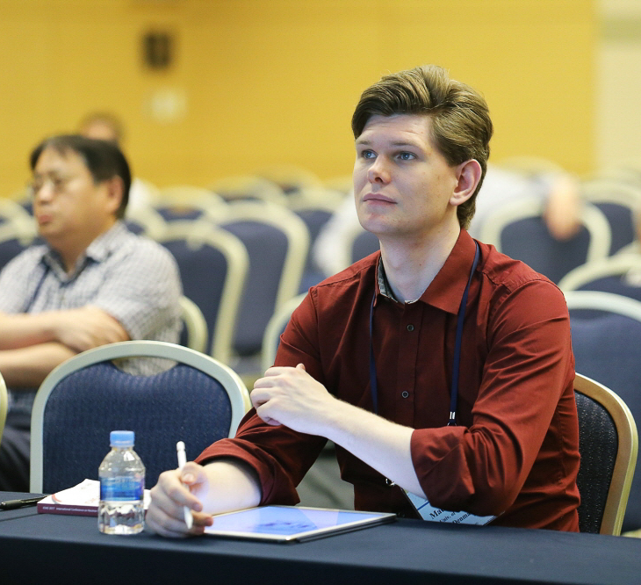
Introduction
Mads Bertelsen
Who am I?
Worked with McStas last 9 years, now McStas developer
PhD from University of Copenhagen under Kim Lefmann in 2017
Now Post Doc at ESS Data Managment and Software Centre, funded by PaNOSC and HighNESS
Writes software, happy when someone wants to use it and learn about my projects!
guide_bot
Automatic guide optimization given requirements and overall geometry (MATLAB)
Union components
Modular samples, multiple scattering within McStas
McStasScript
Flexible McStas Python API
This project has received funding from the European Union’s Horizon 2020 research and innovation programme under grant agreement No. 823852

Slide 3
Introduction
Mads Bertelsen
Slight restructuring for today!
guide_bot talk, shorter than planned
break
Union components and simulating sample environments
break
McStasScript and oppertunity to try online!
guide_bot
Automatic guide optimization given requirements and overall geometry (MATLAB)
Union components
Modular samples, multiple scattering within McStas
McStasScript
Flexible McStas Python API
This project has received funding from the European Union’s Horizon 2020 research and innovation programme under grant agreement No. 823852

Slide 4
guide_bot
Guide design workflow
General problem, provide the best guide for given beam requirements
Guide design is a laborious process and many alternative solutions exists
In many cases the amount of work involved means only few solutions are investigated
Beam requirements and constraints
(figure of merit)
Think of guide geometries
Compare solutions
Simulate, optimize, characterize
HighNESS is funded by the European Framework for Research and Innovation Horizon 2020, under grant agreement 951782

Slide 5


guide_bot
guide_bot was my attempt to provide a tool that will ease the process of guide design
The first version of guide_bot was written in 2013 using MATLAB
Simple system for describing guide geometry
Writes McStas instrument file corresponding to the geometry
Sets up numerical optimization using iFit written by Emmanuel Farhi
Runs on ESS DMSC cluster
Produces figures describing the guide performance
This first version of guide_bot is sadly obsolete
New version is being written in python
iFit
https://github.com/mads-bertelsen/guide_bot
Bertelsen, M. (2017). The automatic neutron guide optimizer guide_bot.
Nuclear Instruments and Methods in Physics Research Section A: Accelerators, Spectrometers, Detectors and Associated Equipment, 830, 313-324. https://doi.org/10.1016/j.nima.2017.06.012

Slide 6
guide_bot
Input Job description
Geometry string
Optimization
Optimization of the guide
Output
Guide characterization
Scan of optimizations
Description of desired beam
Instrument length
Facility information
Computing options
Coating description (not optimized)

Slide 7

guide_bot
Input Job description
Geometry string
Optimization
Optimization of the guide
Output
Guide characterization
Scan of optimizations
S

Slide 8

guide_bot
Input Job description
Geometry string
Optimization
Optimization of the guide
Output
Guide characterization
Scan of optimizations
S S

Slide 9
guide_bot
Input Job description
Geometry string
Optimization
Optimization of the guide
Output
Guide characterization
Scan of optimizations
S S E S

Slide 10
guide_bot
Input Job description
Geometry string
Optimization
Optimization of the guide
Output
Guide characterization
Scan of optimizations
Module | Description
S | Straight guide
E | Elliptic guide
P | Parabolic guide
G | Gap
C | Curved guide
K | Kink
Selene | Selene guide system
Slit | Slit
M | Monochromator
Contributed by Leland Harriger, NIST, USA

Slide 11
guide_bot
Input Job description
Geometry string
Optimization
Optimization of the guide
Output
Guide characterization
Scan of optimizations
S C(start=6) S(maxlength=20)
Code | Function
length | Length of the module
start | Start of the module
StartWidth | Start width of a module
StartHeight | Start height of a module
EndWidth | End width of a module
EndHeight | End height of a module

Slide 12
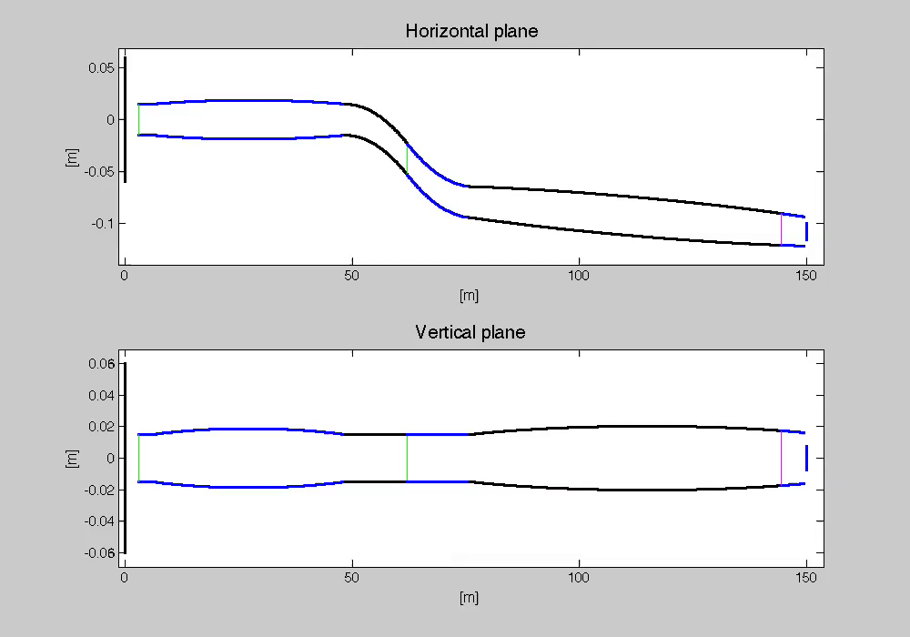
guide_bot
Input Job description
Geometry string
Optimization
Optimization of the guide
Output
Guide characterization
Scan of optimizations

Slide 13
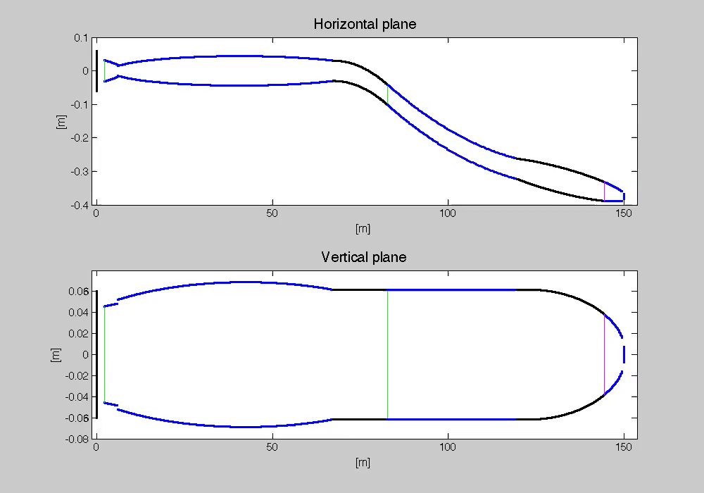
guide_bot
Input Job description
Geometry string
Optimization
Optimization of the guide
Output
Guide characterization
Scan of optimizations

Slide 14
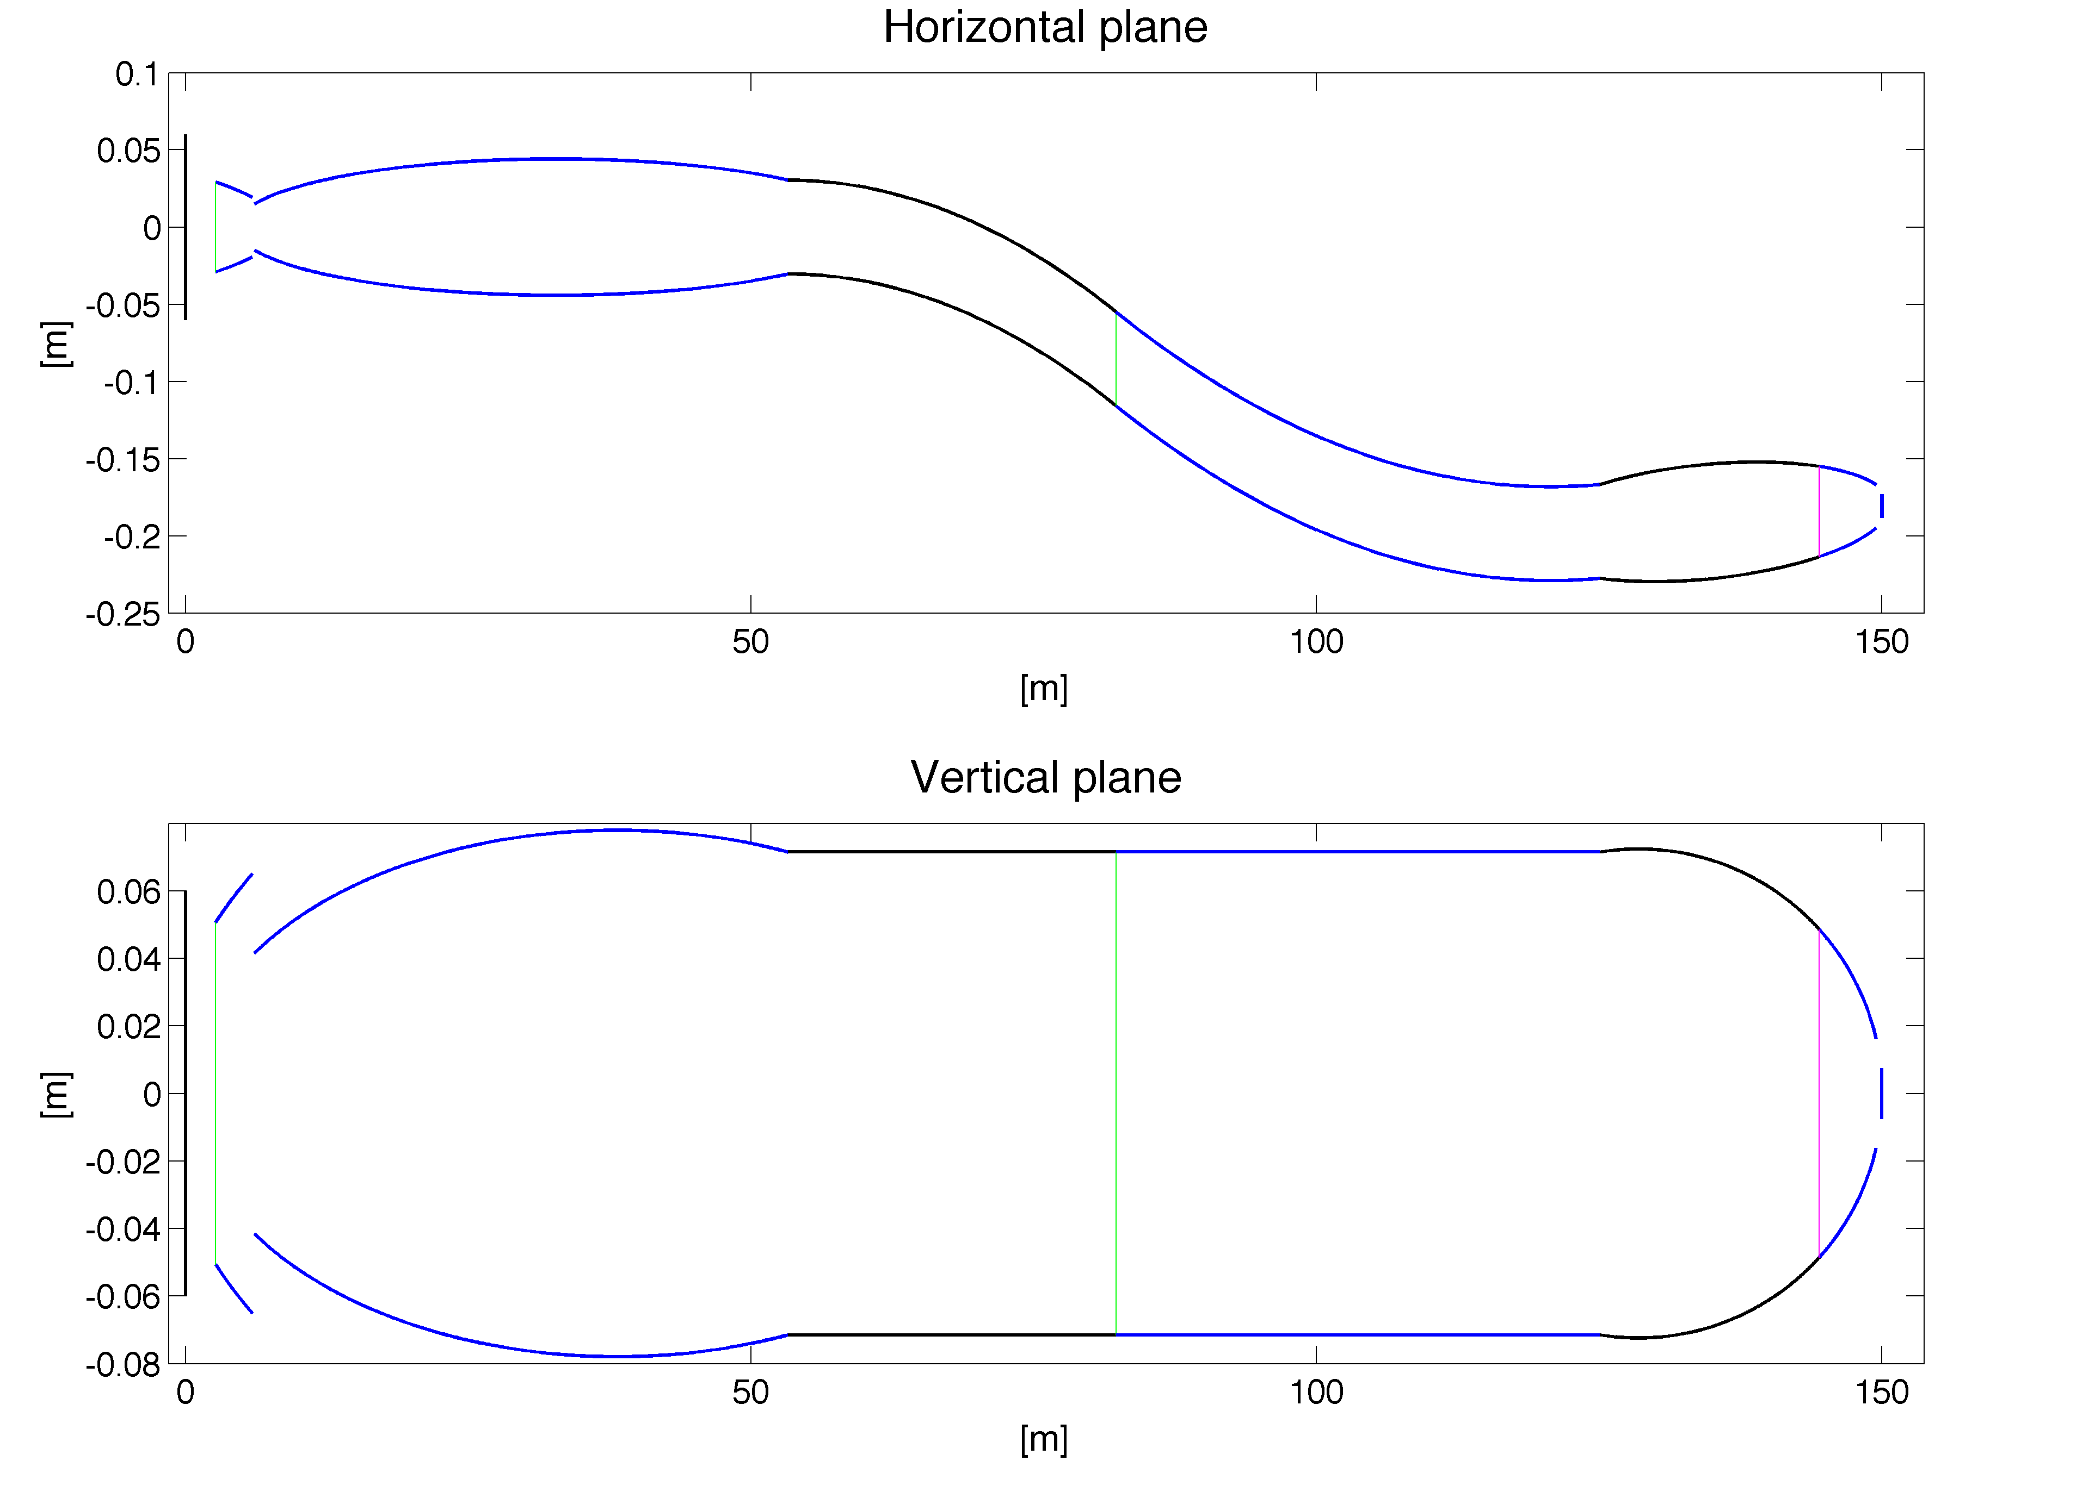
guide_bot
Input Job description
Geometry string
Optimization
Optimization of the guide
Output
Guide characterization
Scan of optimizations

Slide 15
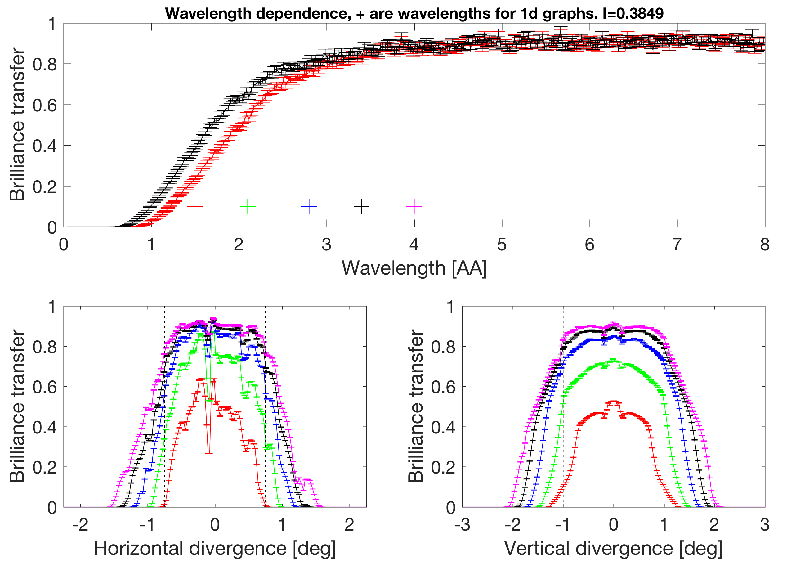
guide_bot
Input Job description
Geometry string
Optimization
Optimization of the guide
Output
Guide characterization
Scan of optimizations

Slide 16
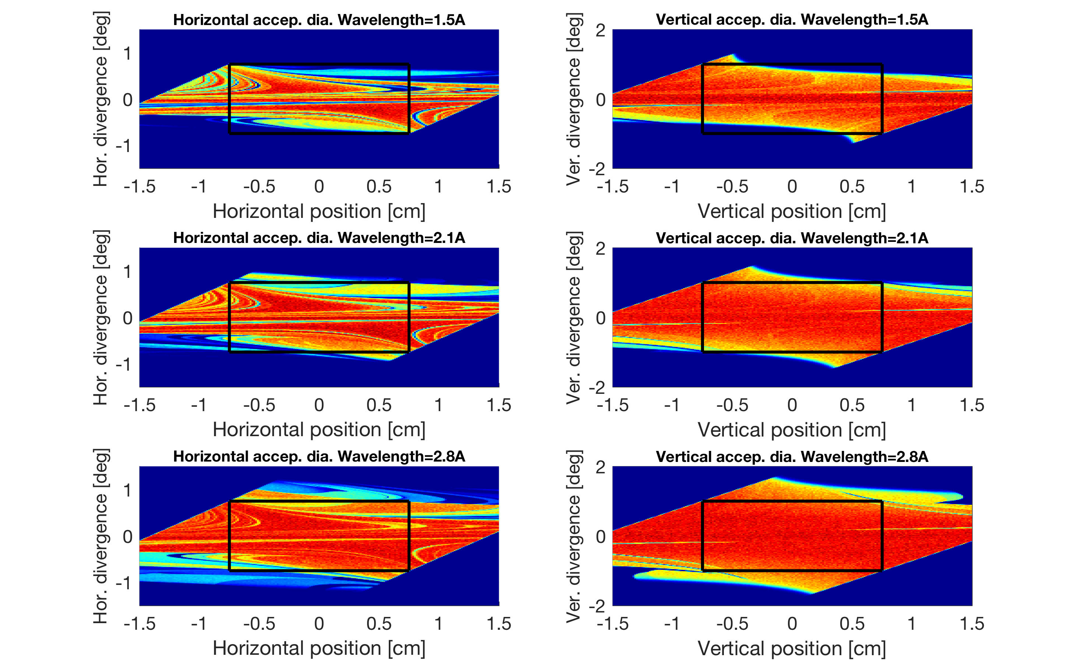
guide_bot
Input Job description
Geometry string
Optimization
Optimization of the guide
Output
Guide characterization
Scan of optimizations

Slide 17
guide_bot
ESS moderator height scan
Input Job description
Geometry string
Optimization
Optimization of the guide
Output
Guide characterization
Scan of optimizations
Often the beam requirements are not well defined
”How large a sample would be reasonable before loosing brilliance transfer?”
Scan beam requirements and optimize all guides for value
Scan dimensions Moderator dimensions Divergence requirement Sample size

Slide 18
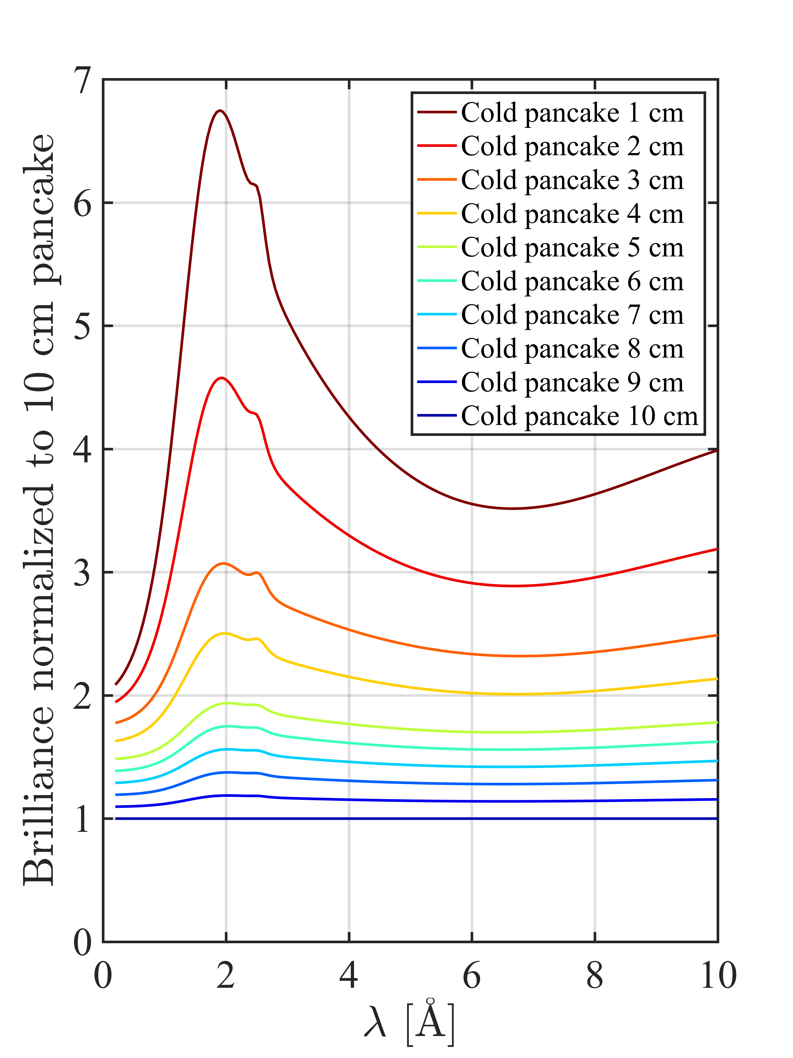
guide_bot
ESS moderator height scan
Scan dimensions Moderator dimensions Divergence requirement Sample size
Used in connection with ESS moderator decision
Input Job description
Geometry string
Optimization
Optimization of the guide
Output
Guide characterization
Scan of optimizations

Slide 19
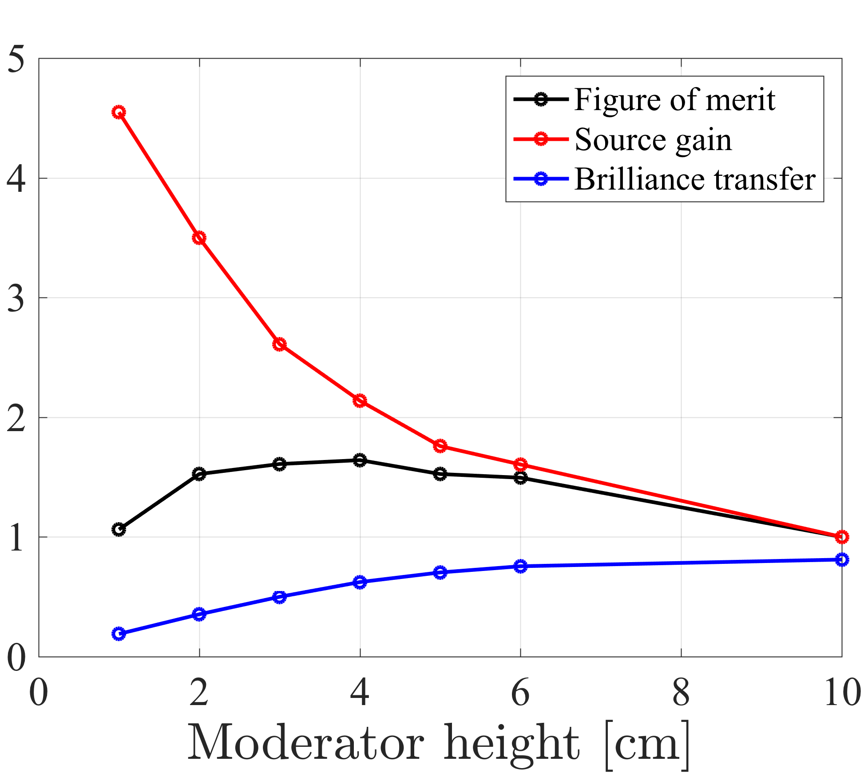
guide_bot
ESS moderator height scan
Input Job description
Geometry string
Optimization
Optimization of the guide
Output
Guide characterization
Scan of optimizations
C-SPEC results

Slide 20
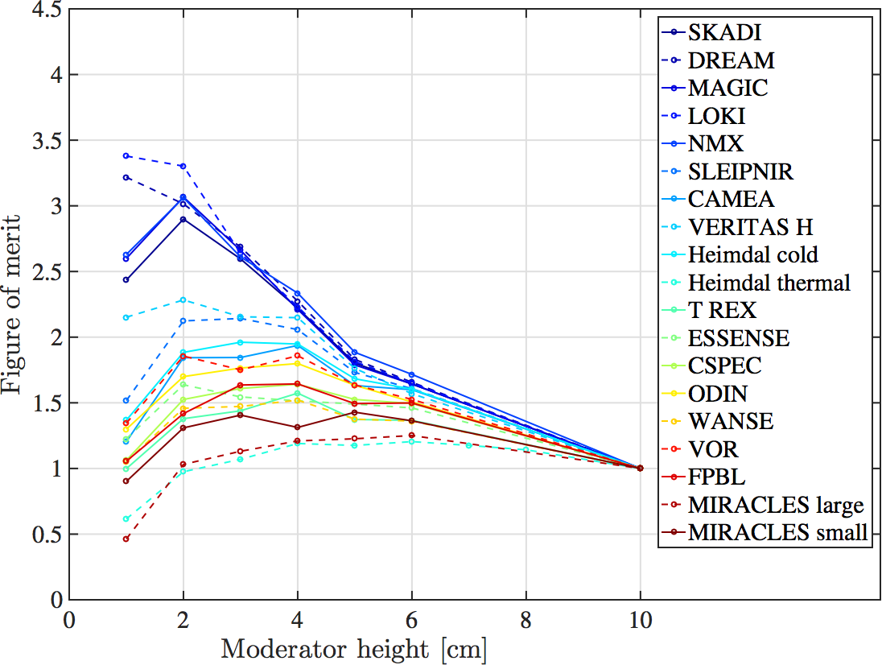
guide_bot
ESS moderator height scan
Input Job description
Geometry string
Optimization
Optimization of the guide
Output
Guide characterization
Scan of optimizations
Guide start 2 m from source

Slide 21
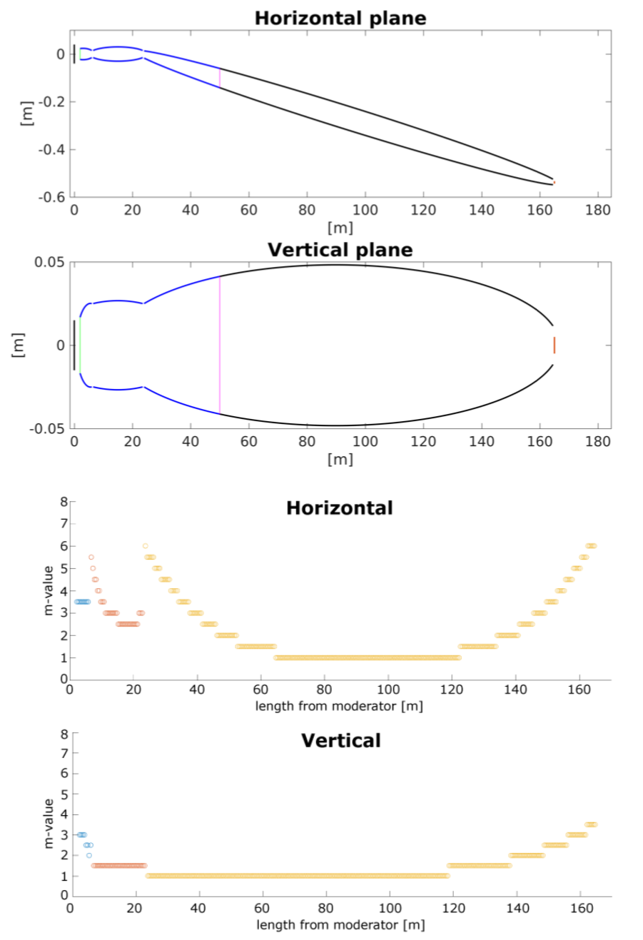
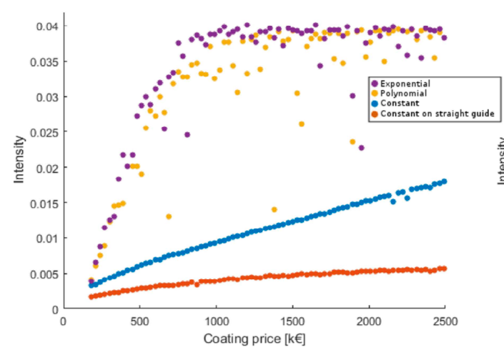
guide_bot
CoatingWriter expansion
Coating optimization add-on to guide_bot by Martin Olsen (KU)
Can optimize coating / geometry simultaneously or sequentially
https://github.com/MartinAOlsen/CoatingWriter
Olsen, M. A., Bertelsen, M., & Lefmann, K. (2018). Optimizing neutron guides: CoatingWriter.
Journal of Neutron Research, 20(4), 137-139. https://doi.org/10.3233/JNR-180098

Slide 22
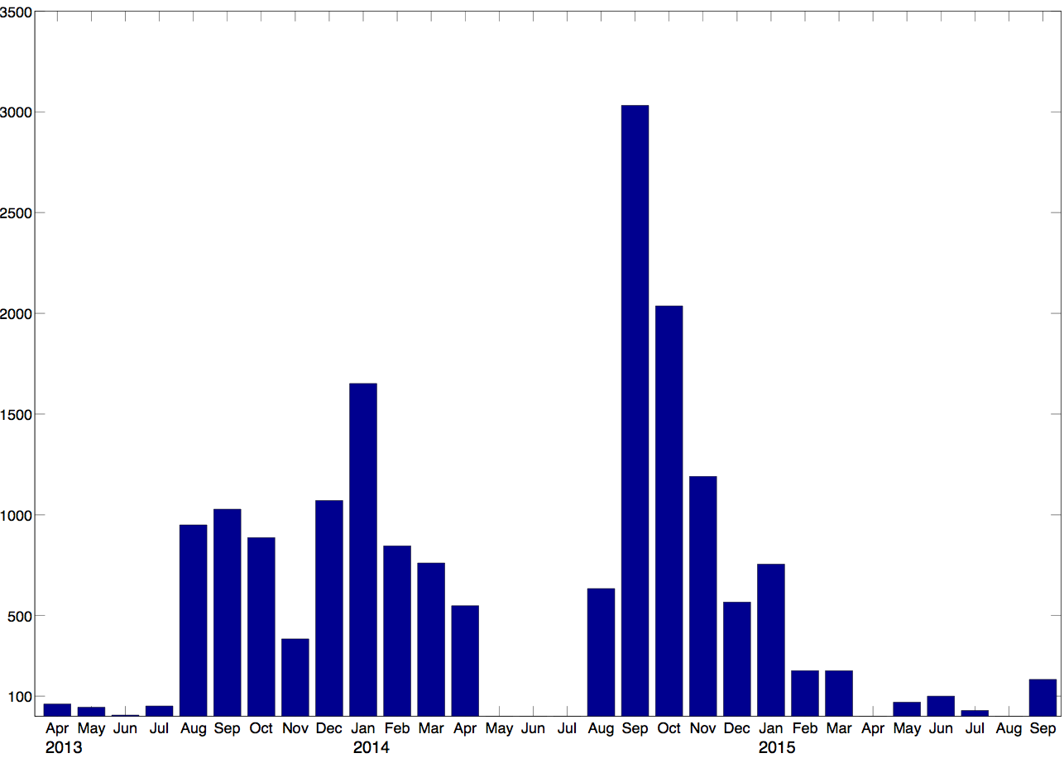
guide_bot
Summary
Performed more than 20000 guide optimizations
Tens of millions of McStas simulations
Designed guides for several ESS instruments
Used at PSI and NIST
Now too difficult to install / maintain
Guide optimizations per month 2013-2015
3000
2000
1000

Slide 23
guide_bot
Progress on python version
Motivation for making python version of guide_bot
Want to avoid the requirement of MATLAB license
Want to provide better customization of source / figure of merit
Object oriented design more suitable for the task
Can use McStasScript as McStas API and python dependencies for optimization
Can provide a package that is easier to install and more reliable
HighNESS is funded by the European Framework for Research and Innovation Horizon 2020, under grant agreement 951782

Slide 24
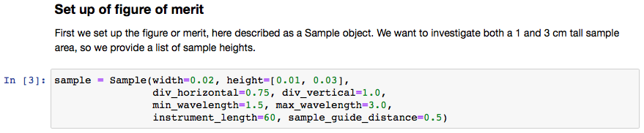
guide_bot
Python guide_bot example
HighNESS is funded by the European Framework for Research and Innovation Horizon 2020, under grant agreement 951782

Slide 25
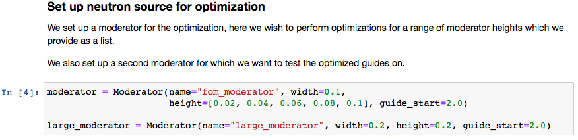
guide_bot
Python guide_bot example
HighNESS is funded by the European Framework for Research and Innovation Horizon 2020, under grant agreement 951782

Slide 26
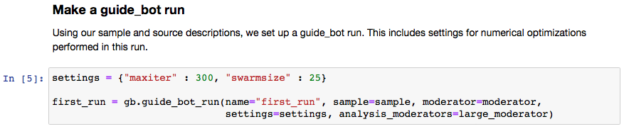
guide_bot
Python guide_bot example
HighNESS is funded by the European Framework for Research and Innovation Horizon 2020, under grant agreement 951782

Slide 27
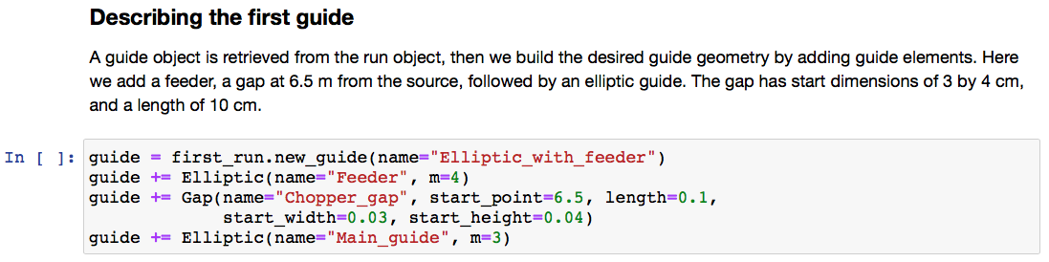
guide_bot
Python guide_bot example
HighNESS is funded by the European Framework for Research and Innovation Horizon 2020, under grant agreement 951782

Slide 28
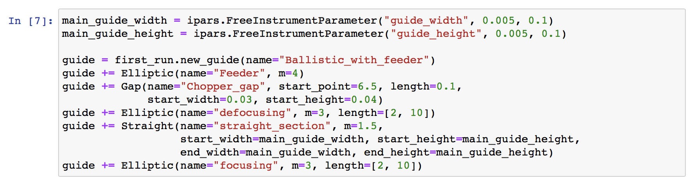
guide_bot
Python guide_bot example
Defines custom parameters
Sets min / max length
Use of our custom
parameters
HighNESS is funded by the European Framework for Research and Innovation Horizon 2020, under grant agreement 951782

Slide 29
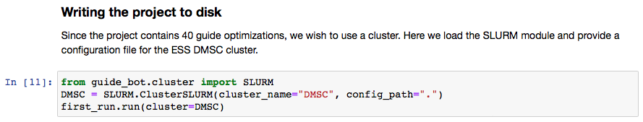
guide_bot
Python guide_bot example
Writes project folder which should be uploaded to cluster
Contains script for running all optimizations
After jobs complete the data can be downloaded
HighNESS is funded by the European Framework for Research and Innovation Horizon 2020, under grant agreement 951782

Slide 30
guide_bot
Progress on python version
Exploration of the data
Show jupyter notebook live demo

Slide 31
guide_bot
Progress on python version
Additional new features in python version
User defined constraints
Scan as many dimensions as desired
Have analysis runs for as many moderators as desired
Easier addition of sources, figure of merit, clusters, guide elements, …
Features not yet implemented in python version
System to handle loosing line of sight
More guide elements (only straight, elliptic and gap available now)
General system handling reflectivity options
Coating optimization
Plotting of the finished guide
Nice report for each optimized guide

Slide 32
guide_bot
Conclusions
The process of guide design can be made significantly easier with a tool like guide_bot
The first version of guide_bot had external users and arguably high impact
My apologies for not maintaining the software
New python version on the way, hope this will satisfy the needs of the community
More professional software, easier to contribute / collaborate, easier to install and truly open source
https://git.esss.dk/highness/guide_bot

Slide 33
Thanks for your attention

