Slide 1
NOBUGS McStas Training October 2016

Slide 2
Agenda
Intro:
McStas interoperability
McStas scattering kernels
Data Analysis software // scattering kernels
First example
SasView
Exercise

Slide 3
McStas – key features
Does one well defined job: Neutron transport
Output of McStas is well defined: p, x, v, s, t
Easy to add and define new transport and scattering properties (c-code)

Slide 4
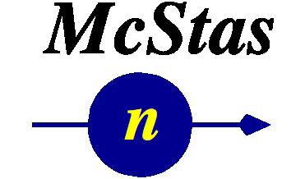

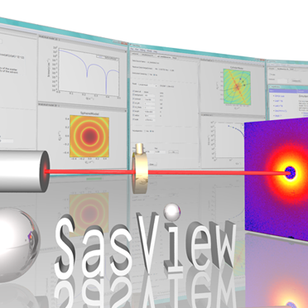
McStas interoperability
Neutron transport
Reduction
Data analysis
Mantid

Slide 5
McStas interoperability
Try to link different simulation tools as much as possible
McStas -> Neutron transport
Mantid -> Data reduction
Data analysis -> Your own preferred fit engine of choice
E.g. SANS
Use same scattering kernels in the neutron transport simulations = McStas
Use same scattering kernels in the analysis tool = SasView
Prototype: SasView models available in McStas

Slide 6
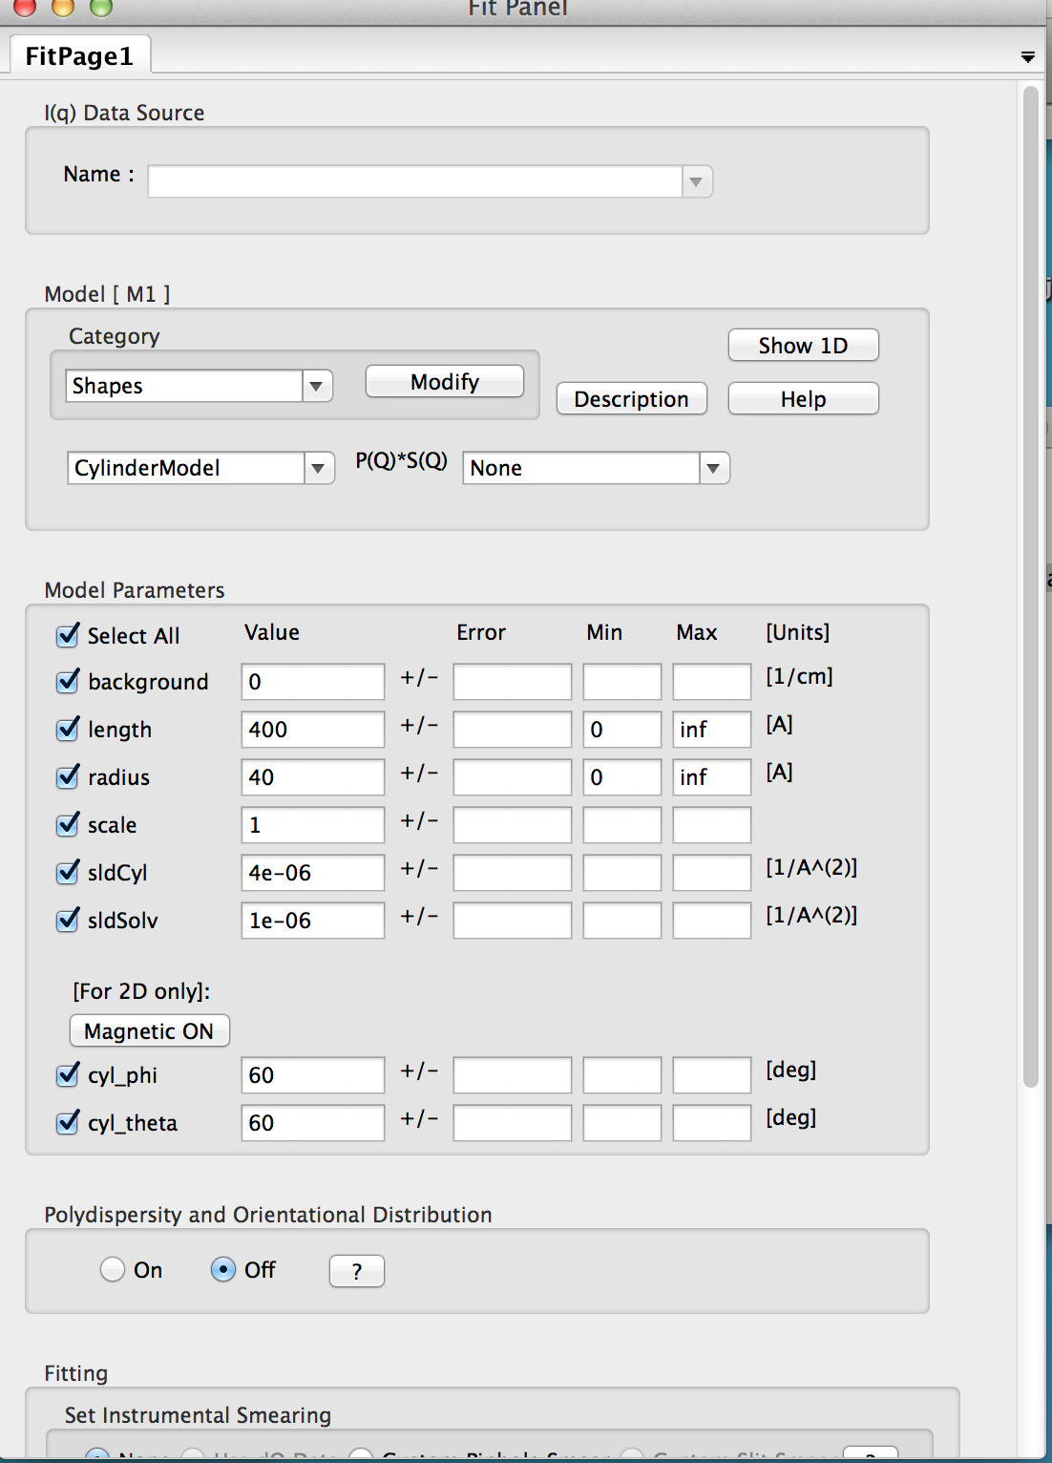
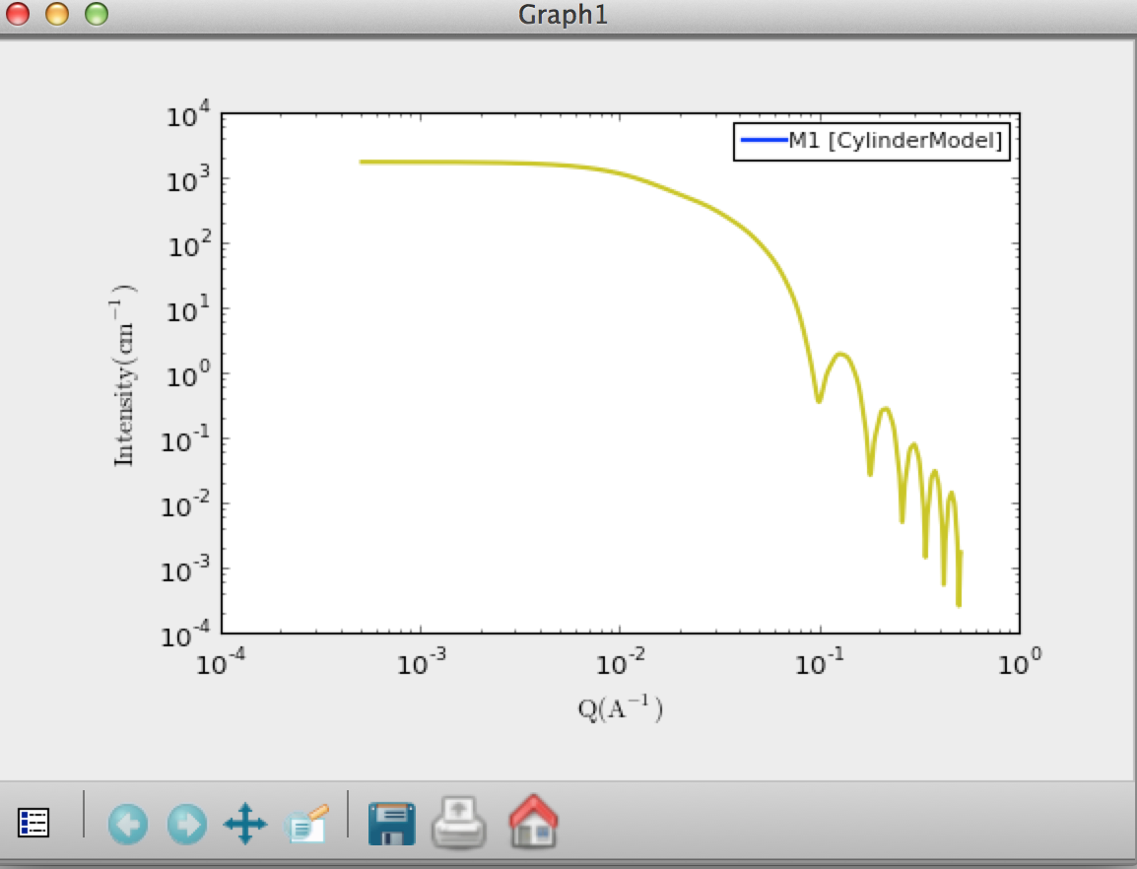
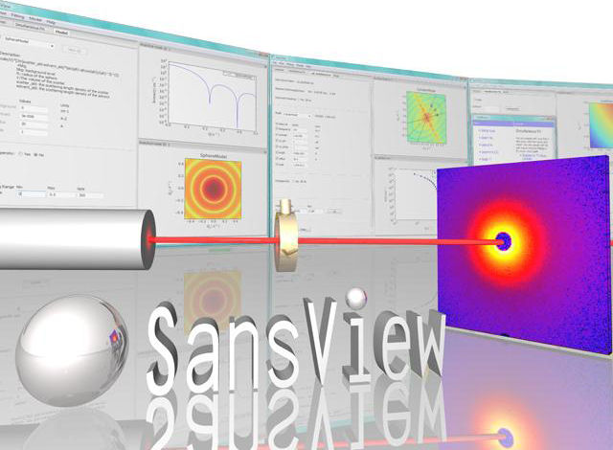
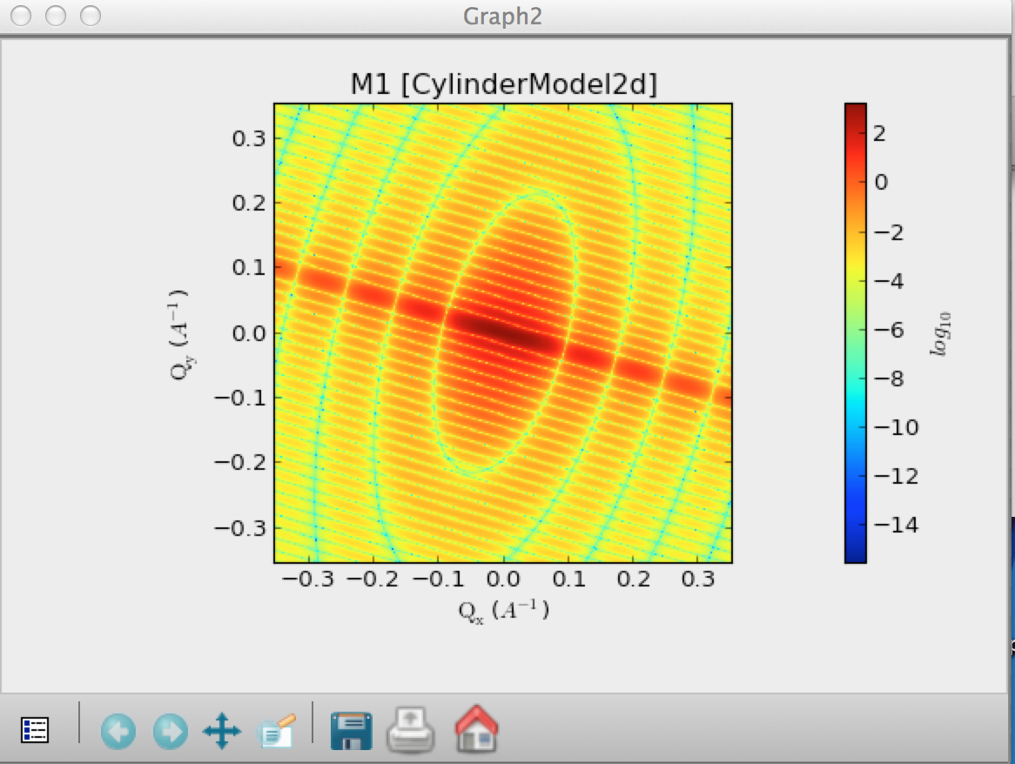
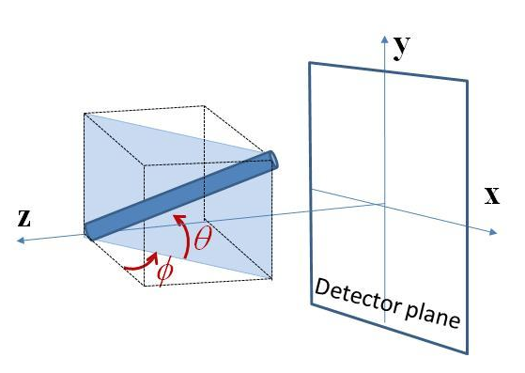
SANS - SasView
LoKI team needed 2D scattering kernels in McStas
Use SasView scattering kernels in McStas
SasView scattering kernel: Orientated cylinder

Slide 7
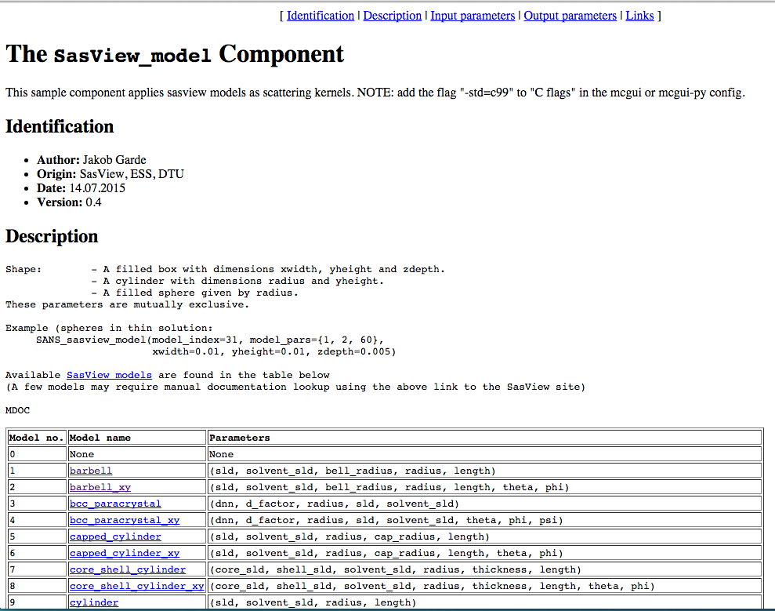
McStas mcdoc: SasView_model

Slide 8
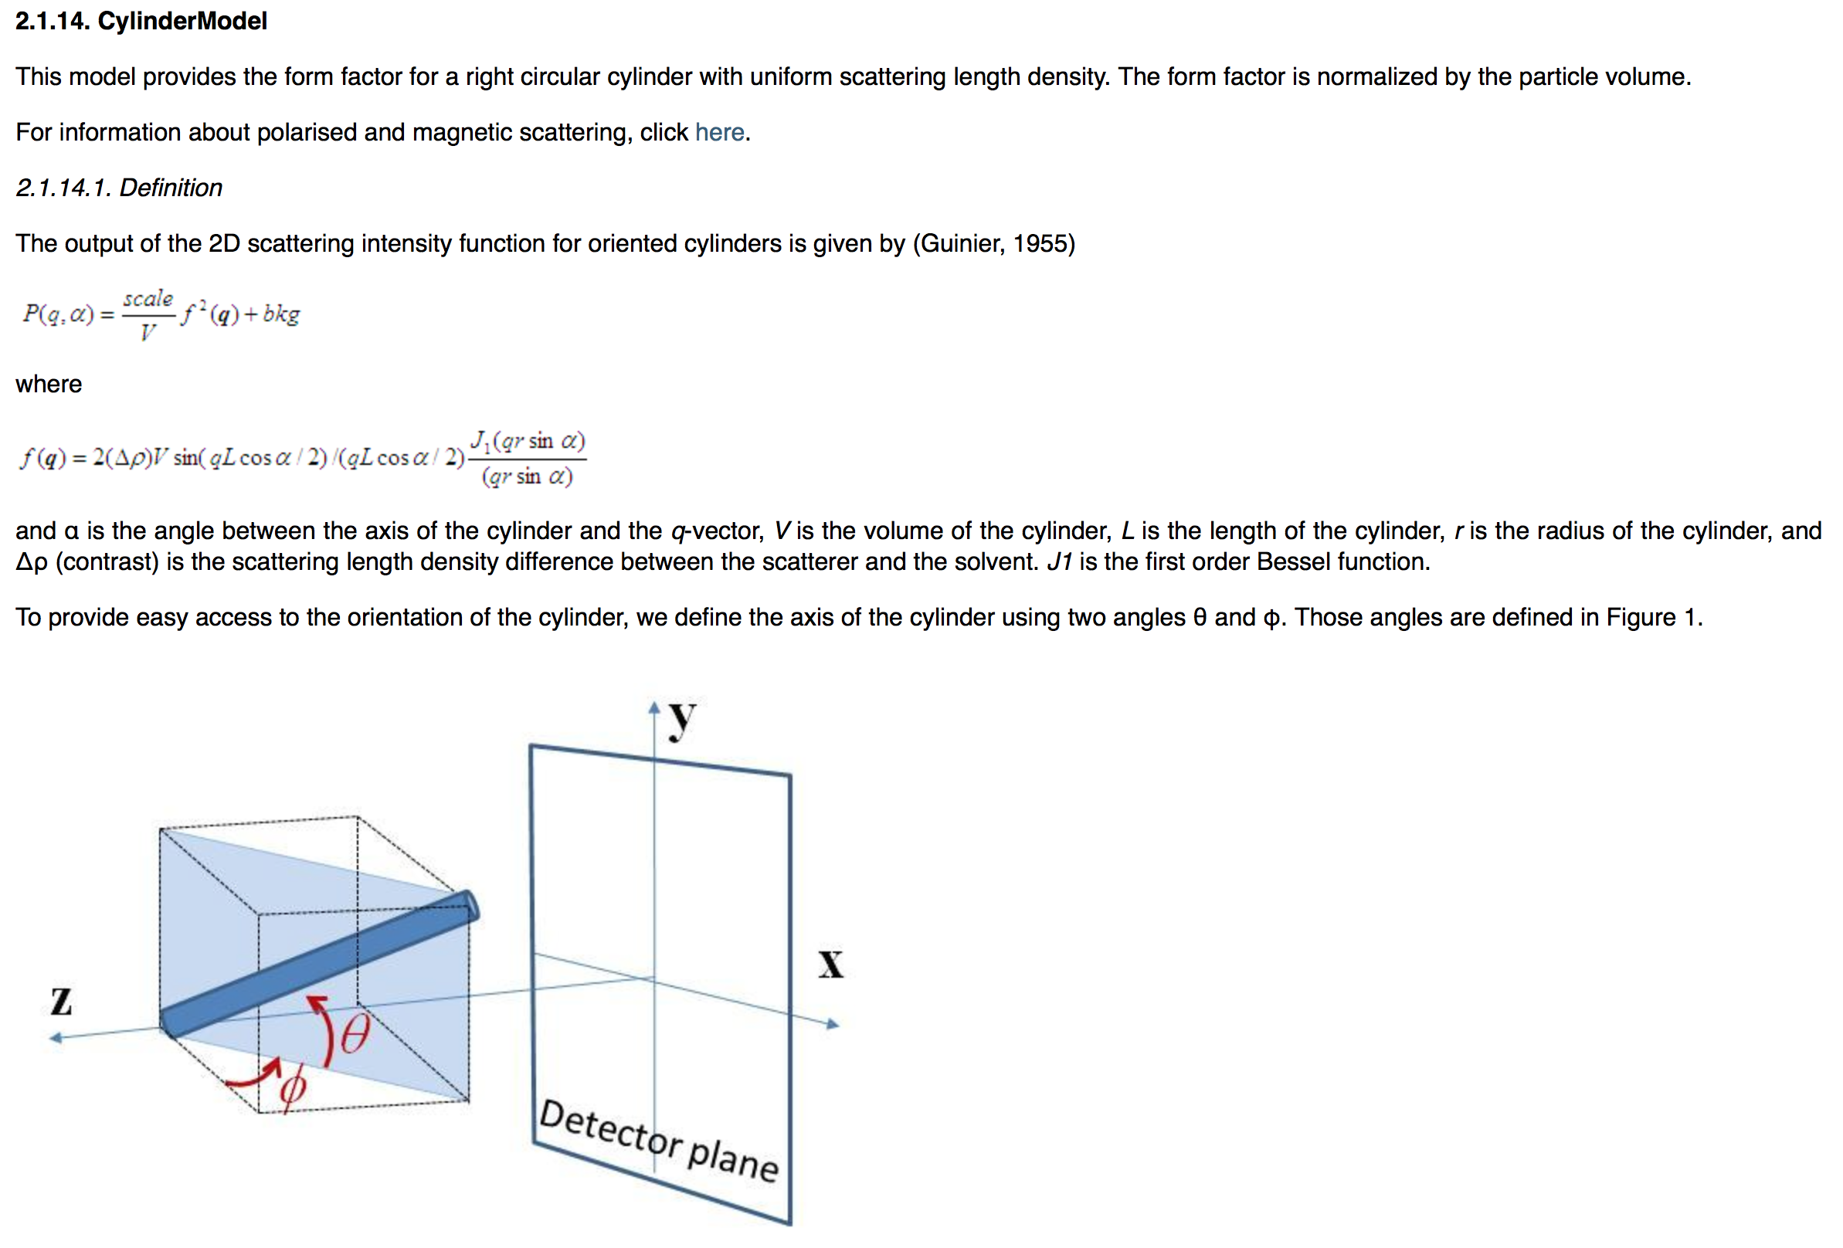
McStas mcdoc: SasView_model
Links to SasView documentation

Slide 9
McStas interoperability
Neutron transport
Reduction
Data analysis
Mantid

Slide 10
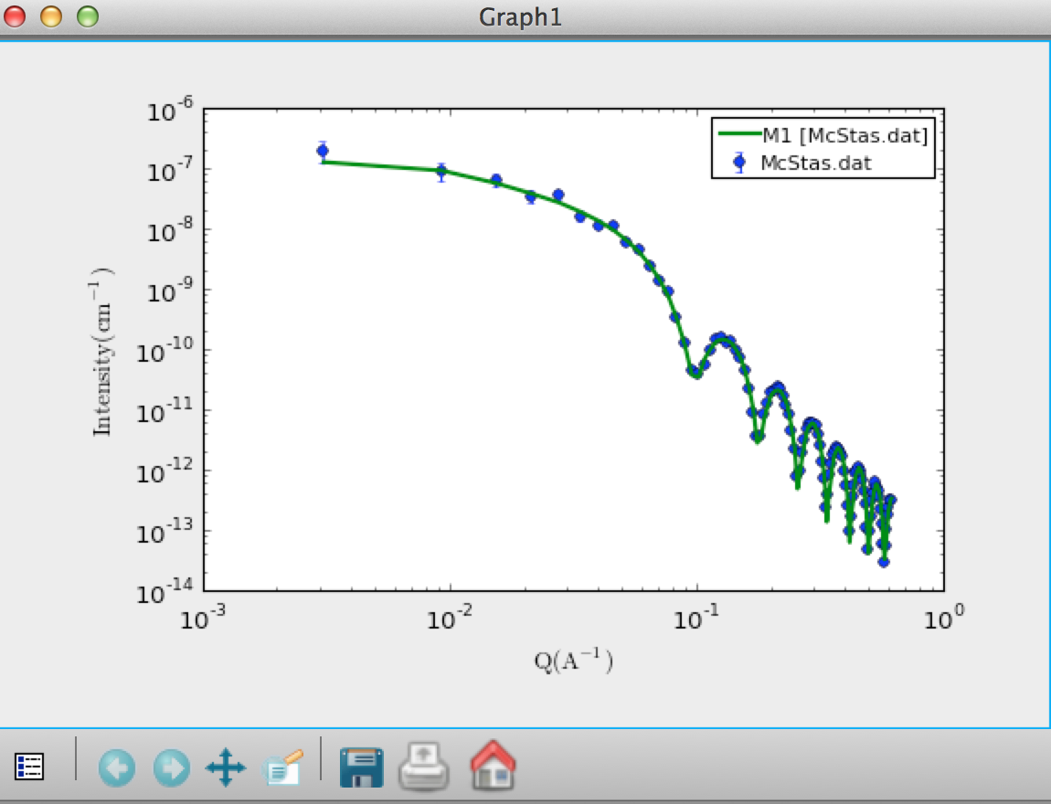
SasView -> McStas -> SasView
SasView cylinder model (1D) scattering kernel used in McStas
radius = 40 Å, length = 400 Å
McStas event data saved as I(q)
SasView reads McStas I(q) data
SasView fit engine gives:
radius = 40 Å
Length = 401 Å

Slide 11
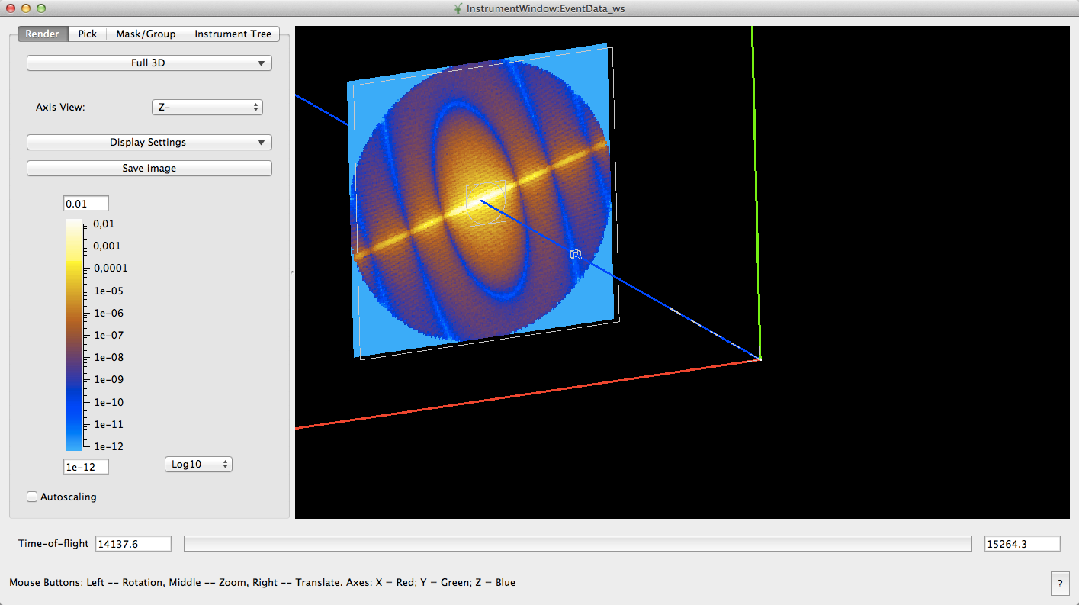
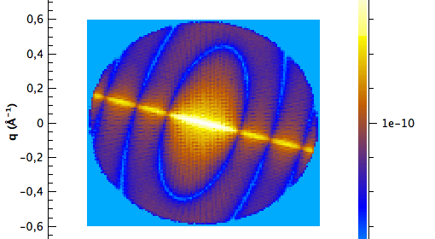
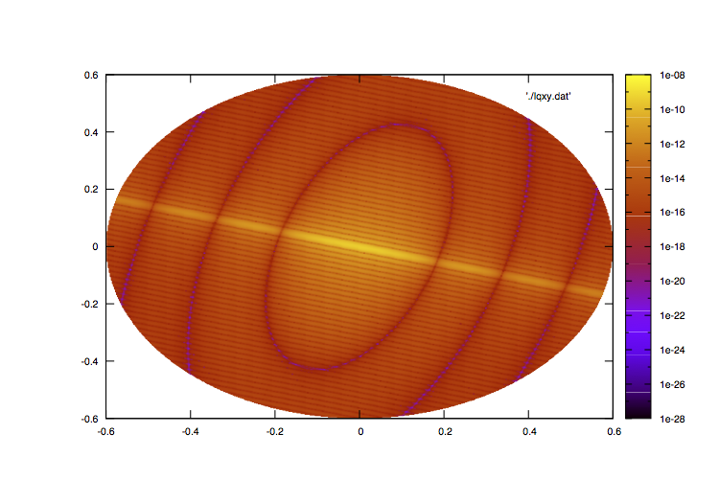
SasView -> McStas -> Mantid -> SasView
McStas -> event data
Mantid -> I(qx,qy)
SasView -> model parameters
2D scattering kernel: Orientated cylinder

Slide 12
Summary
Straight forward to add scattering kernels to McStas from other c-code
Consider if your favorite analysis tool can be linked to McStas

Slide 13
Exercise I
Load templateSasView_Mantid.instr
Try 2 or 3 different models
Try to write your own SANS scattering component
Use Sans_spheres.comp as template
Try e.g. the broad_peak.py model from SasView
See https://github.com/SasView/sasmodels/blob/master/sasmodels/models/broad_peak.py

