Slide 1
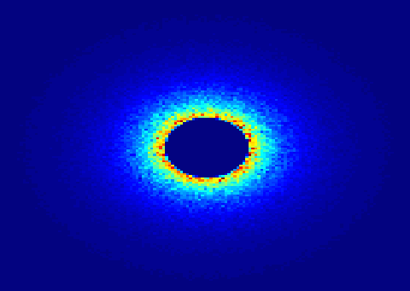
SANS
Small Angle Neutron Scattering

Slide 2

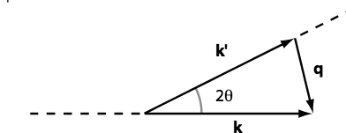
WHAT IS SANS?
Small Angle Neutron Scattering
Elastic Scattering
Small angle -> small q -> big r
Gain information on the molecular scale 10-100Å
Low signal to noise
Contrast method
Instrument requirements: good collimation, long flight distance after detector.
Still not enough? Wanna learn more? Check out
http://smallangle.org/content/Learning-About-SAS

Slide 3
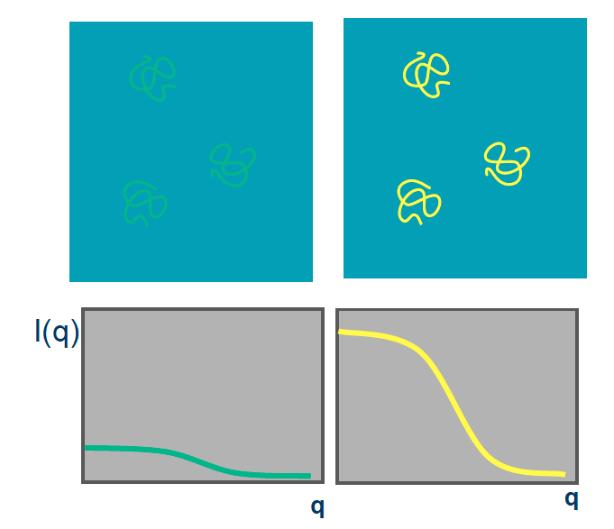
SANS Sample
SANS method can be used for many samples
Specific sample: Molecule + Liquid (buffer solution)
Isotropic scattering

Slide 4
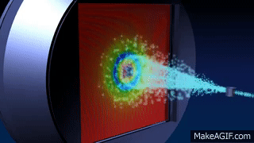
ILL.FR

Slide 5

SCATTERING LENGTH DENSITY
Model the scattering power of a material (e.g. molecule)
Length scale larger than atomic dimension
Look up Scattering Length Densities at:
http://sld-calculator.appspot.com/
https://www.ncnr.nist.gov/resources/activation/
In McStas: Monodisperse samples

Slide 6
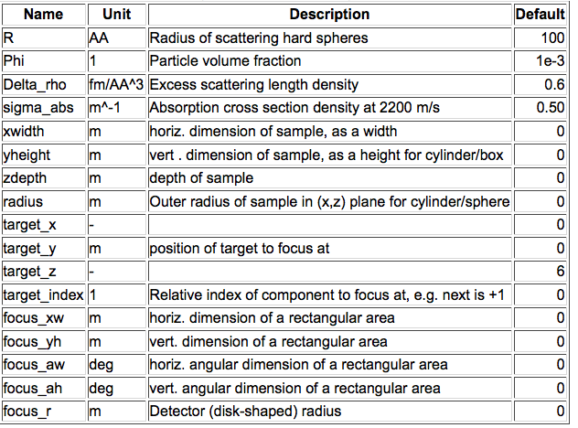
Sans_Spheres.comp

Slide 7
So you don’t like spheres

Slide 8
MORE SANS SAMPLES
Try ellipsoidal and
cylindrical particles
-or-
Elliptic cylinders
Go for Nanodiscs and Liposomes
SANS_AnySamp.comp
SANS_DebyeS.comp
SANSCylinders.comp
SANSEllipticCylinders.comp
SANSGuinier.comp
SANSLiposomes.comp
SANSNanodiscs.comp
SASview.comp
SANSNanodiscsFast.comp
SANSNanodiscsWithTags.
SANSNanodiscsWithTagsFast
SANSPDB.comp
SANSPDBFAST.comp
SANSShells.comp
SANSSpheres.comp
Sample form: Box only
Particle concentration: MOLAR
As always, more info at
http://mcstas.org/download/components

Slide 9
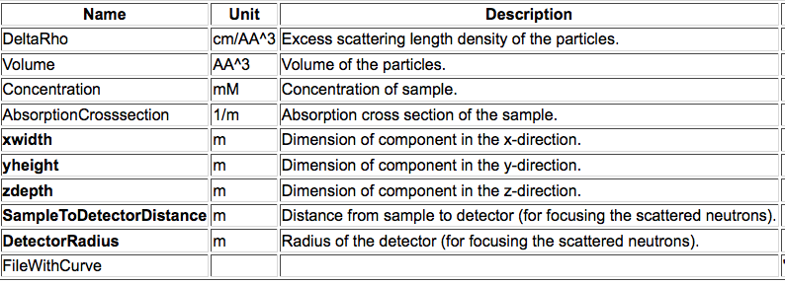
SANSCurve.comp
Mimick the behaviour of a sample: Feed I(q) curve

Slide 10
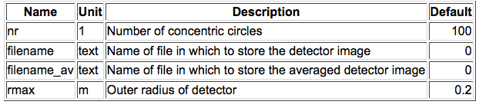
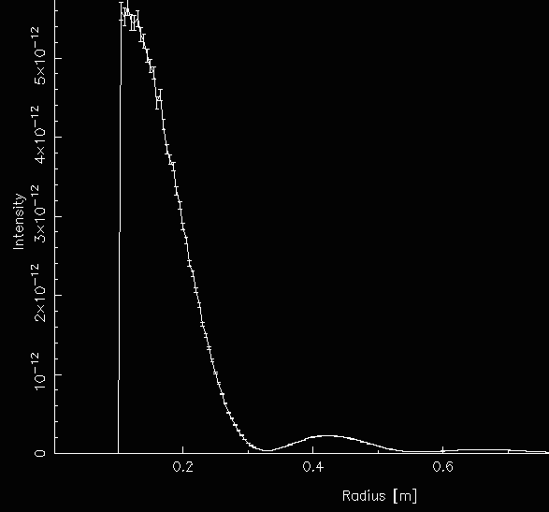
Revisit Monitors: PSD_monitor_rad.comp
COMPONENT My_monitor = PSD_monitor_rad(
nr=124, filename=“detector_image.dat”,
filename_av=“radial_averag.dat”, max=1)
AT (0, 0, 12) RELATIVE Sample

Slide 11
SANS Q MONITOR
I(r) and I(q) profiles
Input Parameters
RadiusDetector [m]
DistanceFromSample [m]
NumberOfBins
LambdaMin [AA]
Rfilename string
qFilename string
Restore_neutron
I(q)

Slide 13
EXERCICE 9.5
Open the file Ex_9_5_SANS.instr given to you.
Study the file. Notice the two instrument parameters
Insert a Sans_spheres_sample
  (R = 100, Phi = 1e-3, Delta_rho = 0.6, sigma_abs = 0,
xwidth=0.01, yheight=0.01, zdepth=0.01, focus_r=?, target_z=?)
Insert a PSD_monitor_rad 0.0001m behind the beamstop
  (rmax=0.2, nr=200, give filenames)
Use the instrument parameters to complete the components
Run a simulation with 1e7 neutrons
Plot the I(r) curve.
Change the sample-detector distance.
  What do you observe?
Curious? Lost? Need help?
Try $ mcdoc or visit http://mcstas.org/download/components

Slide 14
RESOURCES
Need more information?
Plan on doing a SANS experiment?
Visit the SANS world directory
Neutron scattering length densities
https://www.ncnr.nist.gov/resources/activation/
http://sld-calculator.appspot.com/
SASview
http://www.sasview.org/
Small angle scattering, various resources, animations and tutorials
http://smallangle.org/

