Slide 2
Exercise: McStas-Mantid
Purpose of the exercise is to be familiar with some McStas–Mantid key words
Learn how to use McStas-Mantid interface
Learn about the Nexus file format
Learn about IDF (Mantid Instrument Definition file)
Learn how-to use already developed (reduction) algorithms in Mantid
Learn about Python scripting in Mantid
McStas files:
  templateSANS.instr
  templatedSANS_Mantid.instr
  templatedSasview_Mantid.instr

Slide 3
Agenda
A brief introduction to the
  McStas GUI
  Mantid GUI
  View McStas data in Mantid
  Simple data analysis in Mantid
Exercise
  How to use the McStas Mantid interface

Slide 4
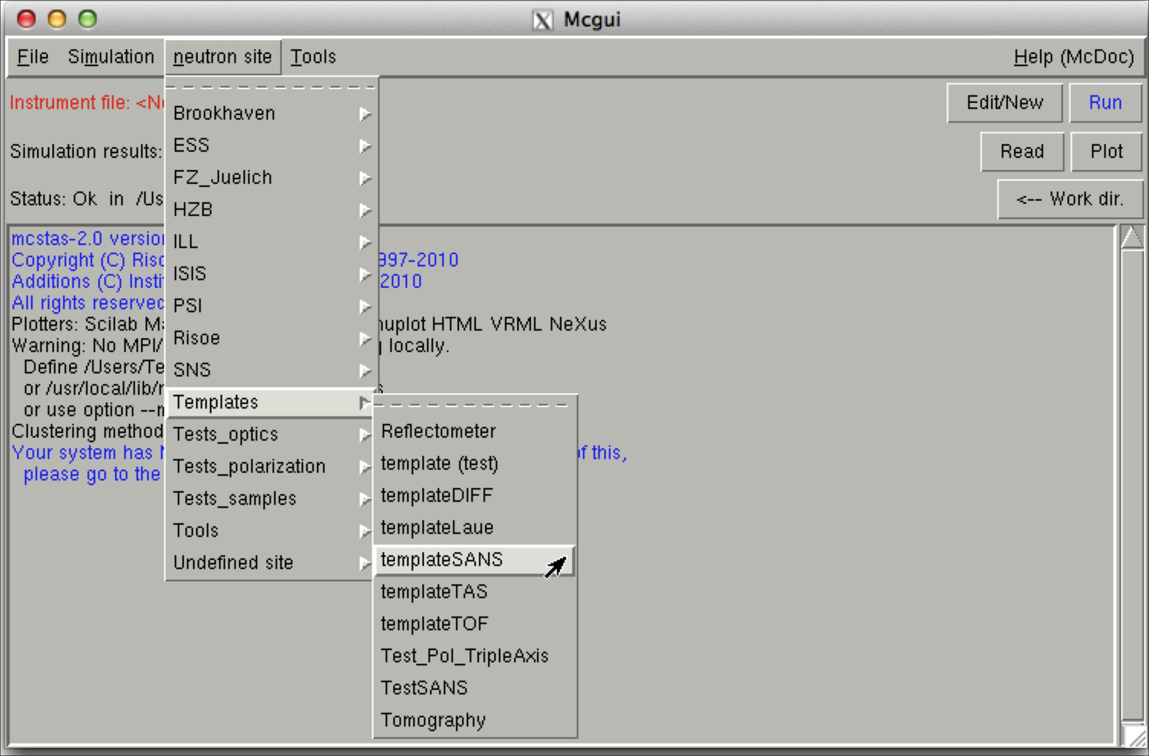
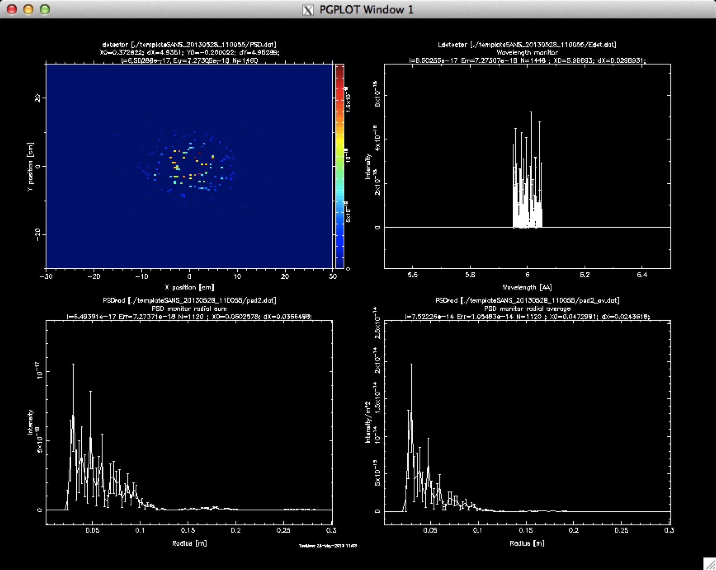
McStas GUI

Slide 5
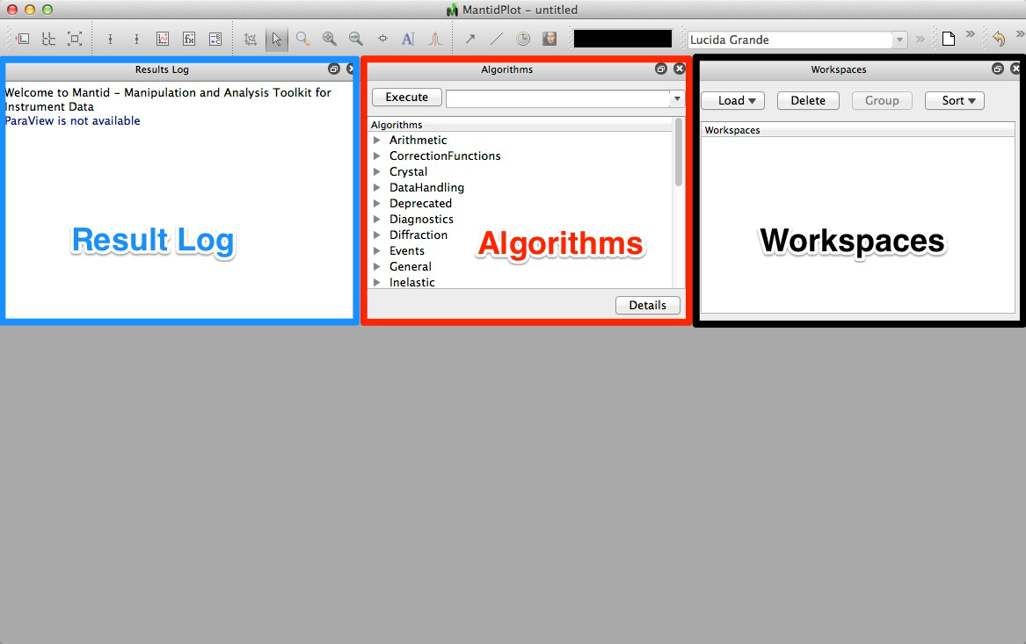
Mantid GUI

Slide 6
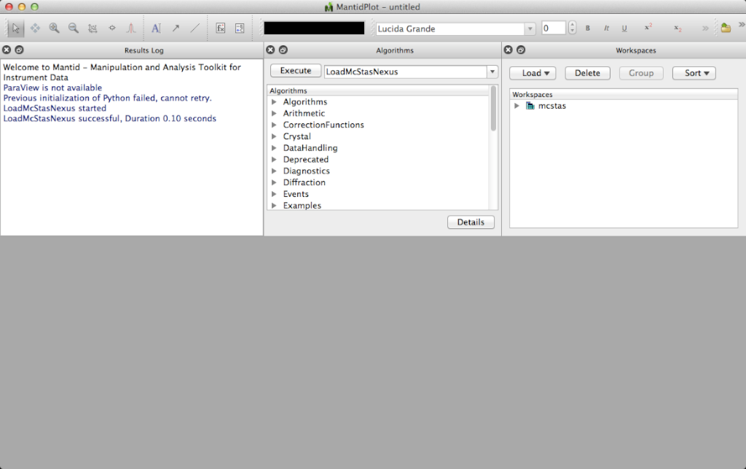
Load McStas Nexus data

Slide 7
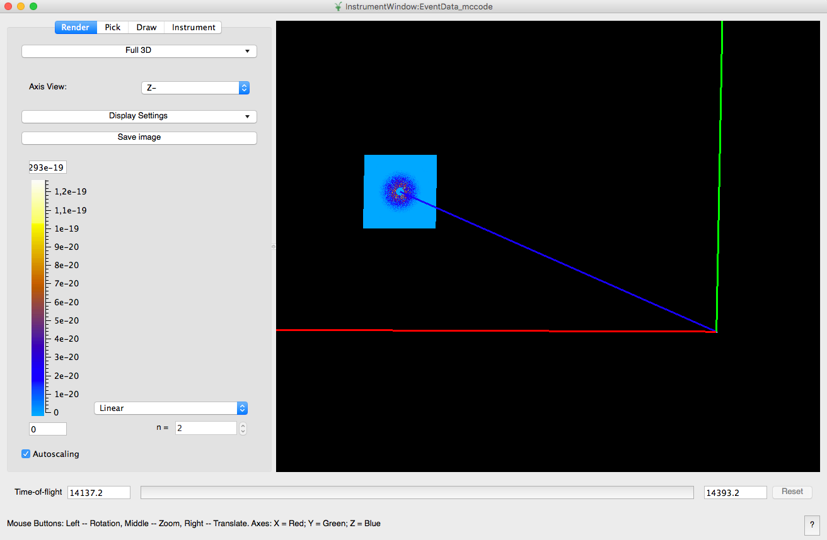
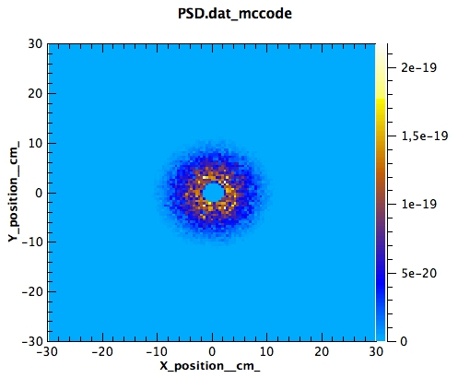
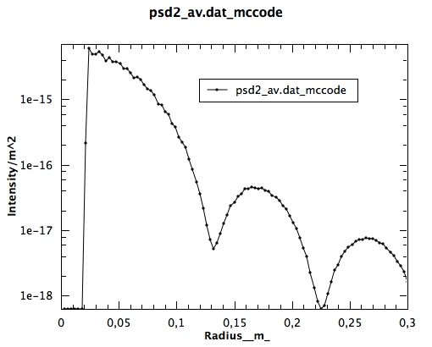
McStas data in Mantid
templateSANS_Mantid.instr
Notes:
Figure 2: McStas simulate mode. Recorded SANS pattern histogram from a 2D position sensitive detector (PSD). The instrument model is templateSANS_Mantid and the sample is hard spheres in dilute solution.

Slide 8
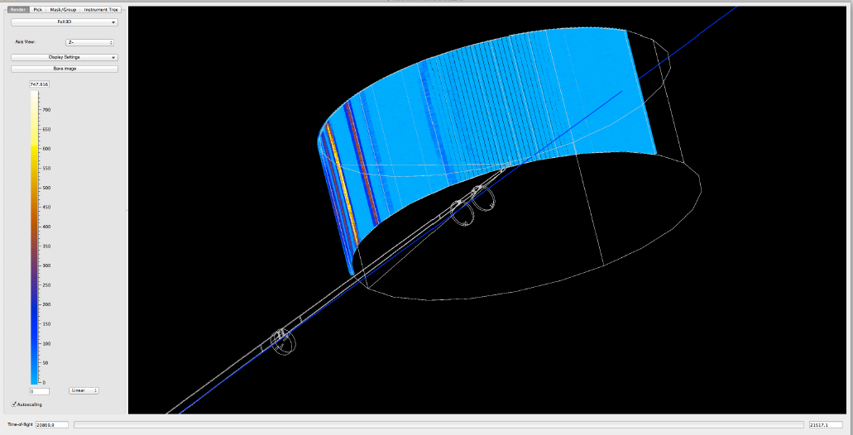
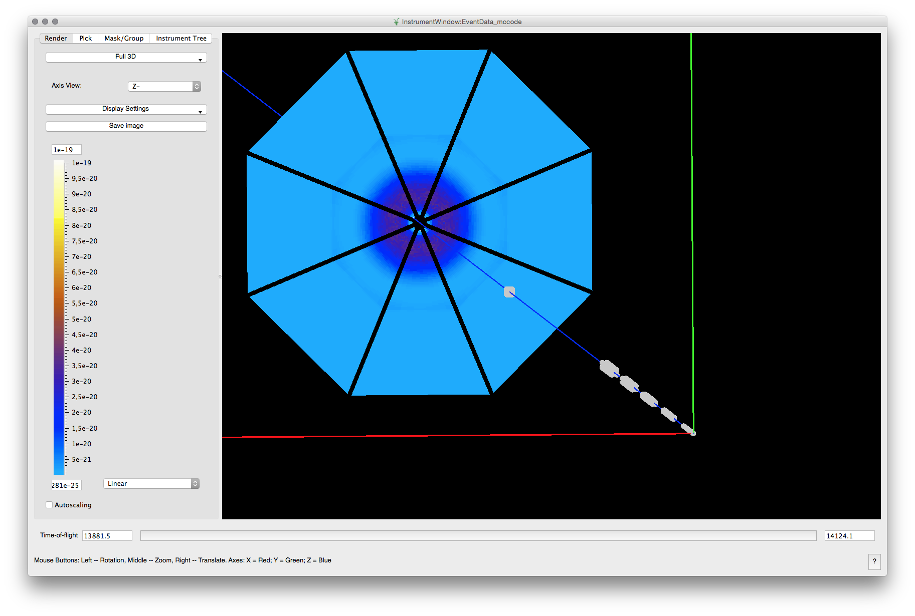
IN5 (ILL) and LoKI (ESS)
Notes:
Figure 4: Mantid instrument view of a McStas generated instrument description of IN5 at ILL. The detector description was generated using the Cylindrical cut ”banana” geometry. For the purpose of visualization Mantid shows all the event data as histogram intensity data displayed on top of the detector geometry.
Figure 5: Mantid instrument view of a McStas generated instrument description of LoKI at the European Spallation Source ERIC. Due to the new and unique LoKI detector design the McStas instrument description was generated using the Geomview OFF geometry, which is capable of describing arbitrary-geometry detectors

Slide 9
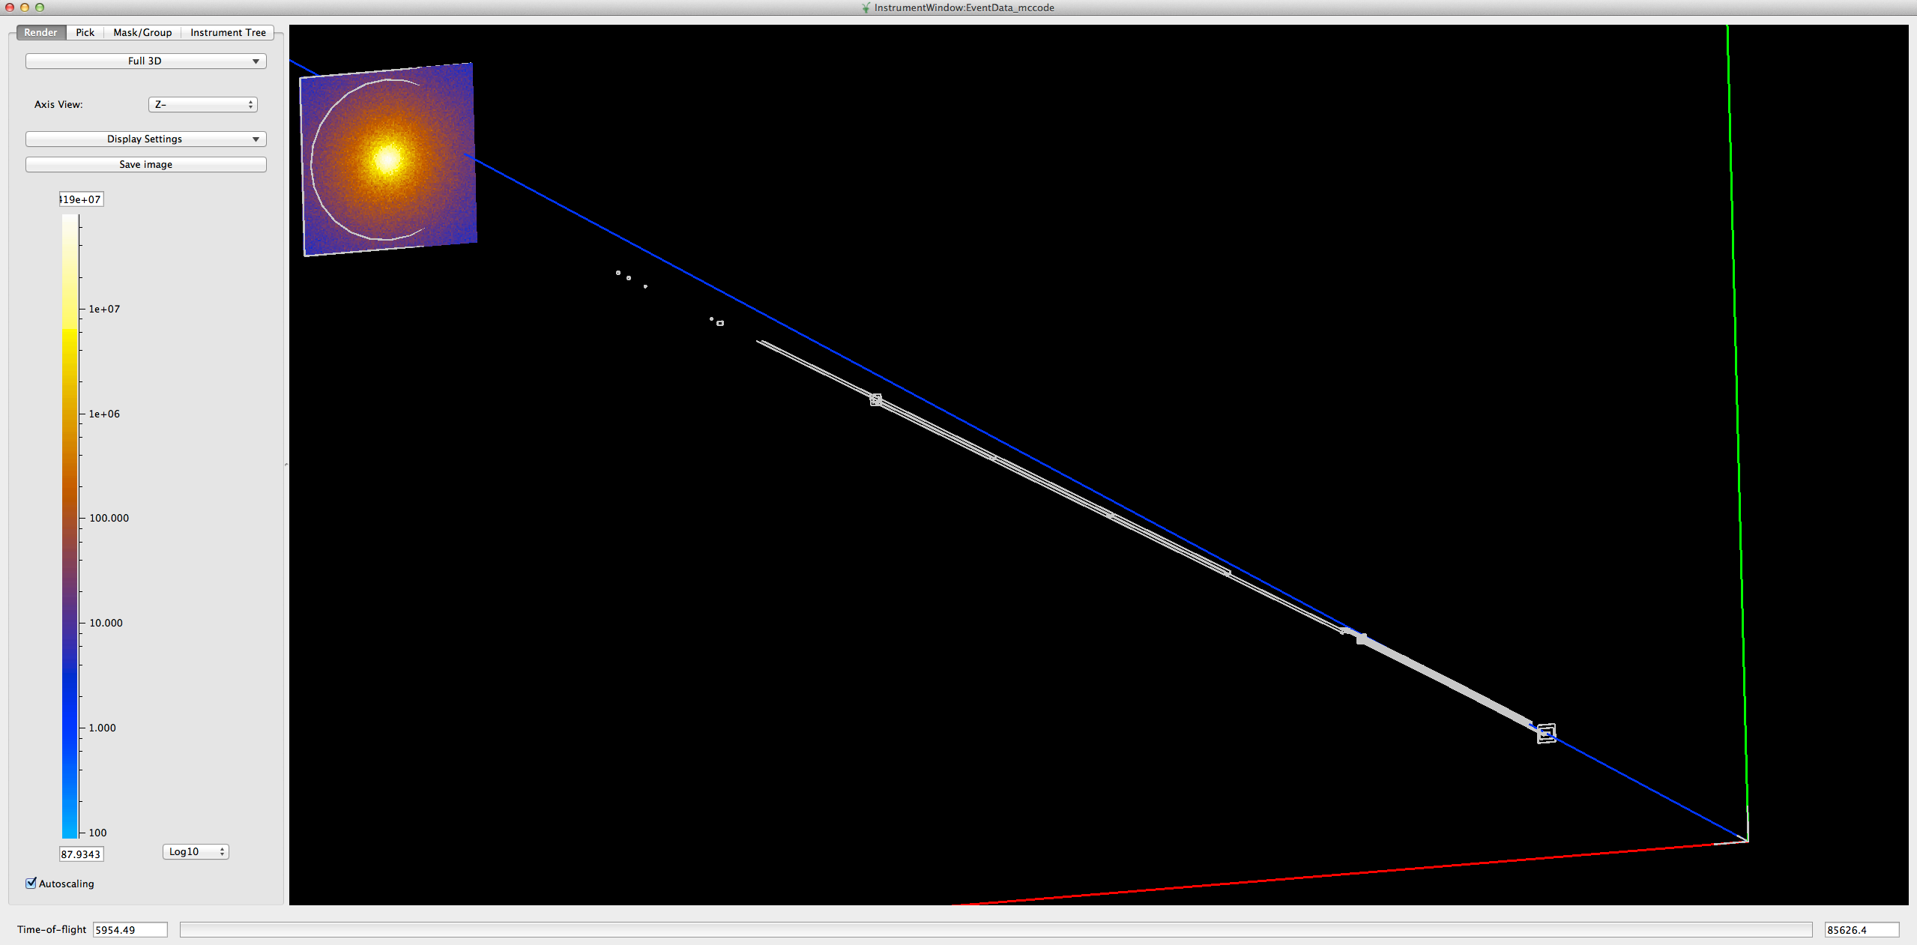
Data reduction and analysis
Mantid view of the McStas event data generated for the ISIS_SANS2d.instr file.
Comparison of rescaled scatting intensity I(q) derived from the experimental data and a McStas simulation.

Slide 10
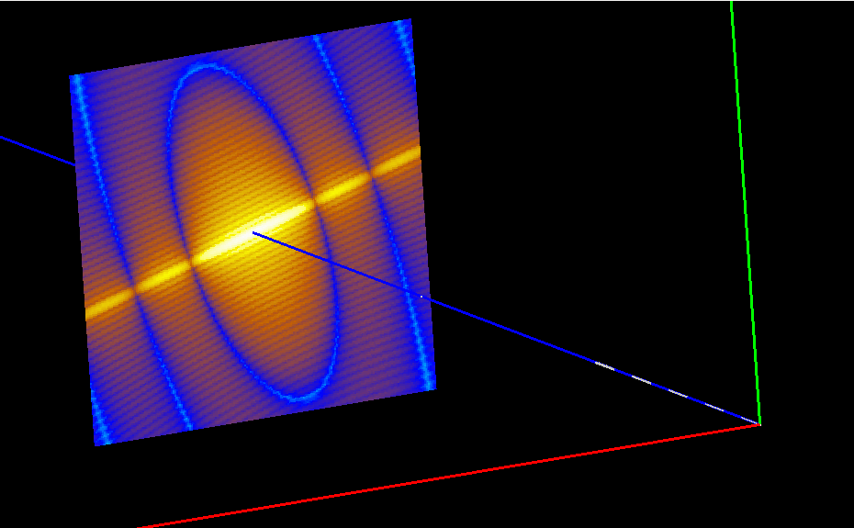
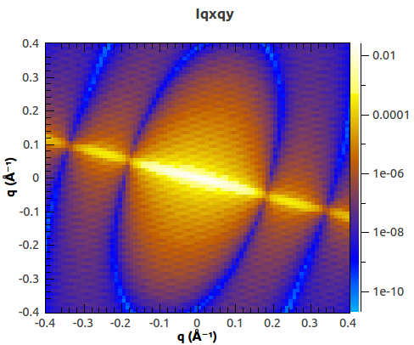
Use Mantid algorithms
2D scattering kernel in McStas: hard cylinders in a dilute solution.
I(qx,qy) obtaind from the McStas event data by using Mantid.
Notes:
Figure 11: Mantid view of the McStas event data generated for virtual SANS experiment using the templateSANS_Mantid instrument. The scattering sample consists of hard cylinders in a dilute solution. All nano particles have the same orientation.
Figure 12: The Mantid reduced data I(qx,qy), based on the McStas event data shown above in Fig 11.

Slide 11
Next Up
Exercise: McStas-Mantid

