Slide 1
6 McStas various utils
Hidden gems and useful little things…
+ Disclaimers and tips for the next couple of days…

Slide 2
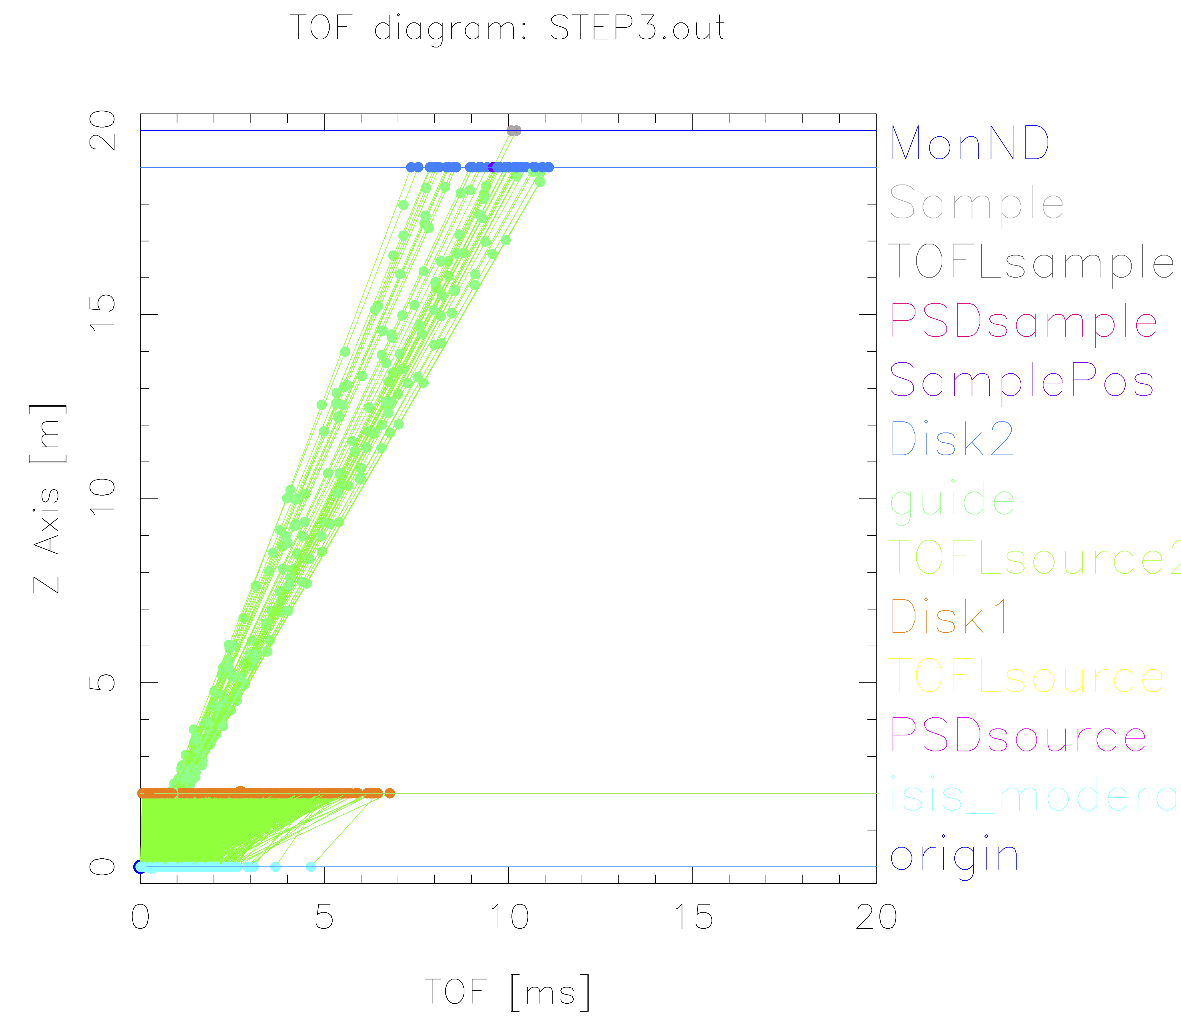
TOF diagram util based on mcdisplay
mcdisplay.pl --TOF --tmax=20 instrument…

Slide 3
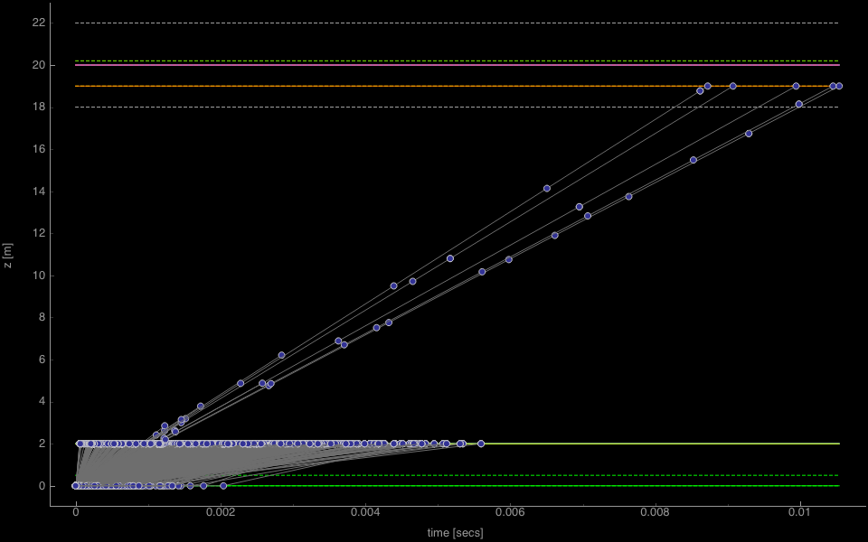
TOF diagram util based on mcdisplay
mcdisplay-pyqtgraph --TOF instr

Slide 4
cif2hkl
Util for generating McStas style “laz/lau” reflection lists from CIF file
Based on CrysFML from the ILL (FullProf)
Compile for your system from https://github.com/McStasMcXtrace/McCode/tree/master/tools/other/cif2hkl
(May also get included in McStas 2.4)

Slide 5
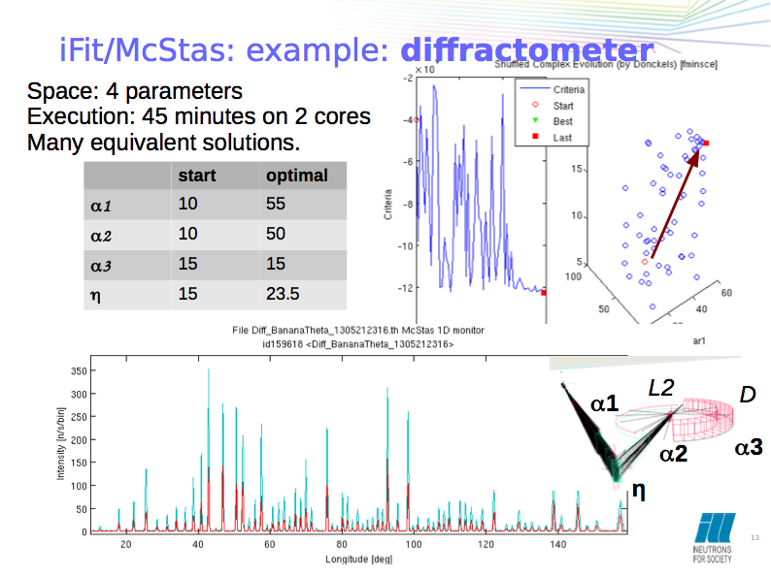
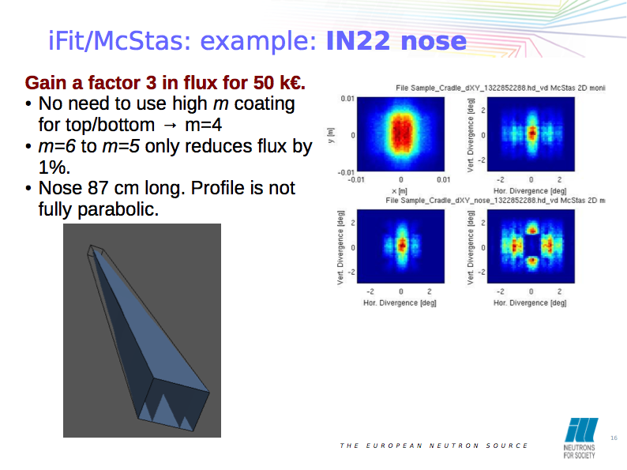
iFit optimiser (http://ifit.mccode.org)
General data / optimisation framework
~ Modern “spec_nd”
Matlab based, but does not require matlab (binary distribution also)
Reads and plots McStas
Can run McStas as a “cost function”, varying instrument parameters

Slide 6
Cluster utility scripts
mcsub cluster scripts
Takes a “mcrun commandline”
Writes batch file “template” for use with PBS or slurm cluster queue systems
https://github.com/McStasMcXtrace/McCode/tree/master/tools/cluster-scripts
./mcsub_slurm.pl
Usage: ./mcsub_slurm.pl [options] [mcrun params]
-h --help Show this help
-rN --runtime=N Specify maximum runtime (hours) [default 1]
-qQNAME --queue=QNAME Specify wanted SLURM queue [default 'express']
-e<mail> --email=<mail> Specify address to notify in reg. sim status [default none]
--nodes=NUM Specify wanted number of nodes [default 1]
--name=NAME Specify slurm job name [default "McSub_<USERNAME>_<TIMESTAMP>"]
After running ./mcsub_slurm.pl NAME.batch is ready for submission using the sbatch command

Slide 7
Vitess - compatibility
Utility script for converting Vitess reflectivity files for use with McStas (https://github.com/McStasMcXtrace/McCode/blob/master/tools/other/Refl_Vitess2McStas.sh)
mcstas2vitess generates Vitess module + tcl snippet from McStas component (poor docs, will improve)

Slide 8
Next: Time for exercises
Forming groups
Suggestion for Thursday-Friday exercises:
Often sitting with a colleague is helpful
Form teams of two people for the exercises
Try to gather complementary knowledge by teaming up with someone from a different work area

Slide 9
Next: Exercises
Disclaimers
You are running a beta - we will likely find new and intersting bugs as we move along… :-)
Programme is flexible - don’t get frustrated if we lag behind, we will either adapt or catch up later!
Much of the teaching material is new / adapted, so there may be inconsistencies / confusion in some parts… :-)

