Slide 1
4 - Moving Optics
Velocity selector
Disk Chopper
Fermi Chopper

Slide 2
Moving optics
Not optics that move
...optics with moving parts

Slide 3
Moving optics
I.e. we can’t do:
COMPONENT something = Sometype(
par1=value1, par2=value2, ….)
AT( f_x(t), f_y(t), f_z(t) )RELATIVE someother
So what can we do?

Slide 4
Moving optics
I.e. we can’t do:
COMPONENT something = Sometype(
par1=value1, par2=value2, ….)
AT( f_x(t), f_y(t), f_z(t) )RELATIVE someother
So what can we do?
Instead, we operate internally in the component on the neutron state, e.g. “rotate” the neutron etc.

Slide 5
Velocity Selectors
-
Select the neutron energy you want

Slide 6






Velocity Selectors
absorbing blades
ICANS XXII Oxford 2017 / New development in the McStas Monte Carlo ray-tracing project

Slide 7
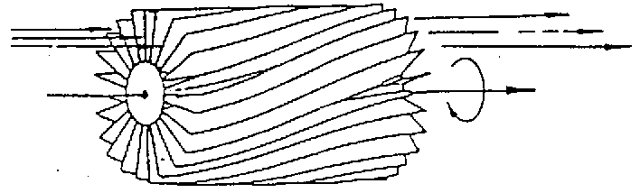
Velocity Selectors
ICANS XXII Oxford 2017 / New development in the McStas Monte Carlo ray-tracing project

Slide 8
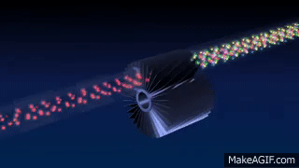
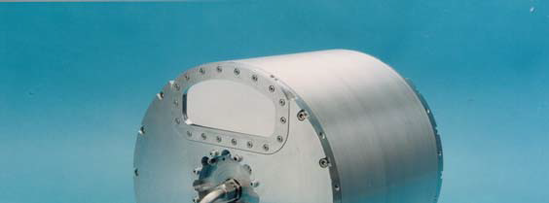
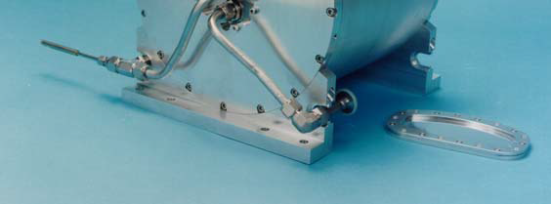
Velocity Selector
‘broad’ monochromatization δλ/λ ≈ 10 %
ILL.FR
Astrium
ICANS XXII Oxford 2017 / New development in the McStas Monte Carlo ray-tracing project

Slide 9
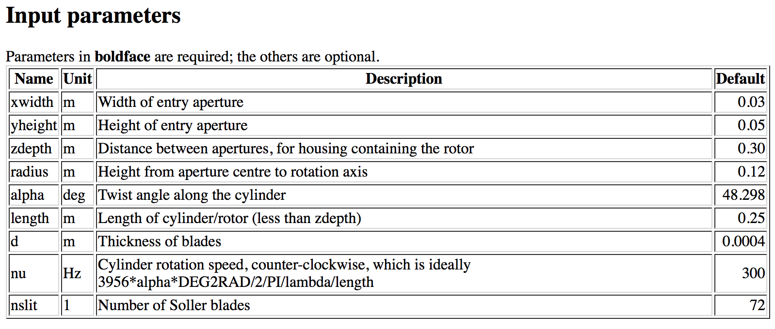
Velocity Selectors
housing

Slide 10
Velocity Selector
Exercise 4.1
-Open the Ex_4_1_selector.instr instrument
- Notice the use of wavelength monitors L_mon
- Notice the use of the V_selector component
-Input parameter defines selector rotational
velocity/frequency (Hz)

Slide 11
Velocity Selector
Exercise 4.1 cont’d
Perform a TRACE at the default f=300Hz
Perform a SIMULATE of 1e7 neutrons at default f
Perform a series of simulations in the range: 150 < f < 800 (e.g. 5 steps)
Compare the transmitted beam in the different cases
Question: What is the ideal rotational speed to select neutrons of 10 Å with the selector from Ex 7.1 (Hint l[Å] ~= 3956 / v [m/s]

Slide 12
Choppers – Fermi and Disk
Define time structure of the beam
Time Of Flight (TOF) measurements

Slide 13
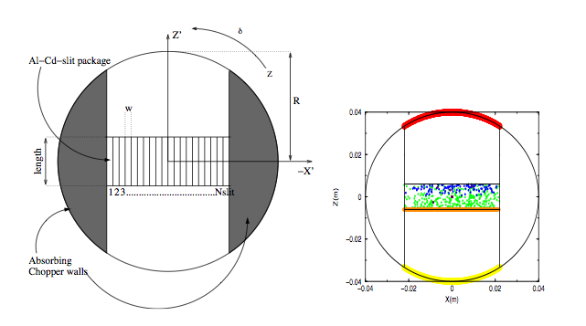
Fermi Chopper

Slide 14
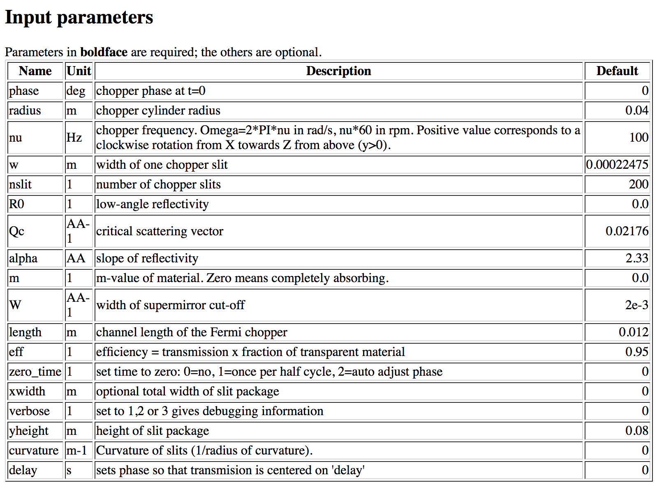
Fermi Chopper

Slide 15
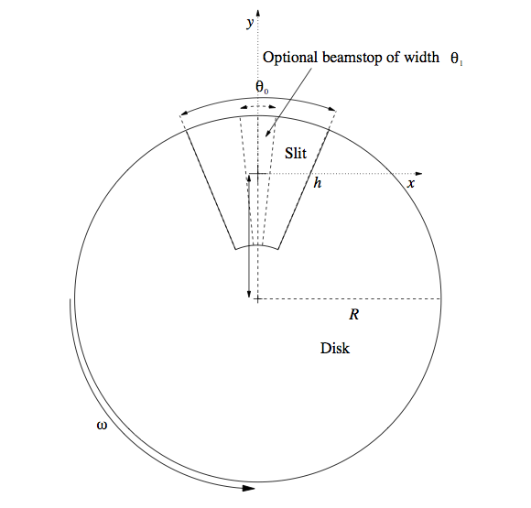
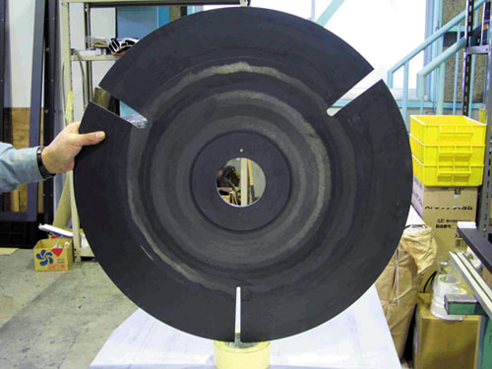
Disk Chopper
If h not explicitly specified, h=R
Auto-centering the beam axis ‘z’ at R-h (half-height of slit)
ICANS XXII Oxford 2017 / New development in the McStas Monte Carlo ray-tracing project

Slide 16
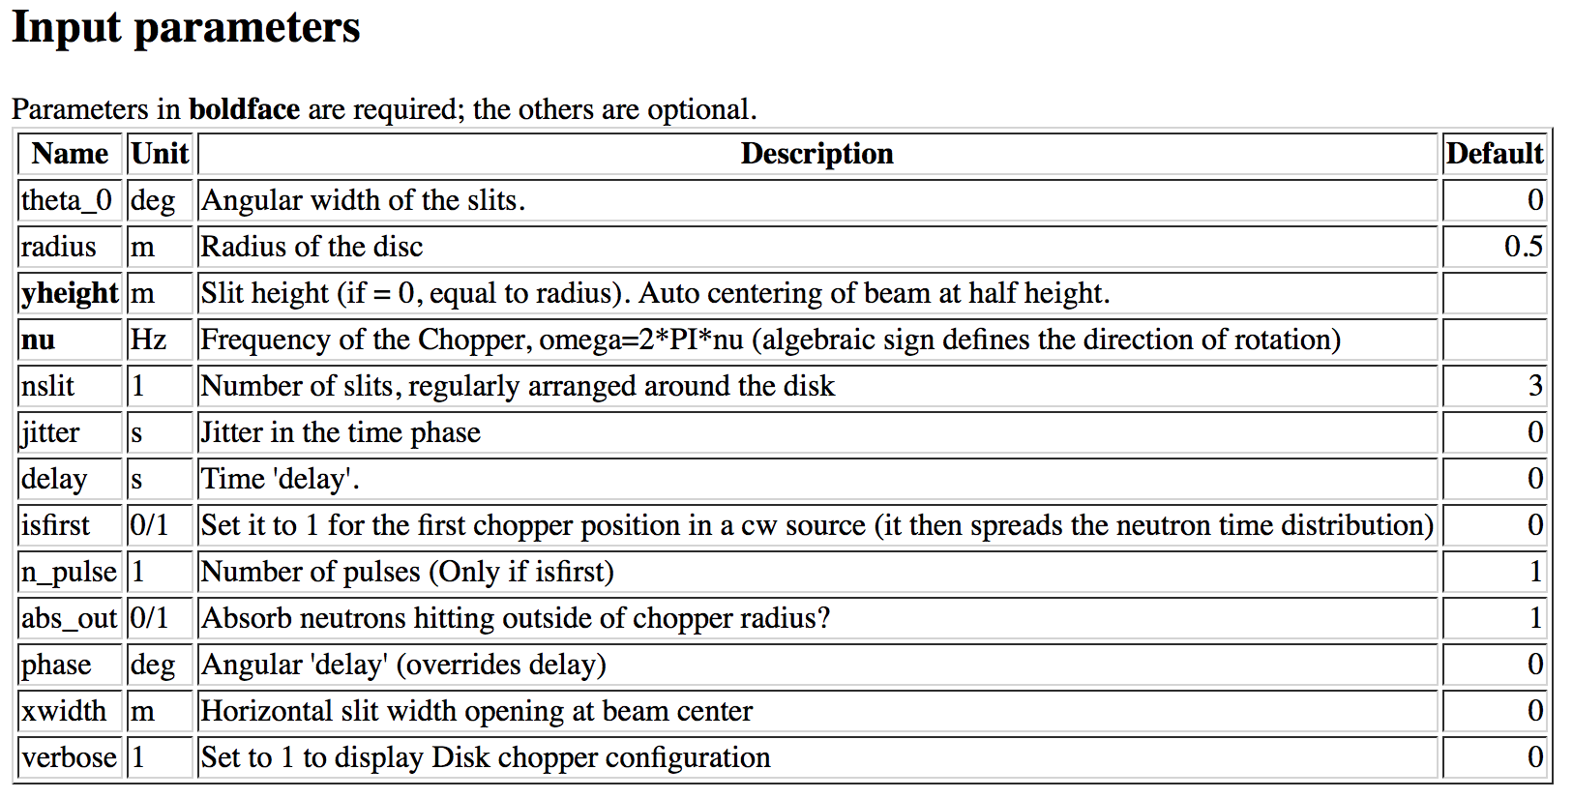
Disk Chopper
nslit placed equidistantly around the disk….
ICANS XXII Oxford 2017 / New development in the McStas Monte Carlo ray-tracing project

Slide 17
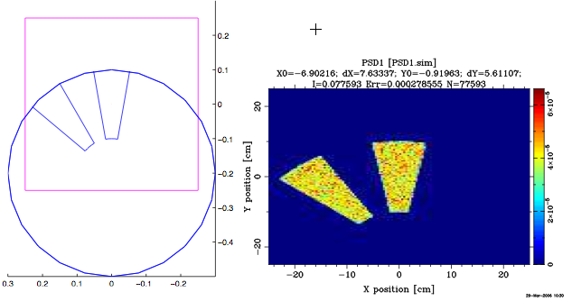
Disk Chopper
Non-equidistant configurations should be realized via the GROUP keyword…. (illustrated below, nu=0)
ICANS XXII Oxford 2017 / New development in the McStas Monte Carlo ray-tracing project

Slide 18
Disk Chopper
Exercise 4.2
Open the Ex_4_2_chopper.instr instrument
Notice use of the EXTEND %{ %} section, defining a time structure (1 second, flat distribution)
Notice use of Monitor_nD, our “Swiss army knife” monitor
options=”t auto bins=200”
options="t auto bins=200 x auto bins=200"

Slide 19
Disk Chopper
Exercise 4.2 cont’d:
Insert a disk chopper 0.5 mm after guide exit
Chopper Component Parameters:
- radius of disk-chopper (we use 0.5 m)
- n, number of openings (we use 2)
- Phase (angular phase at t=0, in degrees, we use 90 deg)
Instrument input parameters:
f (Hz) - chopper frequency
Theta0 (degrees) - opening width of slits

Slide 20
Disk Chopper
Exercise 4.2 Cont’d
Make a TRACE to get an overview of the instrument
SIMULATE 1e7 neutrons at the default of f=5Hz and Theta0=10 degrees. While simulation is ongoing, estimate the number of pulses per second?
Try another 1e7 at f=1 hz. Notice space-time correlation in the third TOF panel
At a given frequency, try changing the Theta0 chopper opening to higher and lower value. Comment on the results.

