Slide 1
McStas Introduction
ESS DMSC McStas training
Oct 31st-Nov 2nd 2018

Slide 2
Agenda
A (very) brief introduction to neutrons, Monte Carlo & raytracing
Components of neutron instruments
How McStas works under the hood
Components and instruments
A demo

Slide 3
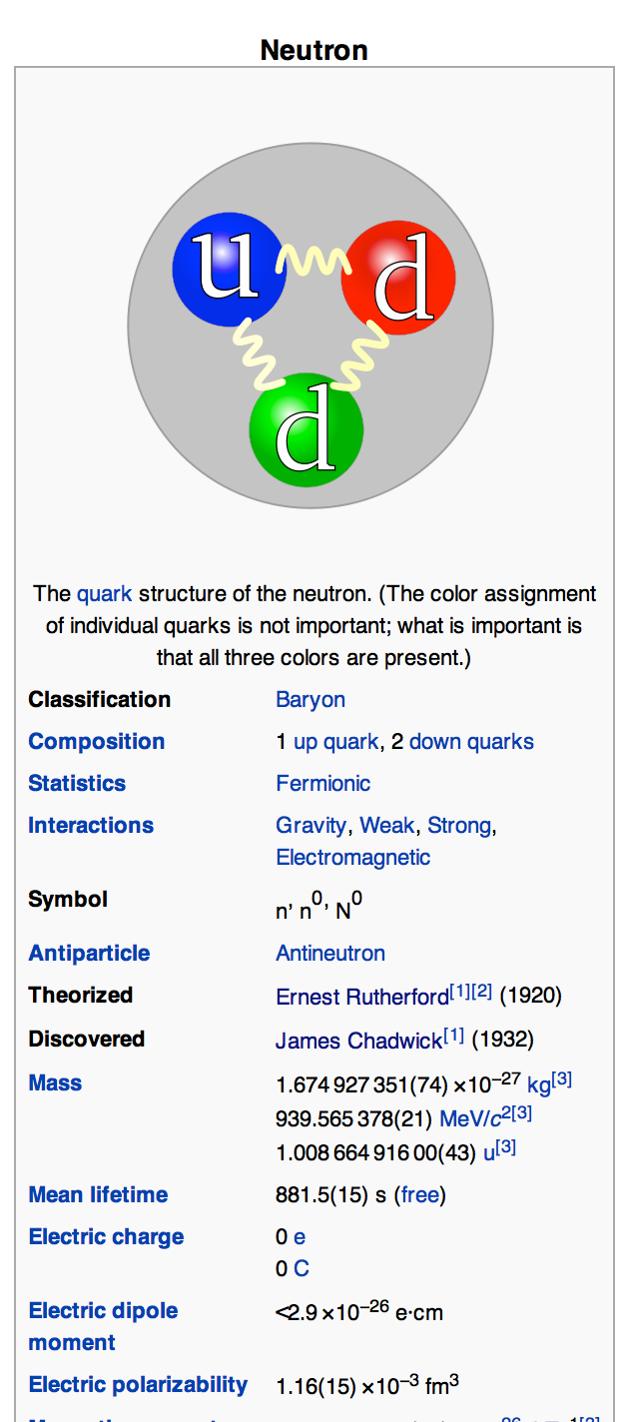
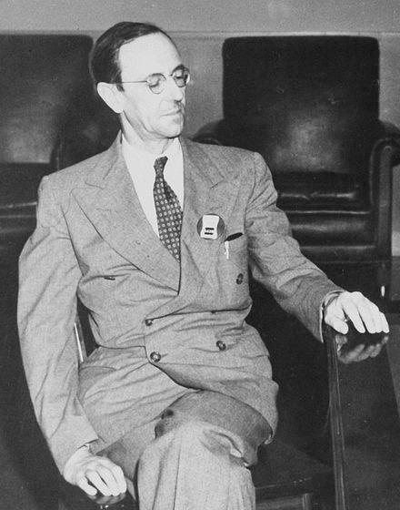
McStas: Neutrons, Monte Carlo & ray-tracing
Subatomic particle discovered by
Sir James Chadwick, 1932

Slide 4
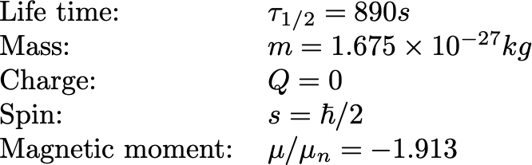
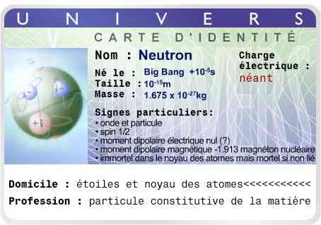



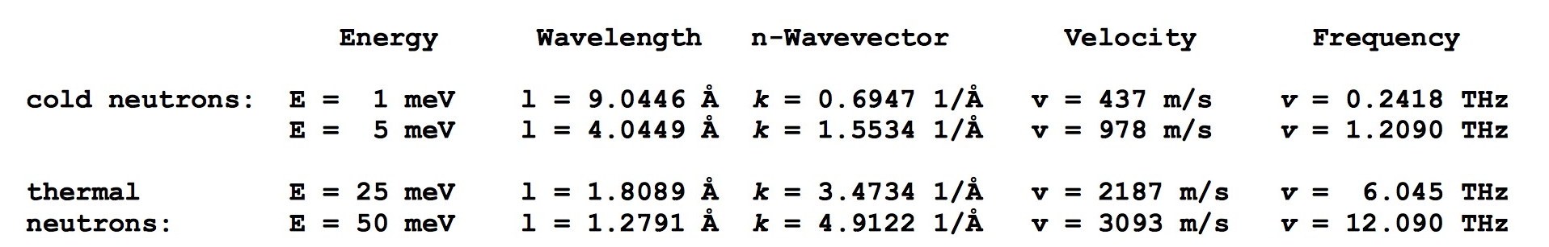
The Neutron
,
Mr. Neutron

Slide 5

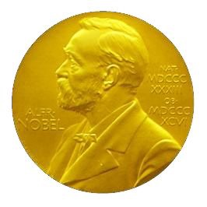


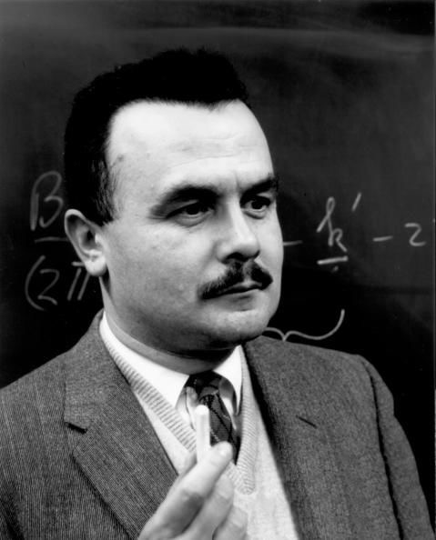
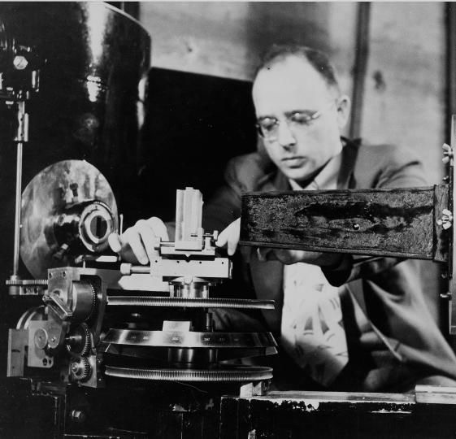

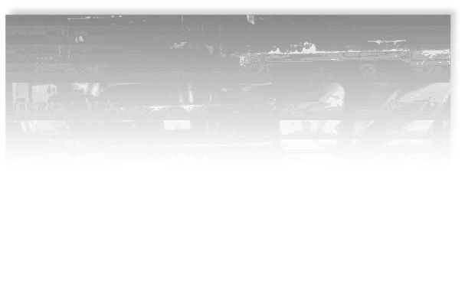
Nobel Prize in Physics, 1994
Awarded for “pioneering contributions to the development
of neutron scattering techniques for studies of condensed matter”
Bertram N. Brockhouse Clifford G. Shull
Neutron spectroscopy
Neutron diffraction technique

Slide 6
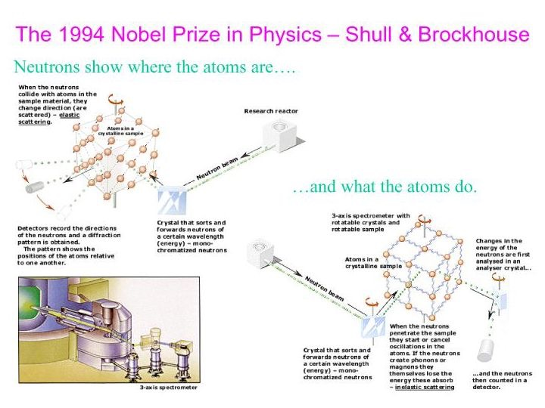
1994 Nobel prize to Shull & Brockhouse

Slide 7
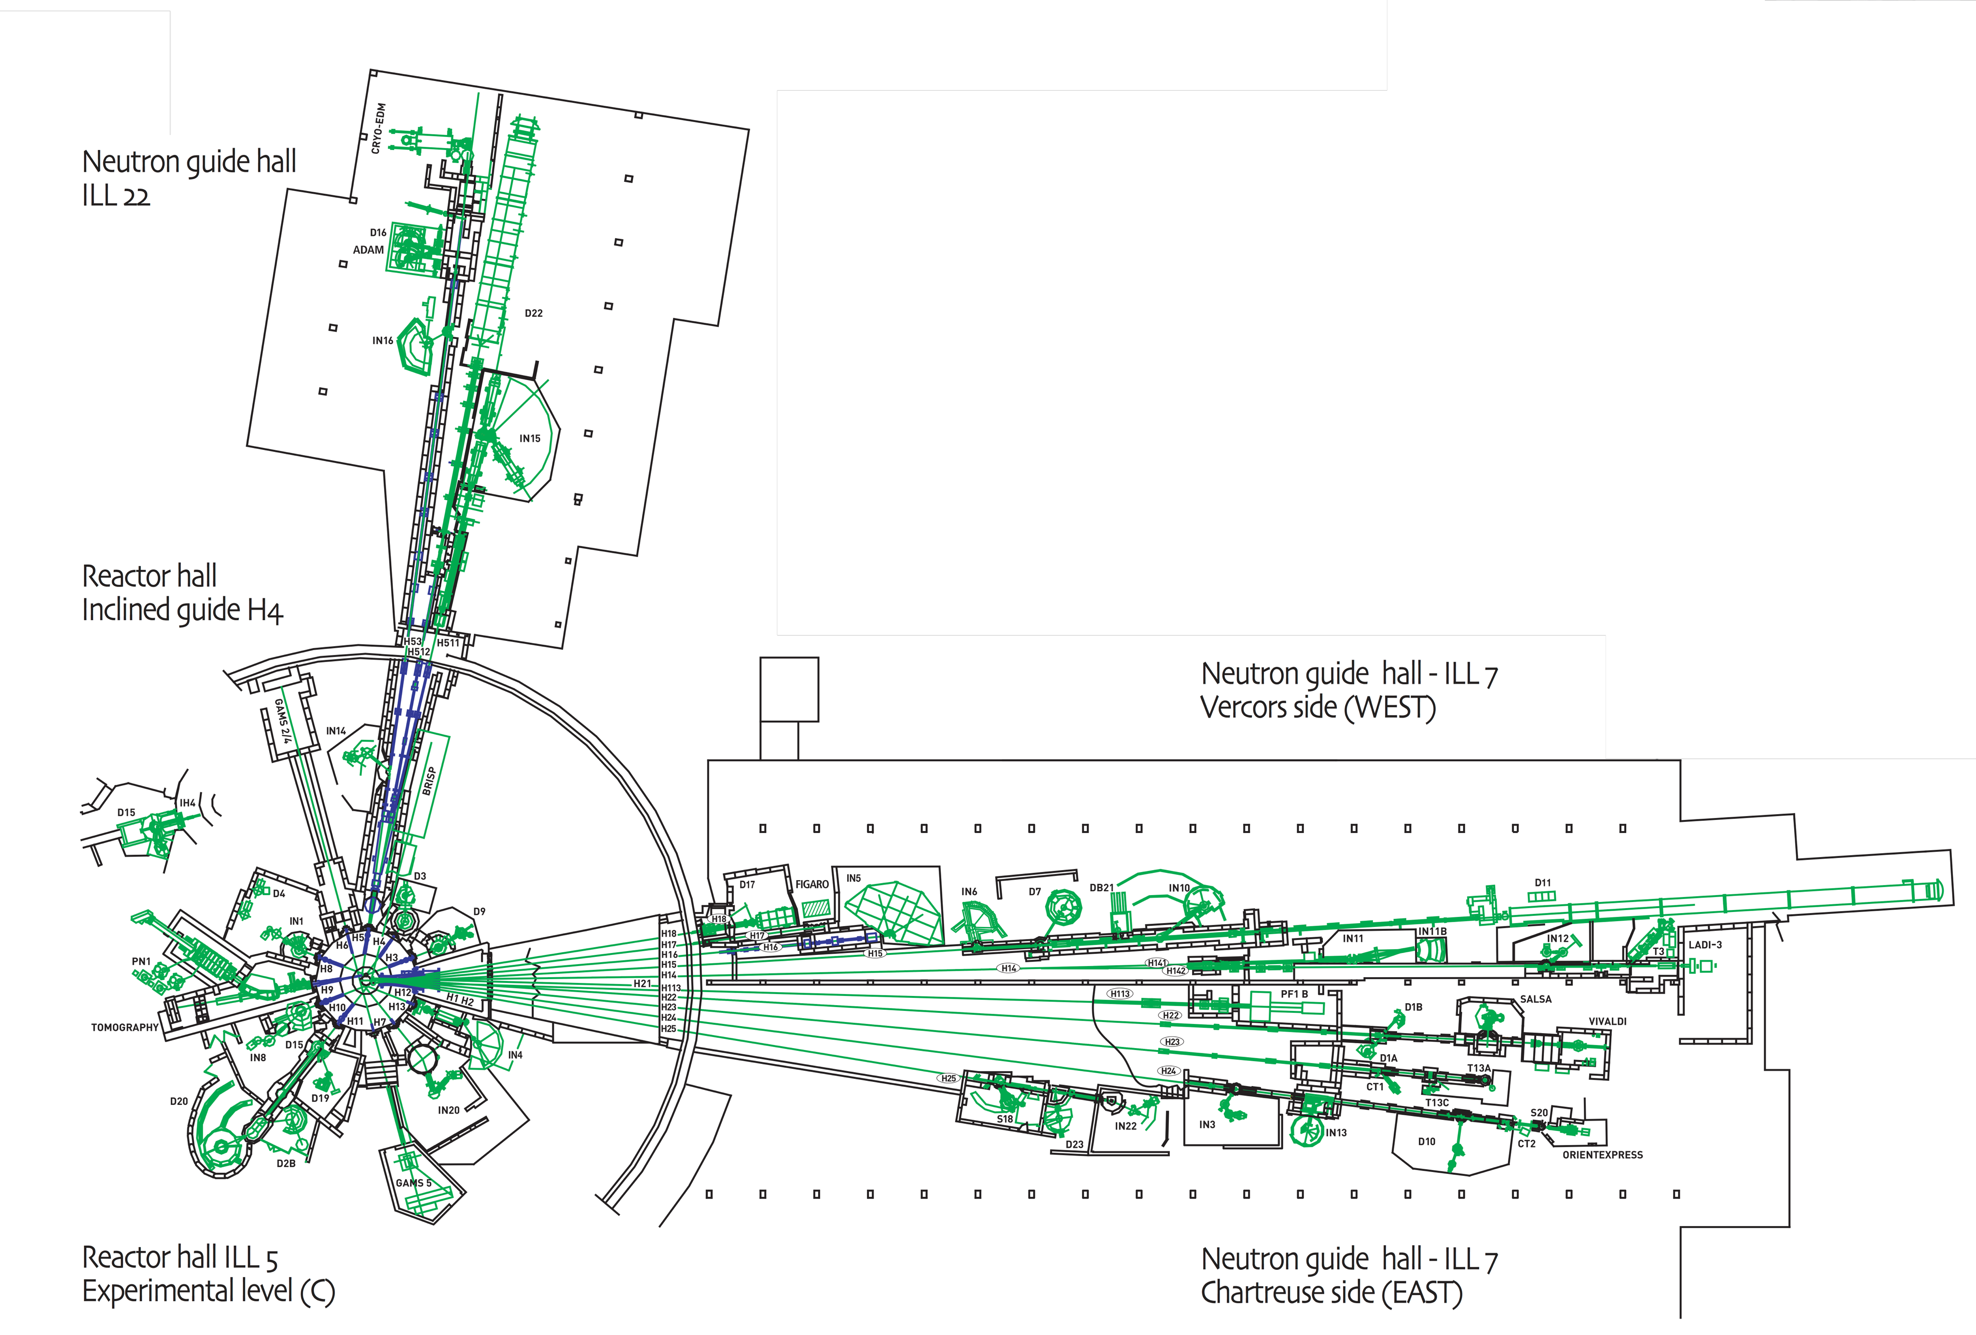
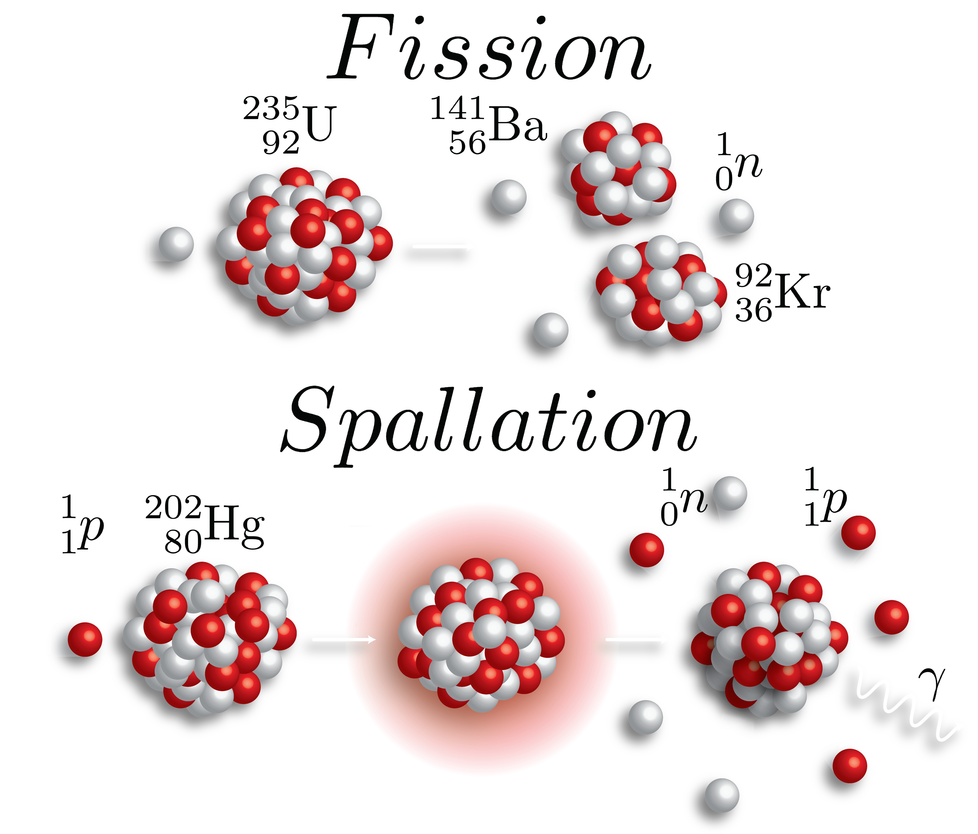

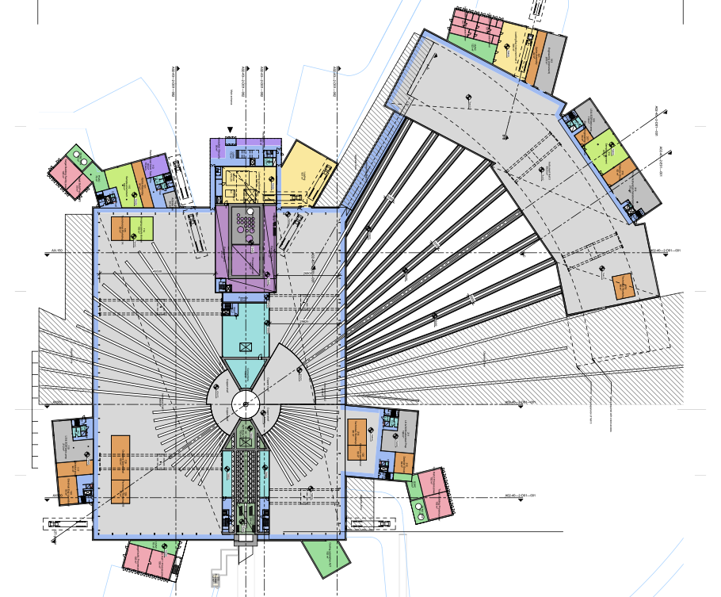

Neutron facilities

Slide 8
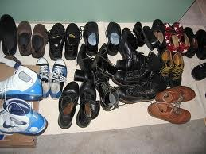
Origin of Monte Carlo methods
Used by Nature since ... (a long time) : diversity of Life
First application using computers:
Metropolis, Ulam and Von Neumann at Los Alamos, 1943
Neutron Scattering and Absorption in U and Pu, Origin of MCNP
Name:
Monte Carlo casino, a random generator (Ulam’s father played poker)

Slide 9



What are Monte Carlo methods ?
Use random generators (play poker)
Explore a complex and large phase space (many parameters)
Integrates microscopic random events into measurable quantities not a usual regular sampling integration
Metropolis algorithm: model energy gap E as a probability
Integrals converge faster than any other method (for d > 3) when using enough independent events (central limit theorem)
F. James, Rep. Prog. Phys., Vol. 43 (1980) 1145.

Slide 10
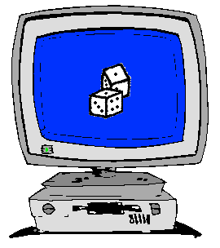
How to implement Monte Carlo methods ?
Good random generator:
from thermal electronic noise (hardware)
or quasi-random generators => quasi-Monte-Carlo
We encounter a probability 0 < p < 1.
Crude Monte-Carlo (yes/no choice):
We shoot n events ξ ∈[0,1]
We keep events that satisfy ξ < p
np events → low statistics
Importance sampling (fuzzy choice – event weighting):
Keep n events, no more random number...
But associate a weight p to each of them (we set ξ = p)
Retain statistical accuracy (1/÷n)

Slide 11
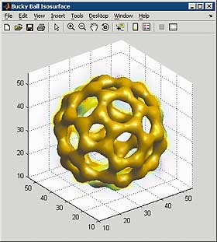
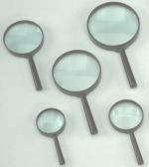
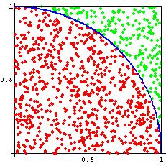
When to use Monte Carlo methods
Dimensionality of phase space must be large (d > 5)
Overall complexity is beyond reasonable analytical methods
Each event can be computed easily and independently MC is the 'lazy guy' method – think microscopic
Examples:
Estimate π from a circle/square (“Buffon needle”)
Area under/inside a curve/volume (integration)
Molecular Dynamics
spin-system phase transitions (Ising model)
nuclear reactions
ray-tracing (light, particles)
π
Number of points for which
{ x²+y²≤ 1, (x,y) ∈ [0,1] }
Ratio circle/square → π/4

Slide 12
Examples of Monte Carlo programs
Each time physics takes place (scattering, absorption, …)
random choices are made.
Light ray-tracing: PoV-RAY and others ...
Nuclear reactor simulations (neutron transport):
MCNP, Tripoli, GEANT4, FLUKA
Neutron Ray-Tracing propagation:
McStas <www.mcstas.org>, Vitess, Restrax, NISP, IDEAS
Neutrons are described as (r, v, s, t), and are transported along
instrument models.
Propagation simply uses Newton rules, incl. gravitation.
X-ray tracing
Shadow, McXtrace, RAY, …

Slide 13
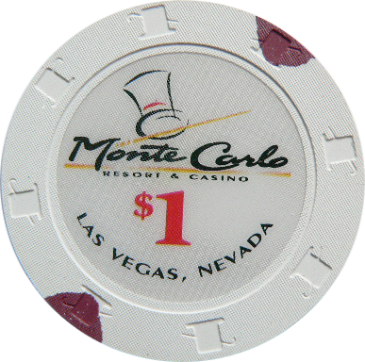
Monte Carlo techniques
Los Alamos has since then developed and perfected many different monte carlo codes leading to what is today known as the codes MCNP5 and MCNPX
State of the art is MCNPX (or soon the merged MCNP6 code) that features numerous (even exotic) particles
MCNP was originally Monte Carlo Neutron Photon, later N-Particle
Mainly used for high-energy particle descriptions in weapons, power reactors and routinely used for estimating dose rates and needed shielding
Does not to date handle coherent scattering of neutrons due to the focus on high energies

Slide 14
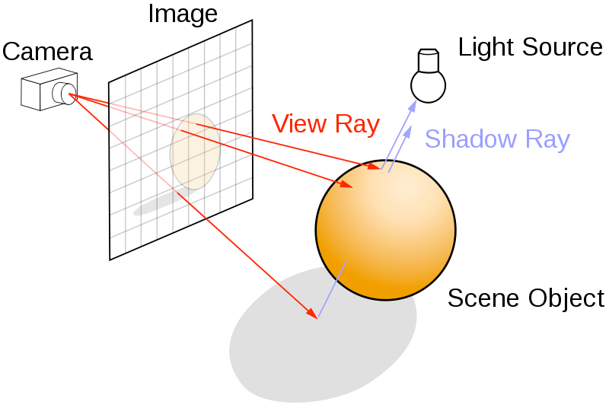
Ray-tracing methods
When neutrons move in “free space”, we use ray-tracing - but in most cases in direction source -> detector
Of course parabolas rather than straight lines are uses to implement gravity

Slide 15
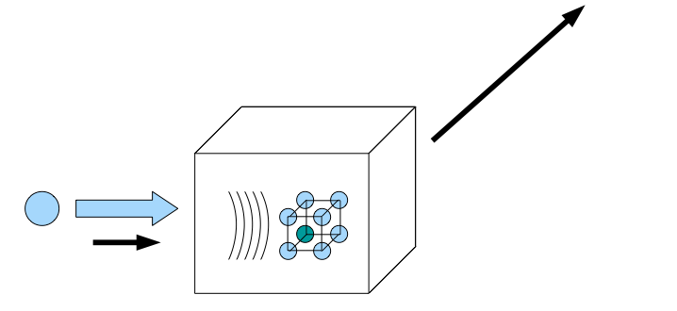
Elements of Monte-Carlo raytracing
Instrument Monte Carlo methods implement coherent scattering effects
Uses deterministic propagation where this can be done
Uses Monte Carlo sampling of “complicated” distributions and stochastic processes and multiple outcomes with known probabilities are involved
- I.e. inside scattering matter
Uses the particle-wave duality of the neutron to switch back and forward between deterministic ray tracing and Monte Carlo approach
Result: A realistic and efficient transport of neutrons in the thermal and cold range

Slide 16
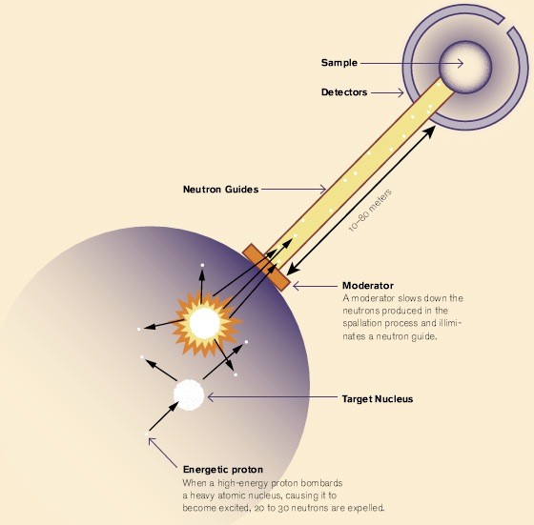
Components of neutron instruments

Slide 17
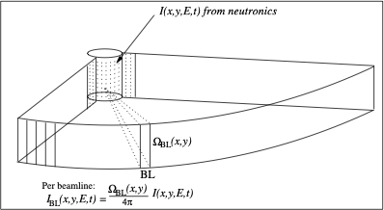
Moderators... (Where McStas starts)

Slide 18
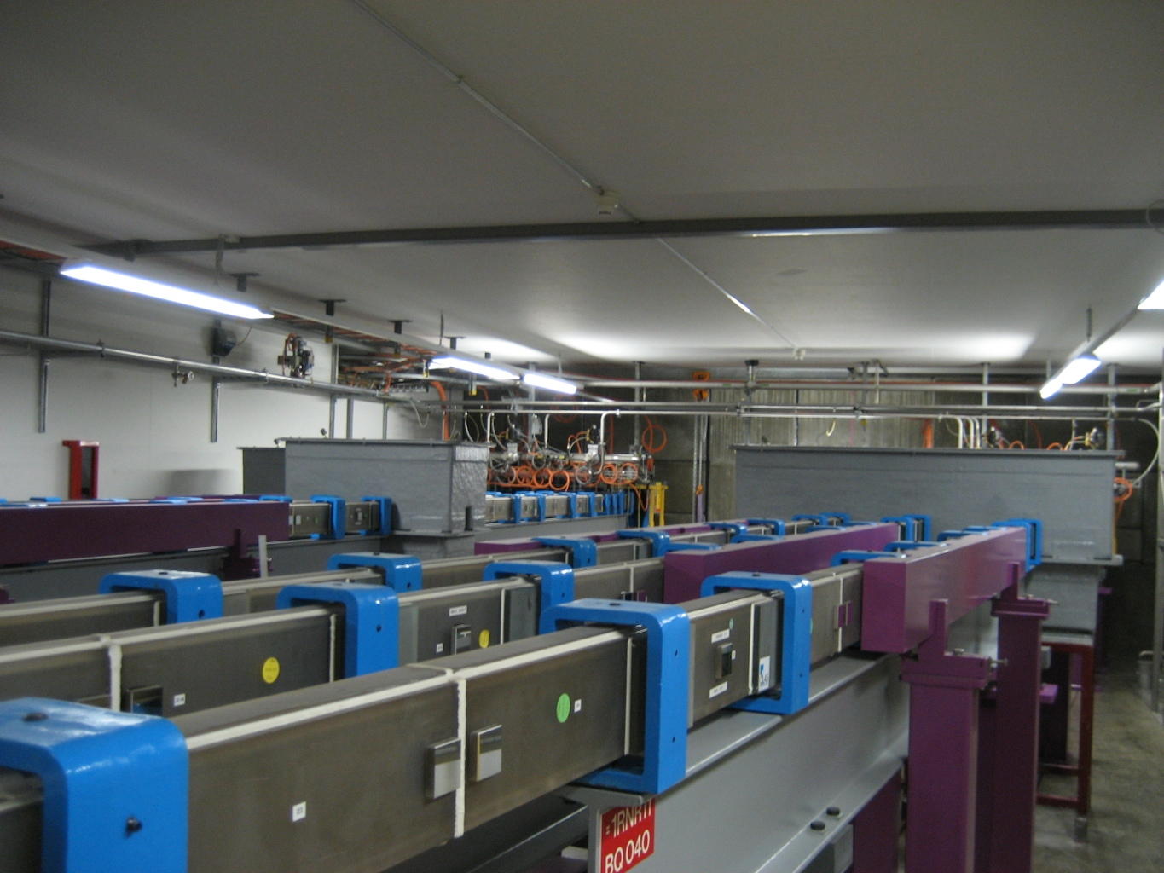
Neutron guides

Slide 19
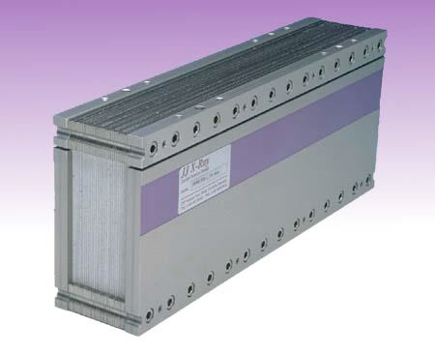
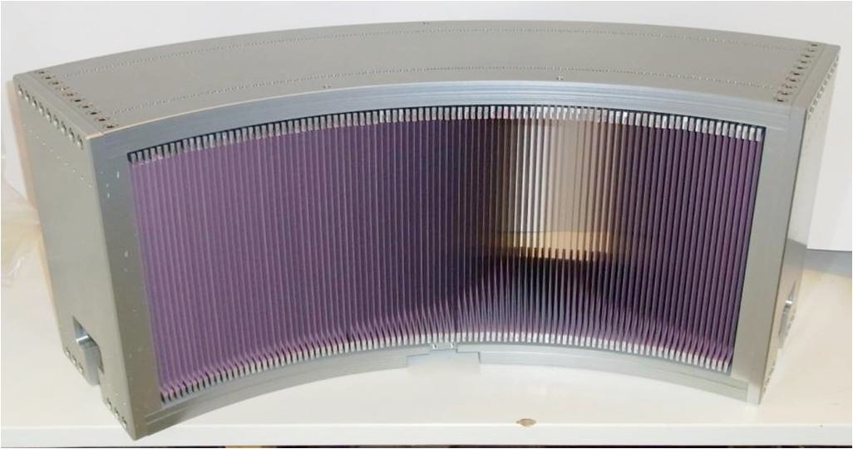
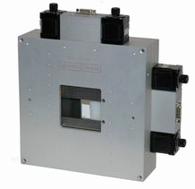
Collimators & slits

Slide 20
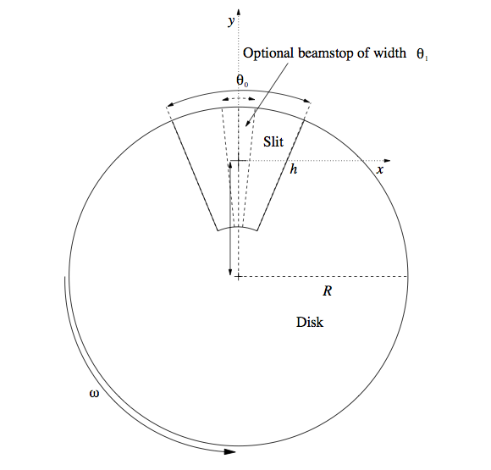
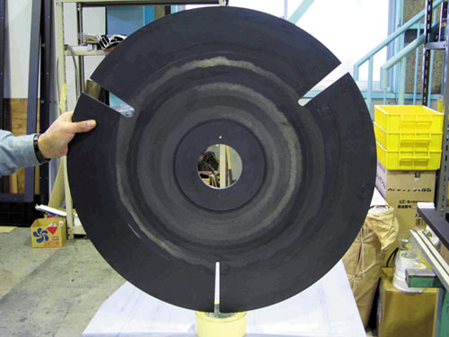
Disk Choppers

Slide 21
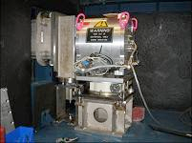
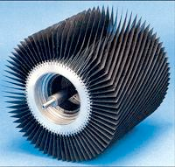
Velocity selector

Slide 22
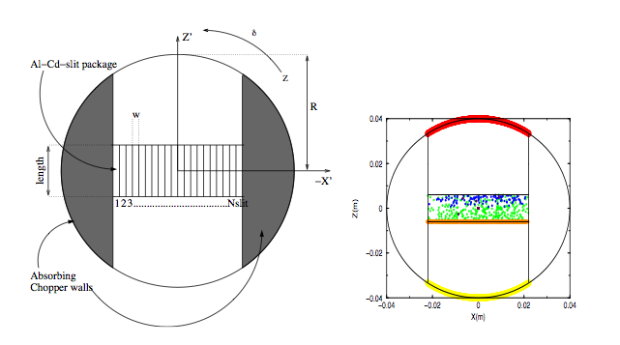
Fermi Choppers

Slide 23
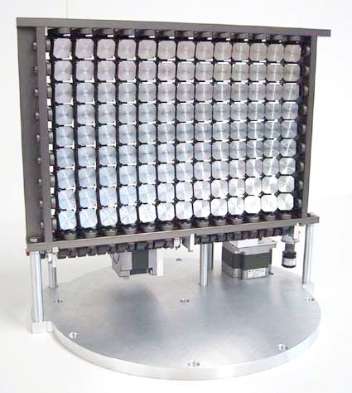
Crystal monochromators (and analyzers)

Slide 24
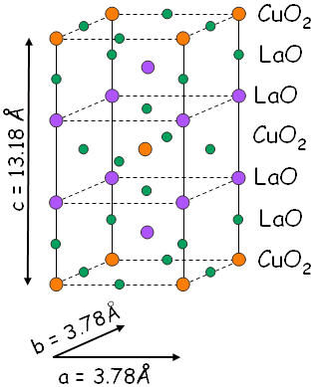
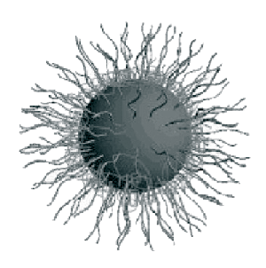
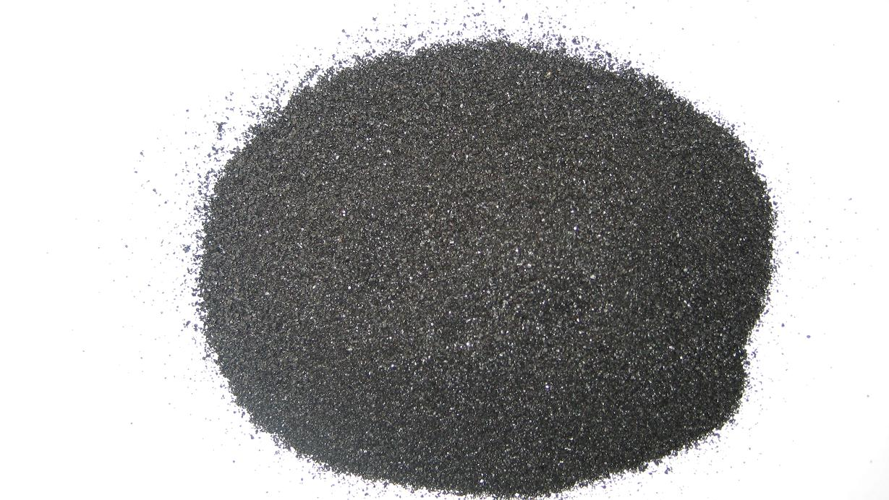

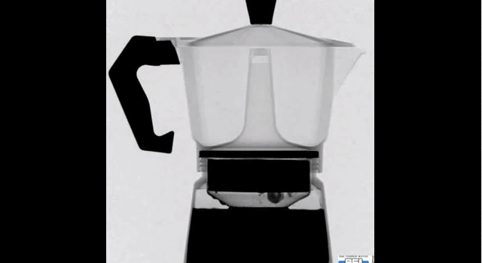
Samples studied...

Slide 25
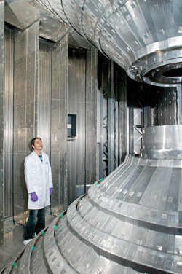
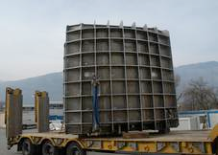
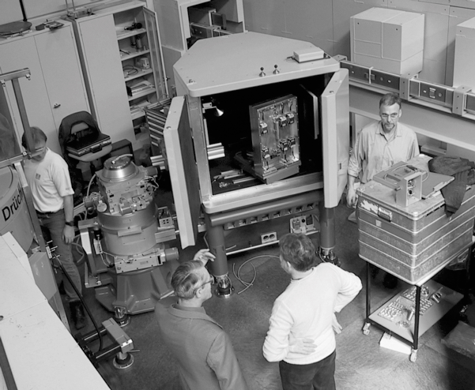
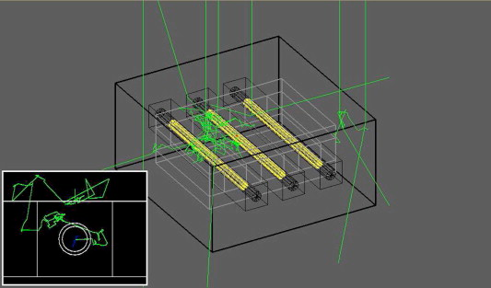
Detectors
x

Slide 26
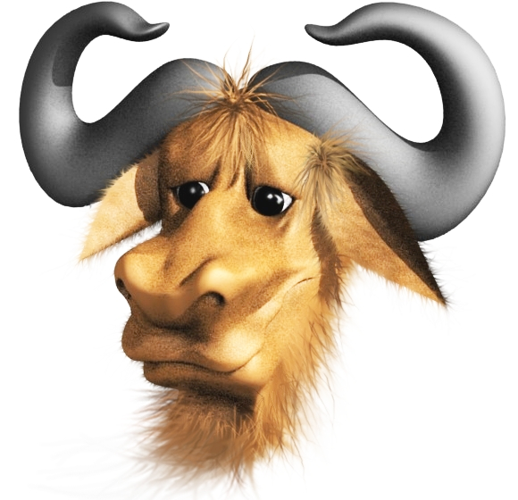
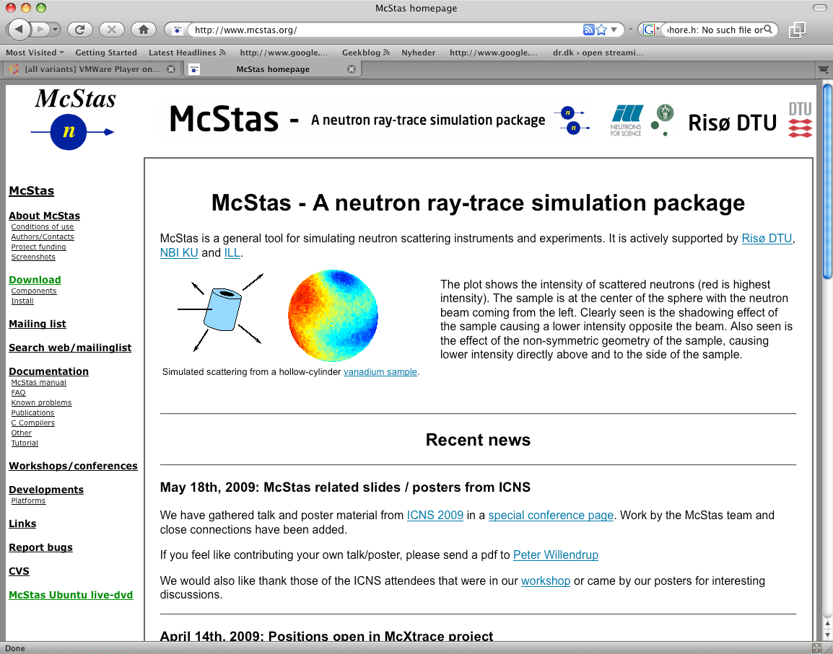
McStas Introduction
Flexible, general simulation utility for neutron scattering experiments.
Original design for Monte carlo Simulation of triple axis spectrometers
Developed at DTU Physics, ILL, PSI, Uni CPH, ESS DMSC
V. 1.0 by K Nielsen & K Lefmann (1998) RISØ
Currently 2.5+1 people full time plus students
GNU GPL license
Open Source
Project website at
http://www.mcstas.org
mcstas-users@mcstas.org mailinglist

Slide 27
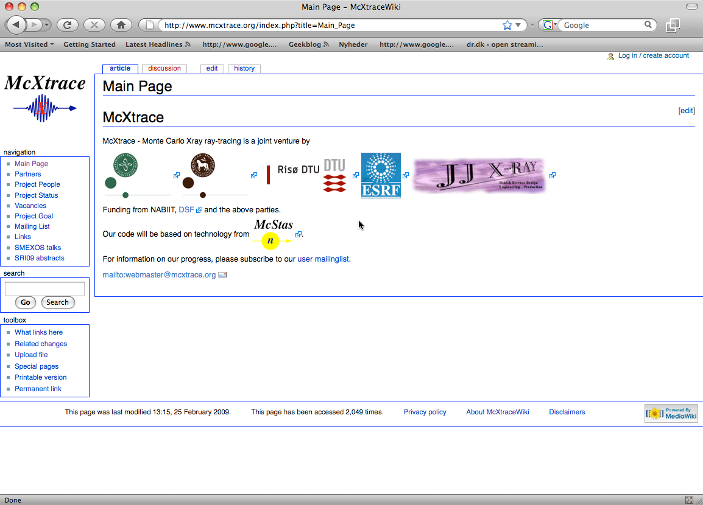
McStas Introduction
McXtrace - since jan 2009 similar for X-rays
Flexible, general simulation utility for neutron scattering experiments.
Original design for Monte carlo Simulation of triple axis spectrometers
Developed at RISØ DTU, KU and ILL, Grenoble.
V. 1.0 by K Nielsen & K Lefmann (1998)
Currently 2.5+1 people full time plus students
GNU GPL license
Open Source
Project website at
http://www.mcstas.org
neutron-mc@risoe.dk mailinglist
Synergy, knowledge transfer, shared infrastructure
4

Slide 28
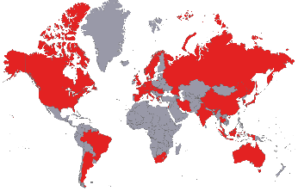

Used in many places

Slide 29
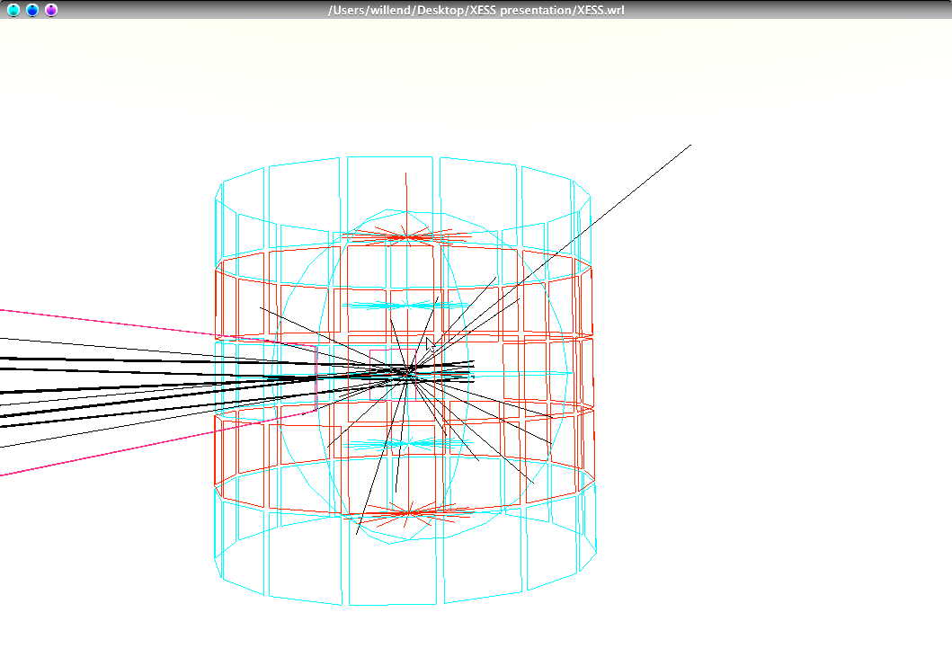
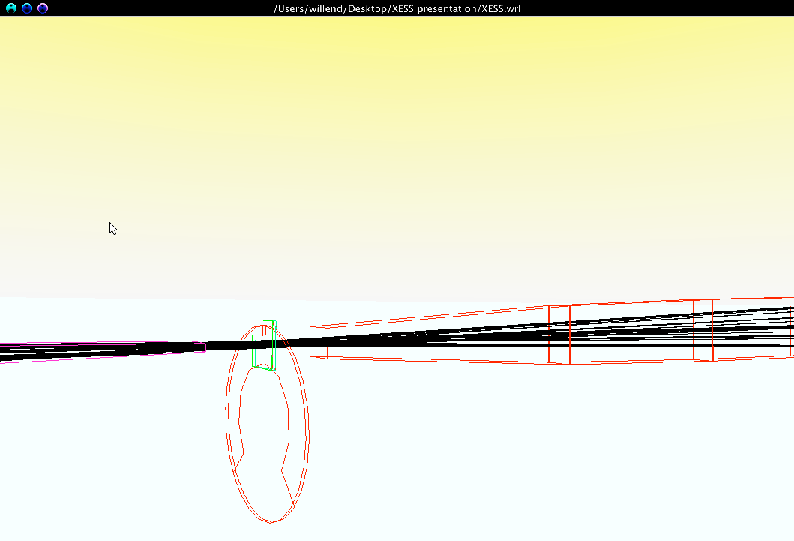
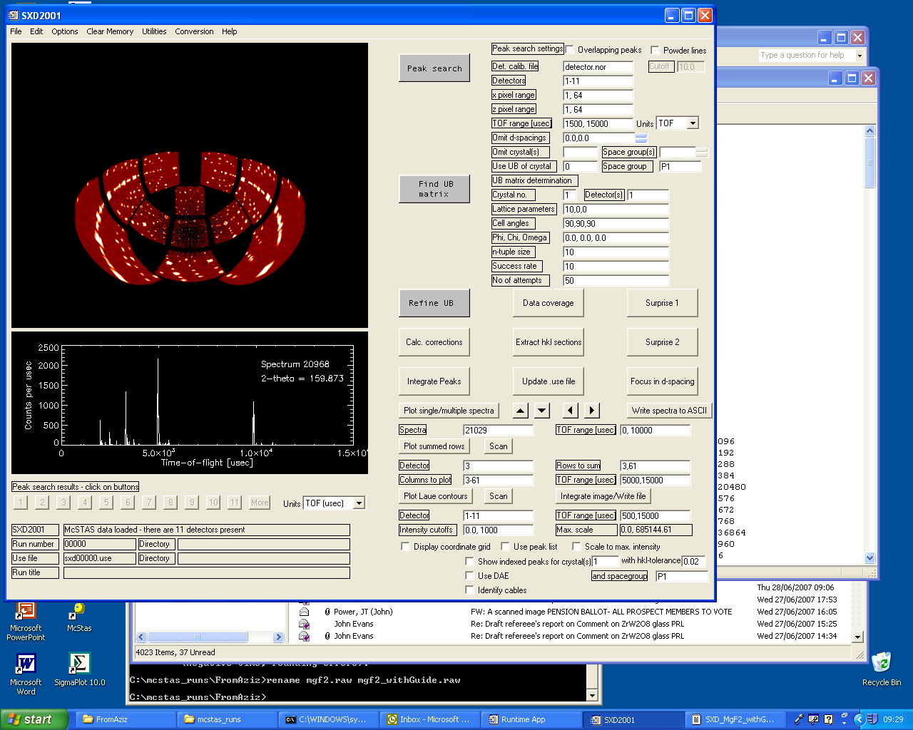
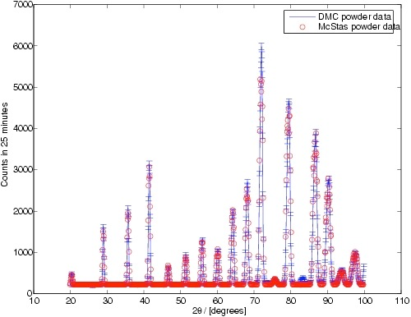
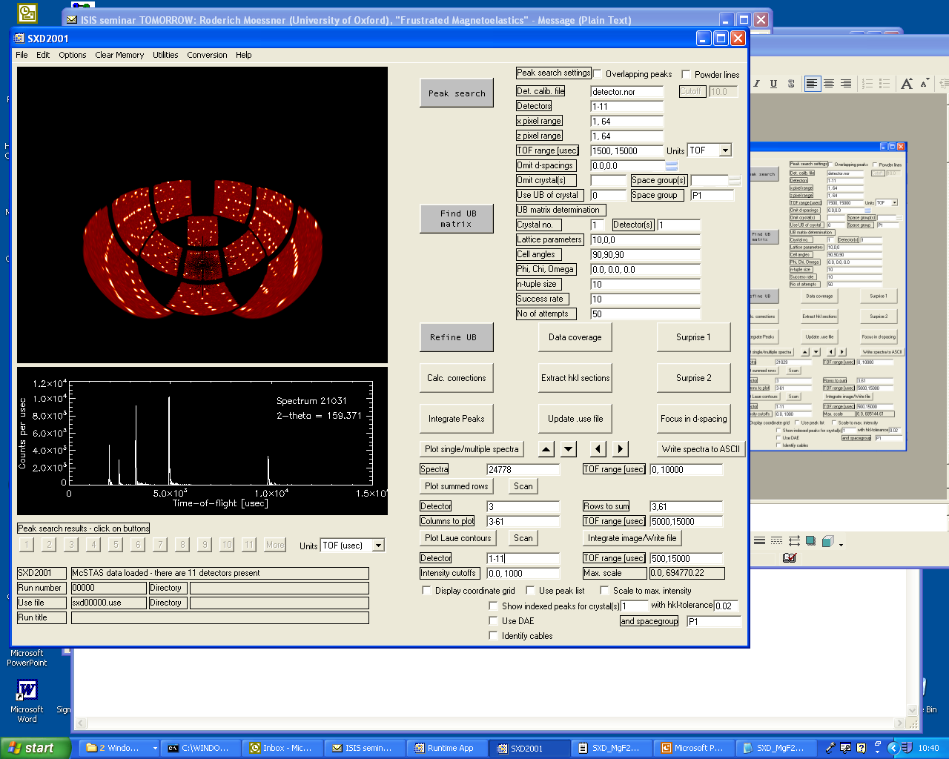




What is McStas used for?
Instrumentation
Planning
Construction
Virtual experiments
Data analysis
Teaching
(KU, DTU)

Slide 30



Instrumentation
Design and optimization of instruments

Slide 31


Virtual experiments (VE)
(definition:)
Simulation of a complete experiment
… from source to detector
Ideally controlled like real experiment.
Data analysed by ”real” analysis programs
A. Daud-Aladine, ISIS
P. Willendrup, Risø DTU; Uwe Filges, L. Keller, PSI

Slide 32


Data analysis (1)
(using VE techiques)
Virtual TOF exp. at IN6, ILL
Liquid Ge sample
Coherent / incoherent
Multiple scattering
And sample environment
All contributions can be separated by VE !
E. Farhi, ILL

Slide 33


Data Analysis (2)
(using VE techniques)
VE data has been used to test data analysis programs
… and to check resolution effects
P. Tregenna-Piggott, PSI
L. Udby, Risø-DTU

Slide 34
Teaching / training purposes
Workshops
Teaching
University of Copenhagen course on Neutron Scattering 2005-, DTU 2011-

Slide 35

Reliability - cross comparisons
Much effort has gone into this
Here: simulations vs. exp. at powder diffract. DMC, PSI
The bottom line is
McStas agree very well with other packages (NISP, Vitess, IDEAS, RESTRAX, ...)
Experimental line shapes are within 5%
Absolute intensities are within 10%
Common understanding: McStas and similar codes are reliable
E. Farhi, P. Willendrup et al., in preparation
P. Willendrup et al., Physica B, 386, (2006), 1032.

Slide 36


McStas: key concepts
Time (t)

Slide 37


McStas: key concepts

Slide 38

McStas: key concepts

Slide 39
McStas: key concepts
Local, internal coordinate system!

Slide 40


McStas: key concepts

Slide 41

In the big picture…

Slide 42




McStas overview
Portable code (Unix/Linux/Mac/Windoze)
Ran on everything from iPhone to 1000+ node cluster!
'Component' files (~100) inserted from library
Sources
Optics
Samples
Monitors
If needed, write your own comps
DSL + ISO-C code gen.

Slide 43

Under-the-hood / inner workings
Domain-specific-language (DSL) based on compiler technology (LeX+Yacc)
Simple Instrument language ISO C
Component codes realizing beamline parts (including user contribs)
Library of common functions for e.g.
I/O
Random numbers
Physical constants
Propagation
Precession in fields
...
Code generation

Slide 44

Implementation

Slide 45


Instrument file

Slide 46



Component file

Slide 47



Generated c-code

Slide 48


Writing new comps or understanding existing is not that complex...
Check our long list of components and look inside... Most of them are quite simple and short... Statistics:
Number of lines of code per component - 199 comps in total
(update: 175)

Slide 49
Including user contribs
Well-developed community support
30-40% of existing and new additions are from users
No direct refereeing of the code, but these requirements:
At least one test-instrument
Meaningful documentation headers (in-code docs)
Contributions go in dedicated contrib/ section of library
Natural life-cycle of contrib’s
Bug-fixes are applied both by contributor and developers
If contributor becomes unavailable either:
Many users of comp: Promote to official components, e.g. in optics/
Few/no users of comp: Move to obsolete/ until next major release

Slide 50







Example suite: ~140 instruments

Slide 51


