Slide 1






ESS Sources in McStas - Analytic + MCPL
Peter Willendrup^{1,3}, Esben Klinkby^{2,4}
¹Physics Department, Technical University of Denmark, Denmark ²Center for Nuclear Technologies, Technical University of Denmark ³ESS DMSC, Copenhagen, Denmark ³ESS, Lund, Sweden
ESS sources in McStas

Slide 2
Agenda
What is MCPL?
“Normal” ESS source in McStas
MCPL files and how they are generated
Use with McStas
ESS sources in McStas

Slide 3
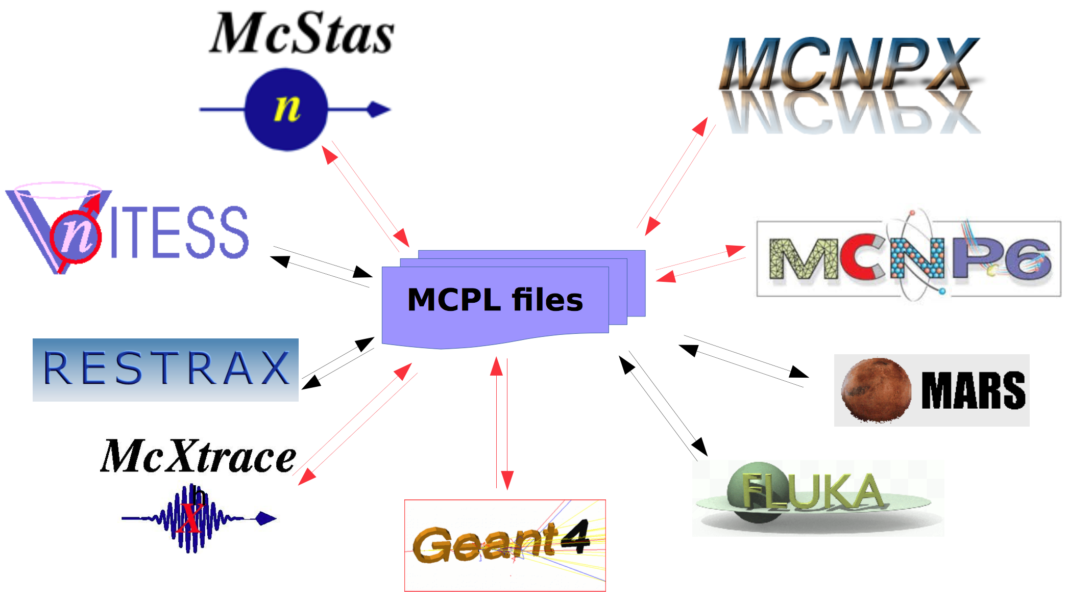
What is MCPL?
MCPL is short for Monte Carlo Particle List
Interchange-file-format for Geant4, MCNP(x), McStas etc…
Created by T Kittelmann, ESS Detector Group, input from DTU, ESS etc.
GitHub site: https://mctools.github.io/mcpl/
Paper: T. Kittelmann et. al. Computer Physics Communications (218) pp. 17-42
Talk on the subject here:
http://coimbra2016.essworkshop.org/slides/MCPL_Kittelmann.pdf
ESS sources in McStas

Slide 4
“Normal” sources in McStas
Describe the moderator(s) ONLY
Describe only thermalised neutrons
Uses analytical curves to express spectra, emission profiles etc., typically modelled using e.g. MCNP
Advantages:
Fast runtime (ESS_butterfly instrument w. guide transports 1e7 neutron rays in 11 seconds on 4 cores)
No stat/bias issues generating further events
Excellent “match” for what the neutron optics can actually transport!
Disadvantages:
The above issues in lacking description of high-energy particles and non-moderator particles
ESS sources in McStas

Slide 5
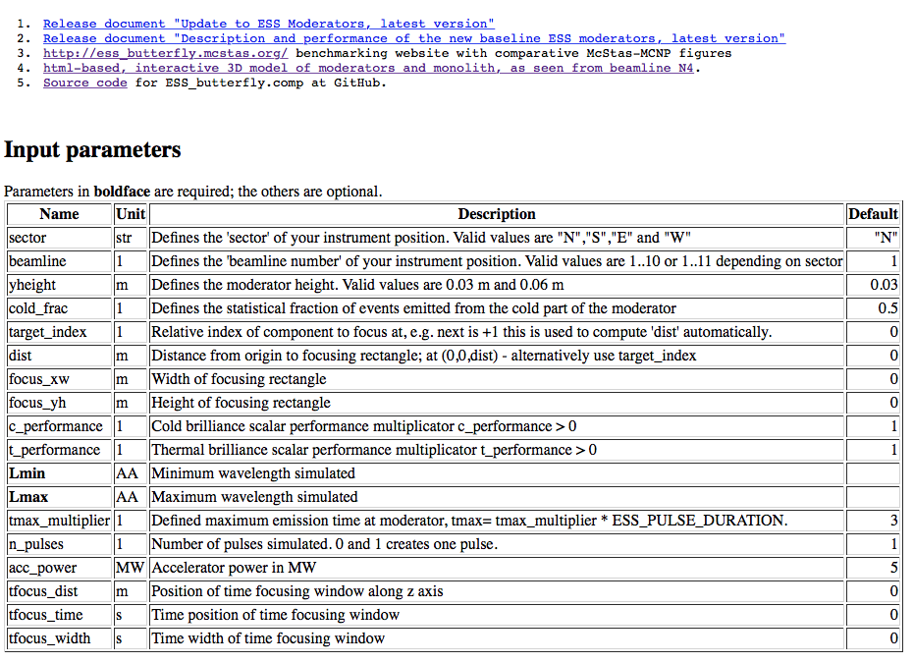
ESS_butterfly McDoc page:
See also http://ess_butterfly.mcstas.org
ESS sources in McStas

Slide 6
ESS_butterfly McDoc page:
See also http://ess_butterfly.mcstas.org
Choice of beamline, e.g.
sector=N,
beamline=3
ESS sources in McStas

Slide 7
ESS_butterfly McDoc page:
See also http://ess_butterfly.mcstas.org
(yheight=0.03 “fixed”)
ESS sources in McStas

Slide 8
ESS_butterfly McDoc page:
See also http://ess_butterfly.mcstas.org
cold_frac ∈ [0,1] cold vs thermal statistics
ESS sources in McStas

Slide 9
ESS_butterfly McDoc page:
See also http://ess_butterfly.mcstas.org
target_index / dist “where should I aim”
target_index = n, will point to nth component “seen from here”, freeform (x,y,z)
dist is (0,0,dist)
ESS sources in McStas

Slide 10
ESS_butterfly McDoc page:
See also http://ess_butterfly.mcstas.org
focus_xw, focus_yh “how much to illuminate”
ESS sources in McStas

Slide 11
ESS_butterfly McDoc page:
See also http://ess_butterfly.mcstas.org
c_ & t_performance “future penalty from engineering”
ESS sources in McStas

Slide 12
ESS_butterfly McDoc page:
See also http://ess_butterfly.mcstas.org
these you know…
ESS sources in McStas

Slide 13
ESS_butterfly McDoc page:
See also http://ess_butterfly.mcstas.org
How far to sample (flat) in time, i.e. extent of pulse + “tail”, in units of nominal pulse duration
ESS sources in McStas

Slide 14
ESS_butterfly McDoc page:
See also http://ess_butterfly.mcstas.org
How many pulses to generate, intensity remains constant (McStas sources pr. def. in units of 1/second!)
ESS sources in McStas

Slide 15
ESS_butterfly McDoc page:
See also http://ess_butterfly.mcstas.org
accelerator power (some time in the future…)
ESS sources in McStas

Slide 16
ESS_butterfly McDoc page:
See also http://ess_butterfly.mcstas.org
“time-focus” at chopper window of certain duration certain distance from here
ESS sources in McStas

Slide 17
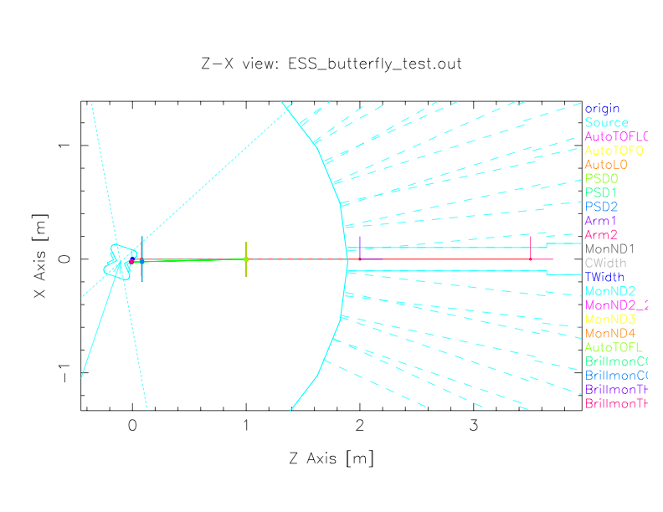
ESS_butterfly mcdisplay output:
http://ess_butterfly.mcstas.org/visualisation/
ESS sources in McStas

Slide 18

ESS_butterfly mcdisplay output:
Drawing only a guide to the eye!
Not engineering quality!
Gergely found discrepancy (~3x8 mm @ W1)
McStas component origin @ focal point
Instrument along “nominal instrument axis” Shown geometries have little reference to
generated neutrons that were based on MCNP
simulations
http://ess_butterfly.mcstas.org/visualisation/
ESS sources in McStas

Slide 19
MCPL files as a McStas source
Describe any particle reaching area near the beam port, arriving from anywhere
Describe all neutrons, any energy - but also gammas etc…
Implemented using the SSW card in MCPN in combination with a dxtran sphere “around” beam port
Advantages:
Describes anything MCNP generates, including thermalised neutrons off the reflector…
Could be used in attempt to model signal-to-noise @ sample, with combined McStas+MCNP transport…
Disadvantages:
Stat/bias issues generating further events (simple repetition brings nothing new)
Files are Gb size as a starting point
In comparison with “normal” McStas source slow
ESS sources in McStas

Slide 20
What did Esben generate
Dirac-delta (time) proton beam on target, 1e5 protons “NPS”.
I.e. McStas component/instrument includes normalisation factors
1/1e5 protons/simulation -> neutrons / incoming proton
1.56e16 protons/s -> neutrons / second (default McStas intensity units)
Uses “target” coordinate system
MC choice on time within pulse length
ESS butterfly 1 design “current model”
Simulations run for “the expected day-1 instruments”
“dxtran sphere” used to illuminate beam port
Size ~ 3-5Gb / beam line
Includes ~ 1e8 particles in total
- out of these ~50% are neutrons
Once reduced to “transportable neutrons” ~ 1e7 events
Takes 5-10 minutes to process through instr w/guide if not filtered in any way…
ESS sources in McStas

Slide 21
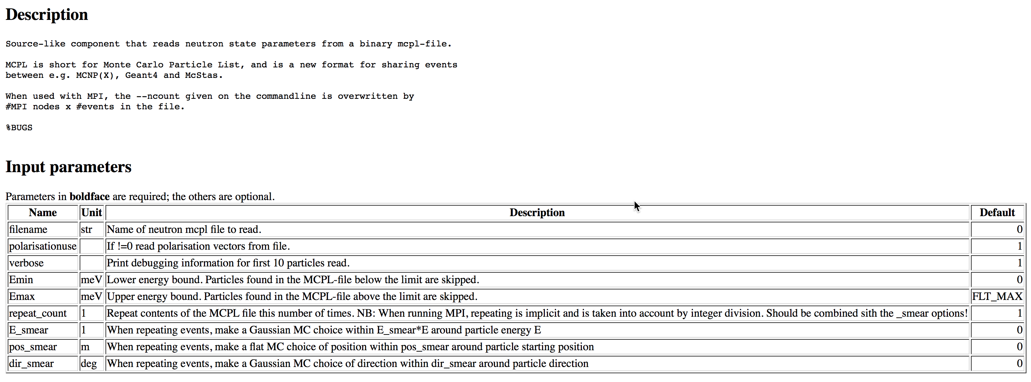

MCPL_input component interface
See also:
https://arxiv.org/abs/1609.02792
https://mctools.github.io/mcpl/
http://coimbra2016.essworkshop.org/slides/MCPL_Kittelmann.pdf
Generic, no reference to “ess” in this
https://mctools.github.io/mcpl/
ESS sources in McStas

Slide 22
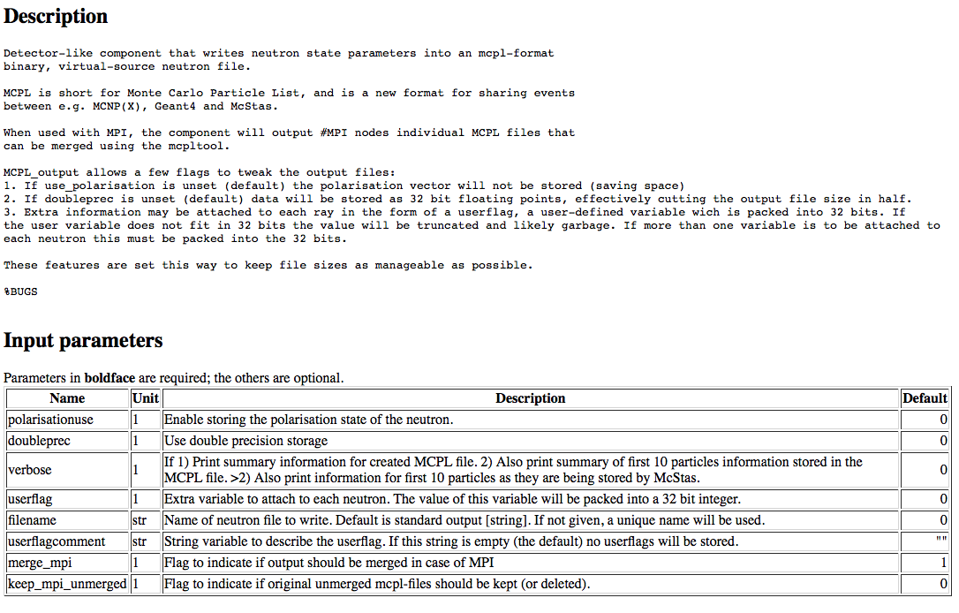
MCPL_output component interface
See also:
https://arxiv.org/abs/1609.02792
https://mctools.github.io/mcpl/
http://coimbra2016.essworkshop.org/slides/MCPL_Kittelmann.pdf
ESS sources in McStas

Slide 23
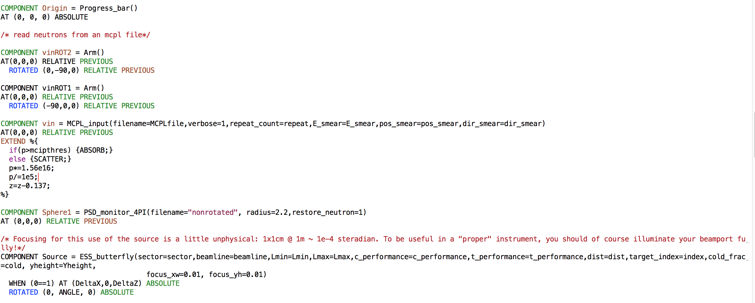
Inserted in instrument file for ESS context
ESS_butterfly_MCPL_test.html
ESS sources in McStas

Slide 24
Default parameters for “repeating events”
All mpi nodes read the file fully and independently… So we’d better do something clever….
E_smear=0.1 ~ MC choice of energy in Gaussian of sigma 0.1*E0
pos_smear=0.01 ~ MC choice on position within sphere of radius 0.01m
dir_smear=0.01 ~ MC choice on direction within cone of 0.01 deg
repeat=N gives a repetition of the events in the file by ceil(N/mpicount)
(10 reps over 4 nodes ~ 3 reps pr node ~ 12 reps)
MC choice applied for nodes of rank > 1 and when file is being repeated at individual node.
ESS sources in McStas

Slide 25
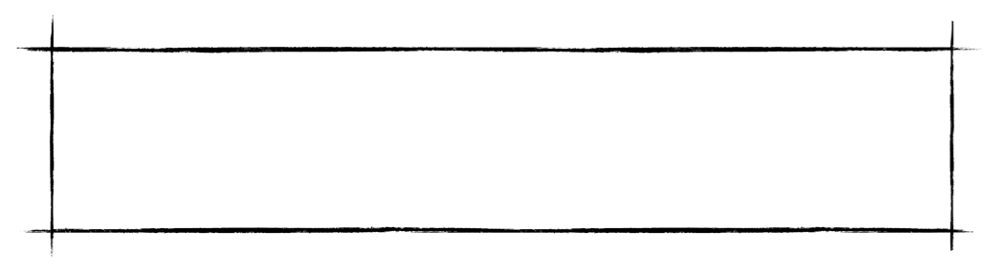
Default parameters for “repeating events”
!! Caution !!
Smear-settings are user parameters - but can clearly be misused!
Make conservative choices here, base on physical / geometrical
considerations please!
All mpi nodes read the file fully and independently… So we’d better do something clever….
E_smear=0.1 ~ MC choice of energy in Gaussian of sigma 0.1*E0
pos_smear=0.01 ~ MC choice on position within sphere of radius 0.01m
dir_smear=0.01 ~ MC choice on direction within cone of 0.01 deg
repeat=N gives a repetition of the events in the file by ceil(N/mpicount)
(10 reps over 4 nodes ~ 3 reps pr node ~ 12 reps)
MC choice applied for nodes of rank > 1 and when file is being repeated at individual node.
ESS sources in McStas

Slide 26
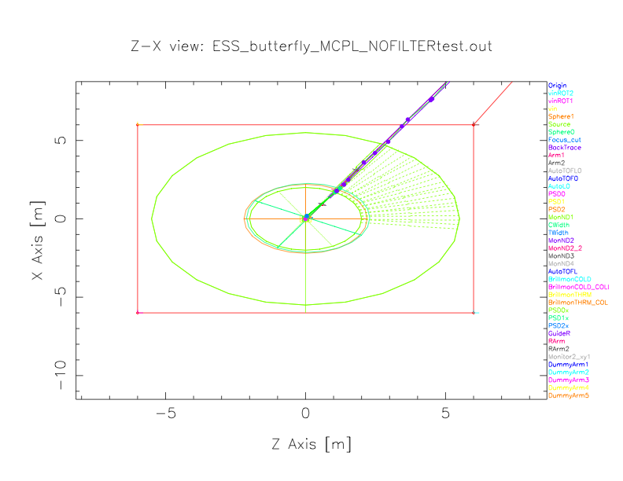
Like “normal” ESS_butterfly_test.instr, but 50 m of
curved guide (curvature 3000 m) added.
ESS sources in McStas

Slide 27
For the McStas users…
Template instrument file creates similar interface as for the “analytical” ESS_butterfly, pick your sector and beam line and you are good to go!
sector=W beamline=8 -> reads W8.mcpl.gz (with filter=1 reads W8_filtered.mcpl.gz)
Plan on expanding this kind of logic and provide a set of “onion-shelled” MCPL files pr. beam line (filters on particle type, energy, position, divergence etc…)
Full documentation with examples will become available on Atlassian
Files will be served on the DMSC cluster
ESS sources in McStas

Slide 28
Analytic vs. event models - PSD after curved guide
Intensity # events
Analytic: 3.58867e+11 / 9.88961e+06
Unfiltered BIG: 3.54106e+11 / 7.55581e+07
McStas filtered BIG: 3.01198e+11 / 1.49028e+07
Filtered MCPL: 3.01273e+11 / 1.48899e+07
Good agreement,
Pics below similar
~ Same intensity
Unfiltered
“BIG” MCPL
“BIG” MCPL
Geom filters
in McStas instr
“Filtered” MCPL (E,neutr)
+geom filters
in McStas instr
Analytic
Images look
the same, and
intensity is of
the same order
(~3e11)
W1
Execution times…
50 sec
5.5 min
2.6 min
1.3 min
ESS sources in McStas

Slide 29
Which source to use when??
Frontend optimisation, final “placement”: I would probably use MCPL based source, but with caution
Anything beyond that / requiring “proper stats”: Use analytic source
ESS sources in McStas

Slide 30
Web resources…
Confluence page “Using MCPL as source term in McStas”
ESS_butterfly “benchmarking website” w/reports etc.
MCPL input files describing ESS beamlines
ESS sources in McStas

