Slide 1






McStas advanced language features
- and other important, not so well known details
Peter Willendrup^{1,5}
Emmanuel Farhi²
Erik Knudsen^{1,5}
Uwe Filges³
Kim Lefmann^{4,5}
¹DTU Physics, Lyngby, Denmark
²Calcul Scientifique, Institut Laue-Langevin (ILL), Grenoble, France
³Niels Bohr Institute, University of Copenhagen, Copenhagen, Denmark
4Paul Scherrer Institut, Villigen, Switzerland
5ESS DMSC, Copenhagen, Denmark

Slide 2
Topics
A quick recap of the most important vocabulary
Simulation to experiment comparison
How to make your McStas more efficient
McStas language macros
Other important details

Slide 3
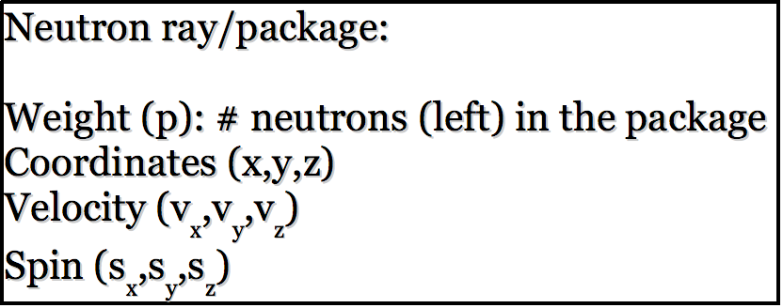
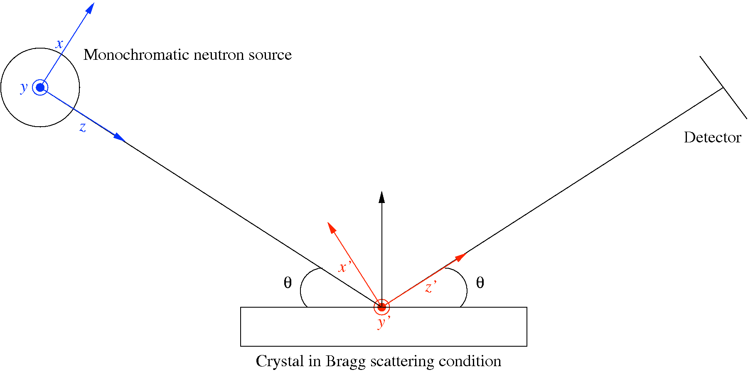
McStas: key concepts
Time (t)

Slide 4
McStas: key concepts
Neutron state parameters are global variables!
Time (t)

Slide 5
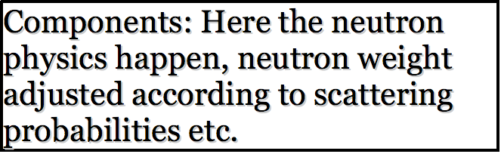
McStas: key concepts

Slide 6
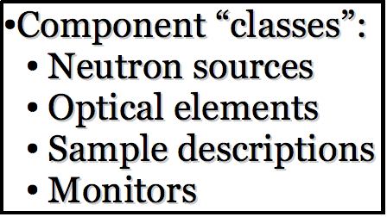
McStas: key concepts

Slide 7
McStas: key concepts
Local, internal coordinate system!

Slide 8
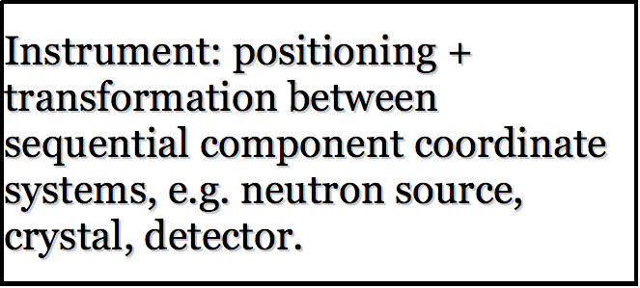
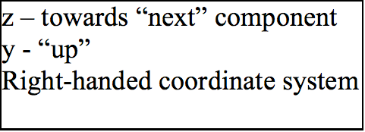
McStas: key concepts

Slide 9
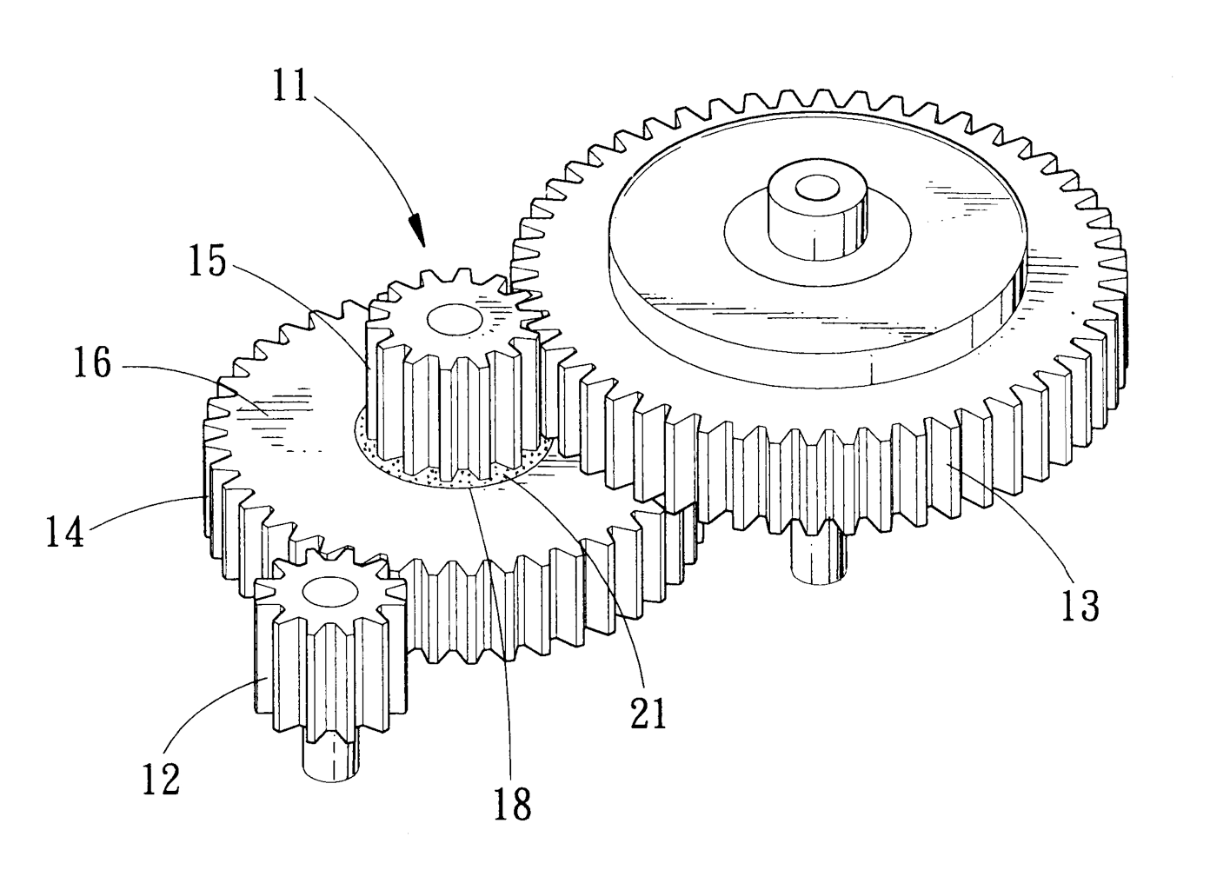
Under-the-hood / inner workings
Domain-specific-language (DSL) based on compiler technology (LeX+Yacc)
Simple Instrument language ISO C
Component codes realizing beamline parts (including user contribs)
Library of common functions for e.g.
I/O
Random numbers
Physical constants
Propagation
Precession in fields
...
Code generation

Slide 10
From the “list of frequent questions”
Why do you need to have the components in this order?

Slide 11
Order of components is important
1
3
2
1
2
3
Starting at the source

Slide 12
Order of components is important
1
3
2
1
2
3
Moving to first comp in the list

Slide 13
Order of components is important
1
3
2
1
2
3
Moving to 3rd comp in list requires “moving back in time”.
Default behavior is to ABSORB this type of neutron.
For monitors use restore_neutron=1 in this case.
For homegrown comps use ALLOW_BACKPROP macro.

Slide 14
Further tips 1:
Simulation to experiment comparison

Slide 15
What is really the information content…?
McStas sources generally provide “intensity” in units of neutrons/s (into a chosen solid angle)
That intensity is carried through the instrument on a discrete set of “neutron rays”

Slide 16

In a histogram sense
Imagine a histogram, e.g. I(λ)
The RMS variance over that set becomes our statistical error bar E
…
…
1
2
3
i
k
In bin i, N events each carrying a fractional intensity pj so that

Slide 17
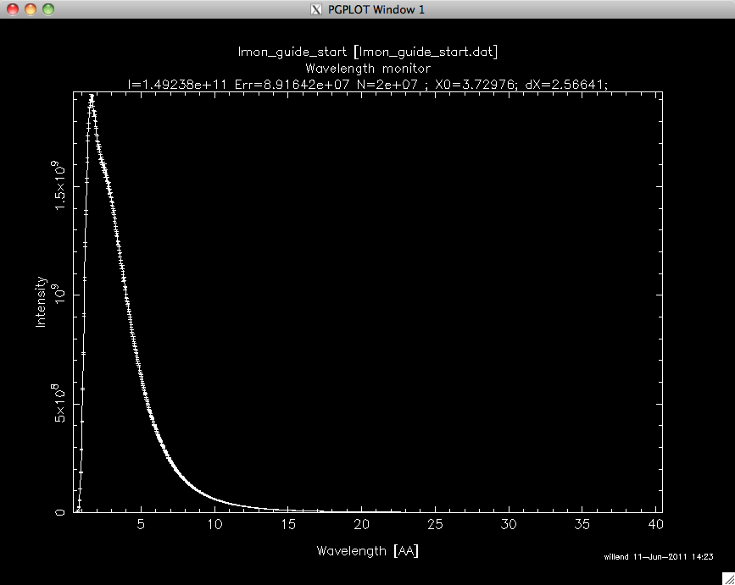
In a histogram sense
Imagine a histogram, e.g. I(λ)
The RMS variance over that set becomes our statistical error bar E
…
…
I
E
N
1
2
3
i
k
In bin i, N events each carrying a fractional intensity pj so that

Slide 18
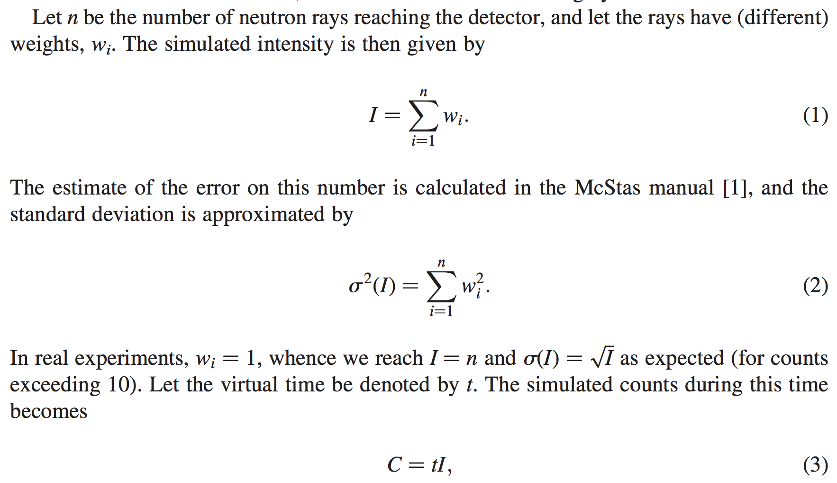
From "Virtual experiments - the ultimate aim of neutron ray-tracing simulations", K. Lefmann et al., Journal of Neutron Research 16, 97-111 (2008)

Slide 19
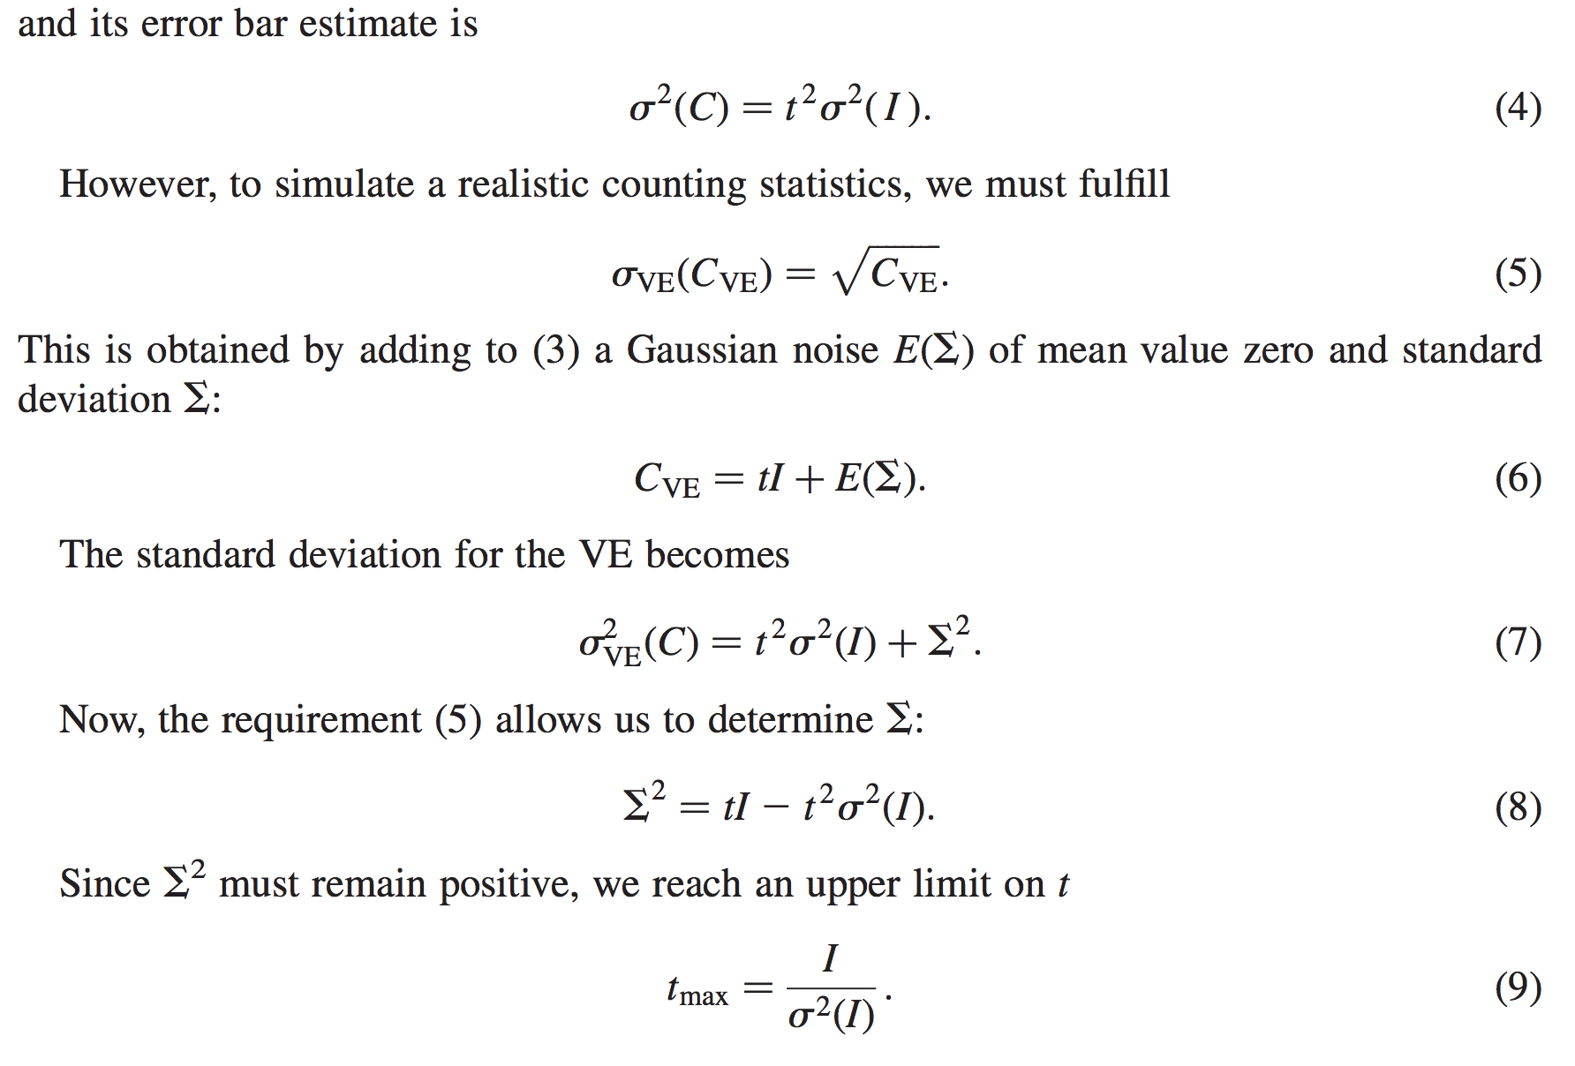
From "Virtual experiments - the ultimate aim of neutron ray-tracing simulations", K. Lefmann et al., Journal of Neutron Research 16, 97-111 (2008)

Slide 20
Sketch of an algorithm…
On a given McStas histogram
For the non-zero bins, calculate
The smallest defines the “maximal counting time” allowed by your statistics
Preferably a “background” should be added - use a “known experimental value” or an estimate…

Slide 21
Important points to remember
Your simulation will only contain elements you provided / defined
… to the precision you defined
Answers the questions you posed
Background essentially only from “sample”, or sample-near objects

Slide 22
Further tips 2:
How to make your McStas more efficient

Slide 23
Onto efficiency…
Apply focusing techniques
At the source (spatially, temporally, in wavelength…)
At the sample, if possible
(carefully!) Apply SPLIT - but only if immediately followed by Monte Carlo choices, e.g. in sample
Alternatively use MCPL o/i which allows repetition - beware of biases!

Slide 24
Onto efficiency…
Apply focusing techniques
At the source (spatially, temporally, in wavelength…)
At the sample, if possible
(carefully!) Apply SPLIT - but only if immediately followed by Monte Carlo choices, e.g. in sample
Alternatively use MCPL o/i which allows repetition - beware of biases!
All of this can be considered “variance reduction”
or biasing

Slide 25
Onto efficiency…
Use MPI parallelisation - included in macOS install from 2.4, easy to get on Linux…
The Intel C compiler is known to give ~factor of 2 wrt. gcc in most cases
- Still consider if you are asking the right question if runtimes reach days/weeks…

Slide 26
Onto efficiency…
Use MPI parallelisation - included in macOS install from 2.4, easy to get on Linux… (Windows: see later slide)
The Intel C compiler is known to give ~factor of 2 wrt. gcc in most cases
- Still consider if you are asking the right question if runtimes reach days/weeks…
Sledge-hammer / brute force!

Slide 27
Advanced language features
Macros and tricks for your instrument...

Slide 28

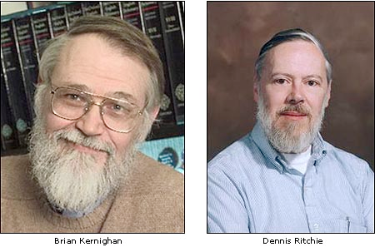
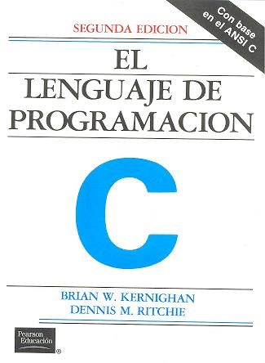
DECLARE / INITIALIZE
Use the DECLARE section define user variables and functions.
DECLARE %{
double myvar;
%}
Use INITIALIZE for initialization of user variables and calculations.
INITIALIZE %{
myvar = sqrt(PI*input_var)*rand01();
%}
- Both use normal c-syntax.
BEWARE: (example) What you do in the c-style areas is c-standard, e.g. trigonometric functions from math.h use radians! - McStas placement specifiers work in degrees, etc...
K & R

Slide 29
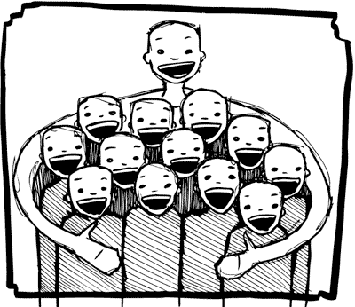
%include
Instrumentfiles can include external c-code or other instrumentfiles... See the examples:
ILL_H15_IN6.instr:%include "monitor_nd-lib"
ILL_H16_IN5.instr:%include "ILL_H16.instr"
ILL_H25_IN22.instr:%include "ILL_H25.instr"
ILL_H25_IN22.instr:%include "templateTAS.instr"
Used in the DECLARE section

Slide 30
Syntax in one, complex view...
{SPLIT} COMPONENT name = comp(parameters) {WHEN condition}
AT (...) [RELATIVE [reference|PREVIOUS] | ABSOLUTE]
{ROTATED {RELATIVE [reference|PREVIOUS] | ABSOLUTE} }
{GROUP group_name}
{EXTEND C_code}
{JUMP [reference|PREVIOUS|MYSELF|NEXT] [ITERATE number_of_times | WHEN condition] }

Slide 31
SPLIT
Increase statistics beyond this point in the instrumentfile
SPLIT n MyArm = Arm()
AT somewhere
will “formulate an if-statement”:
for j=1:n
comp1
comp2
comp3
...
end (of instrument)
ONLY meaningful in case of Monte Carlo choices after SPLIT point...

Slide 32
SPLIT
Increase statistics beyond this point in the instrumentfile
SPLIT n MyArm = Arm()
AT somewhere
will “formulate an if-statement”:
for j=1:n
comp1
comp2
comp3
...
end (of instrument)
ONLY meaningful in case of Monte Carlo choices after SPLIT point...

Slide 33
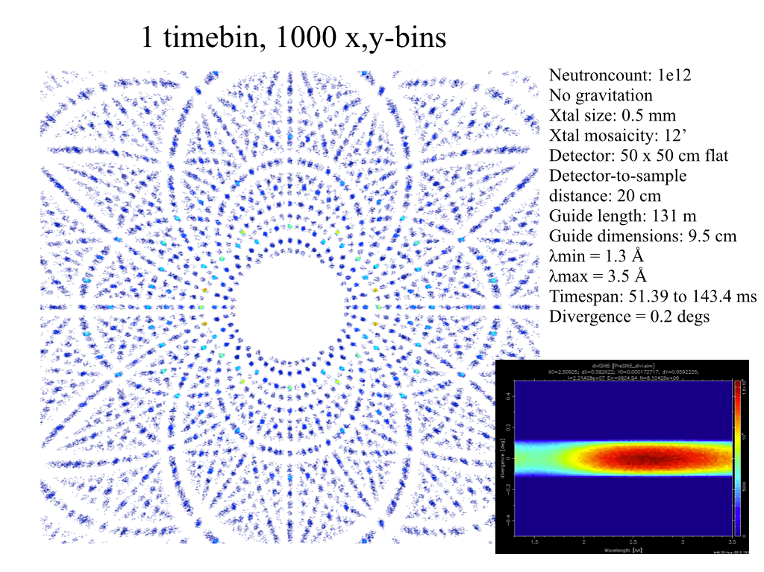
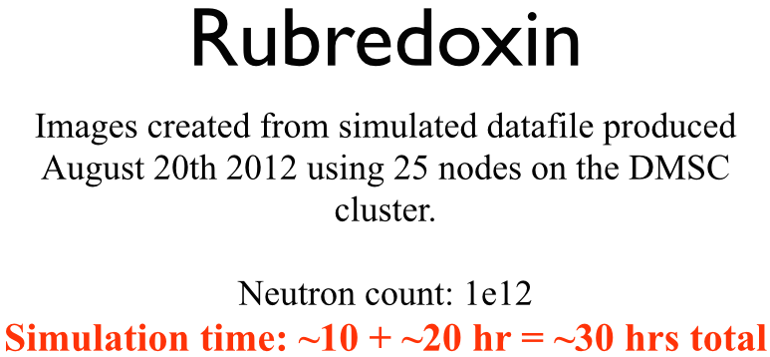
Problem: McStas Single_crystal.comp “slow” for large unit cell diffraction studies
slight sidetrack….
Example: Rubredoxin
Reflection list ~ 124 K reflections (still “small” in the PX world!!)

Slide 34
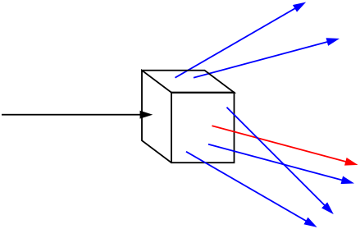
Algorithm improvement: Use incoming neutrons more efficiently - scatter each one on all possible reflections
slight sidetrack….
Red: Original algorithm, one incoming neutron used only once
Blue: Improved algorithm, each incoming neutron scattered (via SPLIT keyword) all possible times
Component makes estimate on average number of “active” diffraction spots - in the case Rubredoxin this is around 50!

Slide 35
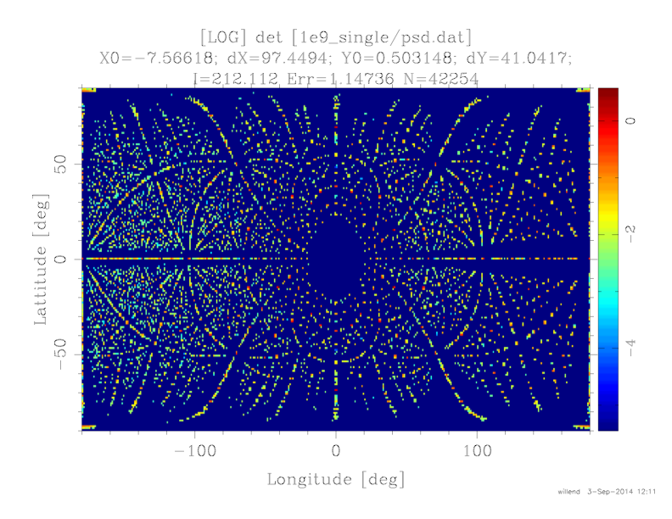
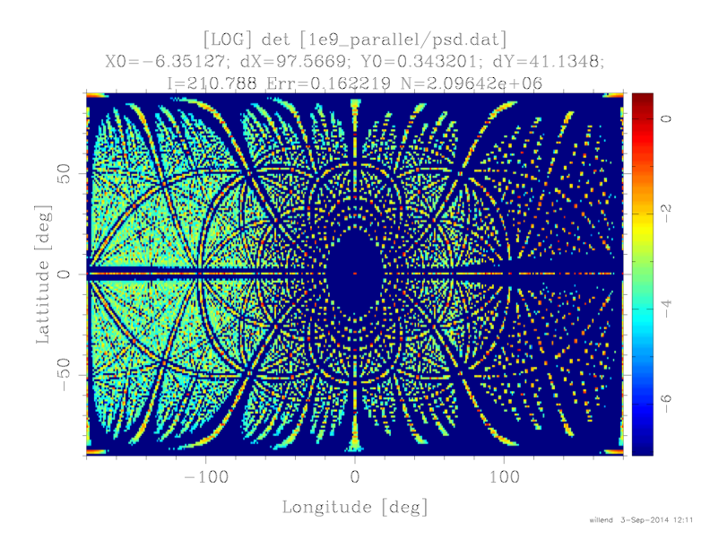
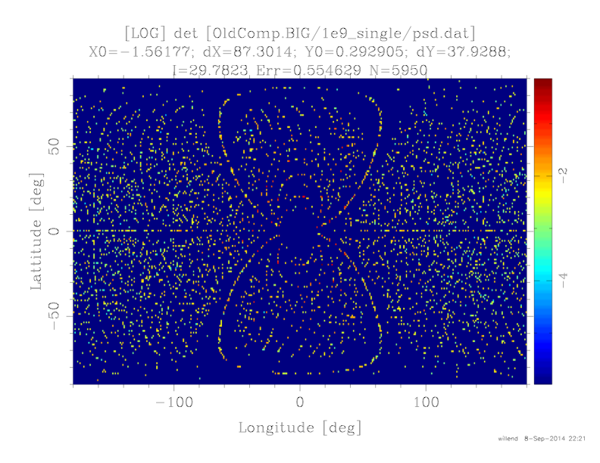
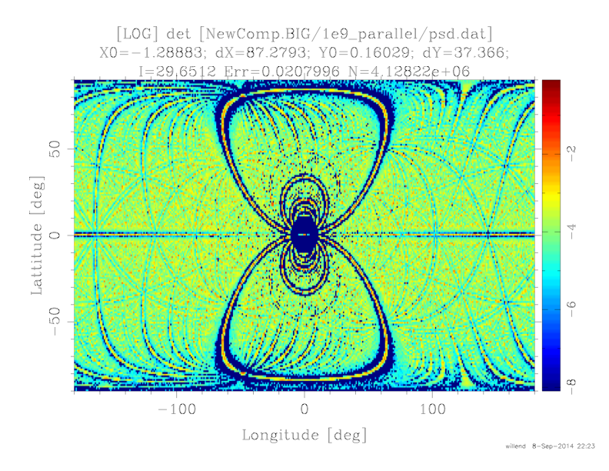
Sim data speak for themselves - 1e9 rays
slight sidetrack….
Old comp
New comp
~ Factor 50
more efficient
Rubedoxin
124K reflections
Predeuterated pyrophosphatase
1.7M reflections
~ Factor 500
more efficient

Slide 36

WHEN
Syntax:
COMPONENT Mine = Yours(blah, blah)
WHEN (c-expression) AT (....)
Is very powerful when combined with EXTEND and user variables, or as a method to let input parameters select if certain components are active.
Example: Use EXTEND to flag if neutron was scattered on one monochromator blade or another. Then later use WHEN to only show contribution from blade N at sample position?
COMPONENT Mon = PSD_monitor(...)
WHEN (myvar==1) AT (0,0,0) RELATIVE Sample
K & R

Slide 37

GROUP - components working in parallel
COMPONENT Mono1 = Monochromator_curved(...)
AT (0,0, -LMM) RELATIVE Cradle ROTATED (0,A1/2,0) RELATIVE Cradle
GROUP IN6Monoks
COMPONENT Mono2 = Monochromator_curved(...)
AT (0,0, 0) RELATIVE Cradle ROTATED (0,A2/2,0) RELATIVE Cradle
GROUP IN6Monoks
- One comp after the other is “tried” in sequential order until the neutron was SCATTERED.

Slide 38
EXTEND
Enrich component behaviour using EXTEND:
COMPONENT Mono1 = Monochromator_curved(...)
AT (0,0, -LMM) RELATIVE Cradle ROTATED (0,A1/2,0) RELATIVE Cradle
GROUP IN6Monoks
EXTEND
%{
if (SCATTERED) { myvar = ;1 }
%}
...
COMPONENT Mono2 = Monochromator_curved(...)
AT (0,0, 0) RELATIVE Cradle ROTATED (0,A2/2,0) RELATIVE Cradle
GROUP IN6Monoks
%{
if (SCATTERED) { myvar = 2 }
%}
K & R

Slide 39
JUMP
A goto. Be careful. Can be used in two situations:
JUMP to myself
JUMP to an Arm
No coordinate transformations are applied... (Meaning that if the Arms you JUMP between do not coincide you will “move” / “reorient” the neutrons...)
Syntaxes:
COMPONENT a=b(...)
WHEN (expr) AT (...) JUMP somewhere
COMPONENT a=b(...)
WHEN (expr) AT (...) JUMP somewhere
Van Halen...

Slide 40
JUMP
A goto. Be careful. Can be used in two situations:
JUMP to myself
JUMP to an Arm
No coordinate transformations are applied... (Meaning that if the Arms you JUMP between do not coincide you will “move” / “reorient” the neutrons...)
Syntaxes:
COMPONENT a=b(...)
WHEN (expr) AT (...) JUMP somewhere
COMPONENT a=b(...)
WHEN (expr) AT (...) JUMP somewhere
BEWARE - This IS a GOTO!
Van Halen...

Slide 41
JUMP
A goto. Be careful. Can be used in two situations:
JUMP to myself
JUMP to an Arm
No coordinate transformations are applied... (Meaning that if the Arms you JUMP between do not coincide you will “move” / “reorient” the neutrons...)
Syntaxes:
COMPONENT a=b(...)
WHEN (expr) AT (...) JUMP somewhere
COMPONENT a=b(...)
WHEN (expr) AT (...) JUMP somewhere
BEWARE - This IS a GOTO!
Van Halen...

Slide 42
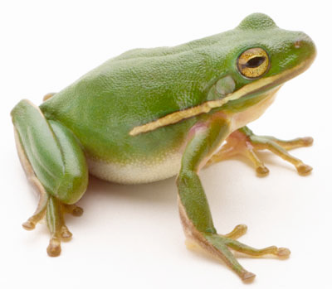
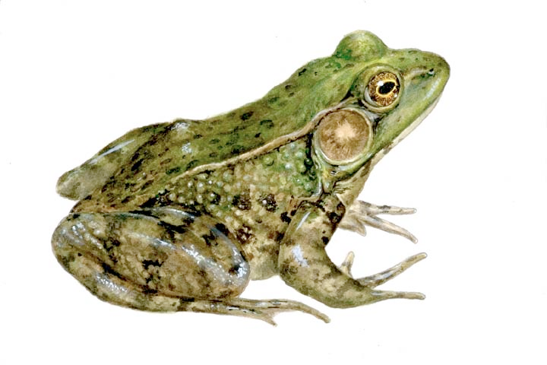
COPY- inside instruments
In instruments: (see ILL_H25.instr)
COMPONENT H25_1 = Guide_gravity(
w1=0.03, h1=0.2, w2=0.03, h2=0.2, l=L_H25_1,
R0=gR0, Qc=gQc, alpha=gAlpha, m=m, W=gW)
AT (0,0,Al_Thickness+gGap) RELATIVE PREVIOUS
ROTATED (0,Rh_H25_1,0) RELATIVE PREVIOUS
COMPONENT COPY(H25_1) = COPY(H25_1)
AT (0,0,L_H25_1+gGap) RELATIVE PREVIOUS
ROTATED (0,Rh_H25_1,0) RELATIVE PREVIOUS
COMPONENT COPY(H25_1) = COPY(H25_1)(W=2*gW)
AT (0,0,L_H25_1+gGap) RELATIVE PREVIOUS
ROTATED (0,Rh_H25_1,0) RELATIVE PREVIOUS

Slide 43
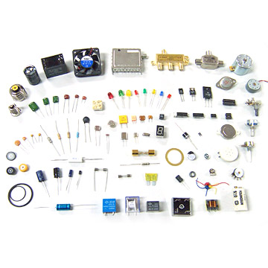
Other advanced topics
Tricks, macros and functions for your components

Slide 44
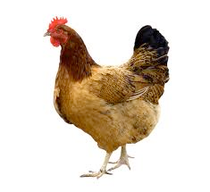
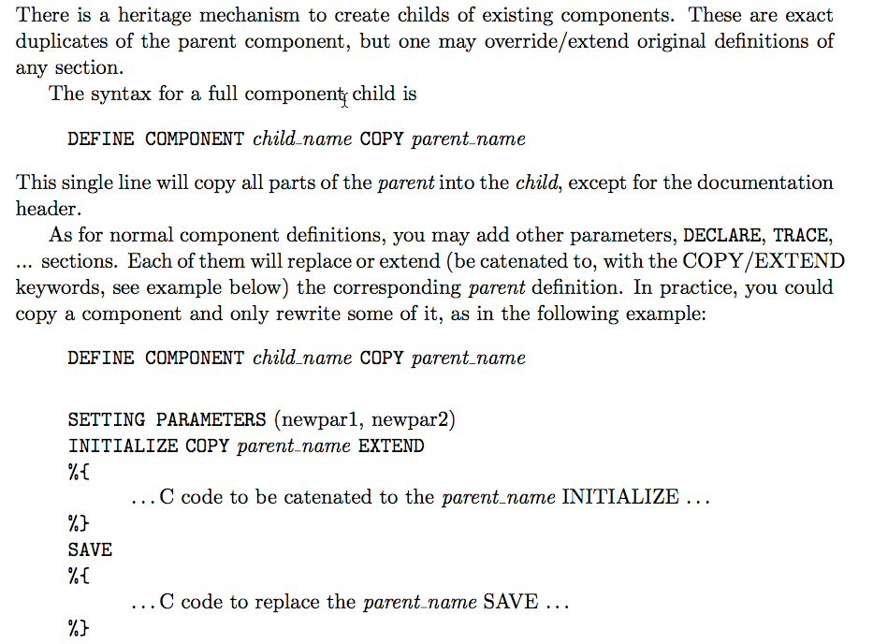
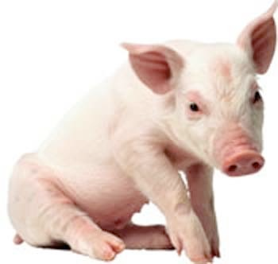
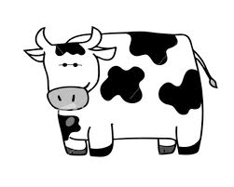
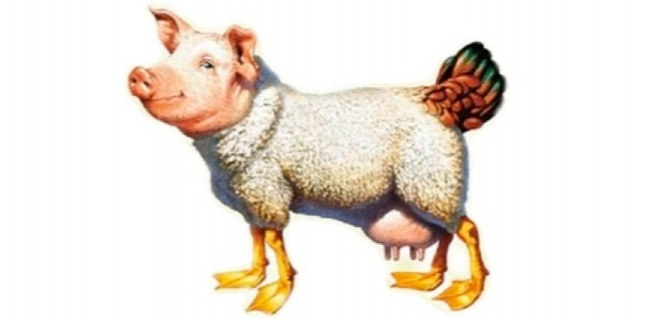
COPY In components:
+
+
=

Slide 45
MPI on Windows
Get both of the installers from
https://github.com/McStasMcXtrace/McCode/tree/master/support/Win32/MSMPI
- install them
Dump this batchfile in bin dir of your McStas installation:
https://github.com/McStasMcXtrace/McCode/blob/master/cmake/support/run-scripts/mpicc.bat
Add C:\Program Files\Microsoft MPI\Bin\ to your system PATH

Slide 46
NeXus libs on Windows
Get last release from
https://github.com/nexusformat/code/releases?after=4.3.1
Install it
Use the MCSTAS_CFLAGS_OVERRIDE or the GUI File->Configuration entry to specify -I and -L directives for linking
i.e.
-DUSE_NEXUS -lNeXus-0
-L"C:\Program Files (x86)\NeXus Data Format\bin" -L"C:\Program Files (x86)\NeXus Data Format\lib\nexus" -I"C:\Program Files (x86)\NeXus Data Format\include"

Slide 47
NeXus libs on macOS
Get homebrew via https://brew.sh
Install it via the recipe given
In a terminal, issue
Use these CFLAGS either via env var or gui
DTUs-MacBook-Pro:Downloads dtuphysics$ brew search nexusformat
homebrew/science/nexusformat ✔
DTUs-MacBook-Pro:Downloads dtuphysics$ brew install homebrew/science/nexusformat
-DUSE_NEXUS -lNeXus -L/usr/local/lib -I/usr/local/include

Slide 48
The end

