Slide 1
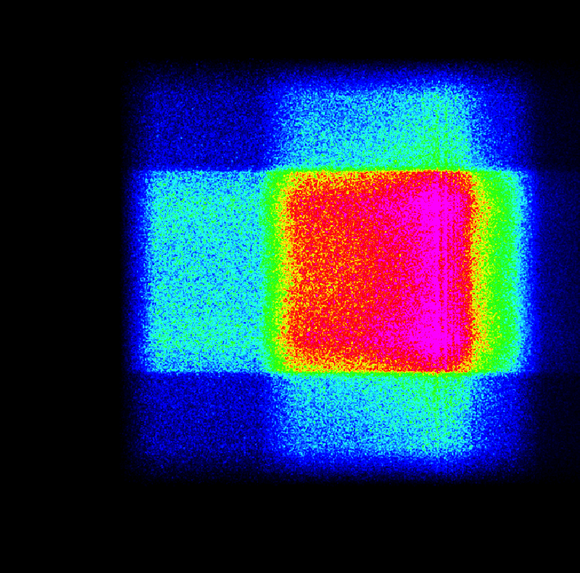
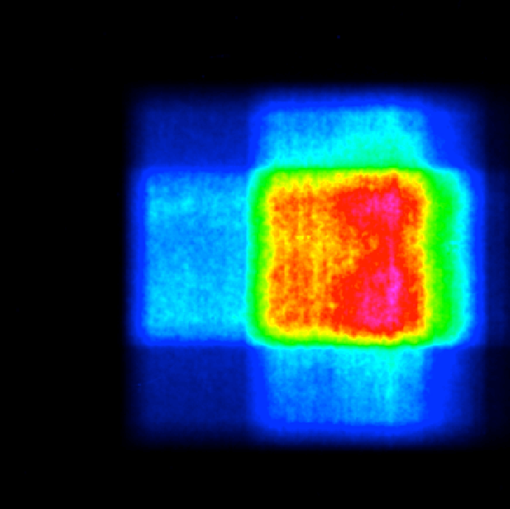
Monitors & Sources
McStas monitors & sources
Sources and Monitors

Slide 2

Access the docs
In this session:
Overview of existing Source and Monitor components
Detailed description of the most commonly used ones
How to ‘call’ them into a *.instr file
Practical Exercise using sources and monitors
IMPORTANT:
All (and more) of this information can be found in the online pdf component documentation, e.g.
http://www.mcstas.org/documentation/manual/mcstas-2.3-components.pdf
- is also distributed with your McStas installation - mcdoc -c
The component documentation along with the “mcdoc component_you_are_searching_for” command, are your best friends when using McStas
Sources and Monitors

Slide 3
Sources
Mathematical:
Source_simple.comp
Source_div.comp
Pulsed sources:
ESS_moderator.comp
Moderator.comp
SNS_source.comp (*)
ISIS_moderator.comp (*)
Reactors :
Source_Maxwell_3.comp
Source_gen.comp
Source_gen4.comp
Source_multi_surfaces.comp (*)
(*) contributed (can be found in /mcstas/installation/folder/contrib )
Sources and Monitors

Slide 4
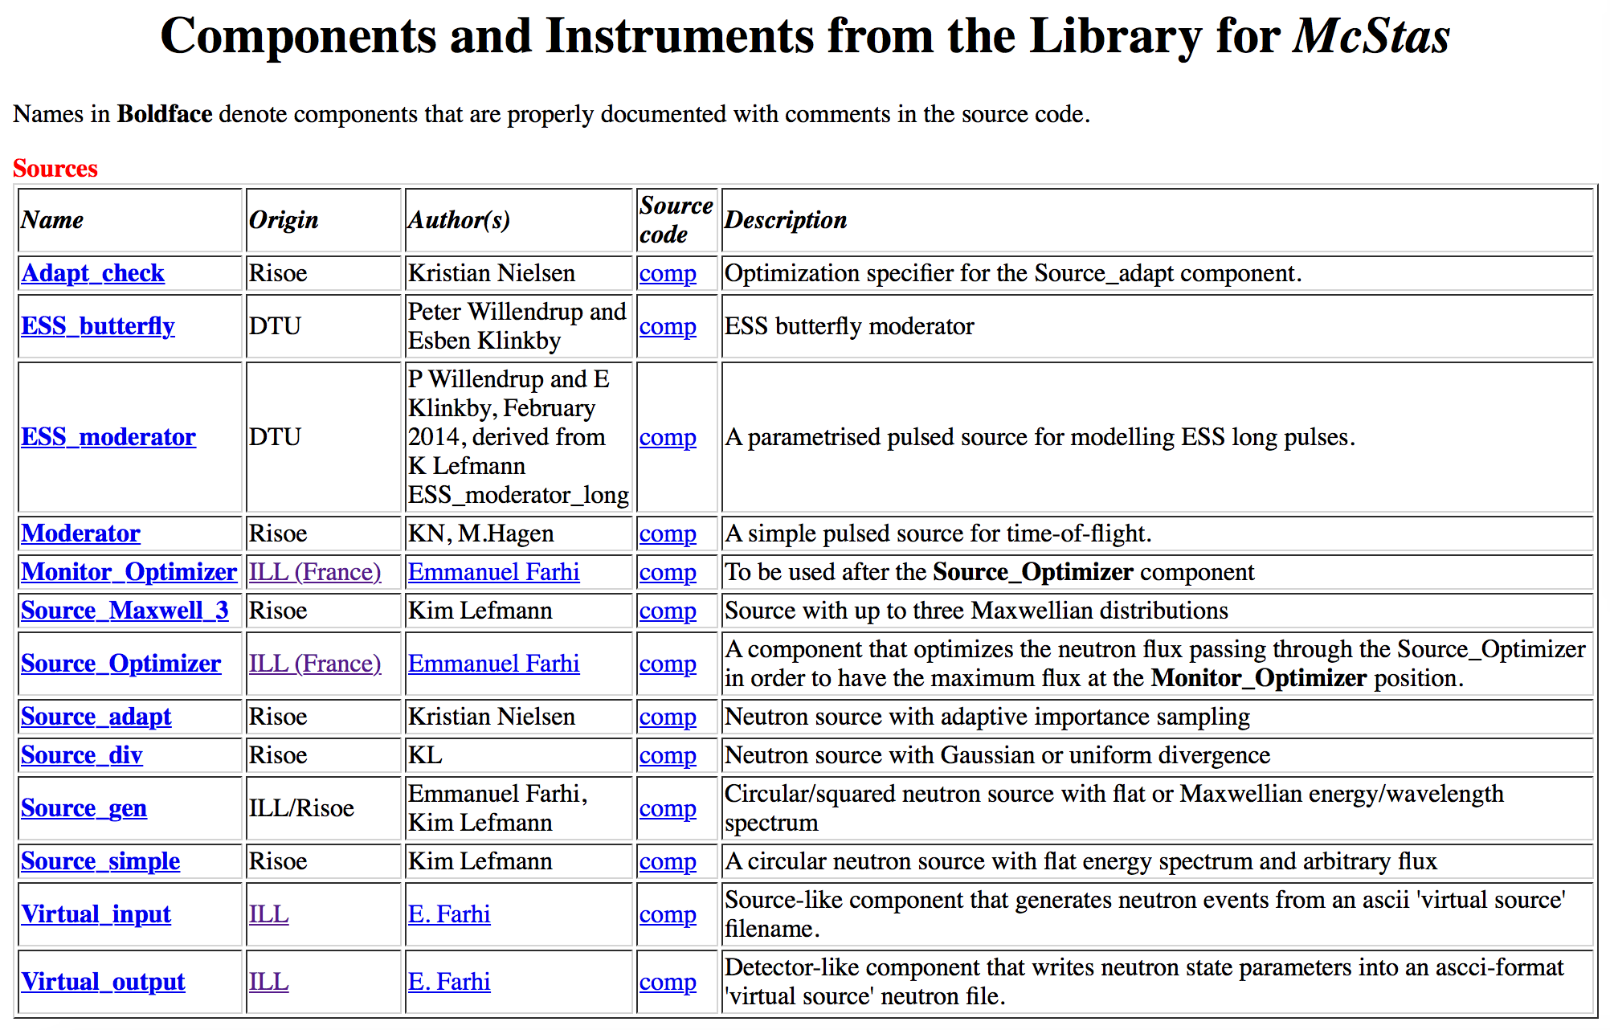
Sources
Typing “mcdoc”, mcdoc source” or “mcdoc moderator” in your command shell, will reveal a list of available sources and moderators.
Or you can search in the directories ‘sources’, ‘contrib’, and ‘obsolete’.
(*) contributed (can be found in /mcstas/installation/folder/contrib )
Sources and Monitors

Slide 5
Sources
Typing “mcdoc”, mcdoc source” or “mcdoc moderator” in your command shell, will reveal a list of available sources and moderators.
Or you can search in the directories ‘sources’, ‘contrib’, and ‘obsolete’.
Steady-state sources
(Reactors & PSI… )
(*) contributed (can be found in /mcstas/installation/folder/contrib )
Sources and Monitors

Slide 6
Sources
Typing “mcdoc”, mcdoc source” or “mcdoc moderator” in your command shell, will reveal a list of available sources and moderators.
Or you can search in the directories ‘sources’, ‘contrib’, and ‘obsolete’.
Pulsed sources
(also SNS_source and ISIS_moderator in the contrib category)
(*) contributed (can be found in /mcstas/installation/folder/contrib )
Sources and Monitors

Slide 7
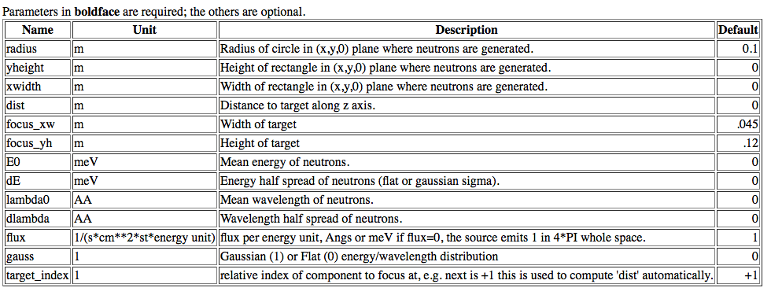
Sources
Source_simple.comp
A Simple continuous source with flat energy/wavelength spectrum
What do we need the distance and target size for?
(let us take a small break and investigate this)
Sources and Monitors

Slide 8
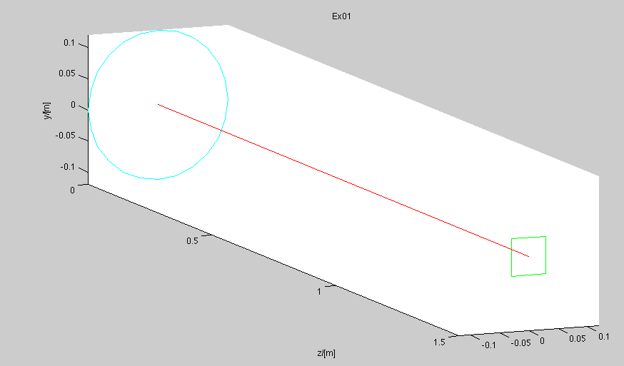
Sources
Sources and Monitors

Slide 9
Sources
Sources and Monitors

Slide 10
Source_simple
Source_simple.comp
A Simple continuous source with flat energy/wavelength spectrum
Example:
COMPONENT my_simple_source = Source_simple(radius=0.1, dist=2.0,
focus_xw=0.1, focus_yh=0.1, E0=14.0,
dE=2.0)
Sources and Monitors

Slide 11
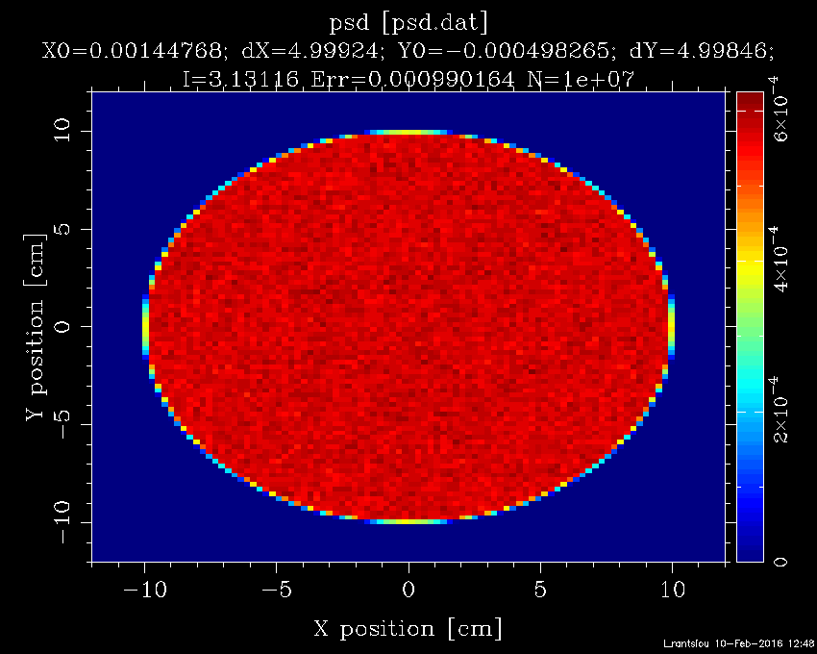
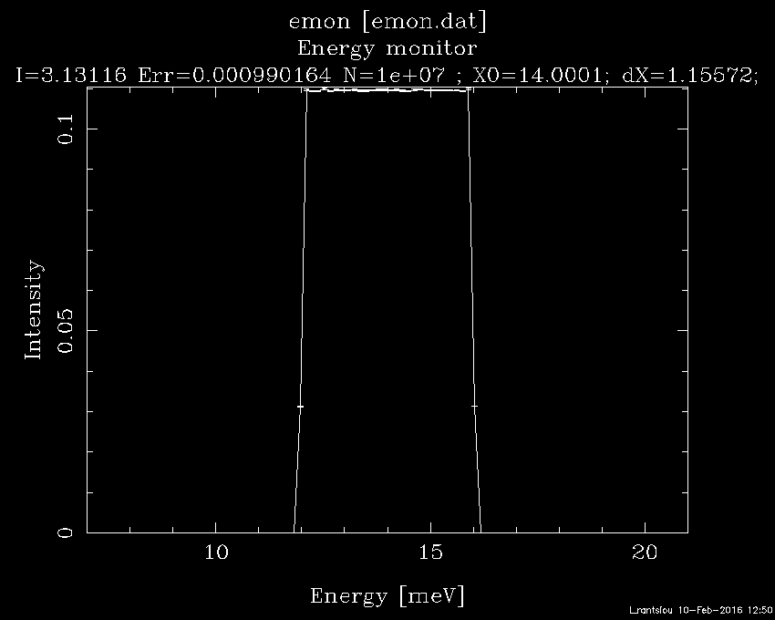
Monitor output PSD / Emon
Source_simple.comp
A Simple continuous source with flat energy/wavelength spectrum
Sources and Monitors

Slide 12
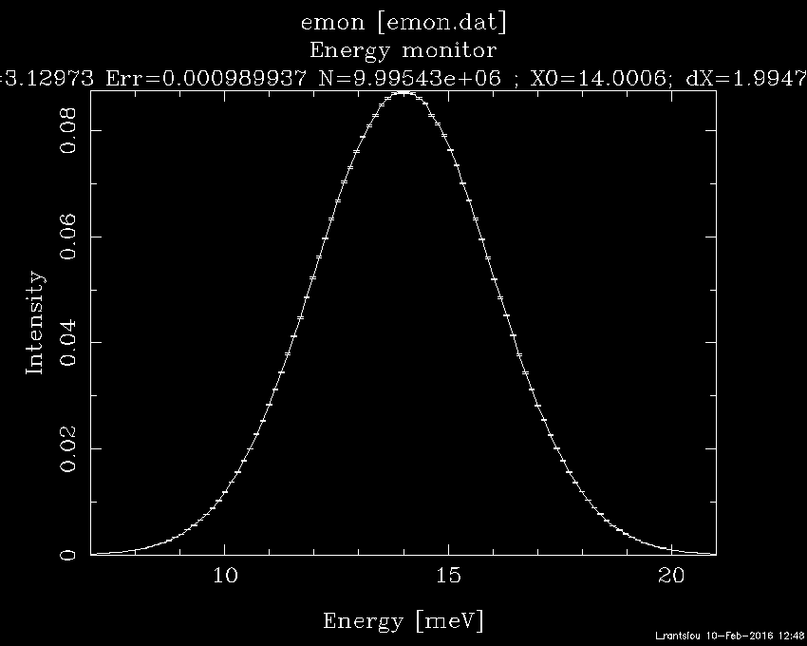
Monitor output PSD / Emon
Source_simple.comp
A Simple continuous source with flat energy/wavelength spectrum
gauss = 1
Sources and Monitors

Slide 13
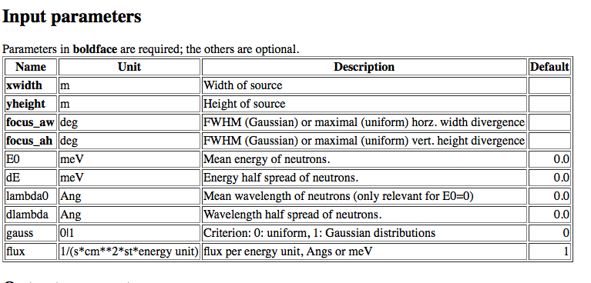
Source_div
Source_div.comp
A Simple continuous source with flat energy/wavelength spectrum
Example:
COMPONENT my_source_div = Source_div(xwidth=0.1, yheight=0.1,
focus_aw=2,focus_ah=2, E0=14, dE=2, gauss=0)
Sources and Monitors

Slide 14
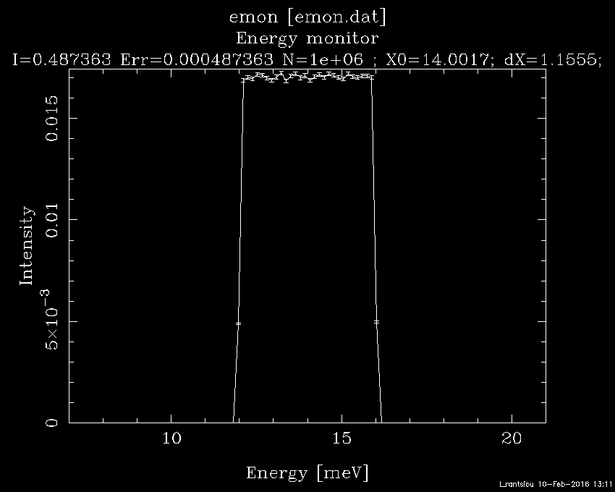
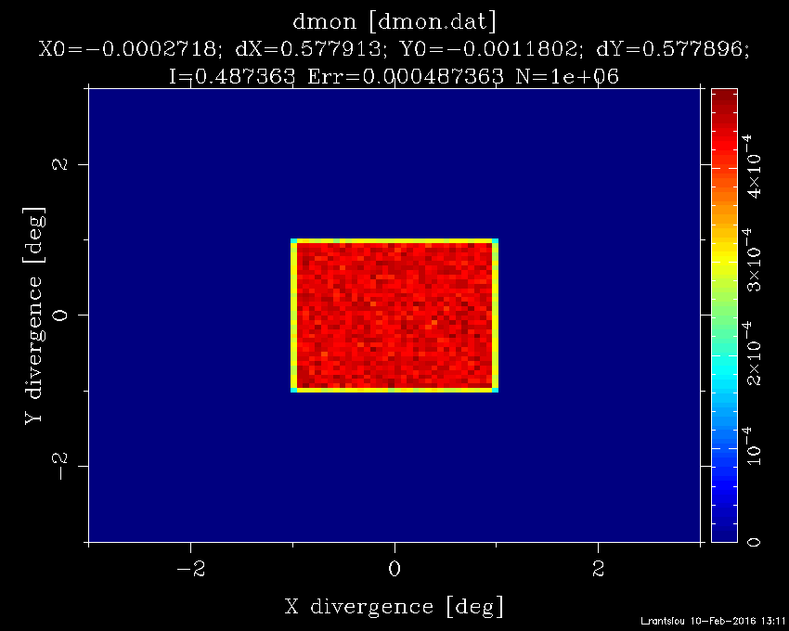
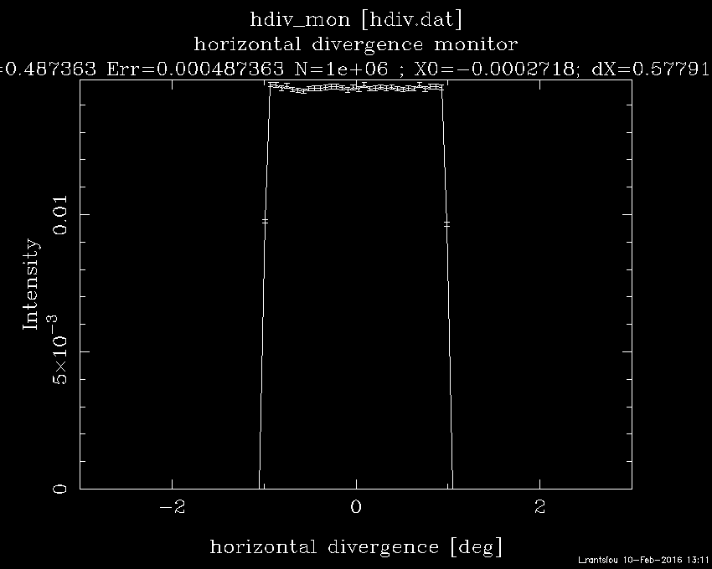
Source_div
Source_div.comp
A Simple continuous source with flat energy/wavelength spectrum
Sources and Monitors

Slide 15
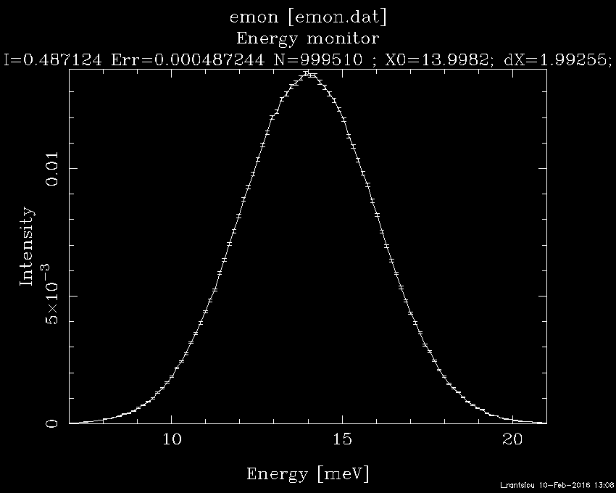
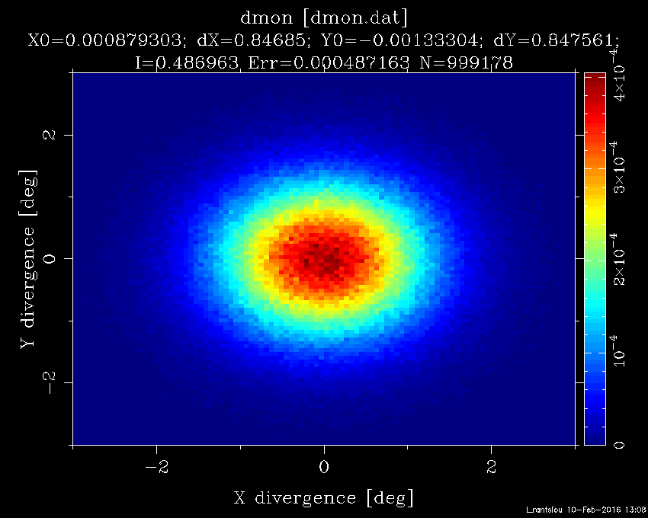
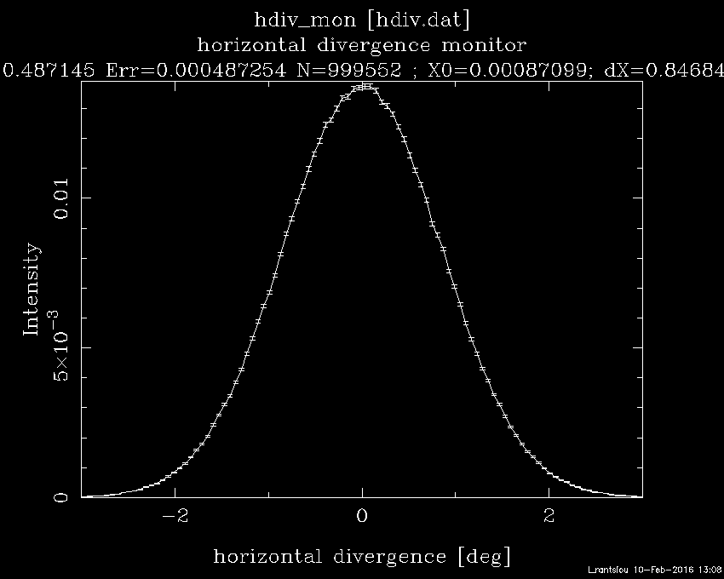
Source_div
Source_div.comp
A Simple continuous source with flat energy/wavelength spectrum
gauss = 1
Sources and Monitors

Slide 16
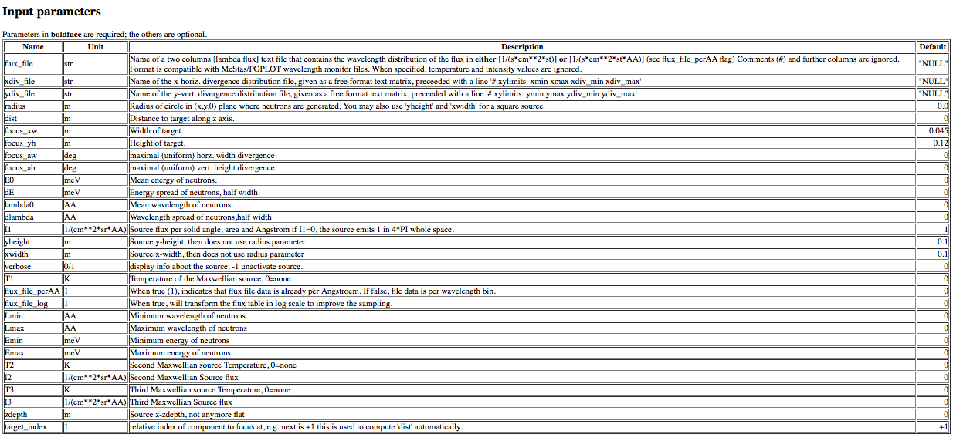
Source_gen
Source_gen.comp
A general continuous source
Example:
COMPONENT my_source_gen = Source_gen(yheight=0.1, xwidth=0.1, Emin=1,
Emax=3, I1=1e13, verbose=1, focus_xw=0.01,
focus_yh=0.01)
Sources and Monitors

Slide 17

Source_gen
Source_gen.comp
A general continuous source
Source input can be an ASCII file!!
Example:
COMPONENT my_source_gen = Source_gen(yheight=0.1, xwidth=0.1,
dist=1.5, focus_xw=0.01, focus_yh=0.01,
lambda0=1, dlambda=8,
flux_file=‘source.dat’)
Sources and Monitors

Slide 18
Source_Maxwell 3 ~ Source_gen
Source_Maxwell_3.comp
A continuous source with a maxwellian spectrum
Sources and Monitors

Slide 19
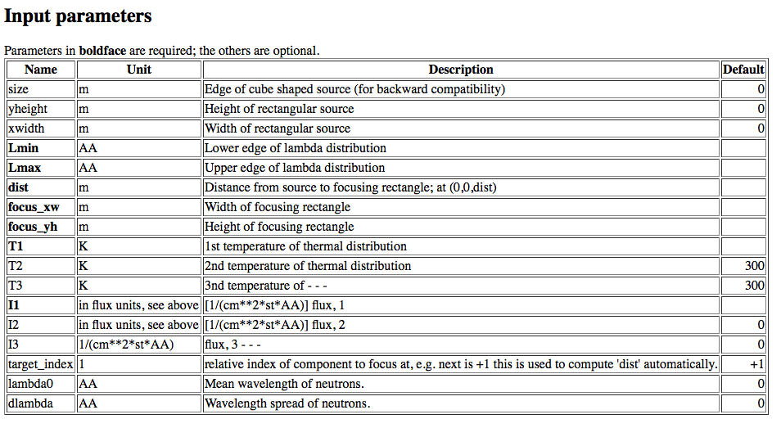
Source_Maxwell_3
Source_Maxwell_3.comp
A continuous source with a maxwellian spectrum
COMPONENT source = Source_Maxwell_3(yheight=0.156, xwidth=0.126,
Lmin=0.1, Lmax=9.0, dist=1.5, focus_xw = 0.025,
focus_yh = 0.12, T1=296.16, I1=8.5E11,
T2=40.68, I2=5.2E11)
Sources and Monitors

Slide 20
Special sources
Special Sources
“Feedback” components:
Adapt_check.comp
Source_adapt.comp
Source_Optimizer.comp
Monitor_Optimizer.comp
I/O mechanisms:
Virtual_input.comp
Virtual_output.comp
Virtual_mcnp_ss_input.comp
Virtual_tripoli4_input.comp
Virtual_mcnp_ss_output.comp
Virtual_tripoli4_output.comp
Vitess_input.comp
Vitess_output.comp
MCPL_input.comp (useful for MCNP/McStas coupling (*))
MCPL_output.comp (useful for MCNP/McStas coupling (*))
(*) Kittelmann, et. al (2017) https://arxiv.org/abs/1609.02792
Sources and Monitors

Slide 21

Special sources
Special Sources
“Feedback” components:
Adapt_check.comp
Source_adapt.comp
Source_Optimizer.comp
Monitor_Optimizer.comp
I/O mechanisms:
Virtual_input.comp
Virtual_output.comp
Virtual_mcnp_ss_input.comp
Virtual_tripoli4_input.comp
Virtual_mcnp_ss_output.comp
Virtual_tripoli4_output.comp
Vitess_input.comp
Vitess_output.comp
MCPL_input.comp (useful for MCNP/McStas coupling (*))
MCPL_output.comp (useful for MCNP/McStas coupling (*))
Need more practical info on that?
Ask the instructors (could say something on friday)
(*) Kittelmann, et. al (2017) https://arxiv.org/abs/1609.02792
Sources and Monitors

Slide 22
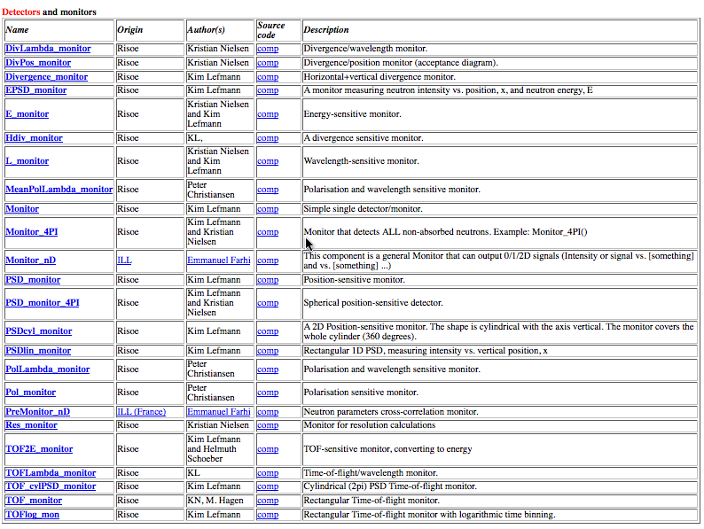
Monitors
Sources and Monitors

Slide 23
Monitors
Semantics
In reality:
Monitor: intensity probe of the beam; transparent to neutrons; has efficiency <1%
Detector: should detect each and every neutron; as high efficiency as possible.
In McStas:
In simulations we can program monitors and detectors to behave any way we like. We refer to both of those indistinguishably as ‘monitors’.
(With exception of PSD_Detector that models a “physical” He³ detector)
Sources and Monitors

Slide 24
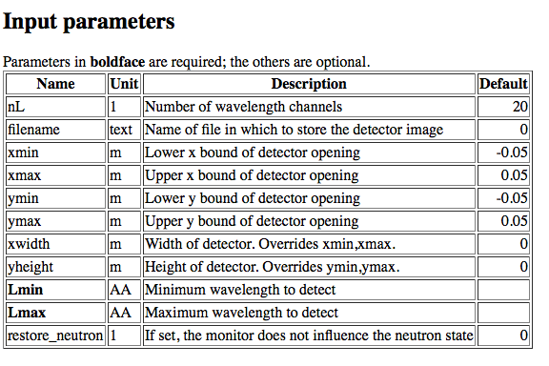
L_monitor
L_monitor.comp
1-D wavelength sensitive monitor
Example:
COMPONENT my_L_monitor = L_monitor(xmin=-0.1, xmax=0.1, ymin=-0.1,
ymax=0.1, nL=20, filename="Output.L",
Lmin=2, Lmax=10)
Sources and Monitors

Slide 25
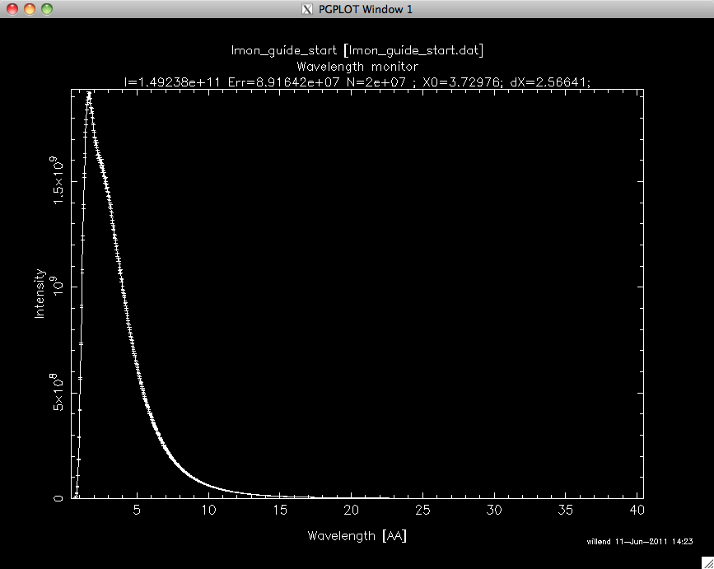
L_monitor
L_monitor.comp
1-D wavelength sensitive monitor
Sources and Monitors

Slide 26
L_monitor
L_monitor.comp
1-D wavelength sensitive monitor
Signal stats, mean & spread wl
# neutron rays / events recorded
Statistical RMS variance on intensity
“Intensity” n/s
Sources and Monitors

Slide 27
L_monitor
L_monitor.comp
1-D wavelength sensitive monitor
Signal stats, mean & spread wl
# neutron rays / events recorded
Statistical RMS variance on intensity
“Intensity” n/s
Same info available “pr. bin”
Sources and Monitors

Slide 28
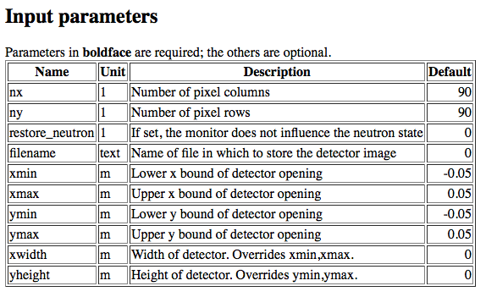
PSD_monitor
PSD_monitor.comp
2-D position sensitive monitor
Example:
COMPONENT my_PSD_monitor = PSD_monitor(xmin=-0.1, xmax=0.1, ymin=-0.1
ymax=0.1, nx=90, ny=90,
filename="Output.psd")
Sources and Monitors

Slide 29
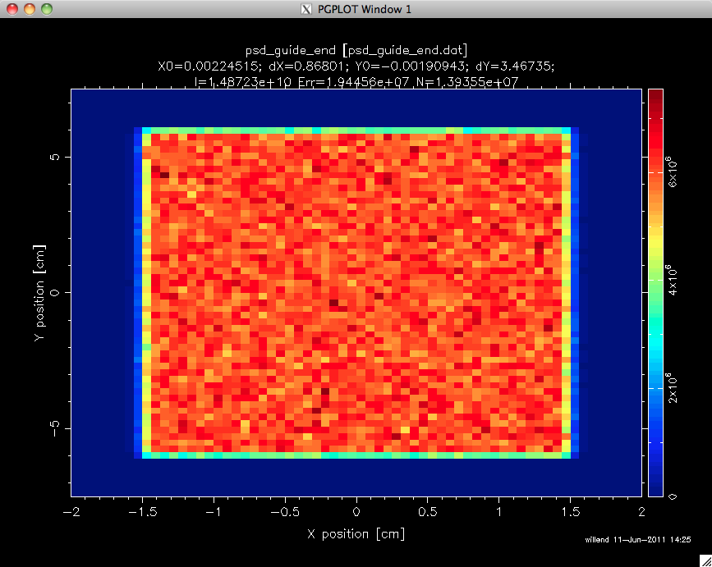
PSD_monitor
PSD_monitor.comp
2-D position sensitive monitor
Example:
COMPONENT my_PSD_monitor = PSD_monitor(xmin=-0.1, xmax=0.1, ymin=-0.1
ymax=0.1, nx=90, ny=90,
filename="Output.psd")
Sources and Monitors

Slide 30
More monitors
More Monitors
TOF_monitor.comp
E_monitor.comp (1-D energy sensitive monitor)
Res_monitor.comp
TOFLambda_monitor.comp (2-D TOF vs. wavelength monitor)
Divergence_monitor.comp (2-D divergence monitor)
EPSD_monitor.comp
DivPos_monitor.comp (2-D divergence and position monitor)
Brilliance_monitor.comp
DivLambda_monitor.comp
Monitor.comp
Hdiv_monitor.comp
PSDlin_monitor.comp
PSD_monitor_4PI.comp
Monitor_Sqw.comp
Pol_monitor.comp
Monitor_4PI.comp
.......
Monitor_nD
Sources and Monitors

Slide 31


More monitors
More Monitors
TOF_monitor.comp
E_monitor.comp (1-D energy sensitive monitor)
Res_monitor.comp
TOFLambda_monitor.comp (2-D TOF vs. wavelength monitor)
Divergence_monitor.comp (2-D divergence monitor)
EPSD_monitor.comp
DivPos_monitor.comp (2-D divergence and position monitor)
Brilliance_monitor.comp
DivLambda_monitor.comp
Monitor.comp
Hdiv_monitor.comp
PSDlin_monitor.comp
PSD_monitor_4PI.comp
Monitor_Sqw.comp
Pol_monitor.comp
Monitor_4PI.comp
.......
Monitor_nD
Sources and Monitors

Slide 32

More monitors
More Monitors
TOF_monitor.comp
E_monitor.comp (1-D energy sensitive monitor)
Res_monitor.comp
TOFLambda_monitor.comp (2-D TOF vs. wavelength monitor)
Divergence_monitor.comp (2-D divergence monitor)
EPSD_monitor.comp
DivPos_monitor.comp (2-D divergence and position monitor)
Brilliance_monitor.comp
DivLambda_monitor.comp
Monitor.comp
Hdiv_monitor.comp
PSDlin_monitor.comp
PSD_monitor_4PI.comp
Monitor_Sqw.comp
Pol_monitor.comp
Monitor_4PI.comp
.......
Monitor_nD
Sources and Monitors

Slide 33
Monitor_nD
Monitor_nD.comp
A general monitor for 0D/1D/2D records
The all-in-one , swiss-army-knife of monitors
Monitor_nD can have almost any shape, and record
any requested standard quantities
Sources and Monitors

Slide 34
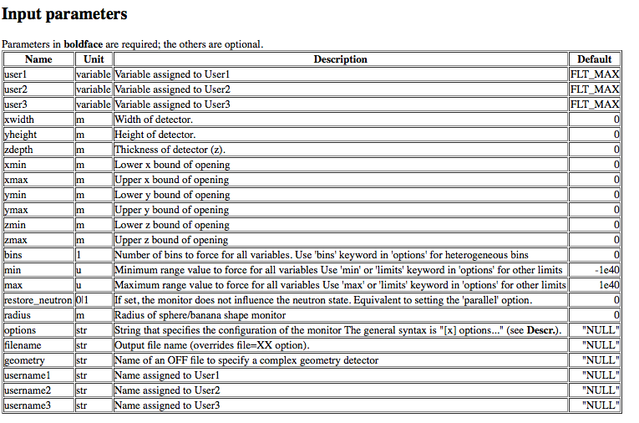
Monitor_nD
Monitor_nD.comp
A general monitor for 0D/1D/2D records

Slide 35
Monitor_nD
Monitor_nD.comp
A general monitor for 0D/1D/2D records
EXAMPLES:
COMPONENT MyMon = Monitor_nD( xwidth = 0.1, yheight = 0.1, zdepth = 0,
options = "intensity per cm2 angle,limits=[-5 5],
bins=10,with borders, file = mon1")
options = "banana, theta limits=[10,130], bins=120, y"
options = "multiple kx ky kz, auto abs log t, and list all neutrons"
COMPONENT MyMo = Monitor_nD(xwidth = 0.1, yheight = 0.1,
user1=age, username1="Age of the Captain [years]",
options="user1, auto")
Sources and Monitors

Slide 36

Mathematical:
Source_simple.comp
Source_div.comp
Pulsed sources:
ESS_moderator.comp
Moderator.comp
SNS_source.comp (*)
ISIS_moderator.comp (*)
Reactors :
Source_Maxwell_3.comp
Source_gen.comp
Source_gen4.comp
Source_multi_surfaces.comp (*)
(*) contributed (can be found in /mcstas/installation/folder/contrib )
Sources and Monitors

Slide 37

A job for you…
EXERCISE 1
Create a new instrument file, named ‘sources_monitors_ex.instr’.
HINT: you can use the ‘template.instr’ file that exists in today’s class folder and you can open it with the editor of your liking, or open it from the McStas gui by clicking either:
File —> New (python) or
neutron site --> Templates --> template_simple (perl)
Add a source using the Source_gen.comp component, with:
source dimensions: (w)0.132m X (h)0.164m
distance to target : 1.5 m
focus area: (w)0.03m X (h)0.12m
wavelength range: 0.1Å to 9.9Å
T1=27.63[K], I1=2.4E12 [n/s/cm²/st/AA], T2=130.76[K],
I2=4.03E12[n/s/cm²/st/AA] ,T3=309.33[K], I3=1.24E13[n/s/cm²/st/AA]
Add the following monitors at two different distances from the source, at 1.5m and 4.5m:
PSD monitor (PSD_monitor)
A linear PSD monitor for the y-direction (PSDlin_monitor)
Wavelength monitor (L_monitor)
2D Divergence monitor (Divergence_monitor)
Divergence-position monitor for the x-direction (DivPos_monitor)
Sources and Monitors

