Slide 1
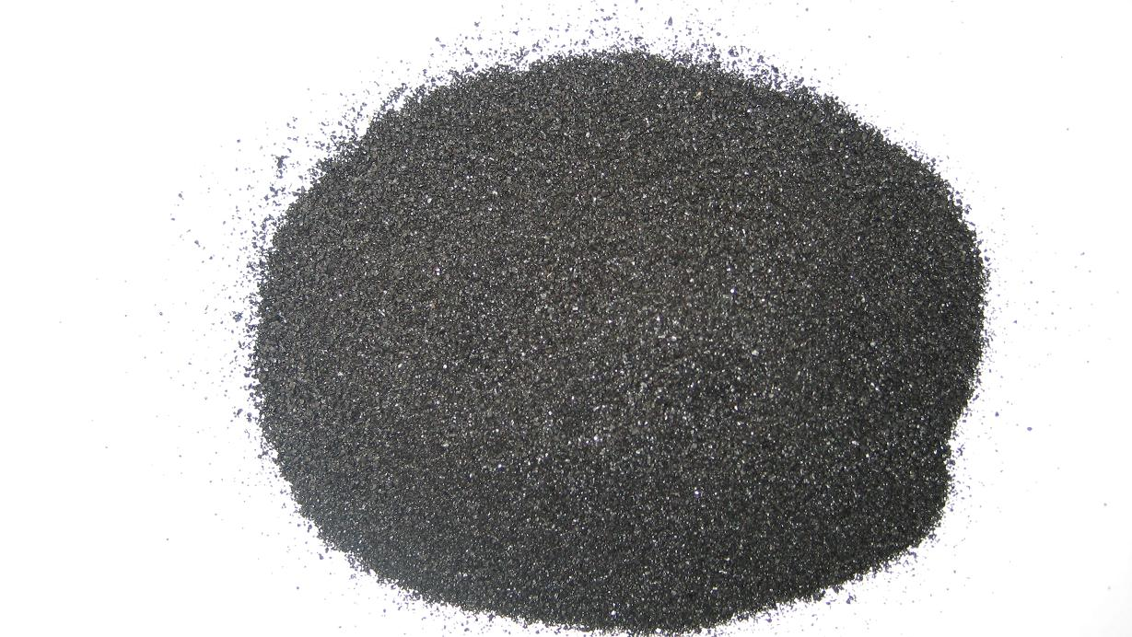

Slide 2
Caution!
We start by a few-slide hand-waving introduction to scattering from condensed matter / crystallography which are disciplines in their own right… :-)
Fasten your seat belts!

Slide 3

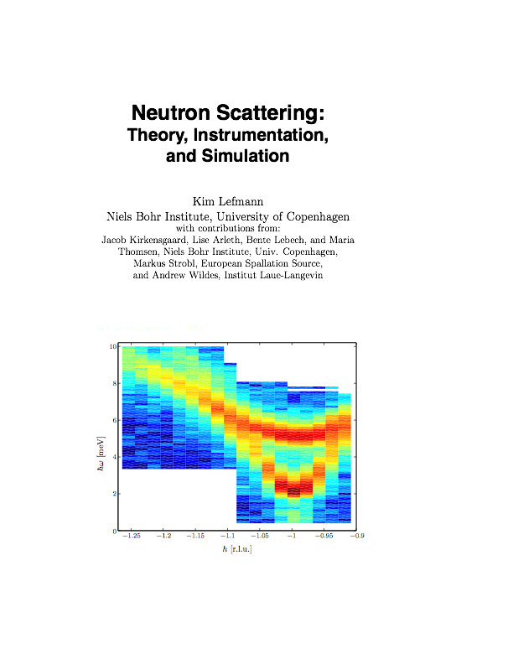
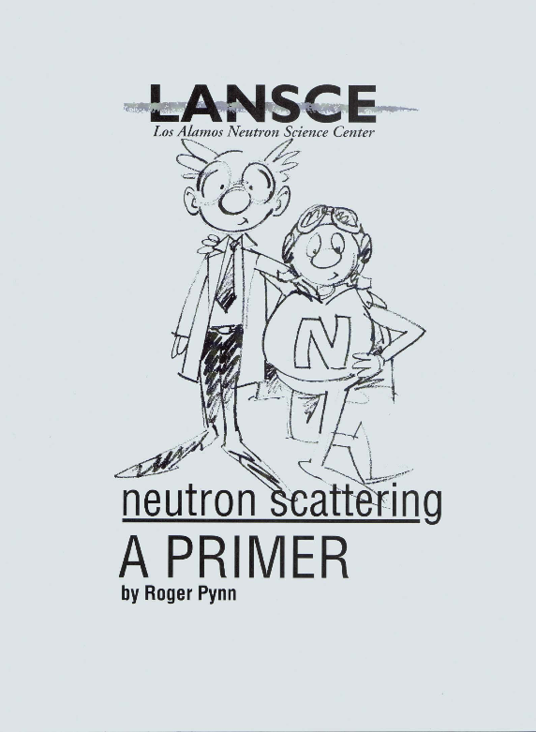
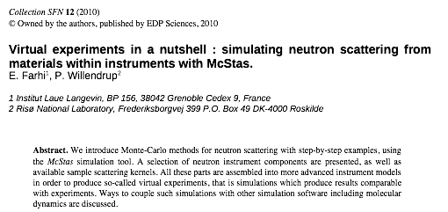
Sources of further reading….
Others explains the details much better than myself, e.g.:

Slide 4
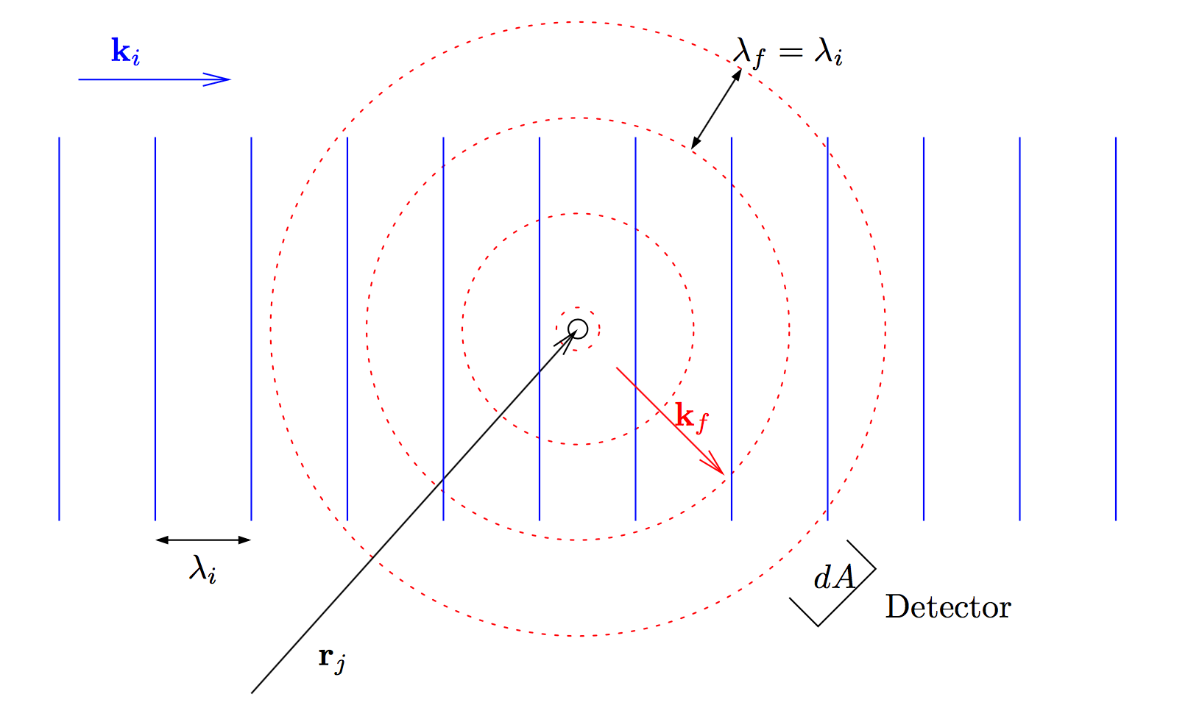

Single neutron elastic scattering on individual nucleus

Slide 5
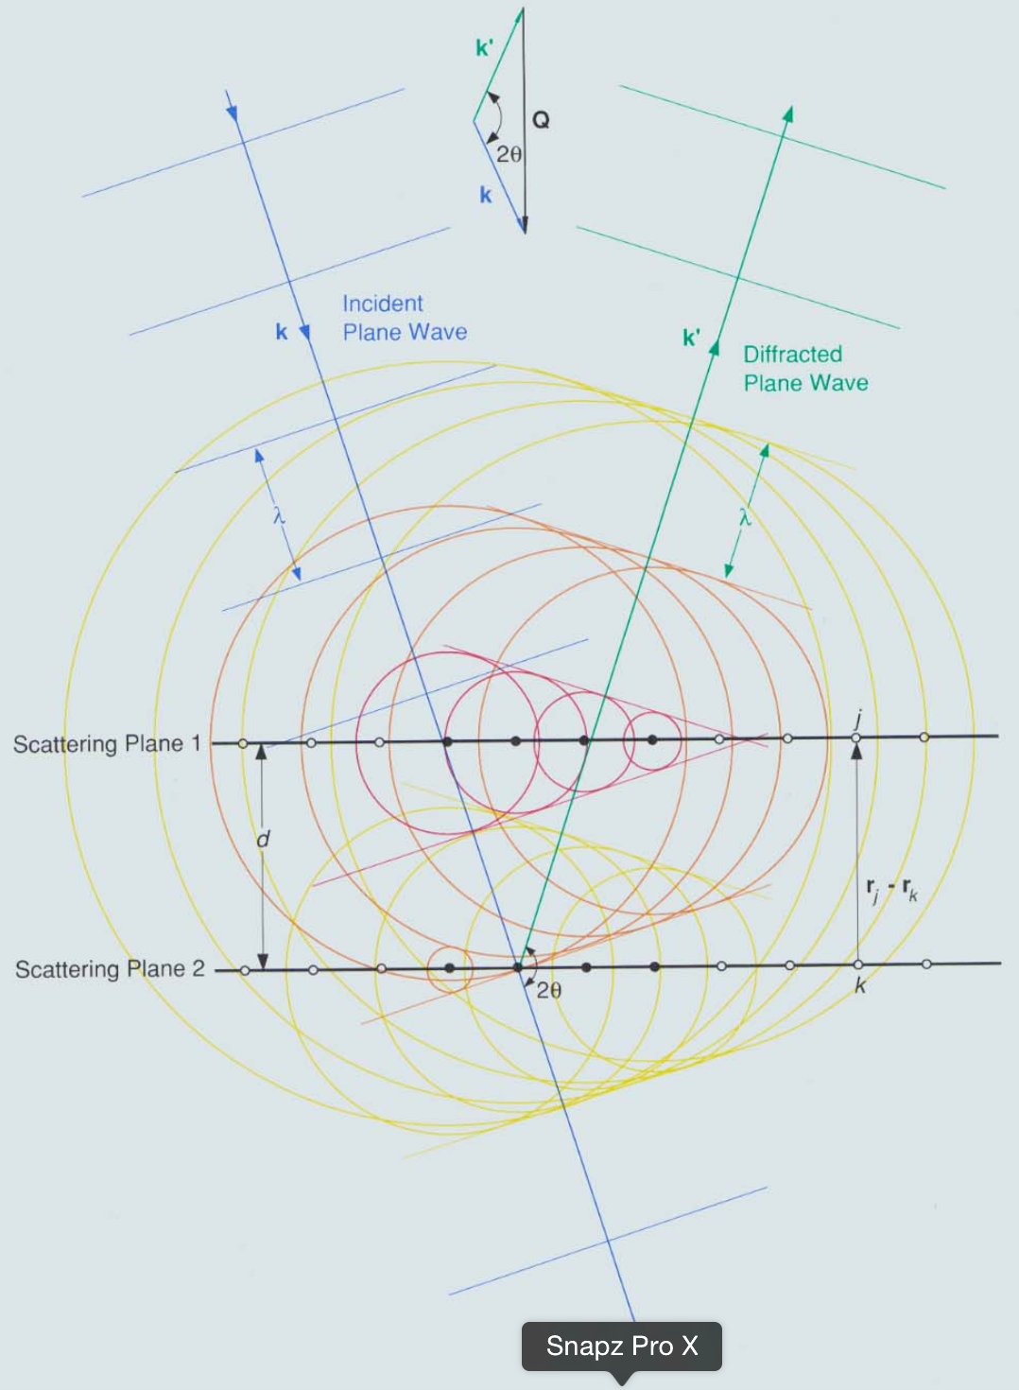
Interference of elastic scattering from a lattice of nuclei (crystal/crystallite)

Slide 6
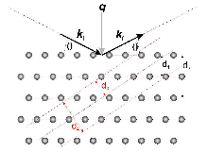


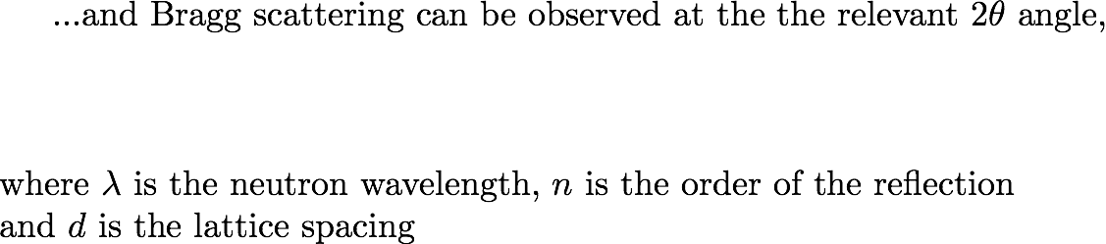
Interference of elastic scattering from a lattice of nuclei (crystal/crystallite)
Structure factor

Slide 7
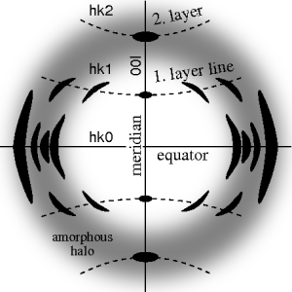
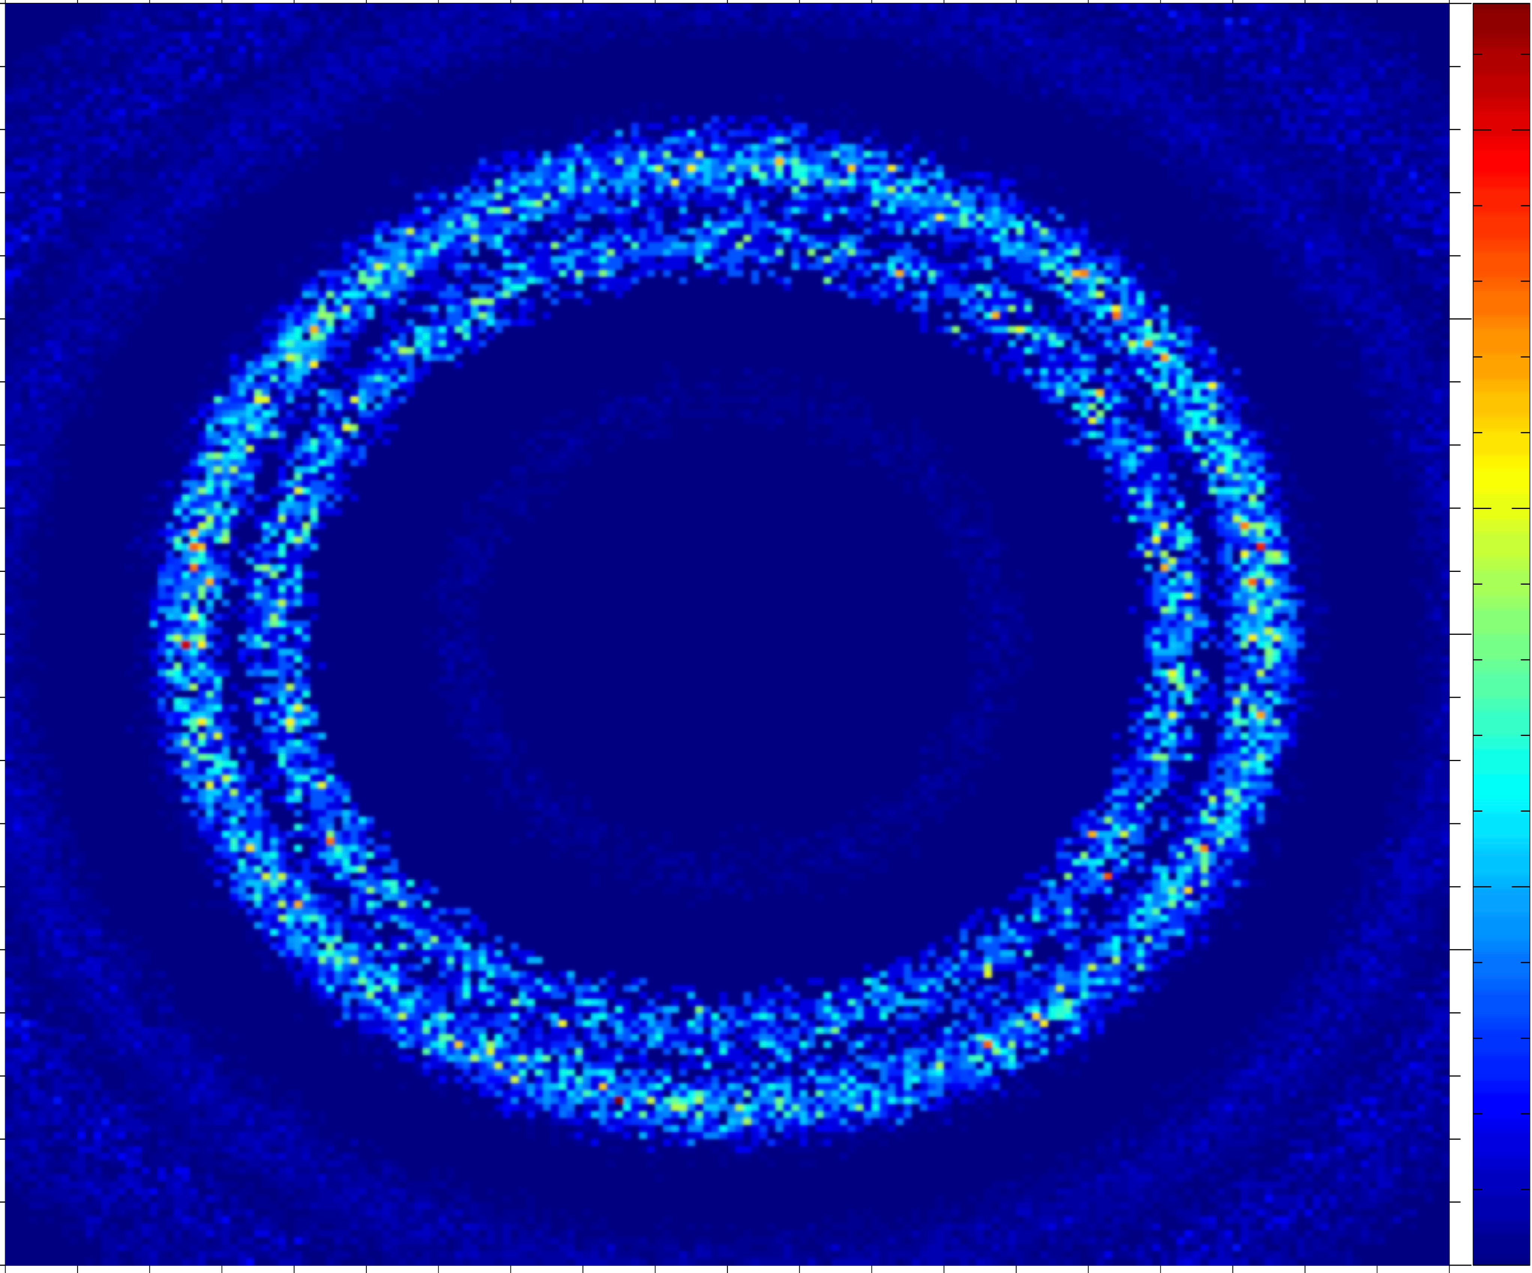
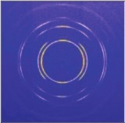
From single crystal / crystallite to powder….
Polycrystal with a little disorder, i.e. a preferred orientation, texture
Powder with complete disorder
Single crystal

Slide 8
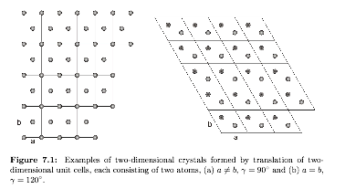
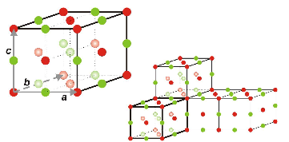



Lattices - in direct and reciprocal space…
Direct space atomic locations
Reciprocal space reflection points…
Each characterised by its Miller indices
Structure factor

Slide 9
Input for the Single_crystal
# TITLE *Aluminum-Al-[FM3-M] Miller, H.P.jr.;DuMond, J.W.M.[1942] at 298 K
# CELL 4.049320 4.049320 4.049320 90.000000 90.000000 90.000000
# SPCGRP F M 3 M CUBIC STRUCTURE
# ATOM AL 1 0.000000 0.000000 0.000000
# SCATTERING FACTOR COEFFICIENTS: AL F= 0.345 CM-12
# Reference: Physical Review (1940) 57, 198-206
#
# Physical parameters:
# sigma_coh 1.495 coherent scattering cross section (single atom) in [barn]
# sigma_inc 0.0082 incoherent scattering cross section (single atom)in [barn]
# sigma_abs 0.231 absorption scattering cross section (single atom) in [barn]
# density 2.70 in [g/cm^3]
# weight 26.98 in [g/mol] (single atom)
# multiplicity 4 in [atoms/unit cell]
# Vc 66.4 volume of unit cell in [A^3]
# v_sound 5100 in [m/s]
# v_sound_l 6420 velocity of longitudinal sound in [m/s]
# v_sound_t 3040 velocity of transversal sound in [m/s]
# T_m 933.5 melting temperature in [K]
# T_b 2792.2 boiling temperature in [K]
# At_number 13 atomic number Z
# lattice_a 4.04932 lattice parameter a in [Angs]
#
# Format parameters: Crystallographica format
# column_j 4 multiplicity 'j'
# column_d 5 d-spacing 'd' in [Angs]
# column_F2 7 norm of scattering factor |F|^2 in [fm^2]
# column_h 1
# column_k 2
# column_l 3
#
# h k l Mult. d-space 2Theta F-squared
-1 -1 -1 8 2.338 24.6973 21.3
-1 -1 1 8 2.338 24.6973 21.3
…
Lau datafiles
header
+
reflection list
Can be used with Single_crystal, PowderN, Isotropic_Sqw

Slide 10
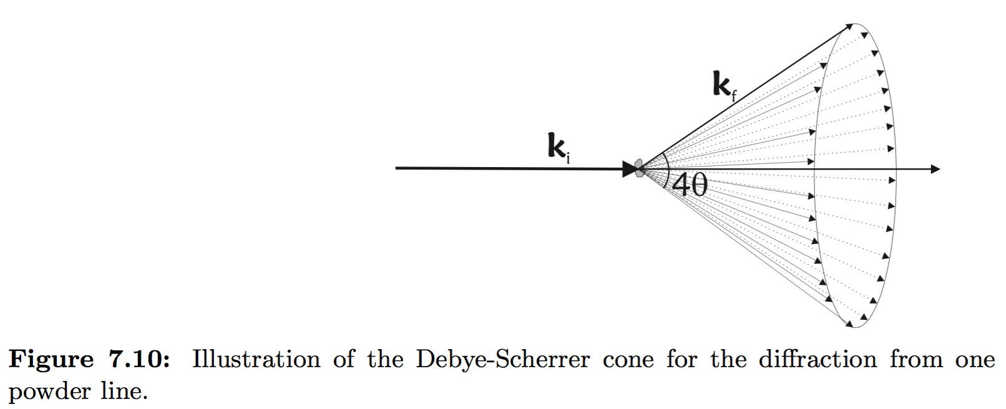
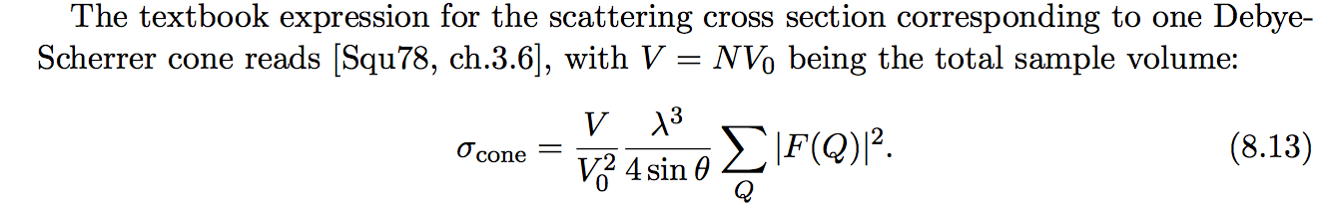
Debye-Scherrer cones

Slide 11
Input for the PowderN
Laz + Lau datafiles
header
+
reflection list
Can be used with PowderN, Isotropic_Sqw
# TITLE *Corundum-Al2O3-[R3-CH] Graafsma, H.;Souhassou, M.;Harkem[1998] [corundum saphire:blue, ruby:red]
# CELL 4.757000 4.757000 12.987700 90.000000 90.000000 120.000000
# SPCGRP R -3 C TRIGONAL STRUCTURE
# ATOM AL 1 0.000000 0.000000 0.352110
# ATOM O 1 0.306260 0.306260 0.250000
# SCATTERING FACTOR COEFFICIENTS: AL F= 0.345 CM-12 ; O F= 0.581 CM-12
# Reference: Acta Crystallographica B (1998) 54, 193-195
#
# Physical parameters:
# sigma_coh 15.683 coherent scattering cross section for Al2O3 in [barn]
# sigma_inc 0.0188 incoherent scattering cross section for Al2O3 in [barn]
# sigma_abs 0.4625 absorption scattering cross section for Al2O3 in [barn]
# density 4.05 in [g/cm^3]
# weight 101.96 in [g/mol] for Al2O3
# multiplicity 6 in [Al2O3/unit cell]
# Vc 254.52 volume of unit cell in [A^3]
# T_m 2273 melting temperature in [K]
# T_b 3773 boiling temperature in [K]
# lattice_a 4.757 lattice parameter a in [Angs]
# lattice_c 12.9877 lattice parameter c in [Angs]
# lattice_cc 120 lattice angle gamma in [deg]
#
# Format parameters: Lazy format <http://icsd.ill.fr>
# column_j 17 multiplicity 'j'
# column_d 6 d-spacing 'd' in [Angs]
# column_F 13 norm of scattering factor |F| in [barn]
# column_h 1
# column_k 2
# column_l 3
#
# H K L THETA 2THETA D VALUE 1/D**2 SIN2*1000 H K L INTENSITY /F(HKL)/ A(HKL) B(HKL) PHA.ANG. MULT LPG
1 0 1 6.35 12.71 4.5175 0.0490 12.25 1 0 1 367.0 4.1 -4.08 0.00 180.00 6 82.14
0 0 3 7.10 14.20 4.0467 0.0611 15.27 0 0 3 110.0 4.3 4.32 0.00 0.00 2 66.01
0 1 2 7.57 15.13 3.7972 0.0694 17.34 0 1 2 10.9 0.8 0.84 0.00 0.00 6 58.18
…

Slide 12
Where to get these files…
$MCSTAS/data
Windows: c:\mcstas-2.2a\lib\data
Linux: /usr/(local)/share/mcstas/2.2a/data
OS X: /Applications/McStas-2.2a/Contents/Resources/mcstas/2.2a/data
- Or make your own via
Finding a CIF file for the given structure
e.g. from ICSD http://icsd.fiz-karlsruhe.de
Process it using
cif2hkl at http://barns.ill.fr/cif2hkl.html
Crystallographica, using the guide
https://github.com/McStasMcXtrace/McCode/wiki/Single-crystal---and-generating-its-input

Slide 13
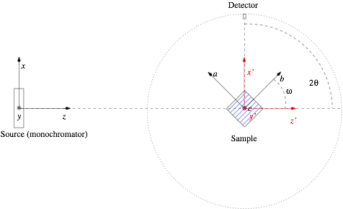
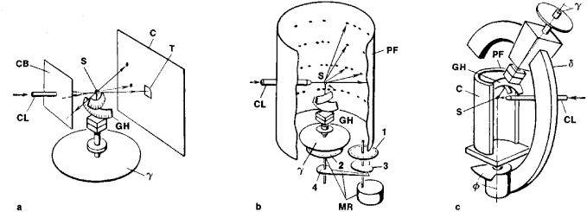
Laue diffractometers
… for single crystal diffraction

Slide 14
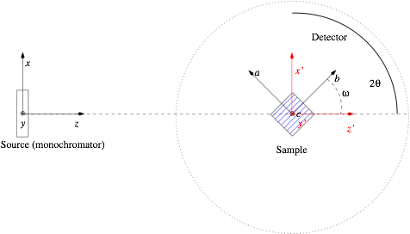
Powder diffractometers
… for powder diffraction

Slide 15
You will now simulate both
Exercise 9.2 on powders
Exercise 9.3 on single crystals

Slide 16
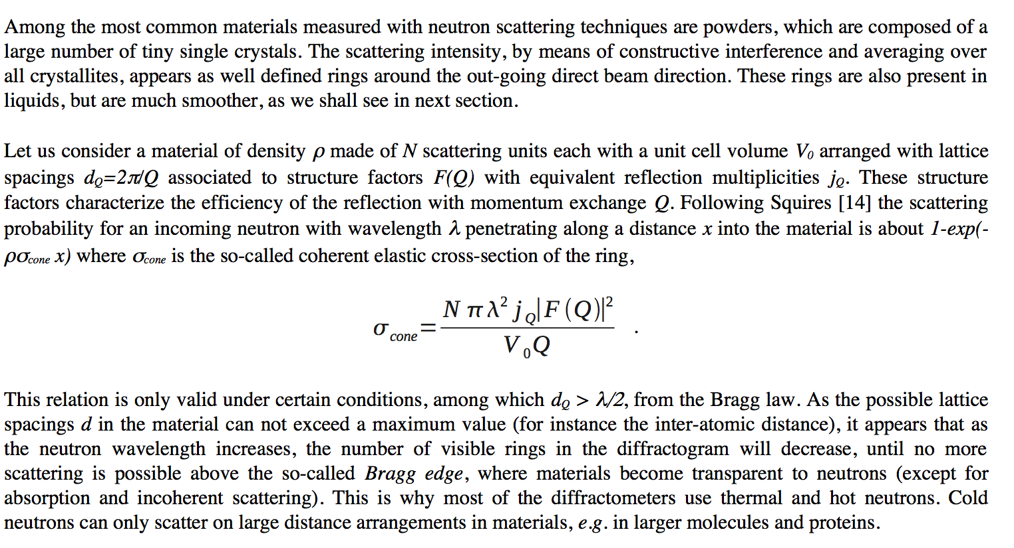
9.2 PowderN - intro

Slide 17
9.2 PowderN - construct a simple instrument file
Construct the below instrument file using mcgui….
/************************************************************************************************
* Instrument: powder_simple.instr
* %Description
* A powder scattering example.
* * %Parameters * lambda: [Angs] incoming neutron wavelength (monochromatic) * material: [Angs] Powder structure file (lazy/fullprof/crystallographica) ************************************************************************************************/
DEFINE INSTRUMENT powder_simple (Lambda=2.36, string material="Na2Ca3Al2F14.laz") TRACE
COMPONENT Source= Source_simple(dist=1, radius=0.01, focus_xw=0.01, focus_yh=0.01, lambda0=Lambda, dlambda=Lambda*0.01)
AT (0,0,0) ABSOLUTE
COMPONENT powder= PowderN(reflections = material, radius = 0.005, yheight = 0.05)
AT (0,0,0.5) RELATIVE PREVIOUS
COMPONENT banana= Monitor_nD(xwidth=1, yheight=0.3, options="banana ; theta limits=[10,130] bins=240 ; y bins=50”)
AT (0,0,0) RELATIVE PREVIOUS
END

Slide 18
9.2 - PowderN and datafiles
The equations from Squires relating to powders have been directly implemented in the PowderN component.
This handles single, coherent scattering and many d-spacing structure factors, with absorption correction and incoherent
elastic scattering. However, no multiple or inelastic scattering is taken into account,
which the Isotropic_Sqw component can cope with, in its powder mode (see exercise 9.4).
In the example at hand, we present a usage example which produces so-called Debye-Scherrer rings from a structure factor list.
The model geometry is shown in the left figure on next page, and the 2D ideal diffraction detector in the right figure on next page,
for a Na₂Ca₃Al₂F₁₄ reference powder. The choice of the material may be any file adapted from Lazy/Pulverix implemented in the
ICSD database and Fullprof (extension .laz) or Crystallographica (extension .lau also used for crystals). Currently, McStas includes
a material data base of about 70 powder and crystal definitions commonly used in neutron scattering. These can be listed from the
McGUI/Help/Component Library Index menu item, and you may easily add your own materials. The material volume may be a box,
a sphere and a cylinder, which all can be bulk or hollow geometries, including concentric arrangements, which we will hear about in
exercise 11.

Slide 19
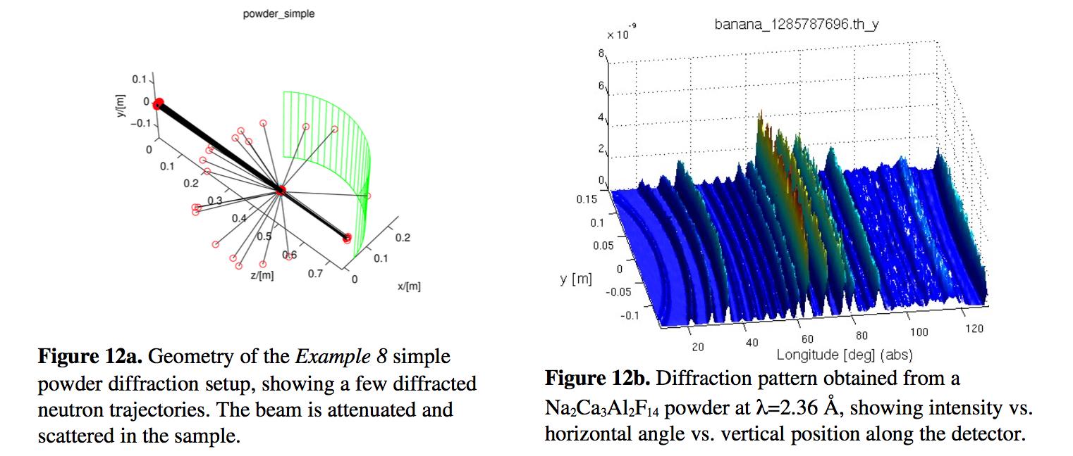
9.2 Perform simulations
Please run your newly created instrument file in trace mode and simulation mode
to see output like the ones below.
Investigate how the peak positions change with varied wavelength, try +/1 Å in
wavelength.
Also try choosing another material from your MCSTAS/data directory.

Slide 20
9.2 Optional extras
As a final optional PowderN exercise, try
Decreasing and increasing
Comment on the results
What is the effect of changing the sample size?
Comment on the results

Slide 21
9.3 Single_crystal - intro
When the sample is a single crystal, the averaging on many crystallites that is responsible for the scattering rings in a powder does not apply.
The Bragg law is still valid, but similarly as a mirror, each atomic plane selects a single reflected monochromatic ray. As there are many structural planes available, a polychromatic neutron beam will be scattered as a large number of distinct rays, forming spots on detectors.
This happens in the monochromators as discussed during the session on optics, but in this case only one reflection of interest is used, the others are scattered around, generating background.

Slide 22
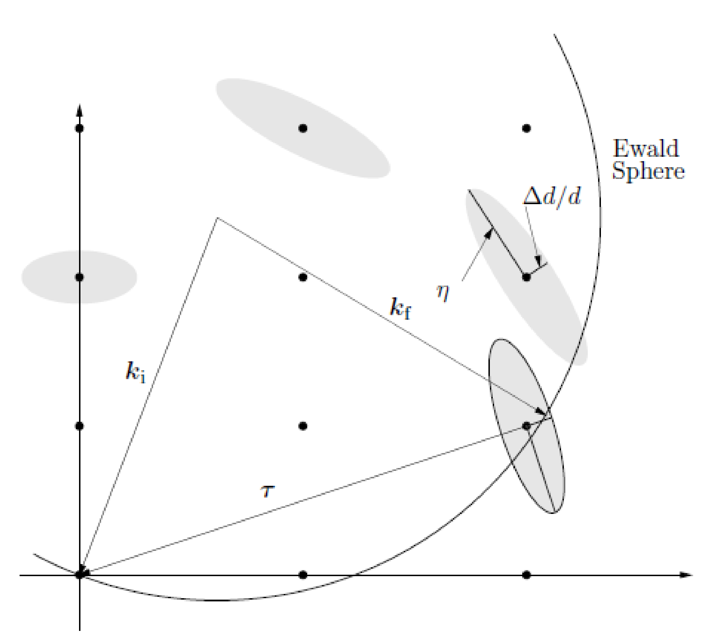
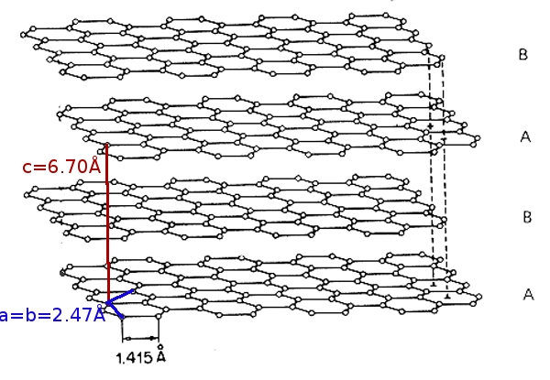
Single_crystal
Properties
●Thick, flat single crystal
- multiple scattering
- absorption
●- incoherent scattering
●Mosaic, isotropic (anisotropic around sample lattice axes)
●Variance of lattice parameter Δd/d=0

Slide 23
9.3 Single_crystal - construct a simple instrument file
Construct the below instrument file using mcgui….
/************************************************************************************************
* Instrument: single_crystal.instr * %Description * A single crystal scattering example.
* * %Parameters * lambda: [Angs] neutron wavelength selected by the monochromator ************************************************************************************************/
DEFINE INSTRUMENT single_crystal (Lambda=1, string material="C_graphite.lau")
TRACE COMPONENT Source= Source_simple(dist=1, radius=0.01, focus_xw=0.01, focus_yh=0.01, lambda0=Lambda dlambda=0.2*Lambda),
AT (0,0,0) ABSOLUTE
COMPONENT SX = Single_crystal(
xwidth = 0.002, yheight = 0.1, zdepth = 0.1, mosaic = 30, reflections = material, barns=0, ax=0, ay=2.14,az=­1.24, bx=0, by=0, bz= 2.47, cx=6.71,cy=0, cz= 0, absorption = 0.014, incoherent = 0.004)
AT (0,0,0.5) RELATIVE PREVIOUS
ROTATED (0,45,0) RELATIVE PREVIOUS
COMPONENT banana= Monitor_nD(xwidth=1, yheight=1, options="banana ; theta limits=[10,130] bins=240 ; y bins=100")
AT (0,0,0.5) RELATIVE Source
END

Slide 24
9.3 Single_crystal input parameters
The Single_crystal component is used the same way as the PowderN, but only accepts .lau type files from e.g. Crystallographica.
This component models coherent and incoherent elastic scattering, with multiple scattering and secondary absorption.
The material volume may be a box, a sphere and a cylinder, which all can be bulk or hollow geometries, including concentric arrangements.
The instrument geometry resembles the previous one for PowderN, now with a tilted graphite plate at the sample. As expected, the scattering shows a number of spots, which each select a single wavelength. The central spot is the direct, transmitted beam.
Currently, McStas does not provide simple ways to add inelastic scattering on top of a mono-crystalline structure, even though there is a way to simulate the neutron scattering on a a simple phonon dispersion.

Slide 25
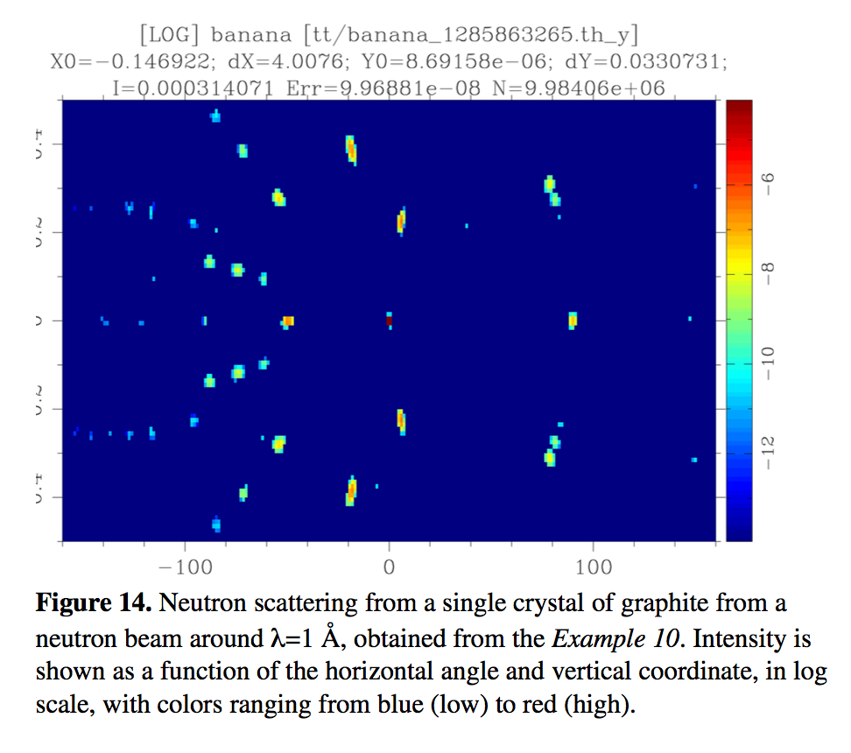
9.3 Perform simulations
Now perform trace to see that all looks OK, then a simulation that should give you output like this:

Slide 26
9.3 Optional extras
Create an instrument input parameter omega to allow rotating the sample.
Perform a scan and look in the subfolders how the spots move on the detector.
Also try
Decreasing and increasing the wavelength spread
Comment on the results

Slide 27
9.3 Optional extras
An additional complex geometry enables to use any point set to describe the material volume (geomview OFF file).
Try the same simulations with an OFF file from the MCSTAS/data directory

