Slide 1






McStas advanced language features
- and other important, not so well known details
Peter Willendrup^{1,5}
Emmanuel Farhi²
Erik Knudsen^{1,5}
Uwe Filges³
Kim Lefmann^{4,5}
¹DTU Physics, Lyngby, Denmark
²Calcul Scientifique, Institut Laue-Langevin (ILL), Grenoble, France
³Niels Bohr Institute, University of Copenhagen, Copenhagen, Denmark
4Paul Scherrer Institut, Villigen, Switzerland
5ESS DMSC, Copenhagen, Denmark

Slide 2
Topics
A quick recap of the most important vocabulary
McStas language macros
Other important details

Slide 3
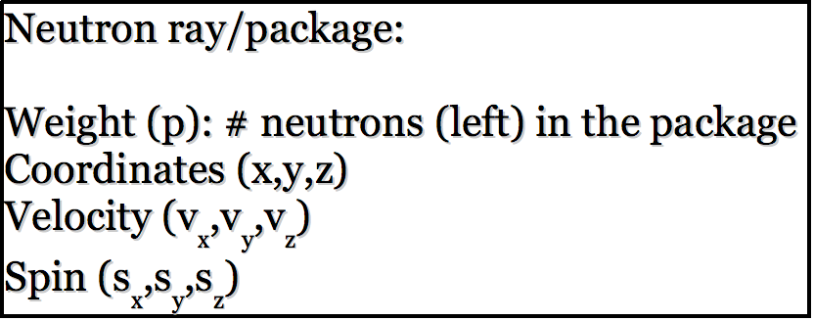
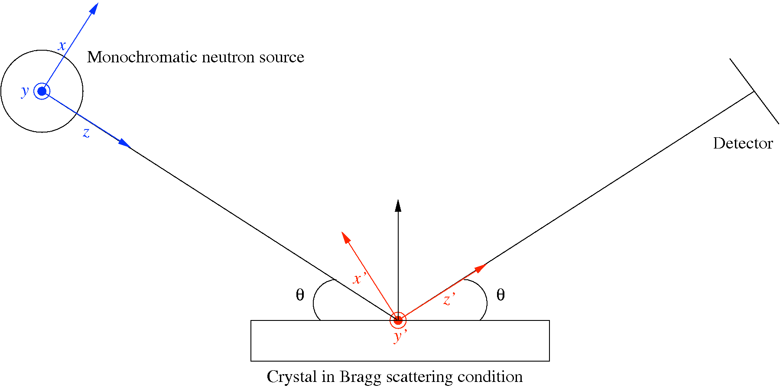
McStas: key concepts
Time (t)

Slide 4
McStas: key concepts
Neutron state parameters are global variables!
Time (t)

Slide 5
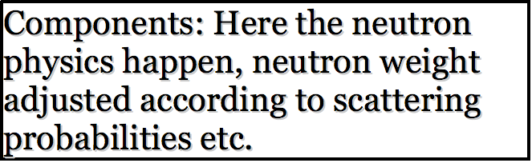
McStas: key concepts

Slide 6
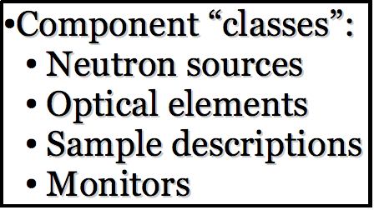
McStas: key concepts

Slide 7
McStas: key concepts
Local, internal coordinate system!

Slide 8
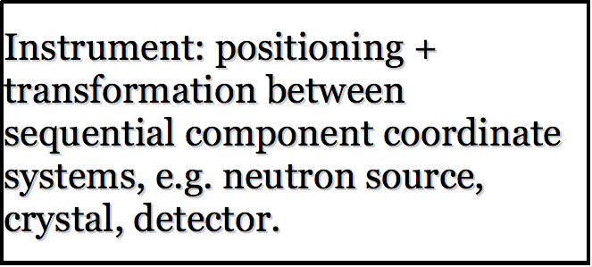
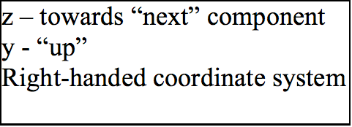
McStas: key concepts

Slide 9
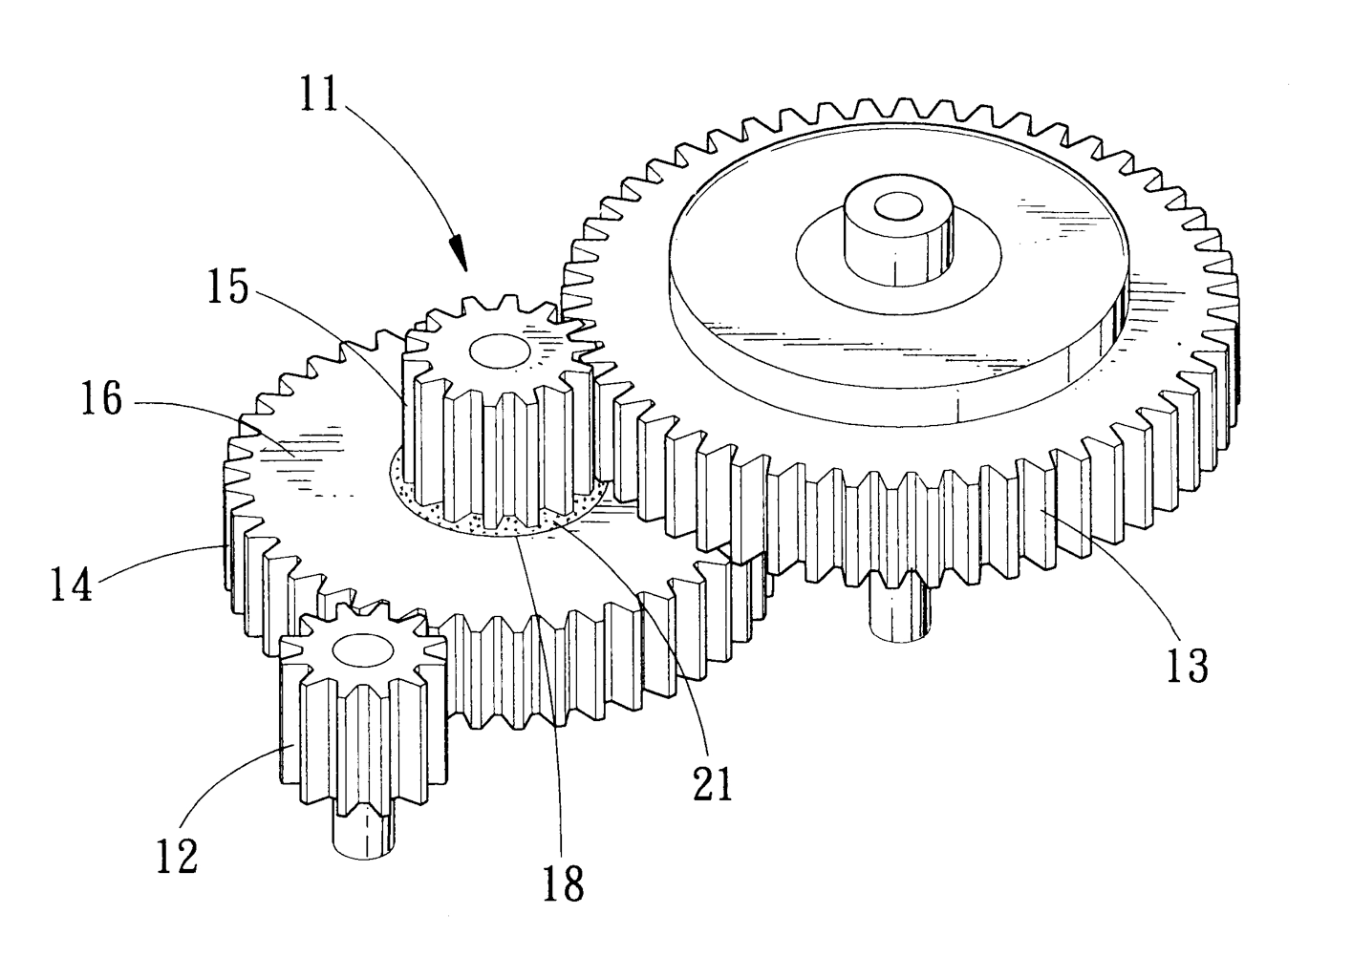
Under-the-hood / inner workings
Domain-specific-language (DSL) based on compiler technology (LeX+Yacc)
Simple Instrument language ISO C
Component codes realizing beamline parts (including user contribs)
Library of common functions for e.g.
I/O
Random numbers
Physical constants
Propagation
Precession in fields
...
Code generation

Slide 10
From the “list of frequent questions”
Why do you need to have the components in this order?

Slide 11
Order of components is important
1
3
2
1
2
3
Starting at the source

Slide 12
Order of components is important
1
3
2
1
2
3
Moving to first comp in the list

Slide 13
Order of components is important
1
3
2
1
2
3
Moving to 3rd comp in list requires “moving back in time”.
Default behavior is to ABSORB this type of neutron.
For monitors use restore_neutron=1 in this case.
For homegrown comps use ALLOW_BACKPROP macro.

Slide 14
Advanced language features
Macros and tricks for your instrument...

Slide 15

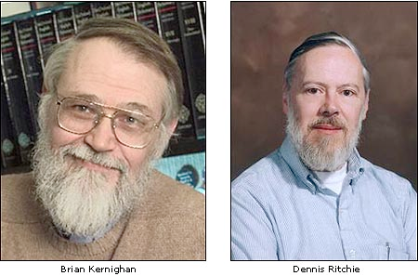
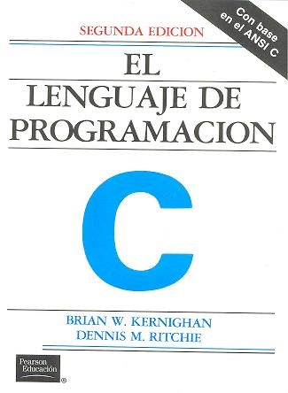
DECLARE / INITIALIZE
Use the DECLARE section define user variables and functions.
DECLARE %{
double myvar;
%}
Use INITIALIZE for initialization of user variables and calculations.
INITIALIZE %{
myvar = sqrt(PI*input_var)*rand01();
%}
- Both use normal c-syntax.
BEWARE: (example) What you do in the c-style areas is c-standard, e.g. trigonometric functions from math.h use radians! - McStas placement specifiers work in degrees, etc...
K & R

Slide 16
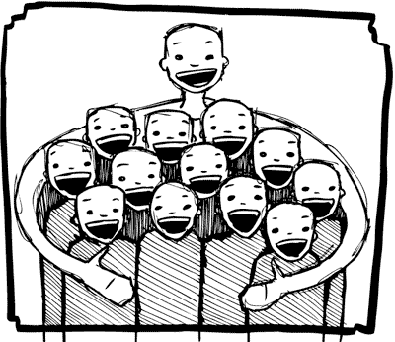
%include
Instrumentfiles can include external c-code or other instrumentfiles... See the examples:
ILL_H15_IN6.instr:%include "monitor_nd-lib"
ILL_H16_IN5.instr:%include "ILL_H16.instr"
ILL_H25_IN22.instr:%include "ILL_H25.instr"
ILL_H25_IN22.instr:%include "templateTAS.instr"
Used in the DECLARE section

Slide 17
Syntax in one, complex view...
{SPLIT} COMPONENT name = comp(parameters) {WHEN condition}
AT (...) [RELATIVE [reference|PREVIOUS] | ABSOLUTE]
{ROTATED {RELATIVE [reference|PREVIOUS] | ABSOLUTE} }
{GROUP group_name}
{EXTEND C_code}
{JUMP [reference|PREVIOUS|MYSELF|NEXT] [ITERATE number_of_times | WHEN condition] }

Slide 18
SPLIT
Increase statistics beyond this point in the instrumentfile
SPLIT n MyArm = Arm()
AT somewhere
will “formulate an if-statement”:
for j=1:n
comp1
comp2
comp3
...
end (of instrument)
ONLY meaningful in case of Monte Carlo choices after SPLIT point...

Slide 19

WHEN
Syntax:
COMPONENT Mine = Yours(blah, blah)
WHEN (c-expression) AT (....)
Is very powerful when combined with EXTEND and user variables, or as a method to let input parameters select if certain components are active.
Example: Use EXTEND to flag if neutron was scattered on one monochromator blade or another. Then later use WHEN to only show contribution from blade N at sample position?
COMPONENT Mon = PSD_monitor(...)
WHEN (myvar==1) AT (0,0,0) RELATIVE Sample
K & R

Slide 20

GROUP - components working in parallel
COMPONENT Mono1 = Monochromator_curved(...)
AT (0,0, -LMM) RELATIVE Cradle ROTATED (0,A1/2,0) RELATIVE Cradle
GROUP IN6Monoks
COMPONENT Mono2 = Monochromator_curved(...)
AT (0,0, 0) RELATIVE Cradle ROTATED (0,A2/2,0) RELATIVE Cradle
GROUP IN6Monoks
- One comp after the other is “tried” in sequential order until the neutron was SCATTERED.

Slide 21
EXTEND
Enrich component behaviour using EXTEND:
COMPONENT Mono1 = Monochromator_curved(...)
AT (0,0, -LMM) RELATIVE Cradle ROTATED (0,A1/2,0) RELATIVE Cradle
GROUP IN6Monoks
EXTEND
%{
if (SCATTERED) { myvar = ;1 }
%}
...
COMPONENT Mono2 = Monochromator_curved(...)
AT (0,0, 0) RELATIVE Cradle ROTATED (0,A2/2,0) RELATIVE Cradle
GROUP IN6Monoks
%{
if (SCATTERED) { myvar = 2 }
%}
K & R

Slide 22
JUMP
A goto. Be careful. Can be used in two situations:
JUMP to myself
JUMP to an Arm
No coordinate transformations are applied... (Meaning that if the Arms you JUMP between do not coincide you will “move” / “reorient” the neutrons...)
Syntaxes:
COMPONENT a=b(...)
WHEN (expr) AT (...) JUMP somewhere
COMPONENT a=b(...)
WHEN (expr) AT (...) JUMP somewhere
Van Halen...

Slide 23
JUMP
A goto. Be careful. Can be used in two situations:
JUMP to myself
JUMP to an Arm
No coordinate transformations are applied... (Meaning that if the Arms you JUMP between do not coincide you will “move” / “reorient” the neutrons...)
Syntaxes:
COMPONENT a=b(...)
WHEN (expr) AT (...) JUMP somewhere
COMPONENT a=b(...)
WHEN (expr) AT (...) JUMP somewhere
BEWARE - This IS a GOTO!
Van Halen...

Slide 24
JUMP
A goto. Be careful. Can be used in two situations:
JUMP to myself
JUMP to an Arm
No coordinate transformations are applied... (Meaning that if the Arms you JUMP between do not coincide you will “move” / “reorient” the neutrons...)
Syntaxes:
COMPONENT a=b(...)
WHEN (expr) AT (...) JUMP somewhere
COMPONENT a=b(...)
WHEN (expr) AT (...) JUMP somewhere
BEWARE - This IS a GOTO!
Van Halen...

Slide 25
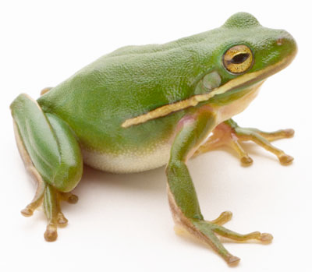
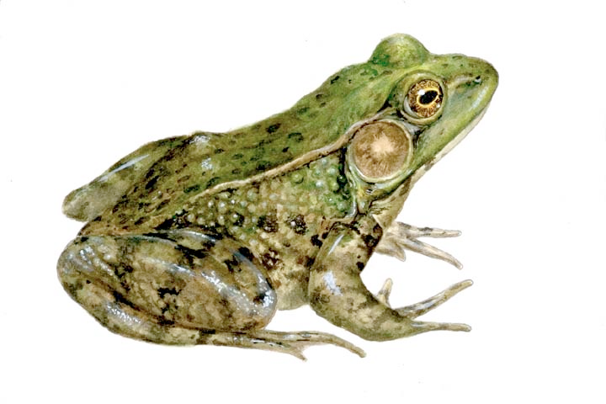
COPY- inside instruments
In instruments: (see ILL_H25.instr)
COMPONENT H25_1 = Guide_gravity(
w1=0.03, h1=0.2, w2=0.03, h2=0.2, l=L_H25_1,
R0=gR0, Qc=gQc, alpha=gAlpha, m=m, W=gW)
AT (0,0,Al_Thickness+gGap) RELATIVE PREVIOUS
ROTATED (0,Rh_H25_1,0) RELATIVE PREVIOUS
COMPONENT COPY(H25_1) = COPY(H25_1)
AT (0,0,L_H25_1+gGap) RELATIVE PREVIOUS
ROTATED (0,Rh_H25_1,0) RELATIVE PREVIOUS
COMPONENT COPY(H25_1) = COPY(H25_1)(W=2*gW)
AT (0,0,L_H25_1+gGap) RELATIVE PREVIOUS
ROTATED (0,Rh_H25_1,0) RELATIVE PREVIOUS

Slide 26
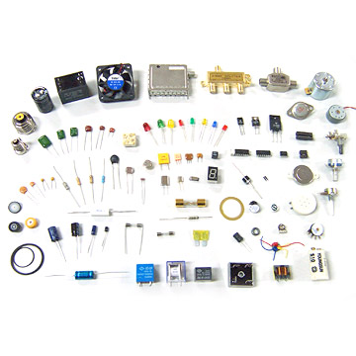
Other advanced topics
Tricks, macros and functions for your components

Slide 27
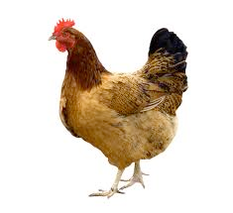
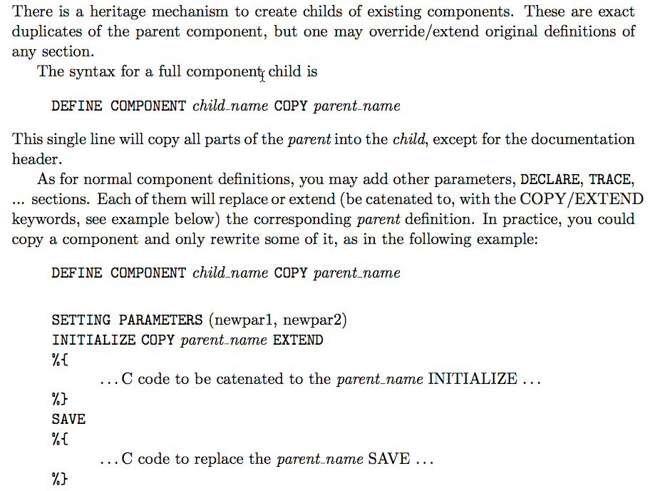
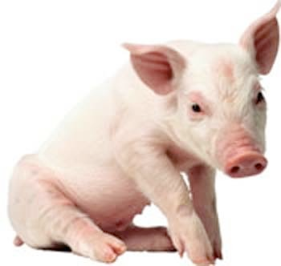


COPY In components:
+
+
=

Slide 28
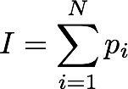

Simulation statistics
Neutron weights (intensities) in McStas are “per unit time”
At a detector bin, N rays with weight pi arrive. We record:
Intensity
Statistical error, root mean square

Slide 29

Scaling a simulation to achieve counts
As noted before, McStas intensities are “per second”.
A maximal “measurement” or integration time can be defined such that
Or in other words, the poisson-law based squareroot error may not become smaller than the scaled version of the statistical error. When a binned monitor is scaled, the minimal Em for the detector bank to be used.

Slide 30
The end

