Slide 1







Peter Willendrup^{1,5}
Emmanuel Farhi²
Erik Knudsen^{1,5}
Uwe Filges³
Kim Lefmann^{4,5}
¹DTU Physics, Lyngby, Denmark
²Calcul Scientifique, Institut Laue-Langevin (ILL), Grenoble, France
³Niels Bohr Institute, University of Copenhagen, Copenhagen, Denmark
4Paul Scherrer Institut, Villigen, Switzerland
5ESS DMSC, Copenhagen, Denmark

Slide 2
Topics
Important runtime library macros/functions
Important component details
Let’s write a simplistic example component

Slide 3

McStas internals 1) Runtime libraries
Typically originates from one or a few (big) components
Resides in $MCSTAS/share
C-style library with .c and .h files
List from 2.2a (most important listed):
    mccode-r.c / mccode-r.h - common with McXtrace, used by all instrs
    mcstas-r.c / mcstas-r.h - neutron specifics, used by all inserts
    read_table-lib.c / read_table-lib.h - Used by comps reading files, e.g. samples
    interoff-lib.c / interoff-lib.h - Used by “any shape” components
    monitor_nd-lib.c / monitor_nd-lib.h - Used when using Monitor_nD and relatives
    ref-lib.c / ref-lib.h - Used by reflecting optics
    interpolation.c / interpolation.h - interpolation library
    nexus-lib.c / nexus-lib.h - NeXus Data format
    pol-lib.c / pol-lib.h - Polarization
    ref-lib.c / ref-lib.h (-”- but should be generalized for e.g. Guides)
    adapt_tree-lib.c / adapt_tree-lib.h - Adaptive source

Slide 4
McStas internals 1) Runtime libraries, ‘share’
Typically originates from one or a few (big) components
Resides in $MCSTAS/share
C-style library with .c and .h files
List from 2.2a (most important listed):
    mccode-r.c / mccode-r.h - common with McXtrace, used by all instrs
    mcstas-r.c / mcstas-r.h - neutron specifics, used by all inserts
    read_table-lib.c / read_table-lib.h - Used by comps reading files, e.g. samples
    interoff-lib.c / interoff-lib.h - Used by “any shape” components
    monitor_nd-lib.c / monitor_nd-lib.h - Used when using Monitor_nD and relatives
    ref-lib.c / ref-lib.h - Used by reflecting optics
    interpolation.c / interpolation.h - interpolation library
    nexus-lib.c / nexus-lib.h - NeXus Data format
    pol-lib.c / pol-lib.h - Polarization
    ref-lib.c / ref-lib.h (-”- but should be generalized for e.g. Guides)
    adapt_tree-lib.c / adapt_tree-lib.h - Adaptive source
Windows - c:\mcstas-2.2a\lib\
Mac OS X - /Application/McStas-2.2.a/Contents/Resources/mcstas/2.2a/
(also as link in /usr/local/mcstas/2.2a/
Debian, Ubuntu etc. - /usr/share/mcstas/2.2a/
Other Unix - /usr/local/mcstas/2.2a/

Slide 5
McStas internals 2) Important runtime libraries
Let’s look at the so-called mcstas runtime or mccode-r.h/c + mcstas-r.h / c
Types of content:
  Inclusion of basic c-libs e.g. math.h
  Portability issues i.e. Linux vs. Mac vs. Win32 specifics (pathdefs, signals, blah, blah...)
  Interoperability with other codes, e.g. DANSE
  I/O and data output formats
  MPI (parallel computing)
  Various useful user macros - you will see the list shortly

Slide 6
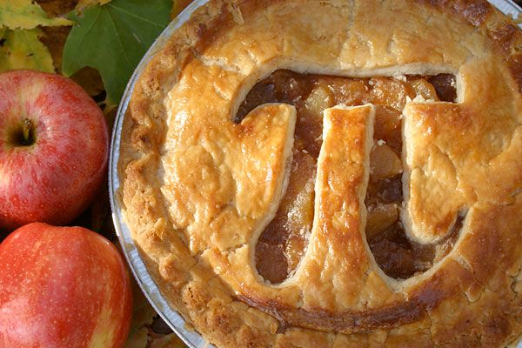
Runtime - constants
#define RAD2MIN ((180*60)/PI)
#define MIN2RAD (PI/(180*60))
#define DEG2RAD (PI/180)
#define RAD2DEG (180/PI)
#define AA2MS 629.622368 /* Convert k[1/AA] to v[m/s] */
#define MS2AA 1.58825361e-3 /* Convert v[m/s] to k[1/AA] */
#define K2V AA2MS
#define V2K MS2AA
#define Q2V AA2MS
#define V2Q MS2AA
#define SE2V 437.393377 /* Convert sqrt(E)[meV] to v[m/s] */
#define VS2E 5.22703725e-6 /* Convert (v[m/s])**2 to E[meV] */
#define FWHM2RMS 0.424660900144 /* Convert between full-width-half-max and */
#define RMS2FWHM 2.35482004503 /* root-mean-square (standard deviation) */
#define HBAR 1.05457168e-34 /* [Js] h bar Planck constant CODATA 2002 */
#define MNEUTRON 1.67492728e-27 /* [kg] mass of neutron CODATA 2002 */
#define GRAVITY 9.81 /* [m/s^2] gravitational acceleration */
# define PI M_PI
# define PI 3.14159265358979323846

Slide 7
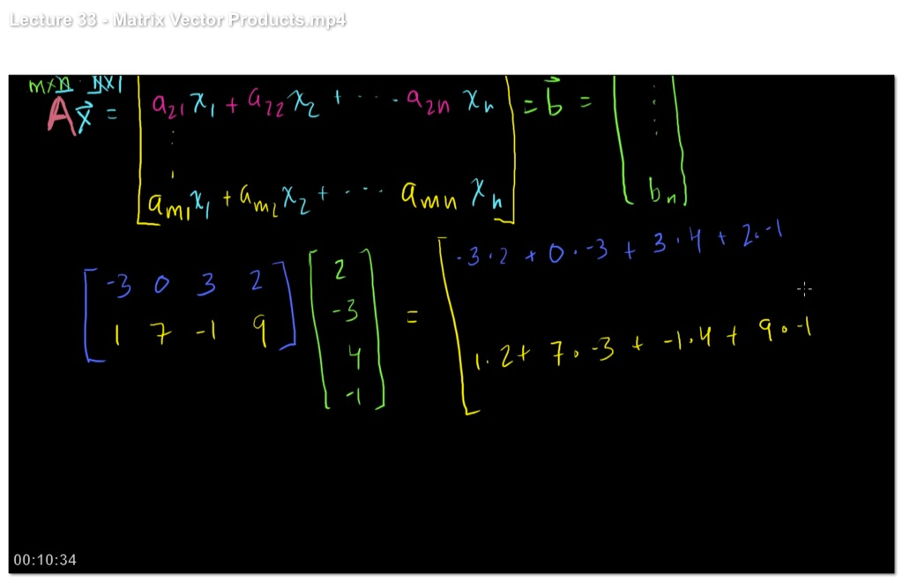
Runtime - Matrix/vector
vec_prod(&x, &y, &z, x1, y1, z1, x2, y2, z2)
double scalar_prod(x1, y1, z1, x2, y2, z2)
NORM(&x,&y,&z)
rotate(&x, &y, &z, vx, vy, vz, phi, ax, ay, az)
mirror(&x,&y,&z,rx,ry,rz,nx,ny,nz)
Coords coords_set(MCNUM x, MCNUM y, MCNUM z);
Coords coords_get(Coords a, MCNUM *x, MCNUM *y, MCNUM *z);
Coords coords_add(Coords a, Coords b);
Coords coords_sub(Coords a, Coords b);
Coords coords_neg(Coords a);
Coords coords_scale(Coords b, double scale);
double coords_sp(Coords a, Coords b);
Coords coords_xp(Coords b, Coords c);
void coords_print(Coords a);
void rot_set_rotation(Rotation t, double phx, double phy, double phz);
int rot_test_identity(Rotation t);
void rot_mul(Rotation t1, Rotation t2, Rotation t3);
void rot_copy(Rotation dest, Rotation src);
void rot_transpose(Rotation src, Rotation dst);
Coords rot_apply(Rotation t, Coords a);
void mccoordschange(Coords a, Rotation t, double *x, double *y, double *z,
double *vx, double *vy, double *vz, double *time,
double *s1, double *s2);
void normal_vec(double *nx, double *ny, double *nz,
double x, double y, double z);

Slide 8
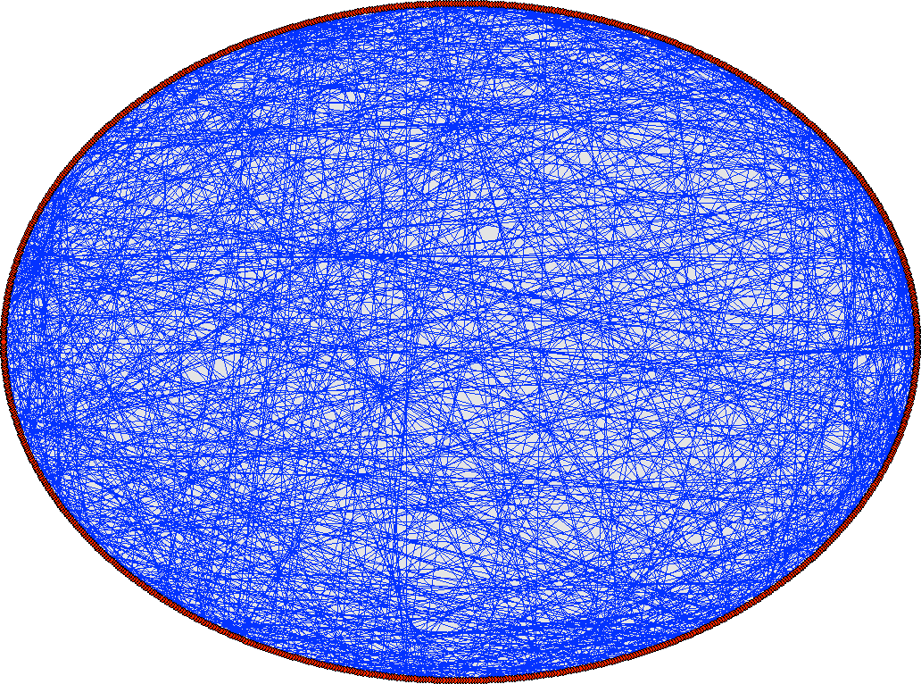
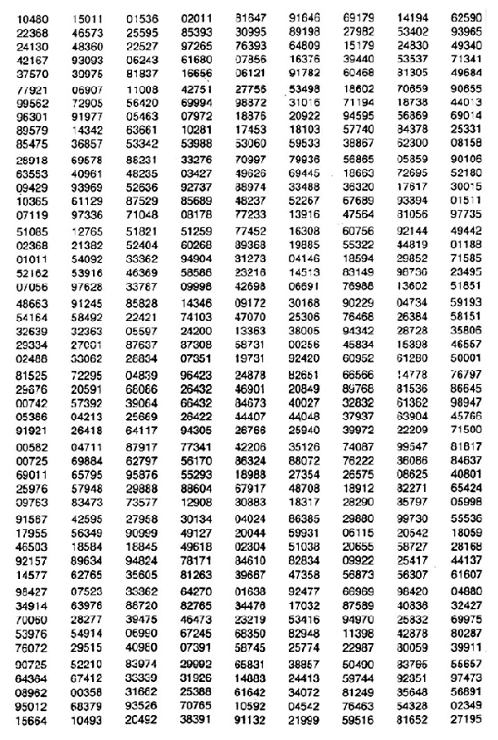
Runtime - random numbers
#define rand01() ( ((double)random())/((double)MC_RAND_MAX+1) )
#define randpm1() ( ((double)random()) / (((double)MC_RAND_MAX+1)/2) - 1 )
#define rand0max(max) ( ((double)random()) / (((double)MC_RAND_MAX+1)/(max)) )
#define randminmax(min,max) ( rand0max((max)-(min)) + (min) )
double randnorm(void);
double randtriangle(void);

Slide 9
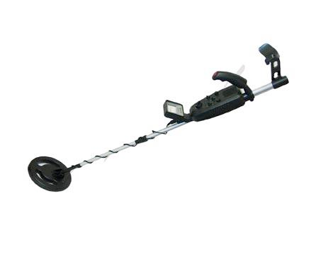
Runtime - detector-output
DETECTOR_OUT(p0,p1,p2)
DETECTOR_OUT_0D(t,p0,p1,p2)
DETECTOR_OUT_1D(t,xl,yl,xvar,x1,x2,n,p0,p1,p2,f)
DETECTOR_OUT_2D(t,xl,yl,x1,x2,y1,y2,m,n,p0,p1,p2,f)
DETECTOR_OUT_3D(t,xl,yl,zl,xv,yv,zv,x1,x2,y1,y2,z1,z2,m,n,p,p0,p1,p2,f)
DETECTOR_CUSTOM_HEADER(t)
t is a filename-string
double mcestimate_error(double N, double p1, double p2);

Slide 10


Runtime - component data
NAME_CURRENT_COMP
INDEX_CURRENT_COMP
POS_A_CURRENT_COMP
POS_R_CURRENT_COMP
ROT_A_CURRENT_COMP
ROT_R_CURRENT_COMP

Slide 11
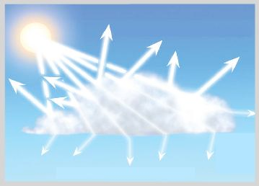
Runtime - simulation flow / neutron state
SCATTER - really means “please update the neutron state for visualization”
ABSORB - really means “cancel further processing of this ray”
STORE_NEUTRON(index, x, y, z, vx, vy, vz, t, sx, sy, sz, p)
RESTORE_NEUTRON(index, x, y, z, vx, vy, vz, t, sx, sy, sz, p)
- index should be INDEX_CURRENT_COMP

Slide 12
Runtime - propagation
ALLOW_BACKPROP - allow negative time when propagating
DISALLOW_BACKPROP - restore default behaviour
PROP_DT(dt)
PROP_X0 / Y0 / Z0

Slide 13
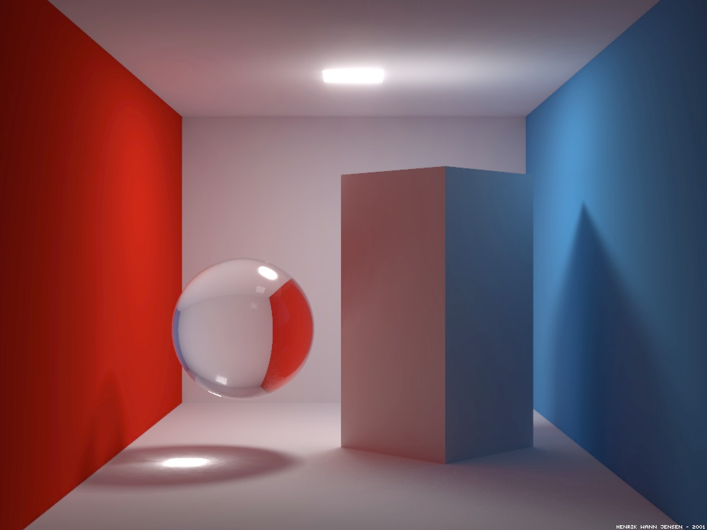
Runtime - space geometry
int inside_rectangle(double, double, double, double)
int box_intersect(double *dt_in, double *dt_out, double x, double y, double z, double vx, double vy, double vz, double dx, double dy, double dz)
int cylinder_intersect(double *t0, double *t1, double x, double y, double z, double vx, double vy, double vz, double r, double h)
int sphere_intersect(double *t0, double *t1, double x, double y, double z, double vx, double vy, double vz, double r)
int plane_intersect(double *t, double x, double y, double z, double vx, double vy, double vz, double nx, double ny, double nz, double wx, double wy, double wz)
int off_intersect(double*, double*, double, double, double, double, double, double, off_struct)

Slide 14

Solid angle “limitation” aka focusing
randvec_target_rect(&vx, &vy, &vz, &solid_angle, tx, ty, tz, focus_xw, focus_yh, ROT_A_CURRENT_COMP);
randvec_target_circle(&vx, &vy, &vz, &solid_angle, aim_x, aim_y, aim_z, focus_r);
randvec_target_rect_angular(&vx, &vy, &vz, &solid_angle,aim_x, aim_y, aim_z, VarsV.aw, VarsV.ah, ROT_A_CURRENT_COMP);

Slide 15

Various other stuff is there - all sorts...
MC_GETPAR(comp, par)
int solve_2nd_order(double *Idt,
double A, double B, double C);
Read any geometry using OFF format
Load ascii tables
Choose Larmor-precession algorithm
...

Slide 16
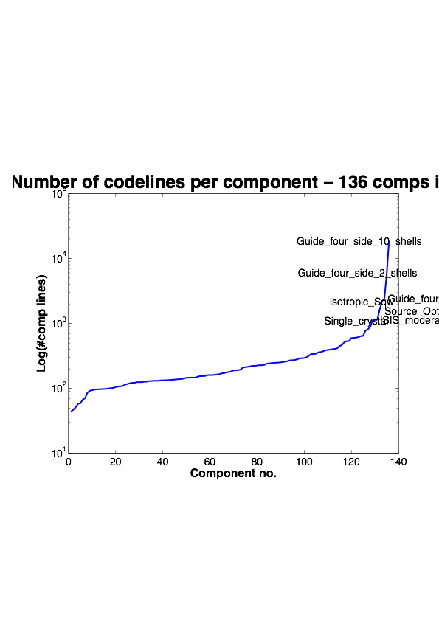

For inspiration...
Check our long list of components and look inside... Most of them are quite simple and short... Statistics:

Slide 17
Shared libs are also not bad...
21 chopper_fermi.h
45 ref-lib.h
47 intersection.h
75 pol-lib.h
76 interoff-lib.h
82 adapt_tree-lib.h
85 ref-lib.c
118 vitess-lib.h
135 nexus-lib.h
156 adapt_tree-lib.c
174 read_table-lib.h
228 monitor_nd-lib.h
264 general.h
280 pol-lib.c
330 nexus-lib.c
498 vitess-lib.c
607 general.c
638 interoff-lib.c
699 chopper_fermi.c
912 intersection.c
991 mcstas-r.h
1101 read_table-lib.c
1688 monitor_nd-lib.c
5473 mcstas-r.c

Slide 18

McStas library - where is what?
/usr/share/mcstas/2.2a on Unix, Linux
/usr/local/mcstas/2.2a on Mac
c:\McStas-2.2a\lib on Windows
Contents:
contrib (Contributed components)
data (All kinds of data files)
doc (home of the manual & component manual)
editors (syntax highlighting for various editors)
examples (example instrument files)
misc (misc. components)
monitors (monitor components)
obsolete (obsolete components)
optics (optics components)
samples (sample components)
share (shared libs, including mcstas-r.h/c)
sources (source components)
tools (perl scripts, matlab backend etc.)

Slide 19
  Let’s try writing a component!
Starting point: Arm.comp
Goal: Perfect mirror

