Slide 1
Developing an interface between MCNPX and McStas for simulation of neutron moderators
Bent Lauritzen
Erik Nonbøl
Esben Klinkby
Peter Willendrup

Slide 2
Motivation
Traditionally two decoupled Monte Carlo codes covers different needs in Neutron Scattering simulations:
  MCNP/X used for TMS calculations
  Neutron ray tracing code, e.g. McStas (talk by P.Willendrup) used for instrument design + data analysis
Even more precise simulations may be possible by combining the best of the two worlds: The detailed description of incoherent scattering from MCNP/X with the coherent scattering of McStas.
Prospects: usage of direct MCNP/X McStas coupling:
  Optimization of complex moderator design
  Shielding along neutron guide
  Crosstalk between neutron guides
Test case: ESS TMS and guide systems.
Add Presentation Title in Footer via ”Insert”; ”Header & Footer”
Notes:
, but the intention is that all developments are general, available for the community

Slide 3
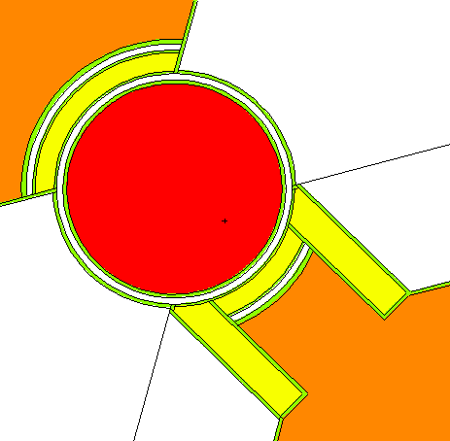
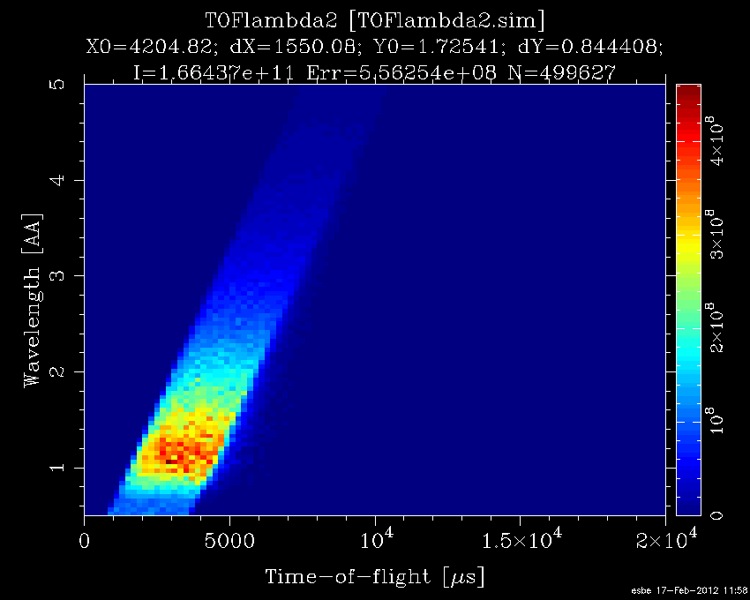
Outline
Explored interfaces:
  Tally fit
  Ptrac
  SSW/SSR
  Compile
  Supermirror
Validation
  First results
  Upcomming
Summarizing experiences
  Cross comparisons
Notes:
Within workpackage XX which is a collaboration between PSI and DTU, we decided to explore all possible ways of interfacing

Slide 4
Tally fitting (present default approach)
Neutron spectrum calculated with MCNP/X at the moderator surface
Spectrum is approximated by simple functions which serves as input to McStas.
Con’s
Pro’s
Fast - MCNP calculation done once-and-for-all
No re-entry (format is write-only)
Correlations (e.g. E, pos, angles) unaccounted for
Avoids licensing issues
Discussed later
4

Slide 5
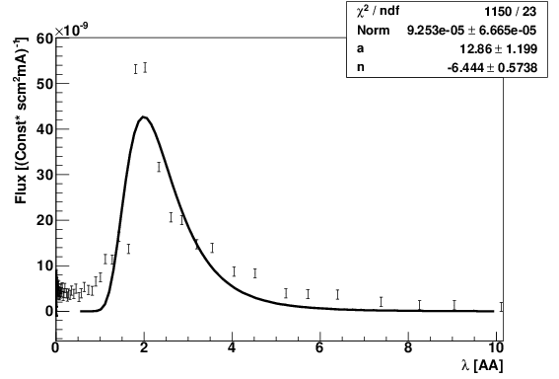
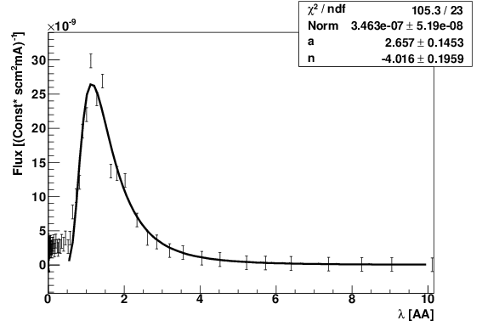
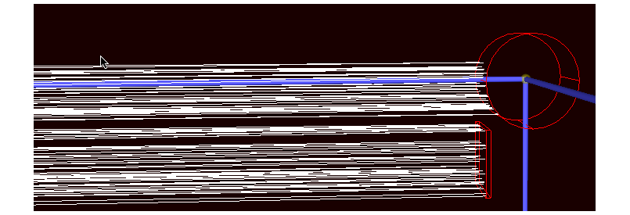
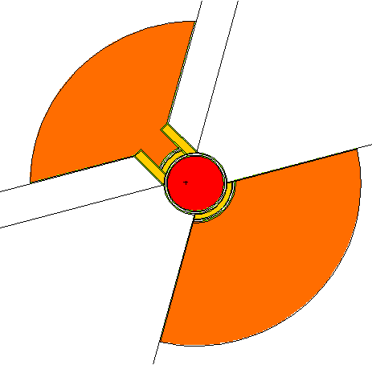
Tally fitting (update)
Based on the latest MCNPX ESS target station (bi-spectral) geometry from ESS-Bilbao (see presentation by F.Sordo), we have developed a McStas component mimicking both geometry and spectra.
The component is named: ESS_Moderator_revised, and is expected to be released shortly.
Mcstas
MCNPX
cold
thermal

Slide 6
Ptrac
Ptrac format
……………………………….
3000 2 10 179 100 2 0
0.00000E+00 0.28640E+00 0.43531E+00 -0.10000E+01 0.00000E+00 0.00000E+00 0.10000E+00 0.10000E+01 0.33356E-02
3000 3 110 179 10 2 0
-0.20000E+00 0.28640E+00 0.43531E+00 -0.10000E+01 0.00000E+00 0.00000E+00 0.10000E+00 0.10000E+01 0.40028E-02
3000 4 120 179 100 2 0
-0.40000E+00 0.28640E+00 0.43531E+00 -0.10000E+01 0.00000E+00 0.00000E+00 0.10000E+00 0.10000E+01 0.46699E-02
3000 5 130 179
……………………………..
MCNP/X can output an ascii file containing individual neutron states: pos, angles, energy, time & weight
The McStas component: MCNP_Virtual_Input converts the neutron state into McStas readable and works as a source
Con’s
Pro’s
Correlations conserved (e.g. E,pos)
Fast
Write out at 1 surface only
No re-entry (format is write-only)
ascii file enormous: ~0.2kB/evt
Cannot run MPI

Slide 7
SSW/SSR
MCNPX
Source Surface Read/Write in MCNPX starts/stops simulations at a given (set of) surface(s)
The neutron state written to binary file.
New McStas components:
MCNP_Virtual_ss_Input & MCNP_Virtual_ss_Output
reads MCNPX output and writes MCNPX input
Neutron propagation started in MCNPX, continued in McStas and finalizing in MCNP
SSR
SSW
Mcstas
ascii file sizable: ~0.1kB/evt
All McStas functionality usable
Correlations conserved (e.g. E,pos)
Write out at selected surfaces only
Re-entry supported
Works with MPI
Notes:
We have successfully deciphered the un-documented binary format

Slide 8
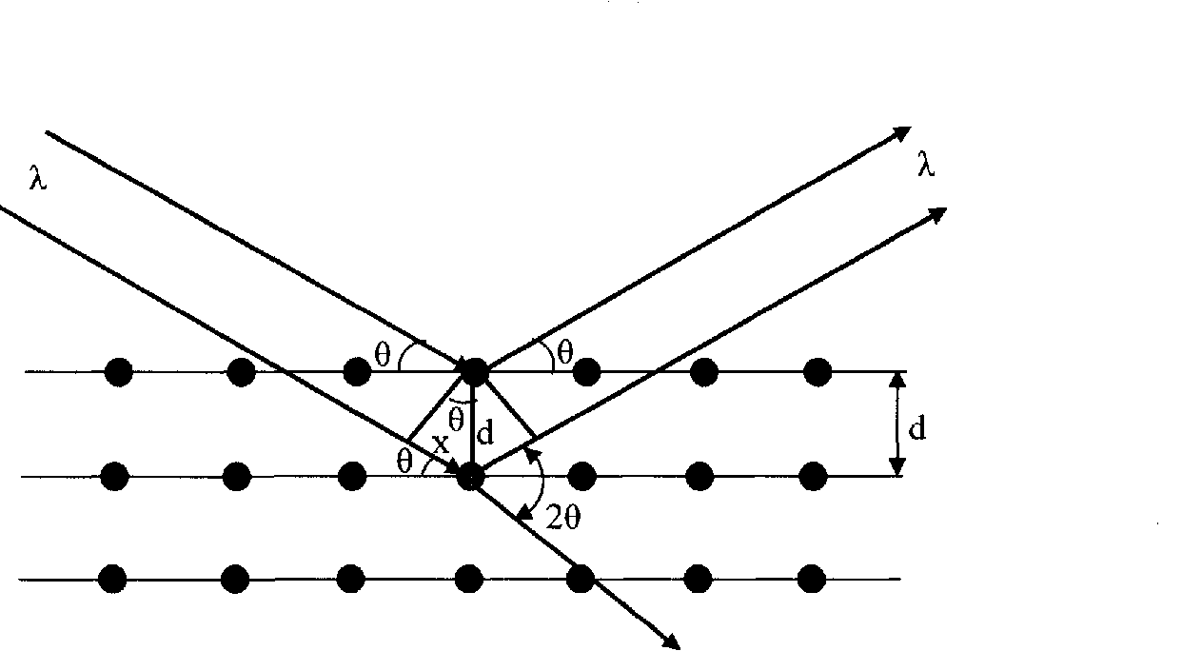
Combined compilation
“-surface”
MCNPX
Mcstas
MCNPX
McStas surface flag introduced in MCNPX
Neutron crossing McStas surface causes initiation of McStas simulation, based on neutron state.
Updated neutron state returned to MCNPX
Method
•n
∼n
~n
Coherent
scattering
•n
Potentially very flexible (but not yet fully developed)
Correlations conserved (e.g. E,pos)
Licensing issue
All McStas functionality usable
Re-entry supported
Slow: MCNPX called for each neutron
in MCNPX input file:
…..
-110 PX -0.2
-120 PX -0.4
…..
Notes:
Reason for difficulty: mcstas c code is autogenerated, i.e. depends on the specific instrument design….

Slide 9
Supermirror
Existing implementation, introducing McStas inspired supermirrors as a surface card in MCNPX (Gallmeier et all, Nuc.Tech. 168(3))
Reflectivity R=R0 if Q<Qc
R=R0/2{1- tanh[(Q –mQc)/W]}{1-a(Q –Qc)} if Q >Qc
Ported to MCNPX 2.7, but not yet validated
Qc
Reflectivity
Doesn’t scale: workload per functionality significant. Only McStas mirrors ported
Re-entry supported
Correlations conserved (e.g. E,pos)
Licensing issue
Avoids intermediate files and multiple codes
Slow
-1
9
Q[Å- ]

Slide 10
Validation:
Fitting distributions vs. importing neutron states
Present approach used for instrument design & physics analysis relies on a once-and-for-all fit to a spectrum.
Clear advantages over porting individual neutrons:
  Preliminary ESS geometry (from ESS-Bilbao), simulation 1M protons with MCNPX takes ~1K CPU hours
  McStas CPU cost for 1M neutrons: hardly measureable <1s
Implicitly McStas assumes:
  Spectrum fit is perfect
  No correlations between: Position at moderator surface, position at guide entrance, momentum
  No scattering between moderator surface and guide entrance
For TMS & instrument design these assumptions are worth questioning

Slide 11
Validation of Tally approach: Fits
No fit is ever perfect – especially not mine

Slide 12
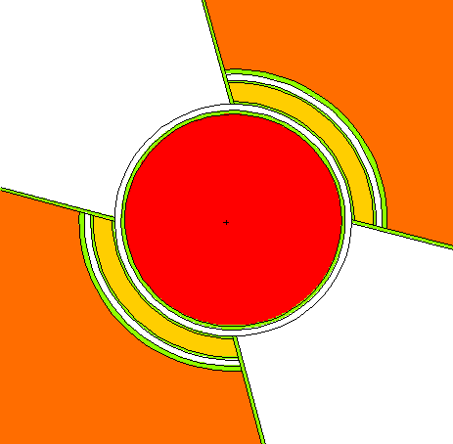
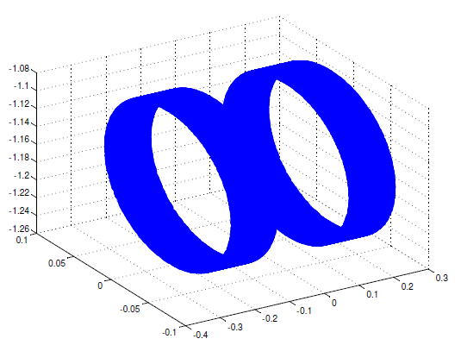
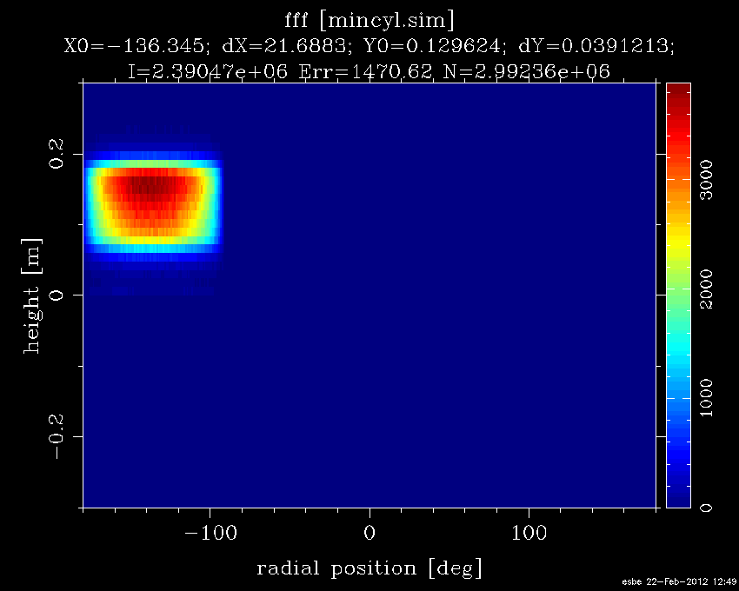
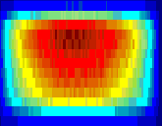
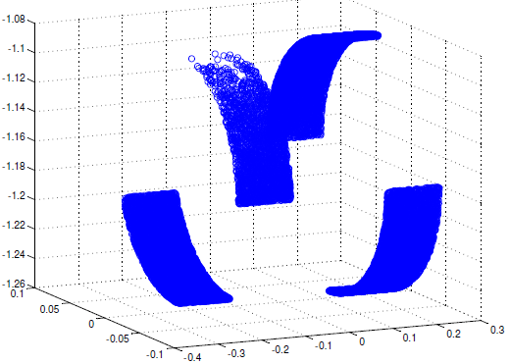
Validation of Tally approach: Correlations
Stress test of the developed SSW/SSR approach:
  Simulate 1M protons hitting target wheel
  Dump all neutrons passing moderator surface to SSW output file (3.5Gb)
  In McStas, placing a PositionSensitiveDetector (PSD) ~at the cold moderator surface gives:
i.e. Non-uniform
Cold moderator surface
all neutrons crossing
height
height
…
Zoom
…
relevant neutrons
degree
degree

Slide 13
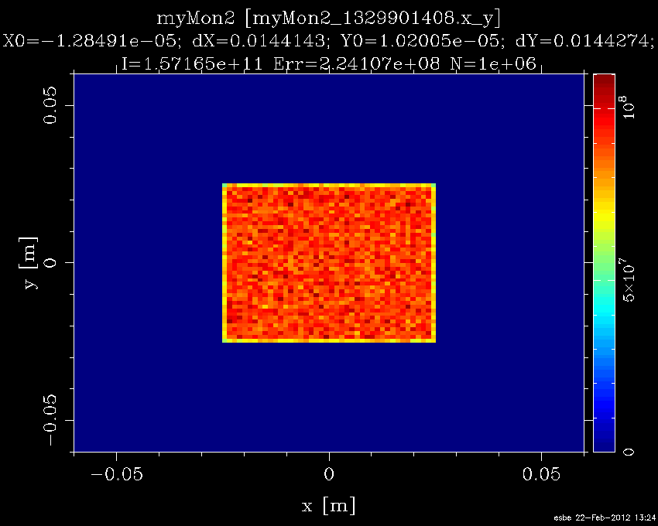
Validation of Tally approach: Correlations
In McStas the procedure to provide neutron states is to connect randomly points at the moderator to points at the guide opening, and assign energy
Placing a PSD detector ~at the guide opening surface gives:
I.e. uniform – but long flight path of ~6m means that a point source assumption is not too far off.
Q: How would the distribution look in MCNP. I.e. SSW card at 6m?
*
*
~6m
~10cmx10cm
Focus retangle:
~5cmx10cm

Slide 14
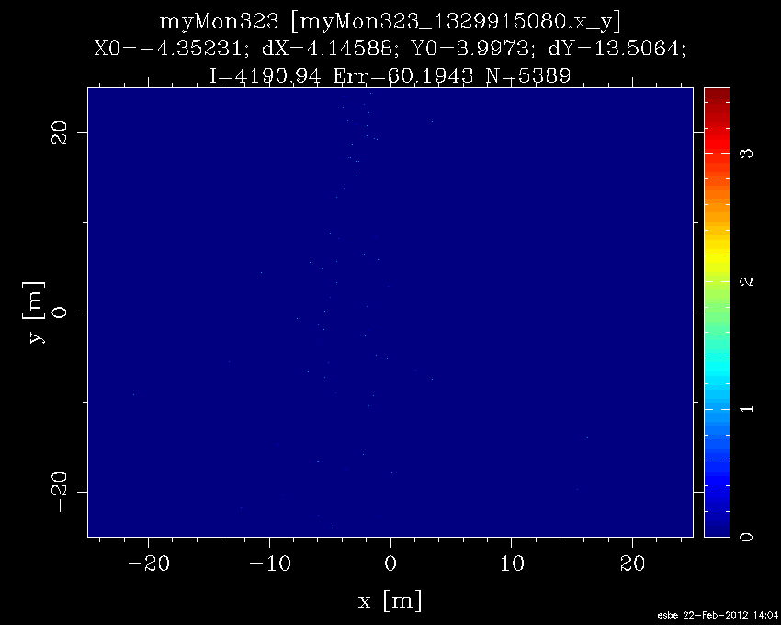
Validation of Tally approach: Correlations
A: Flat – in the empty sense of the word:
No focus -> very few neutrons at guide

Slide 15
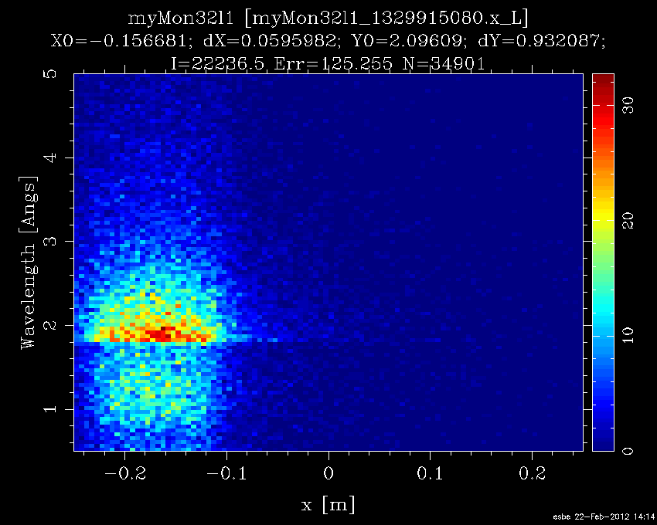
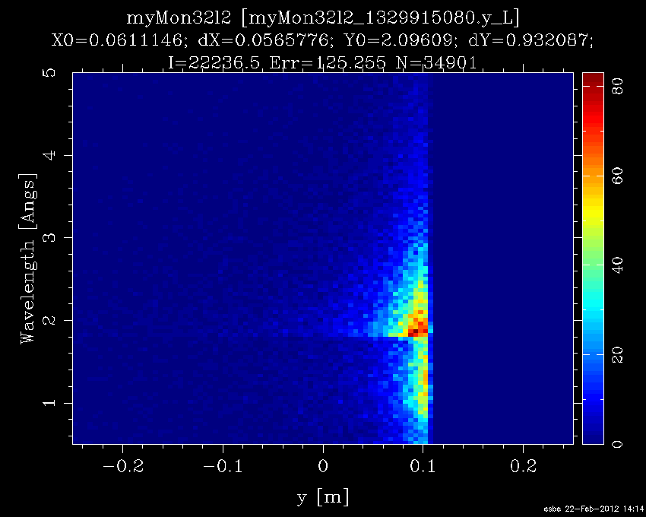
Validation of Tally approach: Correlations
Lots of other comparisons to make:
I.e. correlations between position & energy exist. Important for moderator design etc, but perhaps not for instrument design (?). Being investigated.

Slide 16
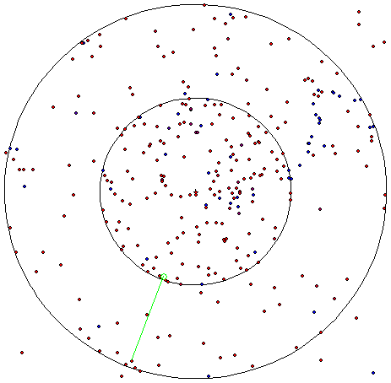
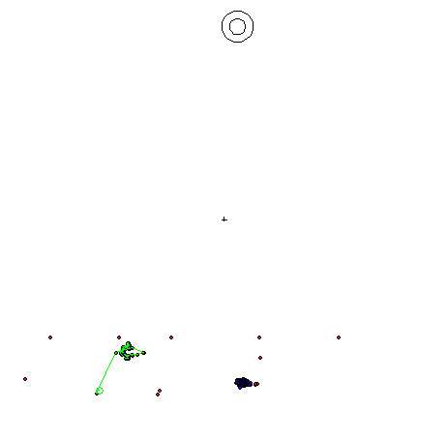
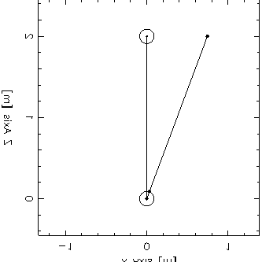
Validation of SSW / SSR approach
Define simplest possible geometry in MCNPX
Run test simulation
Visualize events and pick one
Import to McStas the neutron states as recorded by SSW card
Run simplest possible McStas simulation from SSW input: neutron transport
At z=2m, write SSW & visualize
Based on McStas SSW resume the MCNPX simulation, and visualize

Slide 17
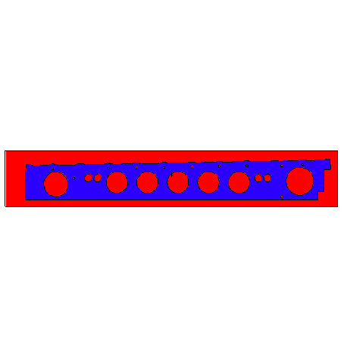
Validation: upcomming
Test all interfaces using ESS prototype guide at SINQ spallation source at PSI in summer 2012
Allows cross validation of simulation approaches against real data
Status (simulation-wise): Using MCAM1) engineering CAD model geometry has been translated into a MCNPX readable geometry (details missing still)
CAD
MCNPX
1)FDS Team, China. Y.Wu, FDS Team, CAD based interface programs for fusion neutron transport simulation, Fusion Engineering and Design 84 (2009) 1987-1992

Slide 18
Cross comparison
 | Re-entry neutrons | Speed | Single neutron trace | Require License | Comments
Tally | No | Fast* | No | Yes/No | Should try to determine validity at least once
Ptrac | No | Fast* | Yes | Yes | Somewhat outdated by SSW/SSR
SSW/SSR | Yes | Fast* | Yes | Yes | Promising…
Compile | Yes | Slow | Yes | Yes | Generalizes poorly (auto gen c-code hacks)
Supermirror | Yes | Slow | yes | yes | Generalizes poorly (but who cares?)
*) The computational heavy MCNP/X calculation can be performed once-and-for-all

Slide 19
Backup slides

Slide 20
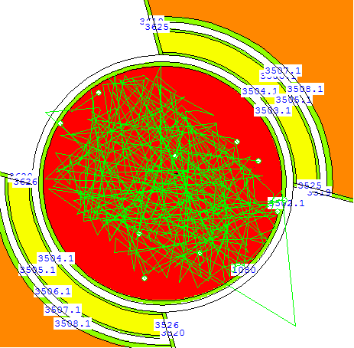
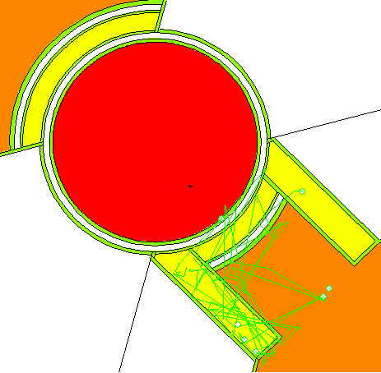
Tally contributions
Contributions to cold spectrum
Contributions to thermal spectrum

Slide 21
Fits
T=75K
(Maxwellian fit)
T=357K
(Maxwellian fit)

