Slide 1
8 Further tips
Simulation to experiment comparison
How to make your McStas more efficient

Slide 2
What is really the information content…?
McStas sources generally provide “intensity” in units of neutrons/s (into a chosen solid angle)
That intensity is carried through the instrument on a discrete set of “neutron rays”

Slide 3

In a histogram sense
Imagine a histogram, e.g. I(λ)
The RMS variance over that set becomes our statistical error bar E
…
…
1
2
3
i
k
In bin i, N events each carrying a fractional intensity pj so that

Slide 4
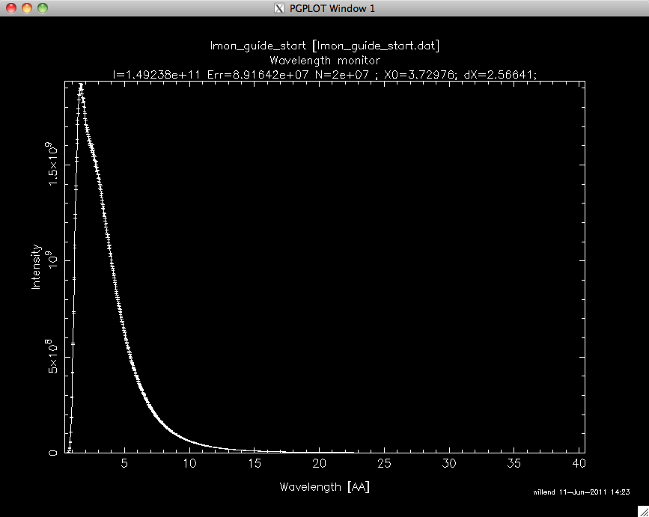
In a histogram sense
Imagine a histogram, e.g. I(λ)
The RMS variance over that set becomes our statistical error bar E
…
…
I
E
N
1
2
3
i
k
In bin i, N events each carrying a fractional intensity pj so that

Slide 5
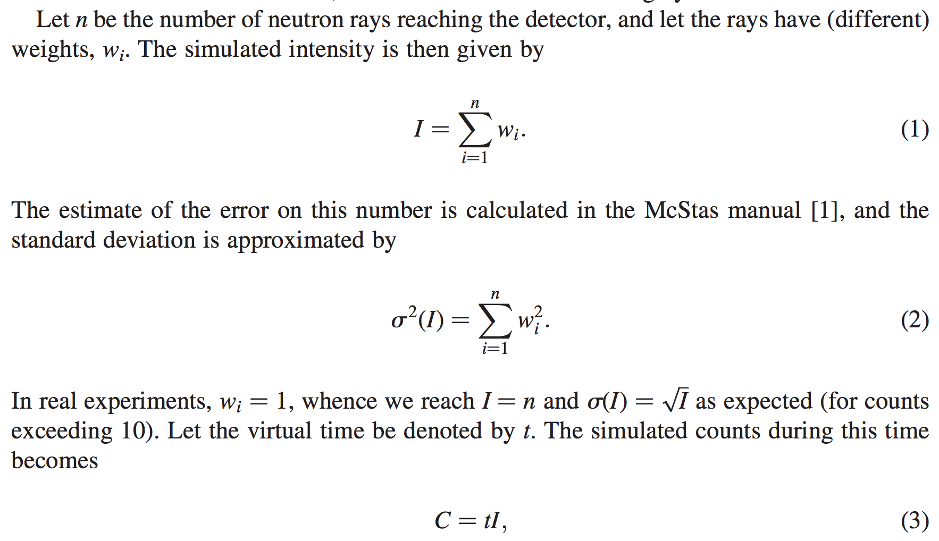
From "Virtual experiments - the ultimate aim of neutron ray-tracing simulations", K. Lefmann et al., Journal of Neutron Research 16, 97-111 (2008)

Slide 6
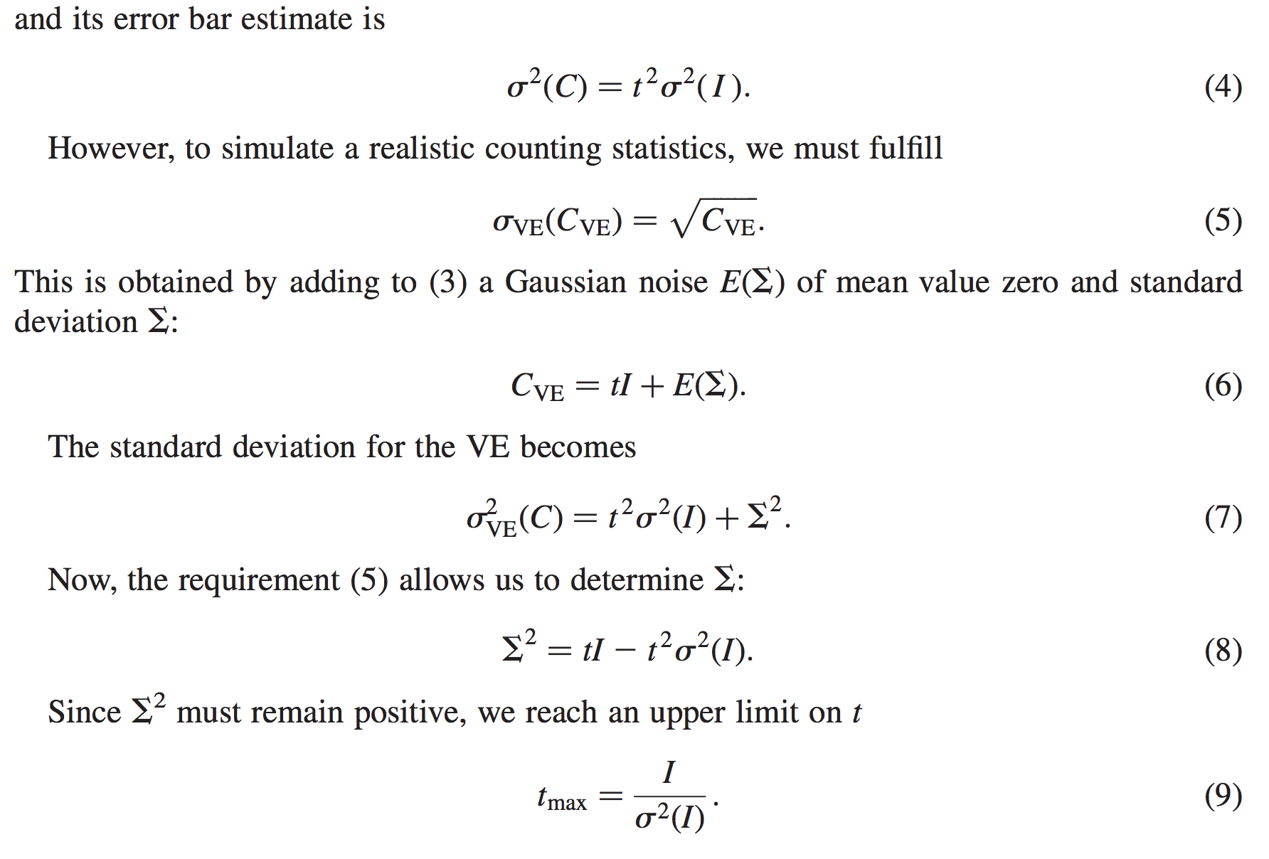
From "Virtual experiments - the ultimate aim of neutron ray-tracing simulations", K. Lefmann et al., Journal of Neutron Research 16, 97-111 (2008)

Slide 7
Sketch of an algorithm…
On a given McStas histogram
For the non-zero bins, calculate
The smallest defines the “maximal counting time” allowed by your statistics
Preferably a “background” should be added - use a “known experimental value” or an estimate…

Slide 8
Important points to remember
Your simulation will only contain elements you provided / defined
… to the precision you defined
Answers the questions you posed
Background essentially only from “sample”, or sample-near objects

Slide 9
Onto efficiency…
Apply focusing techniques
  At the source (spatially, temporally, in wavelength…)
  At the sample, if possible
(carefully!) Apply SPLIT - but only if immediately followed by Monte Carlo choices, e.g. in sample
Alternatively use MCPL o/i which allows repetition - beware of biases!

Slide 10
Onto efficiency…
Apply focusing techniques
  At the source (spatially, temporally, in wavelength…)
  At the sample, if possible
(carefully!) Apply SPLIT - but only if immediately followed by Monte Carlo choices, e.g. in sample
Alternatively use MCPL o/i which allows repetition - beware of biases!
All of this can be considered “variance reduction”
or biasing

Slide 11
Onto efficiency…
Use MPI parallelisation - included in macOS install from 2.4, easy to get on Linux…
The Intel C compiler is known to give ~factor of 2 wrt. gcc in most cases
- Still consider if you are asking the right question if runtimes reach days/weeks…

Slide 12
Onto efficiency…
Use MPI parallelisation - included in macOS install from 2.4, easy to get on Linux…
The Intel C compiler is known to give ~factor of 2 wrt. gcc in most cases
- Still consider if you are asking the right question if runtimes reach days/weeks…
Sledge-hammer / brute force!

