Slide 1

Ron Smith
ISIS Crystallography Group
Tof Powder Diffractometer

Slide 2
Polaris upgrade design - single peak / small number of peaks
(2010, Matt Tucker, Stefan Norberg)
TS1 Project - simulation of complete diffraction pattern
confirmation of existing moderator performance
simulation of proposed new TRAM
Powder diffraction excellent technique for characterising moderator line shapes
Backscattering detector minimises instrument geometry contribution: observed line shape dominated by moderator effects
Δd/d = Δθ cot θ as θ → 90° cotθ → 0 (fixed detector)

Slide 3
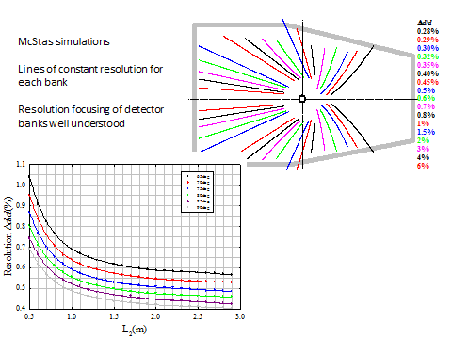
large number of simulations
performed on small cluster of PCs
small number of Bragg peaks simulated
Polaris upgrade detector bank performance as expected

Slide 4
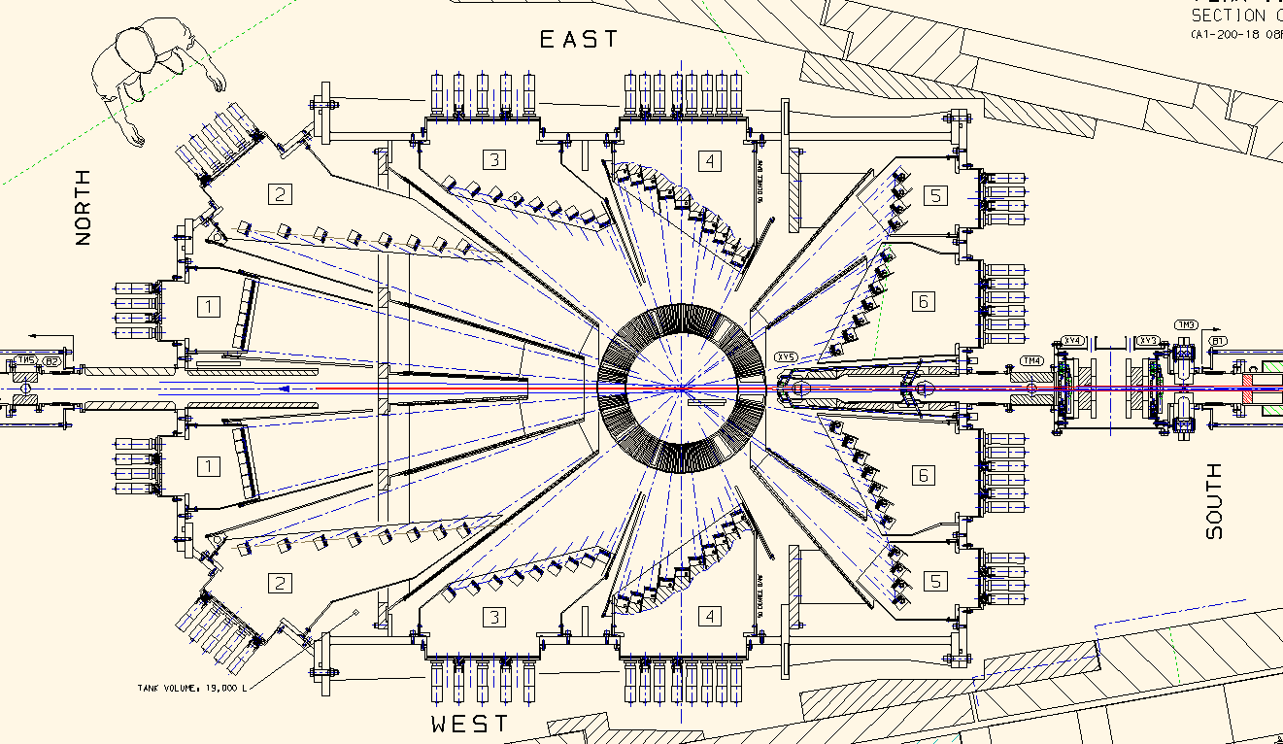

Slide 5
TS1 Project - simulation of complete diffraction pattern
standard powder (real data set available)
vanadium incoherent scattering sample
CeO₂ (ceria) powder
small unit cell, high symmetry (cubic) - minimise reflection overlap
annealed sample available - well defined line shape (no sample dependent broadening) (Kevin Knight)

Slide 6
Generate "normalised" diffraction pattern by dividing sample simulation by a vanadium simulation to remove λ-dependent incident flux intensity ("flat" background)
Simulated pattern has no absorption, multiple scattering or atomic thermal vibration ("temperature factors") corrections
Refine line shape parameters using LeBail method and extract FWHM

Slide 7
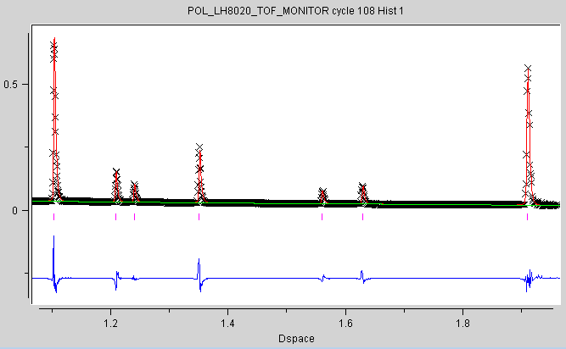
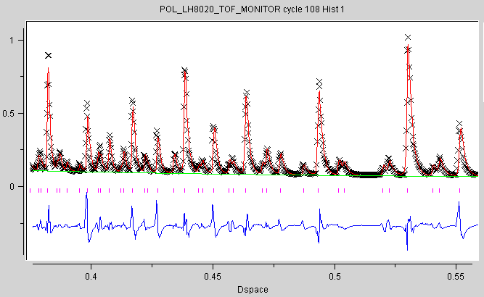

Slide 9
McStas Instrument (.inst) File
DEFINE INSTRUMENT POL(l_min, l_max, char* isisface)
DECLARE
%{
double emin, emax, L2, L1, mod_depth2, ttheta, phi, detpos_x, detpos_y, detpos_z;
%}
INITIALIZE
%{
emin=81.799/l_max/l_max;
emax=81.799/l_min/l_min;
phi=0.0;
L1=14.0;
mod_depth2=0.025;
L2=1.028;
ttheta=156.65;
detpos_x=L2*cos(phi*DEG2RAD)*sin(ttheta*DEG2RAD);
detpos_y=L2*sin(phi*DEG2RAD)*sin(ttheta*DEG2RAD);
detpos_z=L2*cos(ttheta*DEG2RAD);
%}
TRACE
COMPONENT define_origin = Arm()
AT (0, 0, 0) ABSOLUTE
COMPONENT Source = ViewModerator4(
Face = isisface, E0 = emin, E1 = emax, modZPos=0,
dist = L1, xw = 0.008, yh = 0.04
)
AT (0, 0, 0) RELATIVE define_origin
COMPONENT Sample = PowderN(
reflections = "CeO2_reflist.hkl",
format=Fullprof,
radius=0.004,
yheight=0.04,
d_phi=8.36)
AT (0, 0, L1) RELATIVE define_origin
COMPONENT SingleDetector = TOF_monitor(
tmin = 2000.0, tmax = 20000.0, nt = 18000, xwidth = 0.005,
yheight = 0.15,
filename="TOF_monitor_CeO2_pol_LH8020.txt")
AT (detpos_x,detpos_y,detpos_z) RELATIVE Sample
END
.
.
.
.
.
.
.
.
.
.
.
.
.
.
.
.
.
.
.
.
.
.
.
.
.
.
.
.
.
COMPONENT Sample = Incoherent(radius=0.004,
yheight = 0.04, pack = 1,
target_x=detpos_x,
target_y=detpos_y,
target_z=detpos_z,
focus_xw=0.005,focus_yh=0.15)
AT (0, 0, L1) RELATIVE define_origin
.
.
.
.
.
.
.
.

Slide 10
Diffraction works in wavelength
Neutron source (moderator) file
DEFINE INSTRUMENT POL(l_min, l_max, char* isisface)
DECLARE
%{
double emin, emax, L2, L1, mod_depth2, ttheta, phi, detpos_x, detpos_y, detpos_z;
%}
INITIALIZE
%{
emin=81.799/l_max/l_max;
emax=81.799/l_min/l_min;
phi=0.0;
L1=14.0;
mod_depth2=0.025;
L2=1.028;
ttheta=156.65;
detpos_x=L2*cos(phi*DEG2RAD)*sin(ttheta*DEG2RAD);
detpos_y=L2*sin(phi*DEG2RAD)*sin(ttheta*DEG2RAD);
detpos_z=L2*cos(ttheta*DEG2RAD);
%}
TRACE
COMPONENT define_origin = Arm()
AT (0, 0, 0) ABSOLUTE
McStas works in energy
ISIS instrument design places origin at centre of moderator
Detector position...
...and coordinates
(relative to sample)
Fixed point (Goran's instructions)

Slide 11
1st component in diffractometer: neutron source (moderator)
COMPONENT Source = ViewModerator4(
Face = isisface, E0 = emin, E1 = emax, modZPos=0,
dist = L1, xw = 0.008, yh = 0.04
)
AT (0, 0, 0) RELATIVE define_origin
Where are neutrons "created" in simulation?
moderator face
known distance along beamline

Slide 12
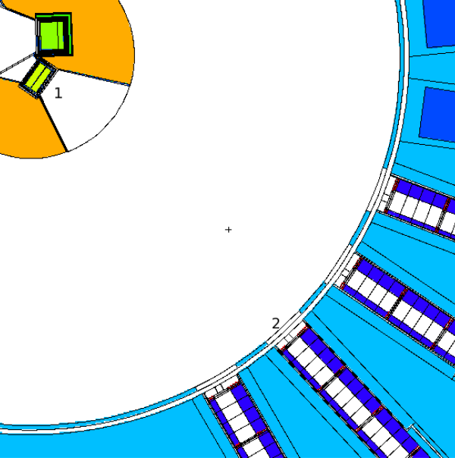
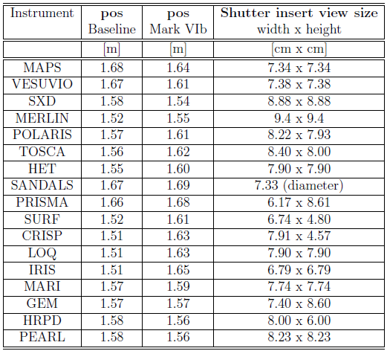
moderator face
insert collimation (~1.6m away) (TS1 project: target and moderator positions may change - insert won't)

Slide 13
Transport neutrons from moderator to sample position:
basic powder diffractometer (no neutron guide): easy...
define a window (width & height) at a chosen distance L from moderator face
L = 1610mm
fixed collimation
insert width/height
moderator width/ height
beam width/ height
L₀ = 14000mm
sample position
insert collimation

Slide 14
1. Neutrons start from moderator face:
COMPONENT Source = ViewModerator4(
Face = isisface, E0 = emin, E1 = emax, modZPos=0,
dist = L1, xw = 0.008, yh = 0.04
)
AT (0, 0, 0) RELATIVE define_origin
(note: ViewModerator4 component)
dist = Polaris primary flight path L1
xw, yh = diameter, height of sample

Slide 15
2. Neutrons start from collimation:
COMPONENT Source = ViewModerator3(
Face = isisface, E0 = emin, E1 = emax, modZPos=0.0,
dist = L1-pos1-0.005, xw = 0.008, yh = 0.04
)
AT (0, 0, pos1) RELATIVE define_origin
(note: ViewModerator3 component)
pos1 ~ 1.6m (distance from moderator face to collimation inside target station)
DIDN'T work...
tried all possible combinations of modZPos, pos1
ALWAYS produced wrong times-of-flight for known d-spacings

Slide 16
Moderator - beamlines don't view all the way to its edges
Insert - define Slit here to block neutrons from edge of moderator (placing Source here eliminates problem)
sample
Source at insert with "ideal" moderator size: penumbra on moderator
this may also affect beam divergence simulating instruments with neutron guides

Slide 17
2nd component in diffractometer: Sample (CeO₂ powder or V)
COMPONENT Sample = PowderN(
reflections = "CeO2_reflist.hkl",
format=Fullprof,
radius=0.004,
yheight=0.04,
d_phi=8.36)
AT (0, 0, L1) RELATIVE define_origin
reflections file is a list of Bragg reflection intensities and positions (sinθ/λ) (may be easily generated (e.g. GSAS, Fullprof,...)
radius and yheight match dimensions of window defined in Source component (ViewModerator4)
d_phi restricts scattered neutrons to ± d_phi/2 degrees out of xz plane (value calculated manually from detector height and L2)
scattering in 2θ is not restricted (a very large number of neutrons will miss the detector...)

Slide 18
COMPONENT Sample = Incoherent(radius=0.004,
yheight = 0.04, pack = 1,
target_x=detpos_x,
target_y=detpos_y,
target_z=detpos_z,
focus_xw=0.005,focus_yh=0.15)
AT (0, 0, L1) RELATIVE define_origin
radius and height of vanadium same as CeO₂ powder
scattering in 2θ and φ is directed only towards the detector (all neutrons reach the detector...)

Slide 19
In GSAS:
structure refinement of a real sample, or simulate a diffraction pattern
Results - Reflist - Option R generates file listing h, k, l, position (sinθ/λ) and F²_{obs} (fixed format - needs a bit of editing)
H K L M sth/lam TOF FWHM FoSq sig Fobs obs phase
1 1 1 8 0.159928123086.2871 66.4729 2.303E+04 1.00 0.000 1 0.000
2 0 0 6 0.184669019996.5625 55.9379 1.948E+04 1.00 0.000 1 0.000
2 2 0 12 0.261163214144.3125 39.2428 40.5 56.2 6.367 0 0.000
3 1 1 24 0.306241012063.7461 34.1804 3.46 6.01 1.861 0 0.000
2 2 2 8 0.319858311550.5078 33.3379 6.66 10.6 2.581 0 180.000
4 0 0 6 0.369340510003.9834 30.0329 40.8 58.5 6.391 0 0.000
3 3 1 24 0.4024795 9180.7734 28.1854 3.55 6.15 1.884 0 0.000
#radius 0.004
#h 0.04
#pack 1.0
#Vc 158.785
#sigma_a 0.63
#sigma_inc 0.003
#frac 0.0107
1 1 1 8 0.1599281 23086.2871 66.4729 2.303E+04 1.00
2 0 0 6 0.1846690 19996.5625 55.9379 1.948E+04 1.00
2 2 0 12 0.2611632 14144.3125 39.2428 40.5 56.2
3 1 1 24 0.3062410 12063.7461 34.1804 3.46 6.01
2 2 2 8 0.3198583 11550.5078 33.3379 6.66 10.6
4 0 0 6 0.3693405 10003.9834 30.0329 40.8 58.5
3 3 1 24 0.4024795 9180.7734 28.1854 3.55 6.15

Slide 20
3rd component in diffractometer: detector
COMPONENT SingleDetector = TOF_monitor(
tmin = 2000.0, tmax = 20000.0, nt = 18000,
xwidth = 0.005, yheight = 0.15,
filename="TOF_monitor_CeO2_pol_LH8020.txt")
AT (detpos_x,detpos_y,detpos_z) RELATIVE Sample
END
width and height set to typical detector pixel size
xyz coordinates relative to Sample position

Slide 21
Initially used TOFLog_monitor Component for detector
generates "logarithmic" bins (width = constant * tof)
matches resolution function in time of flight diffraction ( Δd = constant * d )
Rob Bewley running simulations in parallel (TOF_monitor Component): consistently sharper reflections (~10%)
use TOF_monitor instead and rebin simulated data for analysis (in OpenGenie...)
Large number of simulations
each with different moderator description (.McStas) files
almost all other parameters identical (λ_{min}, λ_{max}, no. of neutron events)
2 short Windows batch files written to simplify procedure

Slide 22
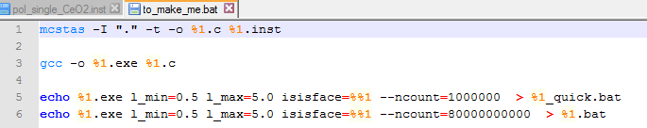
>> to_make_me <name of inst file>
(takes single parameter - the name of the .inst file)
launches McStas (to create C++ instrument code from .inst file)
compiles C++ code to generate executable file
write batch files to automatically run executable ("quick" and long)
>> pol_single_CeO2 <name of Source component.McStas file>
(takes single parameter - the name of the .mcstas file (target/moderator/beam port)
passes "soft wired" wavelength limits and number of events simulated
just need to give the .McStas file name

Slide 23
Rob Bewley simulation with latest Source components
COMPONENT Source = ViewModISISver1(
Face = "TS1verBase2016_LH8020_newVM-var_North07_Polaris.mcstas", E0 = emin, E1 = emax, dist = 14, xw = 0.008, yh = 0.04, modPosition=0,tally=8.4,modXsize=0.12,modZsize=0.12)
AT (0, 0, 0) RELATIVE define_origin
COMPONENT Jaws = Slit(
xmin = -0.04, xmax = 0.04,
ymin = -0.038, ymax = 0.038)
AT (0, 0, 1.64) RELATIVE define_origin
another ViewModerator component
specify size of moderator
Slit at Insert to block neutrons missing sample

Slide 24
"ring" detector (re-coded a 2d rectangular detector)
COMPONENT det156=TOF_monitor_ring(rad_inner=0.407-0.004, rad_outer=0.407+0.004,tmin=1000,tmax=20000,nt=2000, filename="det156.m" )
AT (0,0,-0.943) RELATIVE Sample
GROUP det_all
COMPONENT block1561=Beamstop(xmin=-0.32, xmax=0.32, ymin=-0.2, ymax=0.1)
AT (0,0.4,-0.93) RELATIVE Sample
GROUP det_all
COMPONENT block1562=Beamstop(xmin=-0.32, xmax=0.32, ymin=-0.1, ymax=0.2)
AT (0,-0.4,-0.93) RELATIVE Sample
GROUP det_all
follows Debye-Scherrer cone, in plane ⊥^{ar} to direction of incident beam (z)
use BeamStops to mask sections of cone not required (also d_phi Sample parameter)
GROUP components to re-use neutrons which miss one detector
(Note: Beamstop use above is incorrect...)

Slide 25
doesn't recreate how detectors are actually built (detector pixel face ⊥^{ar} to direction of scattered beam)
better at low and higher (backscattering) 2theta angles (and useless at 2theta = 90°)
Learn how to simulate this over the next 2 days...?

