Slide 1
MERLIN
MCSTAS model
ISIS Mcstas workshop 2017
26/4/17
Rob Bewley

Slide 2
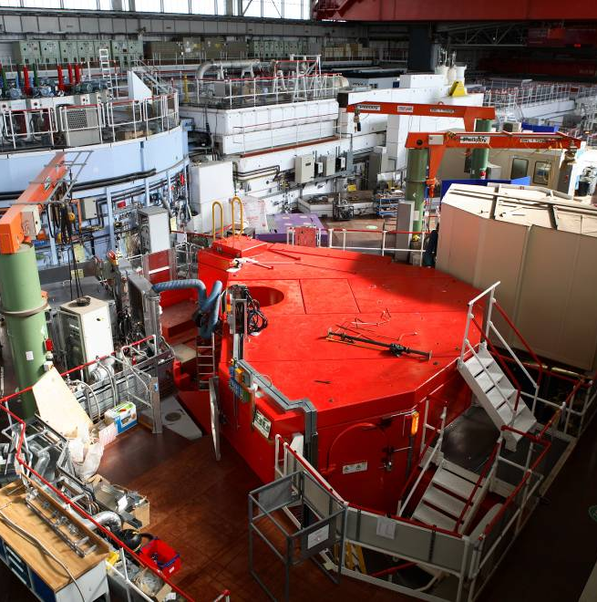
MERLIN
A direct geometry thermal neutron spectrometer

Slide 3
MAPS, MERLIN, MARI and LET all examples of direct geometry TOF spectrometers
sample
E_{i} fixed
Distance
t_{det}
Detectors
detectors
E_{F}
Advantages of Direct geometry;
Low backgrounds
Flexibility –flux↔resolution
Large fixed detector arrays
Sample
Fermi
Chopper
E_{i}
Nimonic
Chopper
Neutron path
Moderator
Time

Slide 4
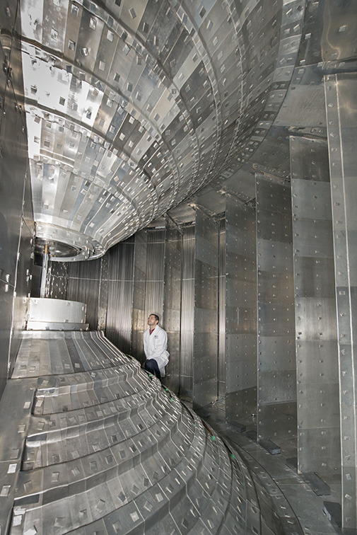
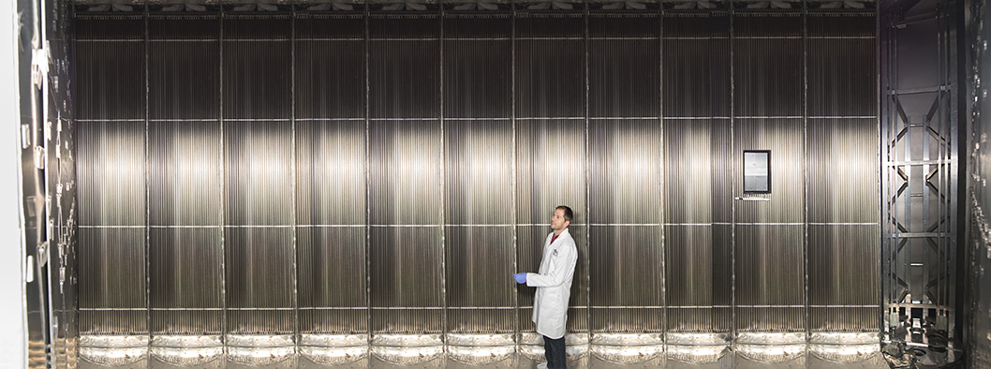
Direct geometry machines can have a very large area of position sensitive detector coverage
MERLIN and LET have π steradians solid angle
Great for mapping out the full 4D S(Q,w) mapping

Slide 5
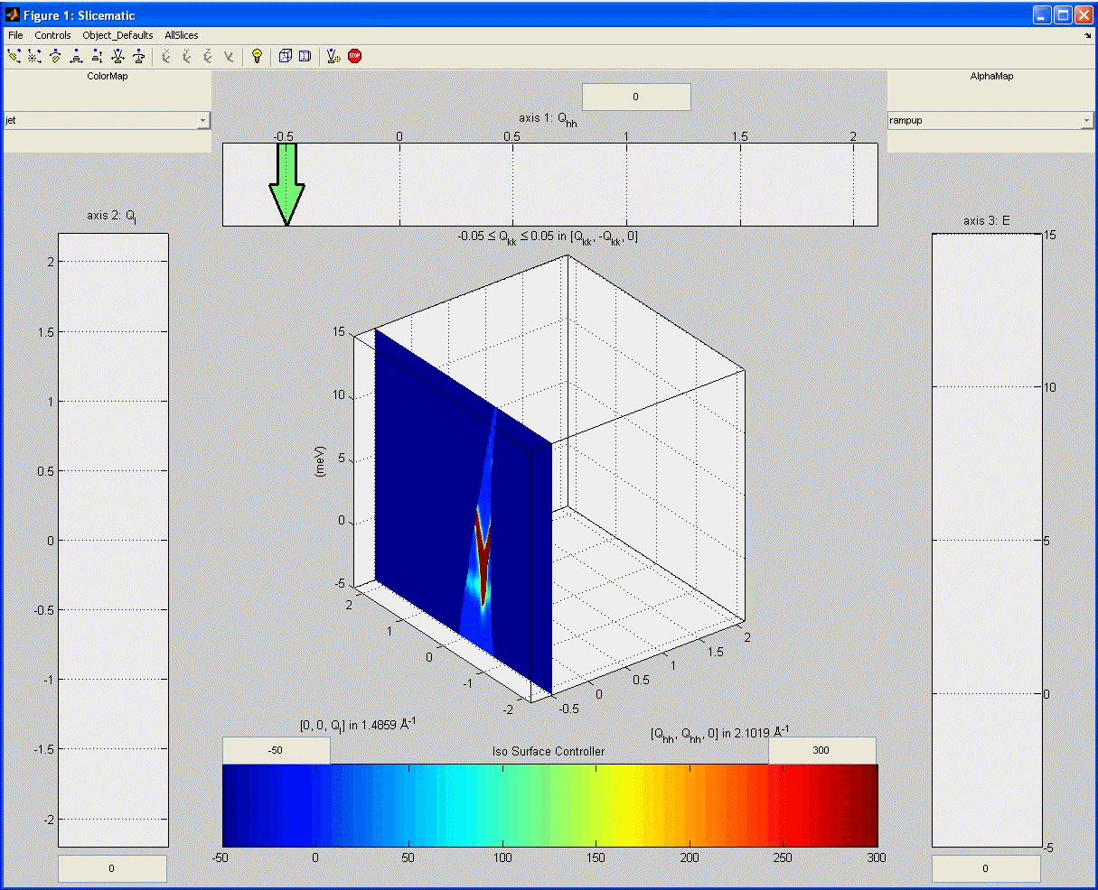
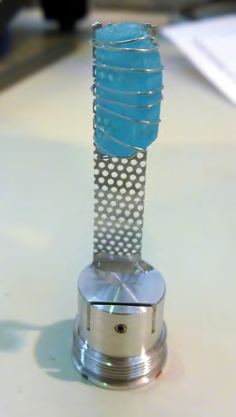
4D data sets
Most experiments on LET/MERLIN want to do HORACE scans (measure the full 4D Qx, Qy, Qz , E data set). V
Rotate-measure-rotate-measure
To build up 4D S(Q,w)

Slide 6
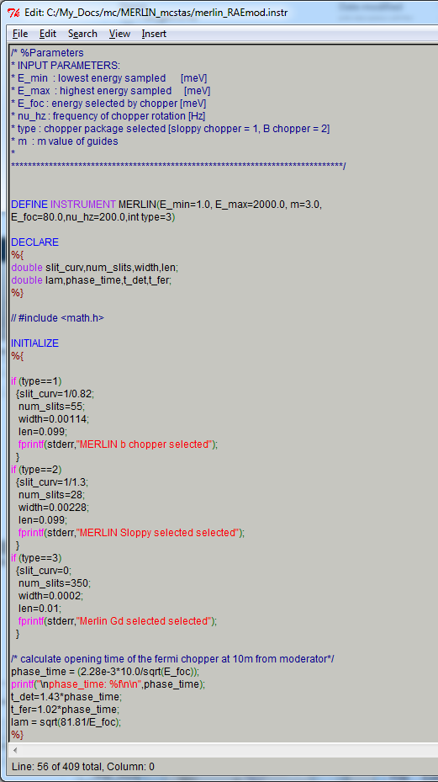
MERLIN.instr
Write comments at top
Remind myself what the input parameters are
/* %Parameters
* INPUT PARAMETERS:
* E_min : lowest energy sampled [meV]
* E_max : highest energy sampled [meV]
* E_foc : energy selected by chopper [meV]
* nu_hz : frequency of chopper rotation [Hz]
* type : chopper package selected [sloppy chopper = 1, B chopper = 2]
* m : m value of guides
*
*******************************************************************************/

Slide 7
MERLIN.INST
Define the instrument
The name of instrument and the input parameters
DEFINE INSTRUMENT MERLIN(E_min=1.0, E_max=2000.0, m=3.0,
E_foc=80.0,nu_hz=200.0,int type=3)

Slide 8
MERLIN.instr
Declare any variables used
DECLARE
%{
double slit_curv,num_slits,width,len;
double lam,phase_time,t_det,t_fer;
%}

Slide 9
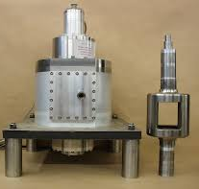
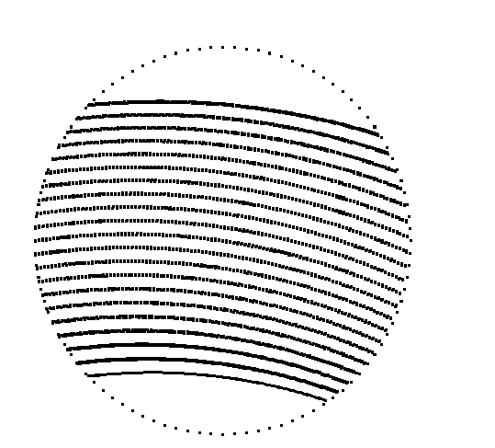
MERLIN.instr
Initialize
Here I define the Fermi chopper parameters depending on chopper package ‘type’ selected
INITIALIZE
%{
if (type==1)
{slit_curv=1/0.82;
num_slits=55;
width=0.00114;
len=0.099;
fprintf(stderr,"MERLIN b chopper selected");
}
if (type==2)
{slit_curv=1/1.3;
num_slits=28;
width=0.00228;
len=0.099;
fprintf(stderr,"MERLIN Sloppy selected selected");
}
if (type==3)
{slit_curv=0;
num_slits=350;
width=0.0002;
len=0.01;
fprintf(stderr,"Merlin Gd selected selected");
}

Slide 10
MERLIN.INST
Initialize
Define the opening time of fermi chopper
i.e time it should open to focus on energy E_foc
Also define a few other parameters
/* calculate opening time of the fermi chopper at 10m from moderator*/
phase_time = (2.28e-3*10.0/sqrt(E_foc));
printf("\nphase_time: %f\n\n",phase_time);
t_det=1.43*phase_time;
t_fer=1.02*phase_time;
lam = sqrt(81.81/E_foc);
%}

Slide 11
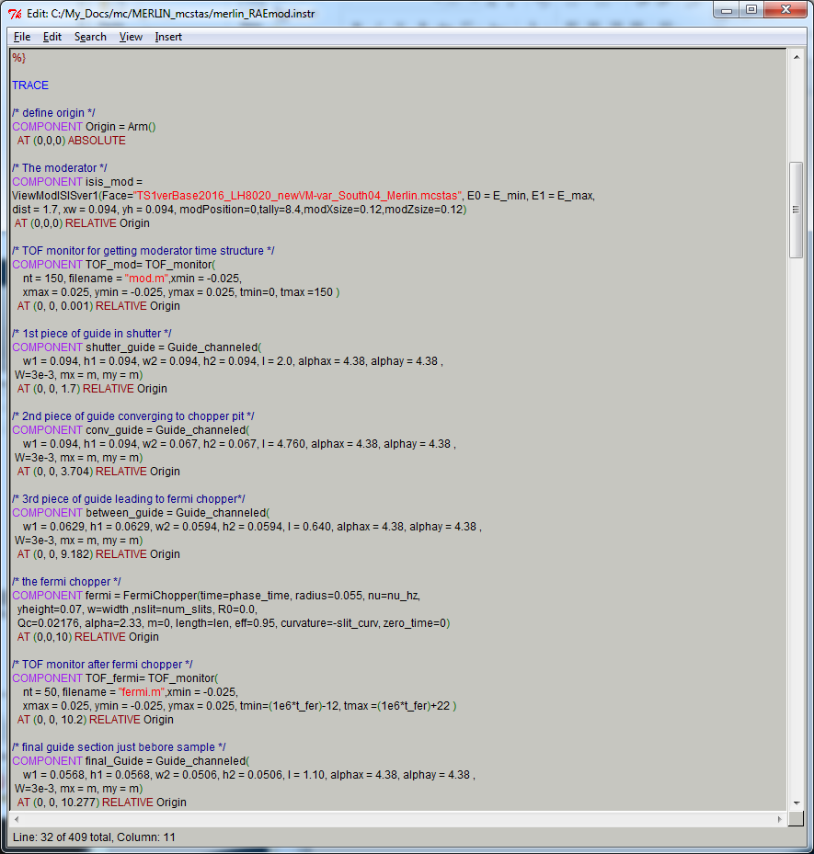
Trace is the start of the instrument components
Define an origin using the Arm()
component
TRACE
/* define origin */
COMPONENT Origin = Arm()
AT (0,0,0) ABSOLUTE

Slide 12
0
Moderator
1.7
Shutter guide
3.7
Converging guide
8.46
T0 chopper
9.18
Converging guide
9.82
10.0
10.27
Fermi chopper
Converging guide
11.37
11.80
sample
/* The moderator */
COMPONENT isis_mod =
ViewModISISver1(Face="TS1verBase2016_LH8020_newVM-var_South04_Merlin.mcstas", E0 = E_min, E1 = E_max,
dist = 1.7, xw = 0.094, yh = 0.094, modPosition=0,tally=8.4,modXsize=0.12,modZsize=0.12)
AT (0,0,0) RELATIVE Origin

Slide 13
0
Moderator
1.7
Shutter guide
3.7
Converging guide
8.46
T0 chopper
9.18
Converging guide
9.82
10.0
10.27
Fermi chopper
Converging guide
11.37
11.80
sample
COMPONENT TOF_mod= TOF_monitor(
nt = 150, filename = "mod.m",xmin = -0.025,
xmax = 0.025, ymin = -0.025, ymax = 0.025, tmin=0, tmax =150 )
AT (0, 0, 0.001) RELATIVE Origin

Slide 14
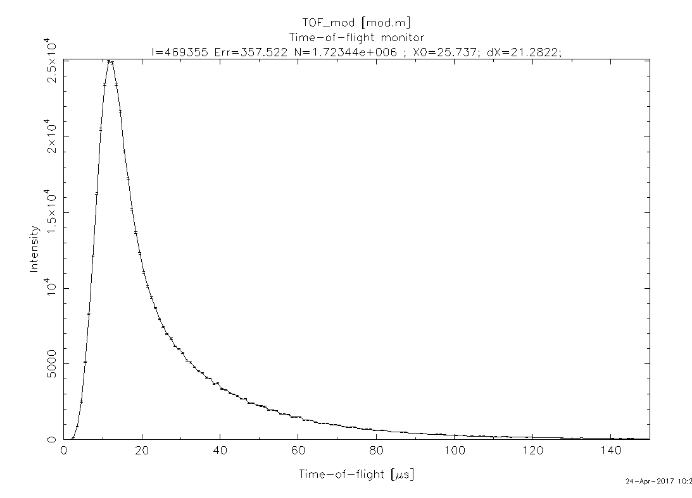
Getting the moderator term
Put E_min just below E_max
Example below E_min=79 Emax= 80 so have moderator shape for 80 meV neutrons

Slide 15
0
Moderator
1.7
Shutter guide
3.7
Converging guide
8.46
T0 chopper
9.18
Converging guide
9.82
10.0
10.27
Fermi chopper
Converging guide
11.37
11.80
sample
COMPONENT shutter_guide = Guide_channeled(
w1 = 0.094, h1 = 0.094, w2 = 0.094, h2 = 0.094, l = 2.0, alphax = 4.38, alphay = 4.38 ,
W=3e-3, mx = m, my = m)
AT (0, 0, 1.7) RELATIVE Origin

Slide 16
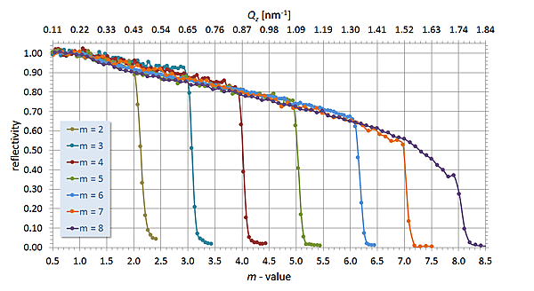
* INPUT PARAMETERS:
*
* w1: (m) Width at the guide entry
* h1: (m) Height at the guide entry
* w2: (m) Width at the guide exit
* h2: (m) Height at the guide exit
* l: (m) Length of guide
* d: (m) Thickness of subdividing absorbing walls
* nslit: (1) Number of channels in the guide (>= 1)
* R0: (1) Low-angle reflectivity
* Qc: (AA-1) Critical scattering vector
* alpha: (AA) Slope of reflectivity
* m: (1) m-value of material. Zero means completely absorbing.
* W: (AA-1) Width of supermirror cut-off for all mirrors
* Qcx: (AA-1) Critical scattering vector for left and right vertical mirrors in each channel
* Qcy: (AA-1) Critical scattering vector for top and bottom mirrors
* alphax: (AA) Slope of reflectivity for left and right vertical mirrors in each channel
* alphay: (AA) Slope of reflectivity for top and bottom mirrors
* mx: (1) m-value of material for left and right vertical mirrors in each channel. Zero means completely absorbing.
* my: (1) m-value of material for top and bottom mirrors. Zero means completely absorbing.

Slide 17
0
Moderator
1.7
Shutter guide
3.7
Converging guide
8.46
T0 chopper
9.18
Converging guide
9.82
10.0
10.27
Fermi chopper
Converging guide
11.37
11.80
sample
COMPONENT conv_guide = Guide_channeled(
w1 = 0.094, h1 = 0.094, w2 = 0.067, h2 = 0.067, l = 4.760, alphax = 4.38, alphay = 4.38 ,
W=3e-3, mx = m, my = m)
AT (0, 0, 3.704) RELATIVE Origin

Slide 18
0
Moderator
1.7
Shutter guide
3.7
Converging guide
8.46
T0 chopper
9.18
Converging guide
9.82
10.0
10.27
Fermi chopper
Converging guide
11.37
11.80
sample
COMPONENT between_guide = Guide_channeled(
w1 = 0.0629, h1 = 0.0629, w2 = 0.0594, h2 = 0.0594, l = 0.640, alphax = 4.38, alphay = 4.38 ,
W=3e-3, mx = m, my = m)
AT (0, 0, 9.182) RELATIVE Origin

Slide 19
0
Moderator
1.7
Shutter guide
3.7
Converging guide
8.46
T0 chopper
9.18
Converging guide
9.82
10.0
10.27
Fermi chopper
Converging guide
11.37
11.80
sample
COMPONENT fermi = FermiChopper(time=phase_time, radius=0.055, nu=nu_hz,
yheight=0.07, w=width ,nslit=num_slits, R0=0.0,
Qc=0.02176, alpha=2.33, m=0, length=len, eff=0.95, curvature=-slit_curv, zero_time=0)
AT (0,0,10) RELATIVE Origin

Slide 20
0
Moderator
1.7
Shutter guide
3.7
Converging guide
8.46
T0 chopper
9.18
Converging guide
9.82
10.0
10.27
Fermi chopper
Converging guide
11.37
11.80
sample
COMPONENT TOF_fermi= TOF_monitor(
nt = 50, filename = "fermi.m",xmin = -0.025,
xmax = 0.025, ymin = -0.025, ymax = 0.025, tmin=(1e6*t_fer)-12, tmax =(1e6*t_fer)+22 )
AT (0, 0, 10.2) RELATIVE Origin

Slide 21
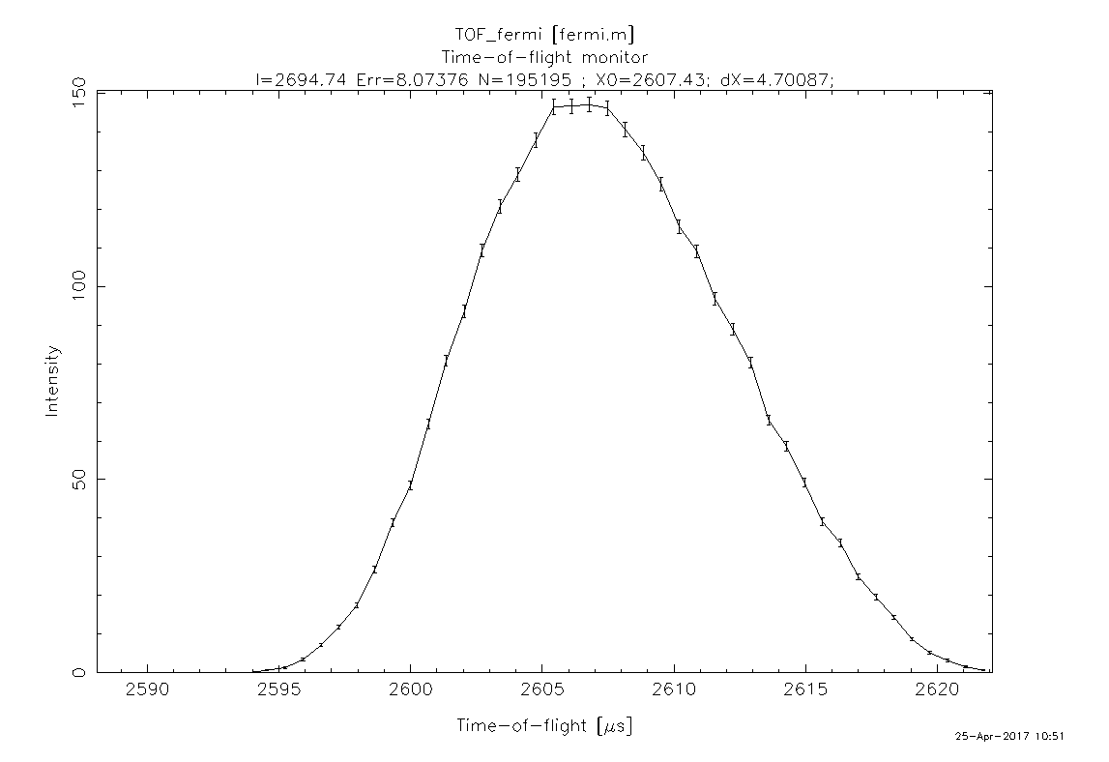
TOF fermi
Use monitors down your beam line to check things are as they should be
E_foc = 80mev λ =1.01Ǻ time= 252.82 x L x λ = 2607 us

Slide 22
0
Moderator
1.7
Shutter guide
3.7
Converging guide
8.46
T0 chopper
9.18
Converging guide
9.82
10.0
10.27
Fermi chopper
Converging guide
11.37
11.80
sample
COMPONENT final_Guide = Guide_channeled(
w1 = 0.0568, h1 = 0.0568, w2 = 0.0506, h2 = 0.0506, l = 1.10, alphax = 4.38, alphay = 4.38 ,
W=3e-3, mx = m, my = m)
AT (0, 0, 10.277) RELATIVE Origin

Slide 23
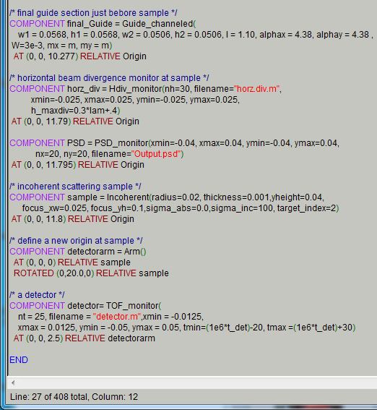
0
Moderator
1.7
Shutter guide
3.7
Converging guide
8.46
T0 chopper
9.18
Converging guide
9.82
10.0
10.27
Fermi chopper
Converging guide
11.37
11.80
sample
COMPONENT horz_div = Hdiv_monitor(nh=30, filename="horz.div.m",
xmin=-0.025, xmax=0.025, ymin=-0.025, ymax=0.025,
h_maxdiv=0.3*lam+.4)
AT (0, 0, 11.79) RELATIVE Origin

Slide 24
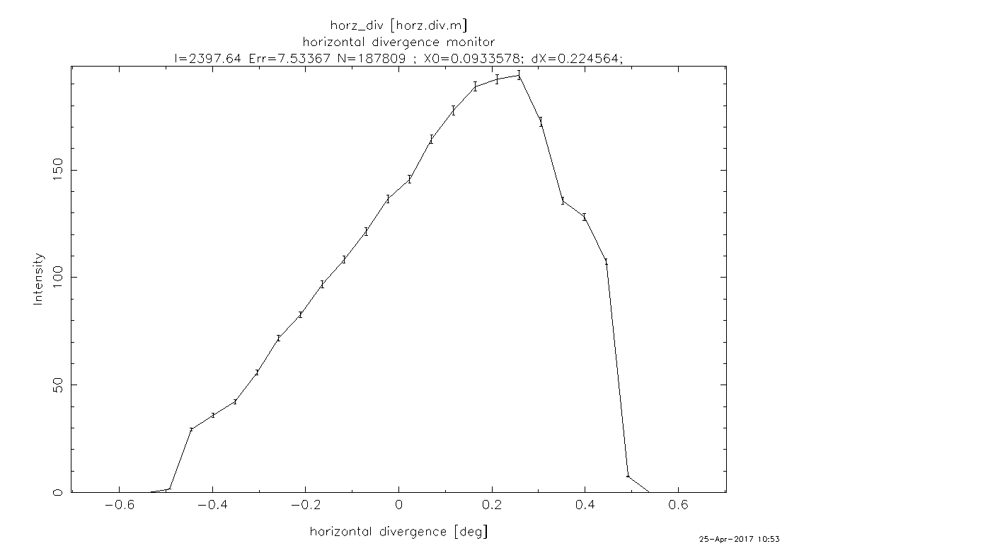
Horizontal divergence

Slide 25
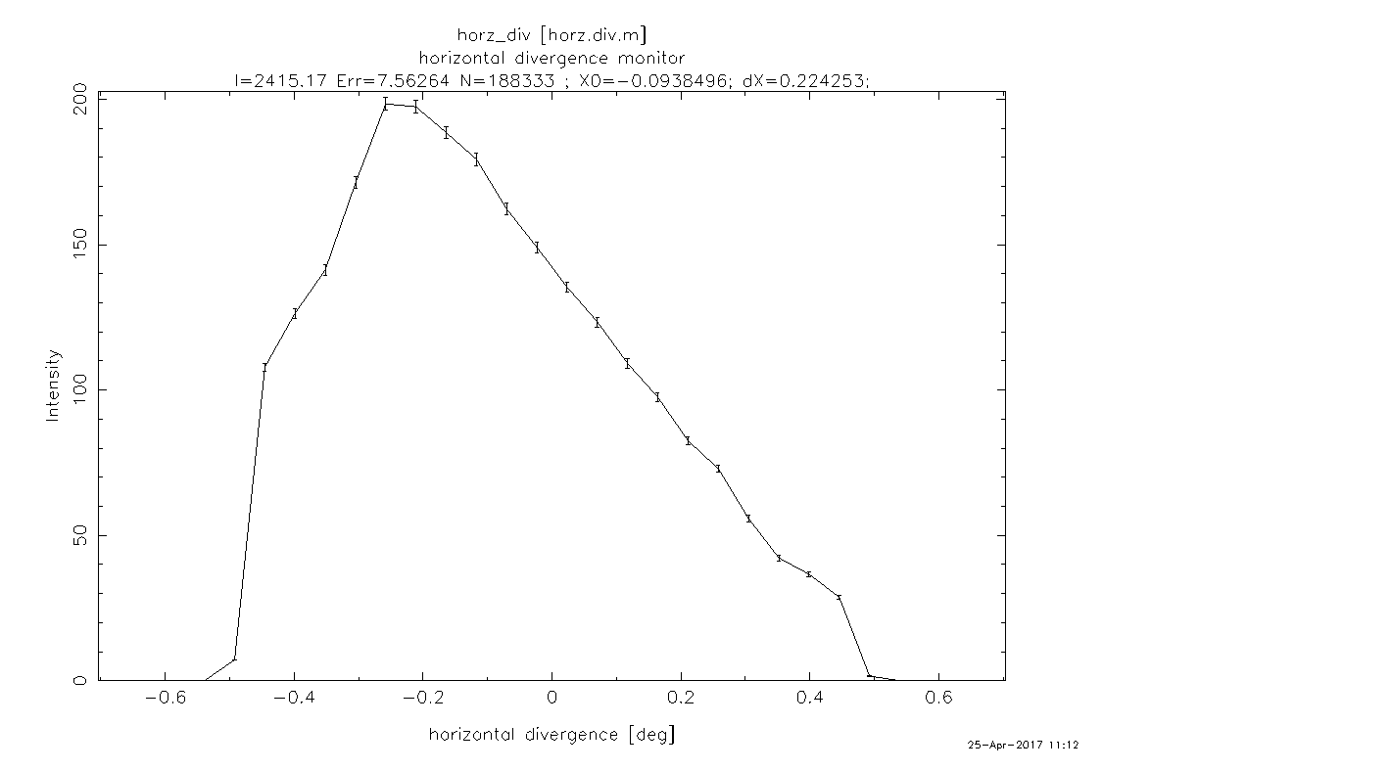
Reverse direction of fermi chopper
COMPONENT fermi = FermiChopper(time=phase_time, radius=0.055, nu=-nu_hz,
yheight=0.07, w=width ,nslit=num_slits, R0=0.0,
Qc=0.02176, alpha=2.33, m=0, length=len, eff=0.95, curvature=-slit_curv, zero_time=0)
AT (0,0,10) RELATIVE Origin

Slide 26
0
Moderator
1.7
Shutter guide
3.7
Converging guide
8.46
T0 chopper
9.18
Converging guide
9.82
10.0
10.27
Fermi chopper
Converging guide
11.37
11.80
sample
COMPONENT PSD = PSD_monitor(xmin=-0.04, xmax=0.04, ymin=-0.04, ymax=0.04,
nx=20, ny=20, filename="Output.psd")
AT (0, 0, 11.795) RELATIVE Origin

Slide 27
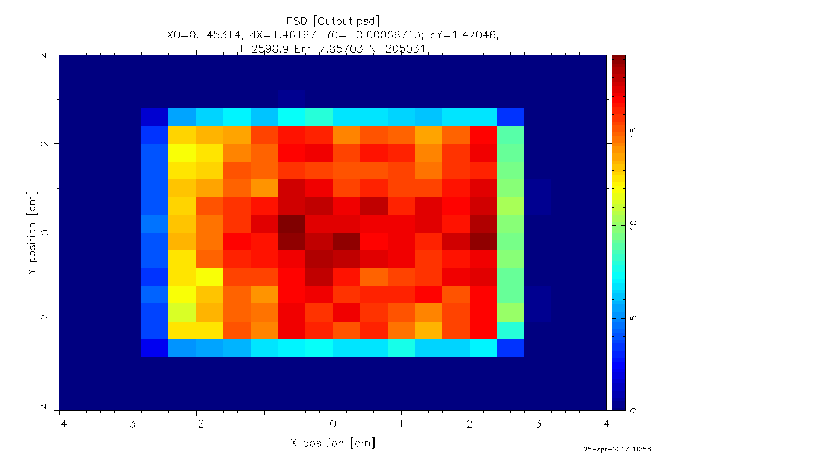
Check for smooth homogeneous beam
With guides and gaps/apertures can get
a structured beam

Slide 28
0
Moderator
1.7
Shutter guide
3.7
Converging guide
8.46
T0 chopper
9.18
Converging guide
9.82
10.0
10.27
Fermi chopper
Converging guide
11.37
11.80
sample
COMPONENT sample = Incoherent(radius=0.02, thickness=0.001,yheight=0.04,
focus_xw=0.025, focus_yh=0.1,sigma_abs=0.0,sigma_inc=100, target_index=2)
AT (0, 0, 11.8) RELATIVE Origin

Slide 29
0
Moderator
1.7
Shutter guide
3.7
Converging guide
8.46
T0 chopper
9.18
Converging guide
9.82
10.0
10.27
Fermi chopper
Converging guide
11.37
11.80
sample
COMPONENT detectorarm = Arm()
AT (0, 0, 0) RELATIVE sample
ROTATED (0,20.0,0) RELATIVE sample

Slide 30
0
Moderator
1.7
Shutter guide
3.7
Converging guide
8.46
T0 chopper
9.18
Converging guide
9.82
10.0
10.27
Fermi chopper
Converging guide
11.37
11.80
sample
COMPONENT detector= TOF_monitor(
nt = 25, filename = "detector.m",xmin = -0.0125,
xmax = 0.0125, ymin = -0.05, ymax = 0.05, tmin=(1e6*t_det)-20, tmax =(1e6*t_det)+30)
AT (0, 0, 2.5) RELATIVE detectorarm

Slide 31
Check instrument looks okay

Slide 32
SIMULATIONS solved a mystery on MERLIN
Views its own water moderator centrally poisoned

Slide 33
Resolution worse than it should be at detector ?
Ei=29 meV Fermi at 600Hz

Slide 34
Ei=29 meV Fermi at 600Hz

Slide 35
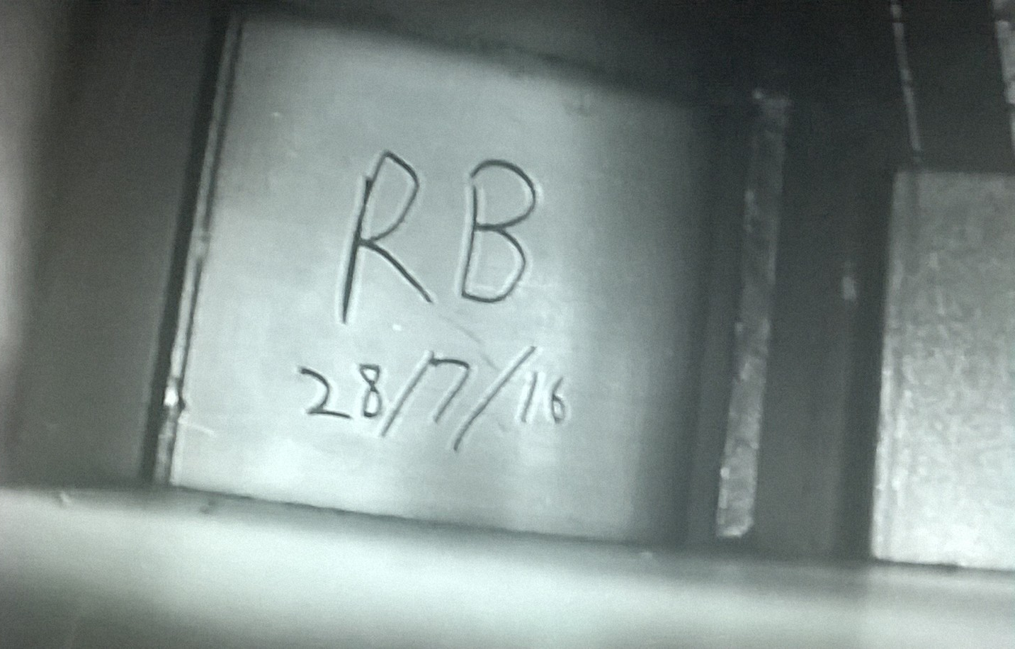
Put new moderator in – I even signed it

Slide 36
Mystery solved -The moderator had no poisoning in it !!
Ei=29 meV Fermi at 600Hz
Mcstas can really help finding problems

Slide 37
Absolute flux at sample position
The way I do it!!
1) Put a wavelength monitor at the sample position with a 1cm2 area, with a 0 to 10Ǻ range with 100 bins (0.1 Ǻ bins)
COMPONENT det_lmon = L_monitor(xmin=-0.005, xmax=0.005,
ymin=-0.005, ymax=0.005, nL=100, filename="det_Lmon.m", Lmin=0.0, Lmax=10)
AT (0,0,11.74) RELATIVE Origin
2) Simulation will give counts per second per bin in monitor for a 1 µamp beam current
3) Multiply simulation output by uamp current (40 TS2 or 160 TS1) and factor of 10 to give counts/cm2.s. Ǻ

Slide 38
Find simulation is often approx. 2 x measured
Mari spectrometer
Gem diffractometer

