Slide 1
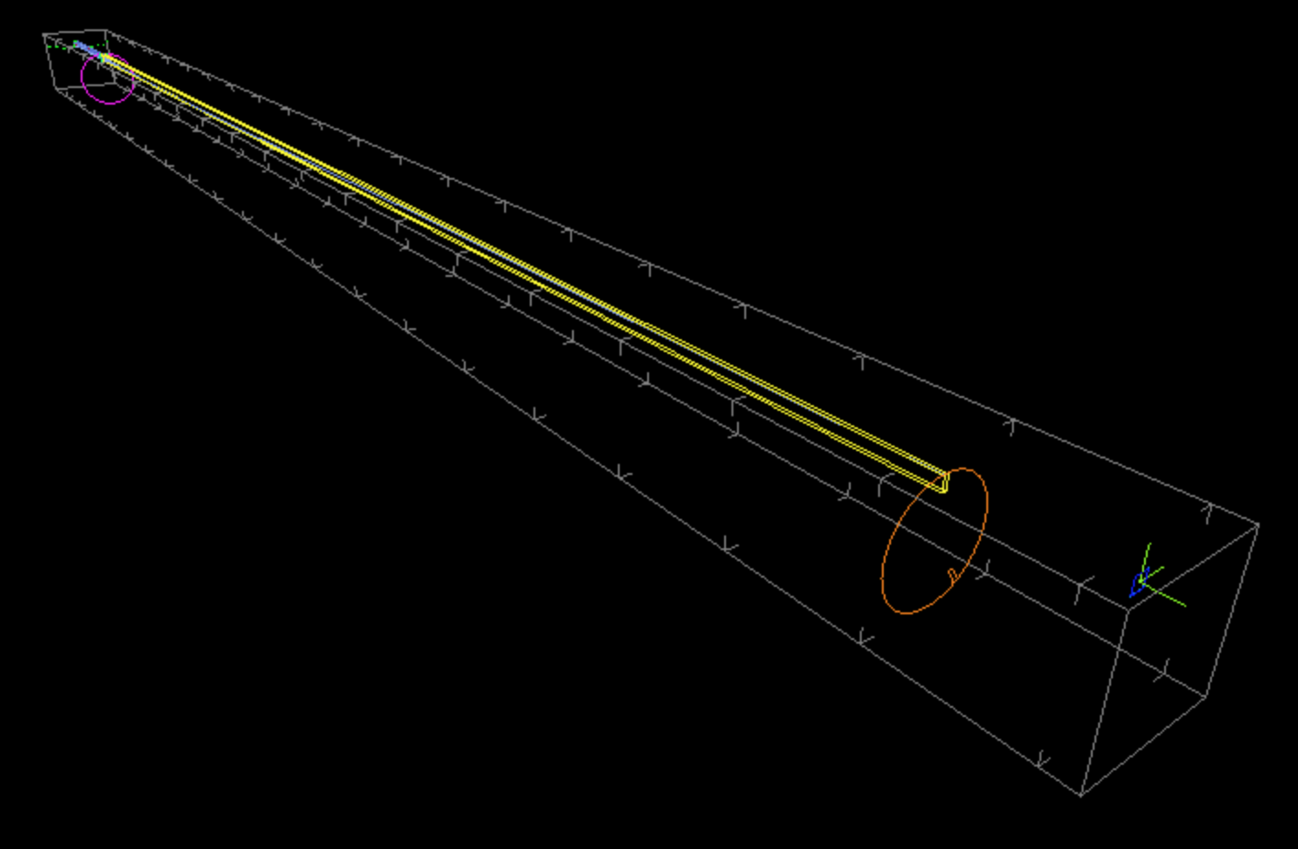
  Exercise 3:
Build yourself a simple TOF instrument!

Slide 2
  Exercise 3:
Build yourself a simple TOF instrument!
ISIS_moderator
2 Disk_chopper’s
Straight m=2
neutron guide
monitors

Slide 3
Start by inserting a source
Define wavelength band 0.1-10 Å
Focus at rectangle 3 x 10 cm @ 2m
COMPONENT isis_moderator = ISIS_moderator(
Emin=0,
Emax=0,
dist=2.0,
Lmin=0.1,
Lmax=10,
target_index=0,
focus_xw=0.03,
focus_yh=0.1)
AT (0, 0, 0) RELATIVE PREVIOUS

Slide 4
Next, insert a set of monitors at the 2m beamport position
COMPONENT PSDsource = PSD_monitor(
filename="PSDsource")
AT (0, 0, 2) RELATIVE isis_moderator
COMPONENT TOFLsource = TOFLambda_monitor(
nL=128,
tmin=0,
tmax=5000,
filename="TOFLsource",
Lmin=0.1,
Lmax=10)
AT (0, 0, 0) RELATIVE PREVIOUS

Slide 5
… and a first chopper
Notice the use of the flag
  WHEN(choppers)
  - so define an input parameter “choppers” to control if choppers are in or out
Also define the input parameter nu
See next page
COMPONENT Disk1 = DiskChopper(radius=0.4, yheight=0.12,
nu=nu, nslit=1, theta_0=5,
delay=ttarget1)
WHEN (choppers) AT (0,0,0.0001) RELATIVE PREVIOUS

Slide 6
… and a first chopper
Calculate the needed ttarget1 chopper phase for selecting 2 Å neutrons using either
  Pocket calculator
  the DEFINE & INITIALIZE sections
  (hint: the constant AA2MS can be used to convert from k [Å⁻¹] to v [m/s])
Insert another set of monitors after the DiskChopper, remember new filenames for the output

Slide 7
Now a guide…
Insert a 17 m straight m=2 guide
Define an input parameter to control if the guide is in or out
COMPONENT guide = Guide(
w1=0.03,
h1=0.10,
w2=0.03,
h2=0.10,
l=17)
WHEN(guide) AT (0, 0, 0.0001) RELATIVE PREVIOUS

Slide 8
Another chopper…
Define a ttarget2 chopper phase for correctly selecting 2Å neutrons
Put a second DiskChopper and sandwich it in sets of monitors like before.
Visualise the instrument using
  mcdisplay-pyqtgraph
  mcdisplay-webgl
  mcdisplay-pyqtgraph --tof
  - and ensure all looks OK

Slide 9
Run simulations to
See that you are in fact selecting 2Å neutrons
Compare intensities with and without guide, with and without choppers
Optionally insert a PowderN sample and a cylindrical TOF monitor - find the relevant parameters using the documentation tools.

