Slide 1
McStas Documentation and help sources
Help resources
McStas website
The manual(s)
mcdoc
Mailing list + archive
Github site
The examples catalogue

Slide 2
McStas Documentation and help sources
Help resources prioritized
mcdoc
The examples catalogue
The manual(s)
McStas website
Github site
Mailing list + archive

Slide 3
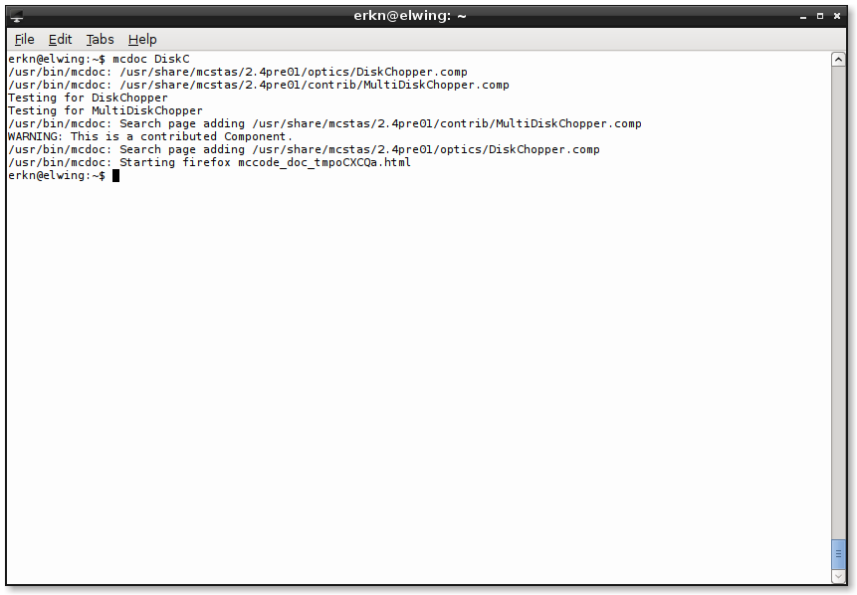
mcdoc
In a terminal:

Slide 4
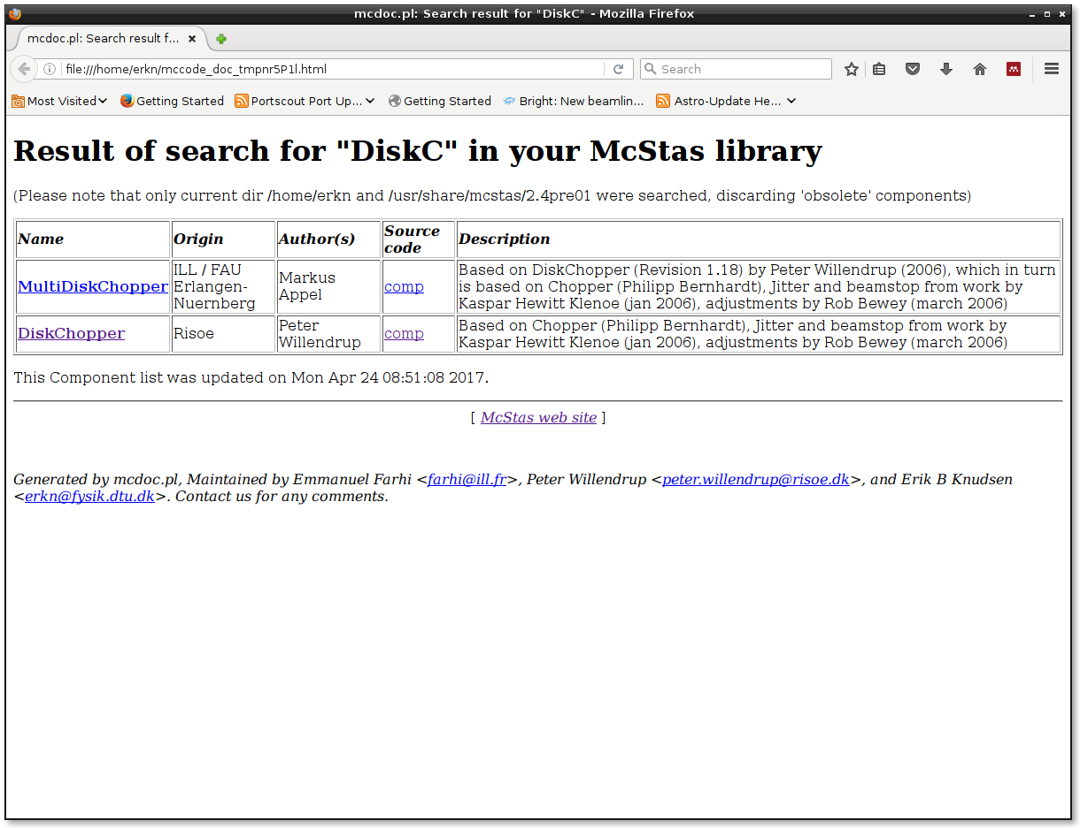
mcdoc
In a terminal

Slide 5
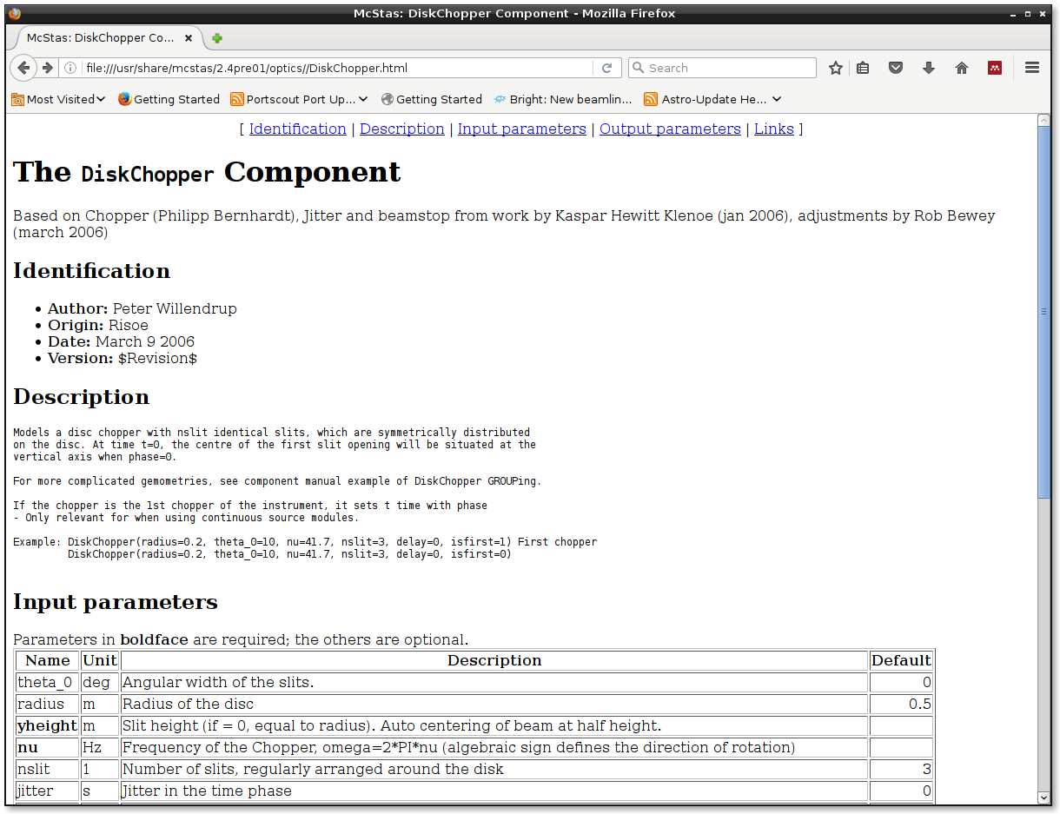
mcdoc
In a terminal

Slide 6
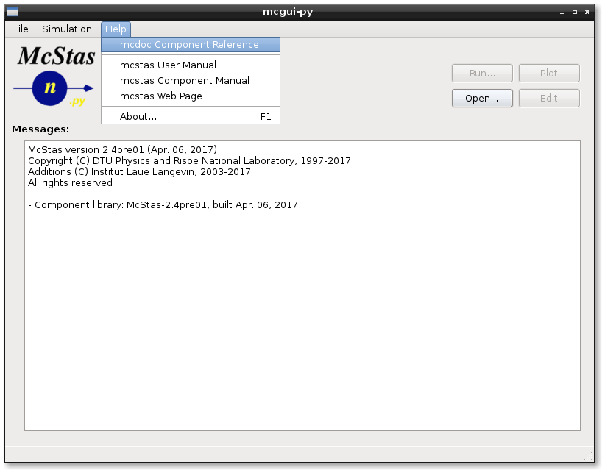
mcdoc
From the GUI

Slide 7
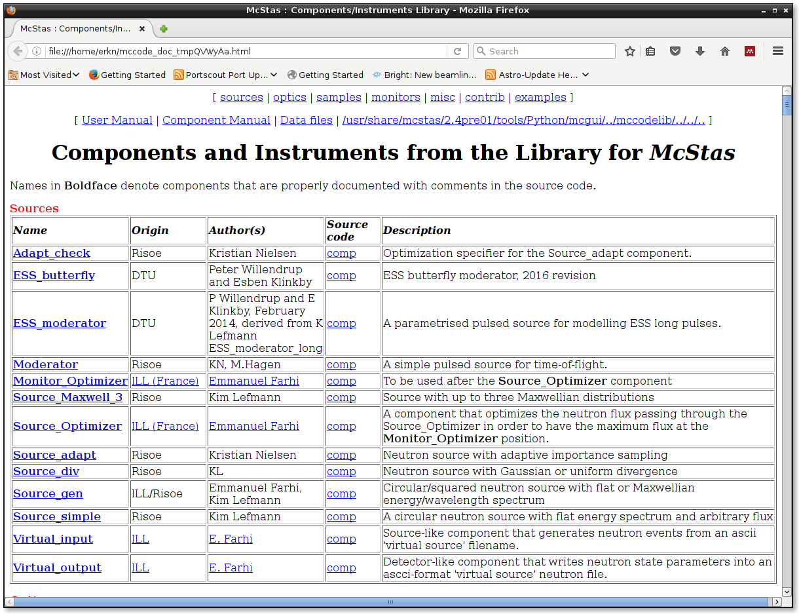
mcdoc
From the GUI

Slide 8
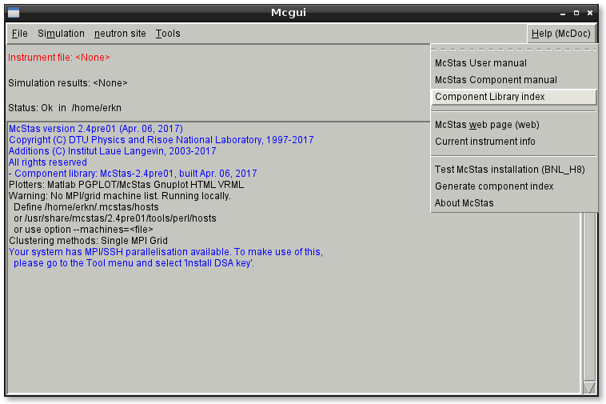
mcdoc
From the old GUI

Slide 9
mcdoc
...but let me show you instead

Slide 10
Examples Directory
Simple grep →
370 examples of Monitor_nD
51 examples of Source_gen
10 examples of ISIS_moderator
10 examples of Single_crystal
Unix/Linux:
grep ISIS_moderator /usr/share/mcstas/2.4pre01/examples/*

Slide 11
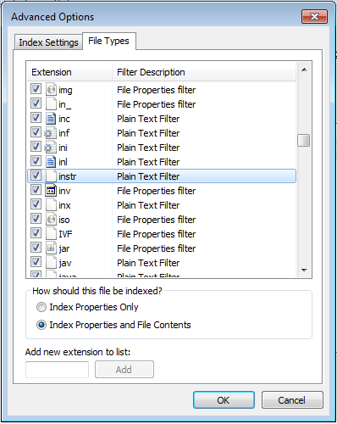
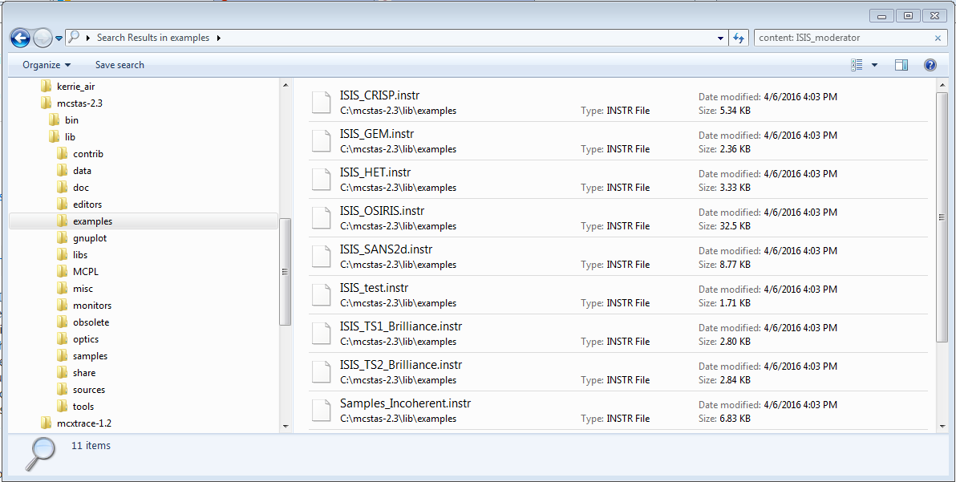
Examples Directory
Windows 7: Edit search settings first to search contents of .instr files
Simple grep →
370 examples of Monitor_nD
51 examples of Source_gen
10 examples of ISIS_moderator
10 examples of Single_crystal
Unix/Linux:
grep ISIS_moderator /usr/share/mcstas/2.4pre01/examples/*

Slide 12
Examples Directory
Windows 7: Edit search settings first to search contents of .instr files
Simple grep →
370 examples of Monitor_nD
51 examples of Source_gen
10 examples of ISIS_moderator
10 examples of Single_crystal
Unix/Linux:
grep ISIS_moderator /usr/share/mcstas/2.4pre01/examples/*

Slide 13
Examples Directory
Simple grep →
370 examples of Monitor_nD
51 examples of Source_gen
10 examples of ISIS_moderator
10 examples of Single_crystal
They have an author name!
For instance:
ISIS_CRISP → R. Dalgliesh
SE_example → me (E. Knudsen)

Slide 14
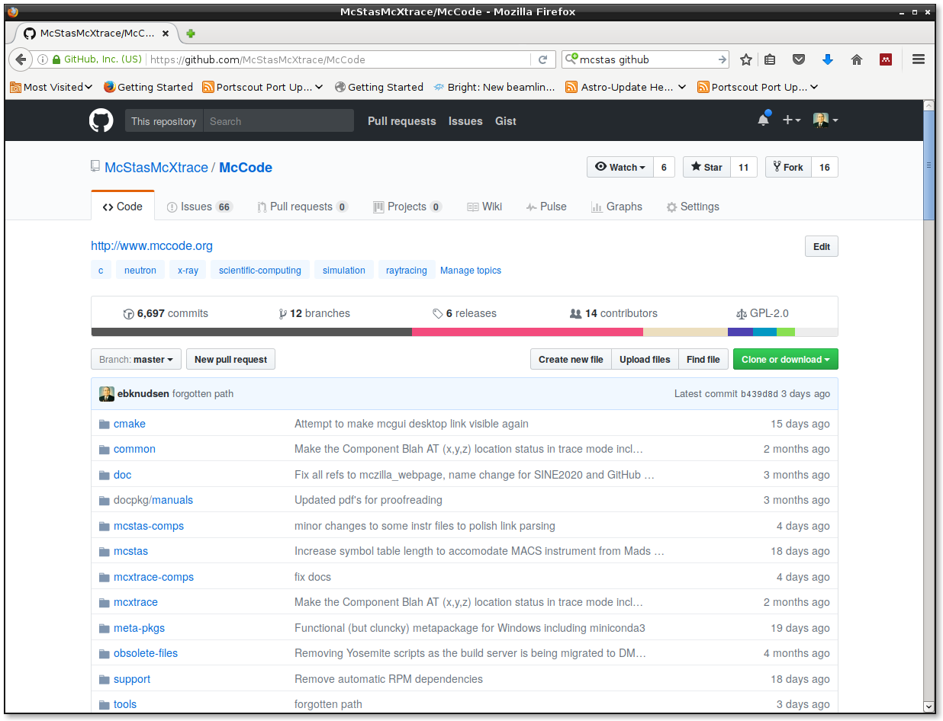
GitHub.com
https://github.com/McStasMcXtrace/McCode

Slide 15
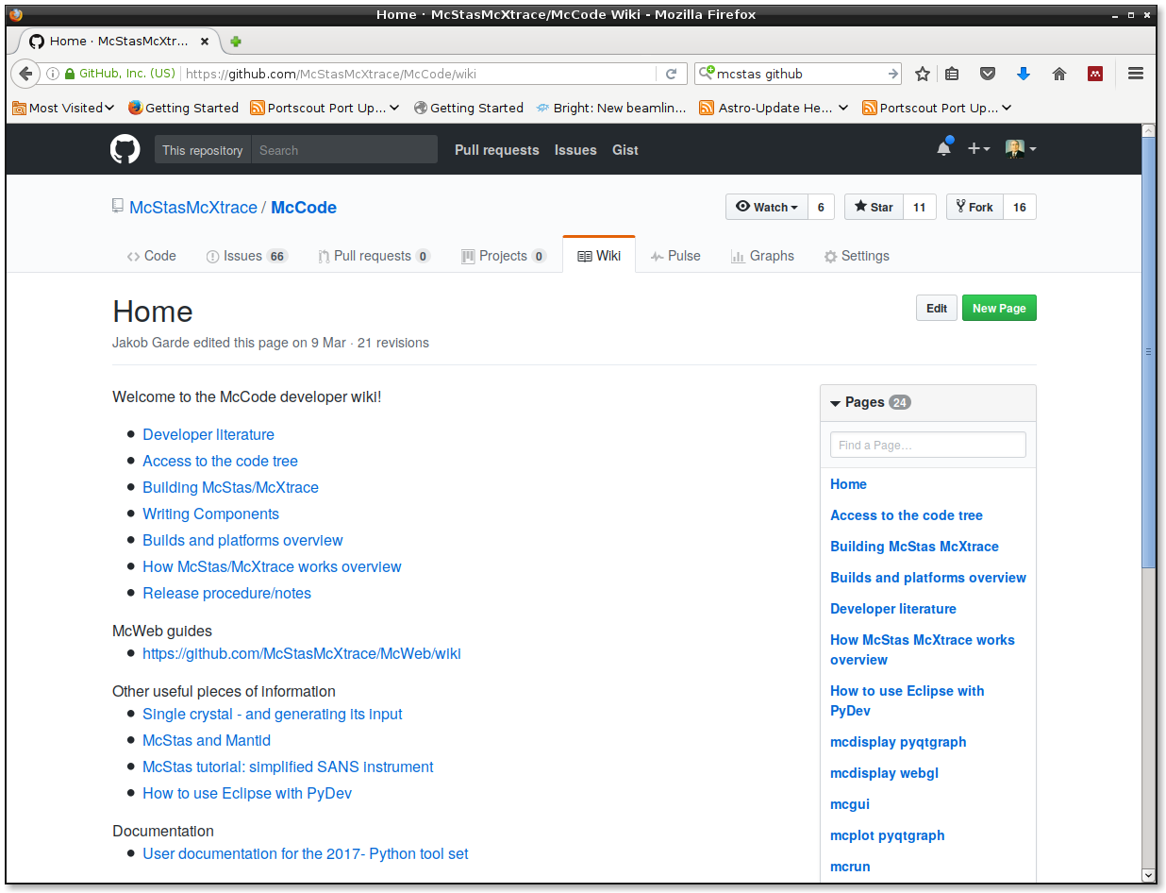
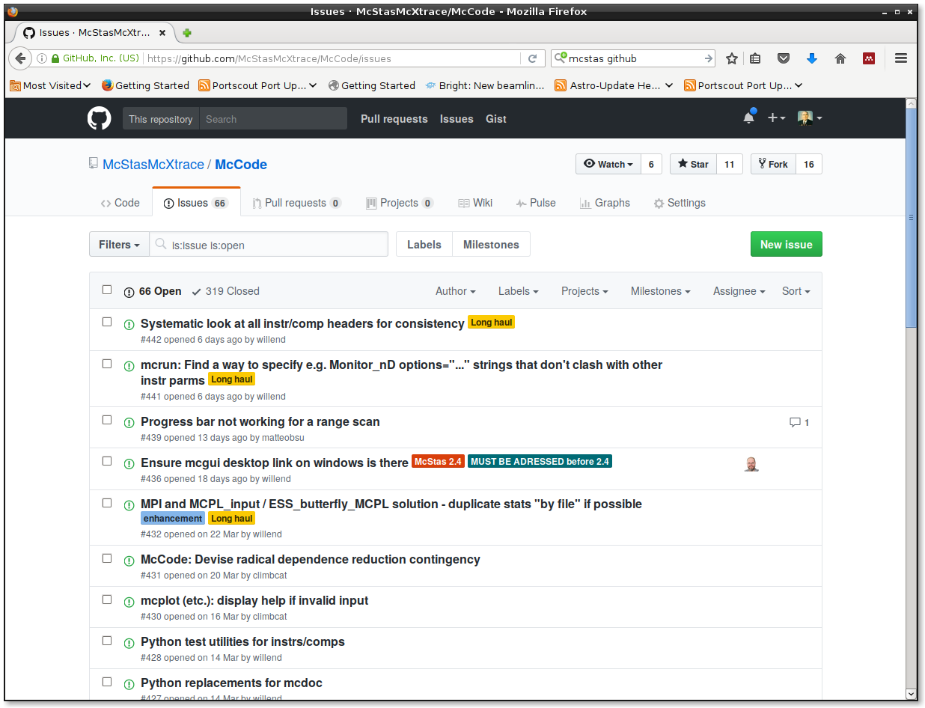
GitHub.com: wiki
Mostly developer oriented docs so far
https://github.com/McStasMcXtrace/McCode

Slide 16
GitHub.com: Issue Tracker
https://github.com/McStasMcXtrace/McCode

Slide 17
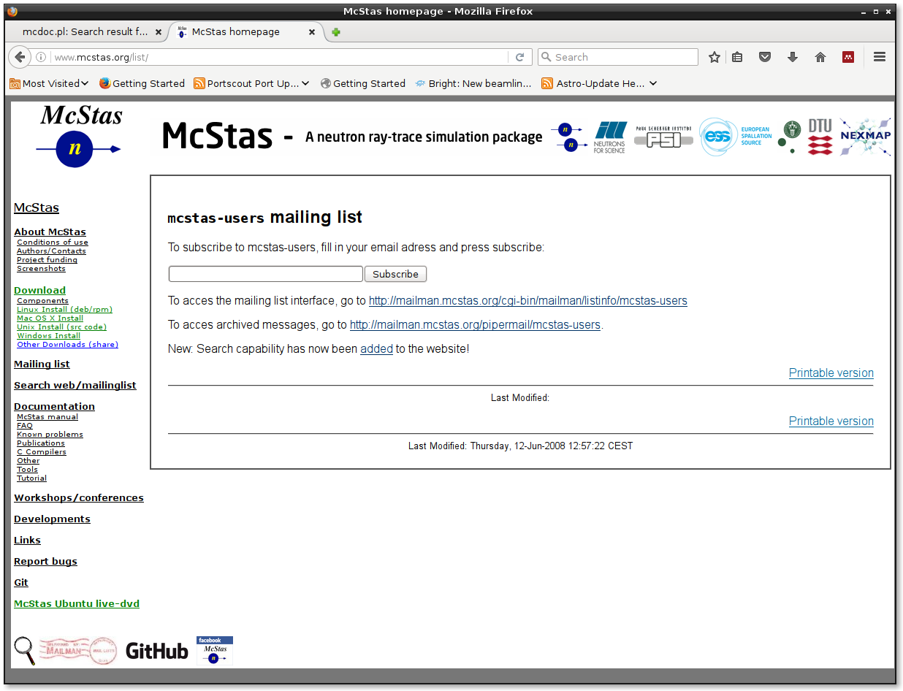
Mailing List

Slide 18
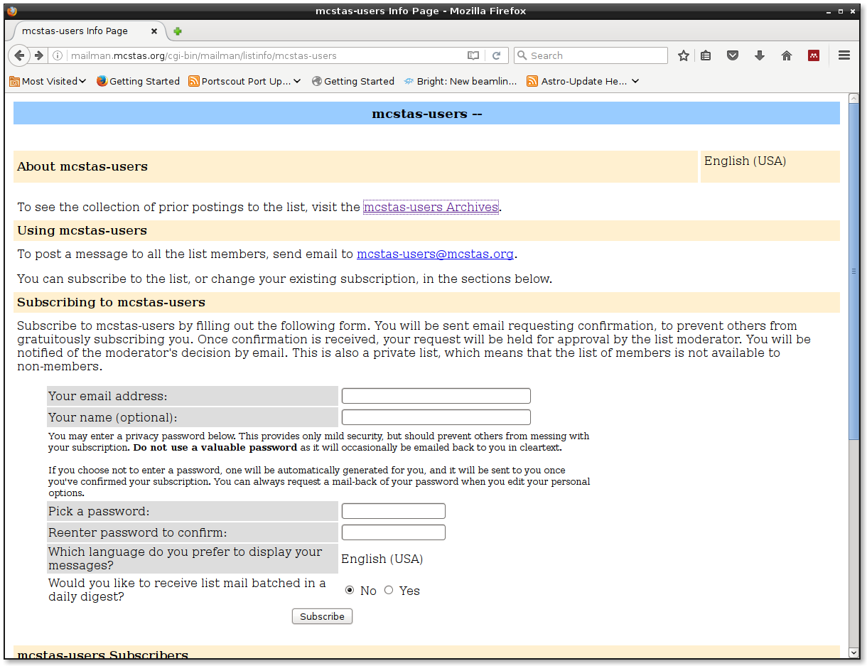
Mailing List

Slide 19
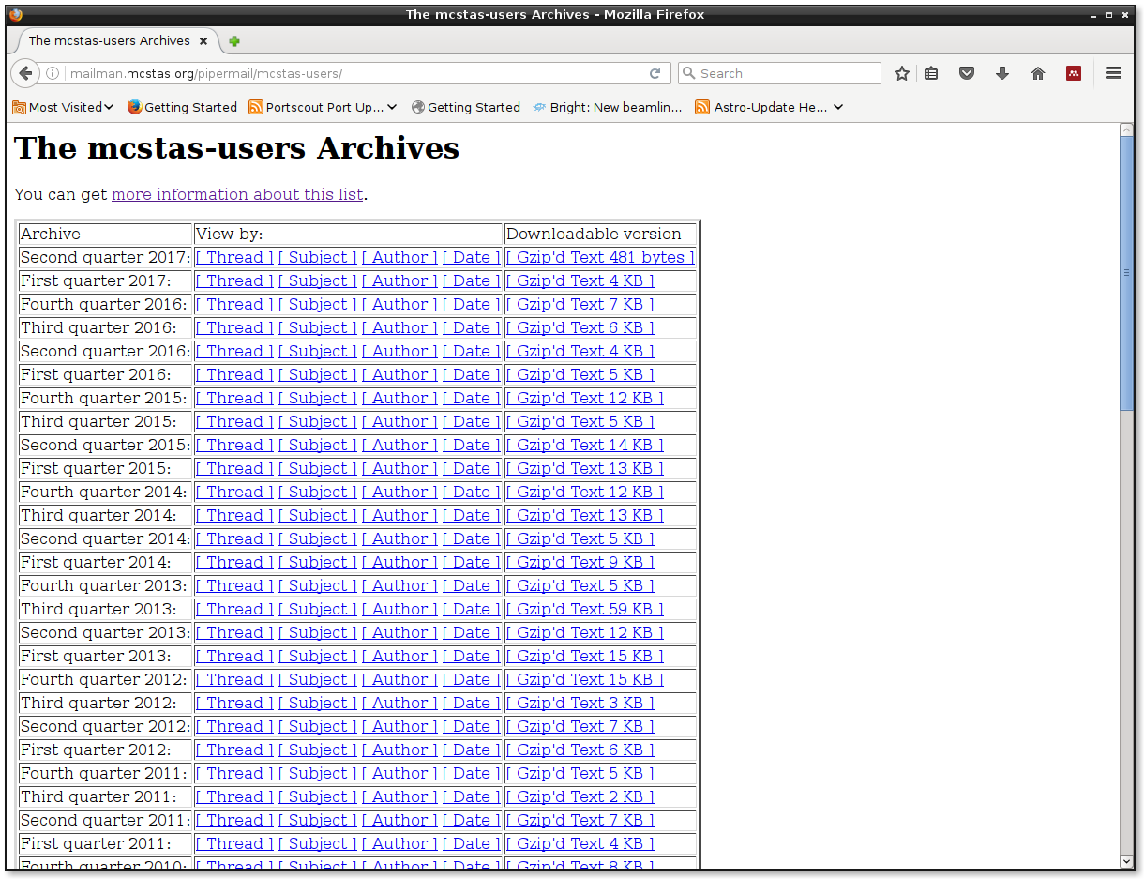
Mailing List - Archive

Slide 20
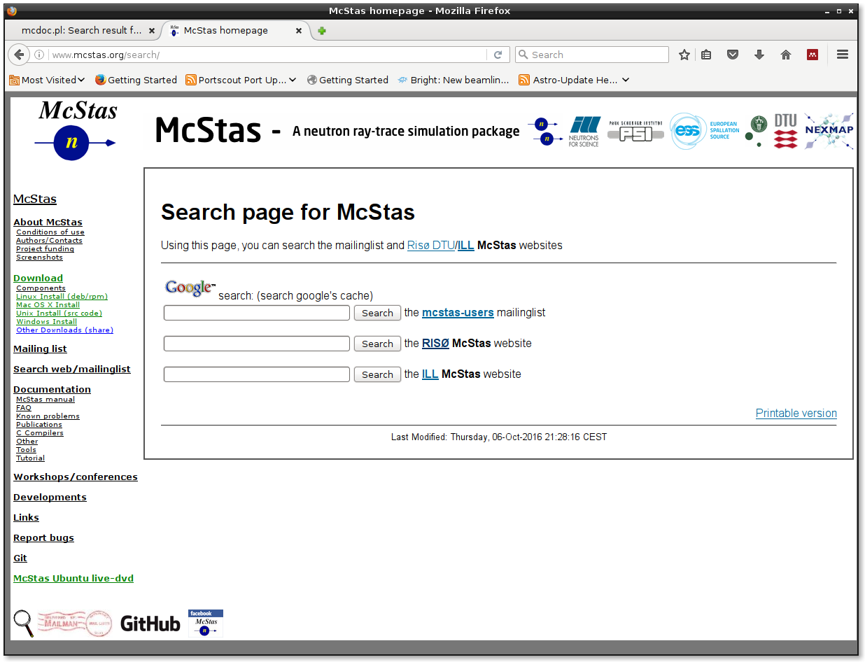
Mailing List Search page

Slide 21

POD?
Question:
Would anyone be interested in manuals as P.O.D.?

