Slide 1
New features in McStas 2.4
ISIS STFC McStas Training April 2017

Slide 2

Agenda
Highlighted new features in 2.3 (April 2016) and 2.4 (May 2017)
Support for MCPL event files for interchange with e.g. Geant4 and MCNP
New component description of the ESS butterfly moderator
New user interface developments
The 'Union' component set for e.g. accurate description of complex sample environments

Slide 3
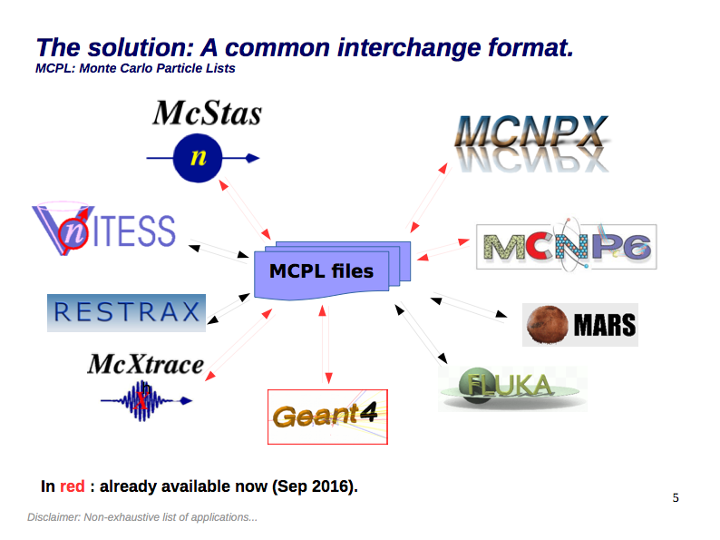
Improved MCPL support

Slide 4

Improved MCPL support
Further information:
https://mctools.github.io/mcpl/
https://arxiv.org/abs/1609.02792
http://coimbra2016.essworkshop.org

Slide 5
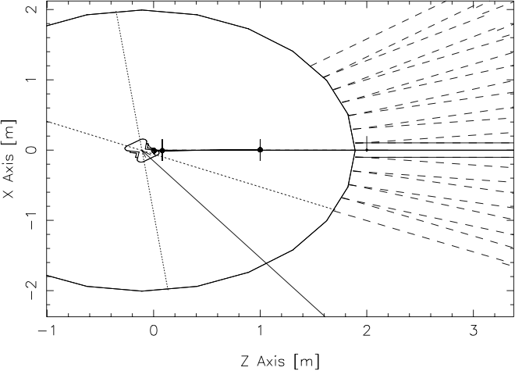
ESS_butterfly mcdisplay output: sector=N, beamline=5

Slide 6
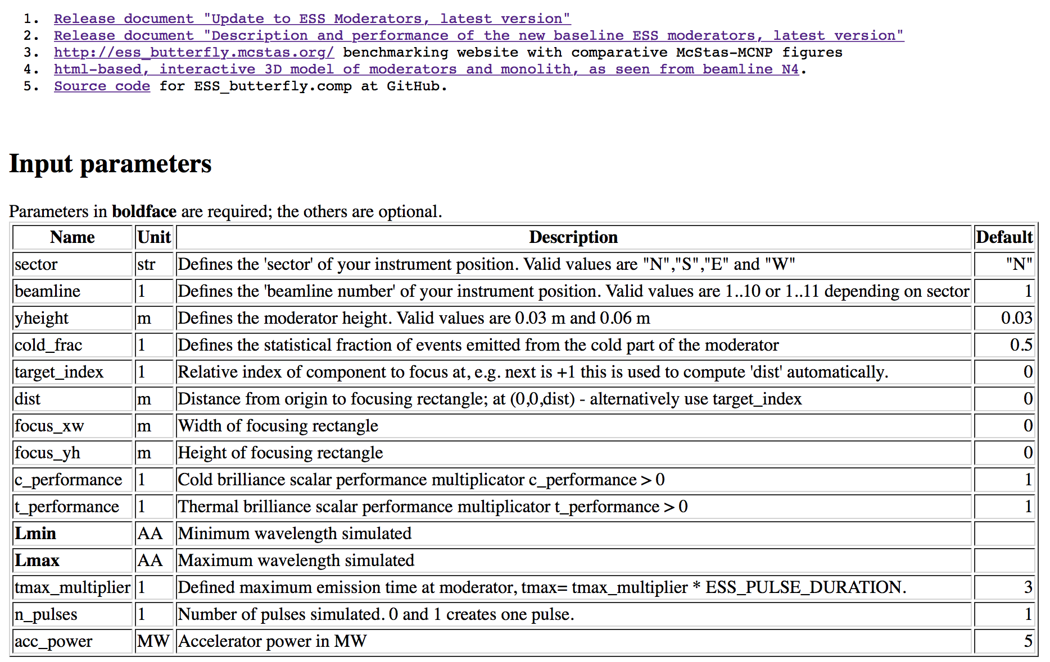
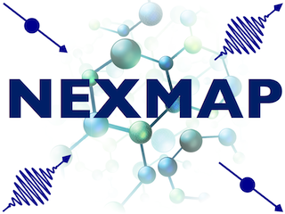




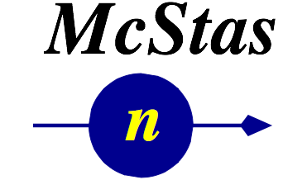
ESS_butterfly McDoc page:
See also http://ess_butterfly.mcstas.org
McStas+MCPL demo, January 20th 2017
WARNING: only for expert McStas users

Slide 7
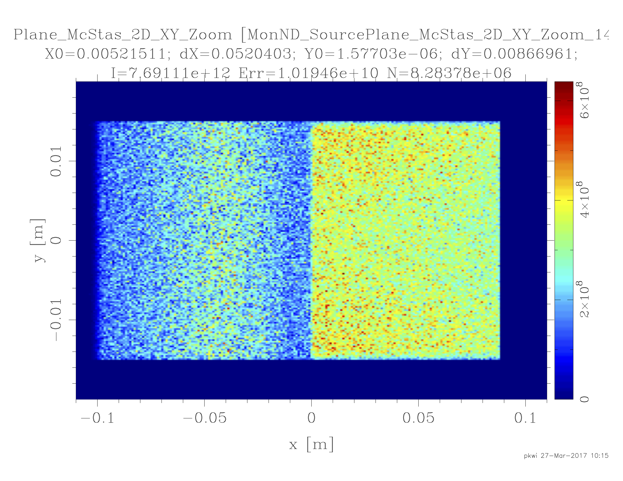
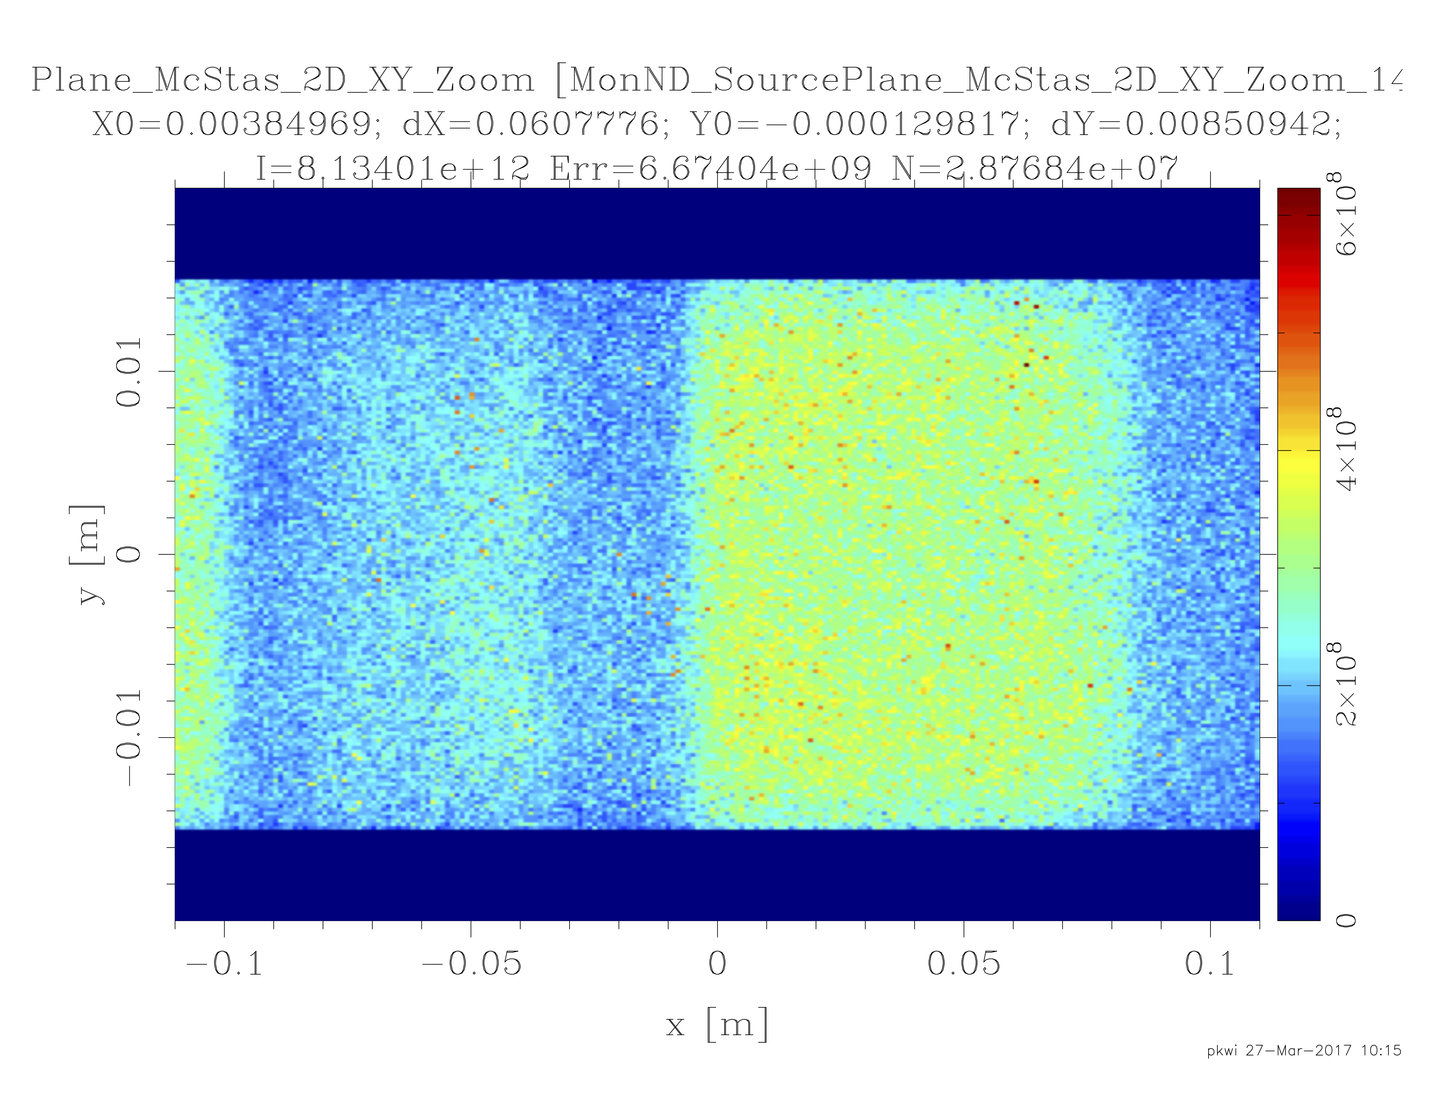
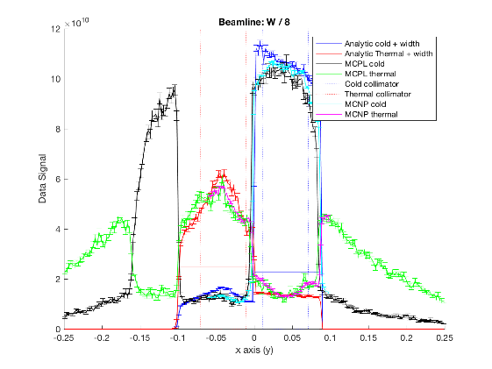
ESS_butterfly mcdisplay output: sector=N, beamline=5
Comes in analytic
and MCPL-based
versions

Slide 8
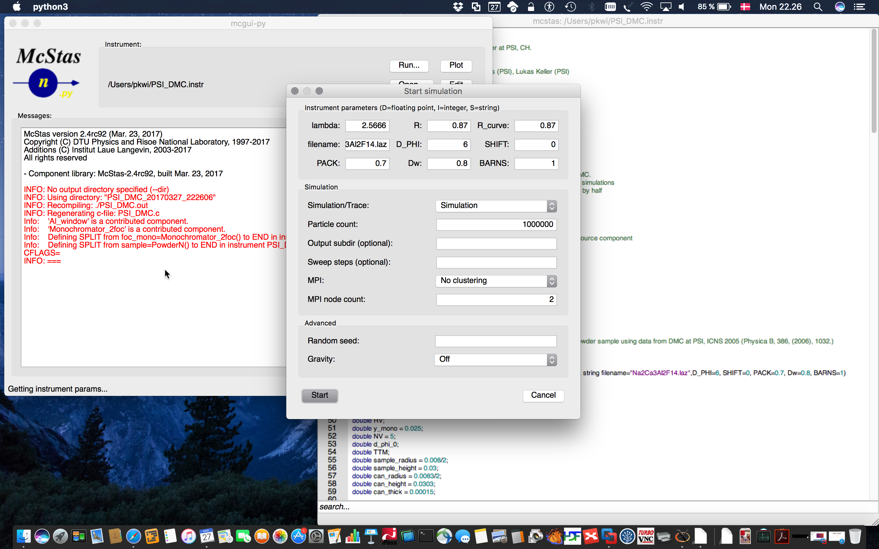
Python tool layer default from 2.4
mcgui Tk/Perl -> PyQt + QScintilla

Slide 9
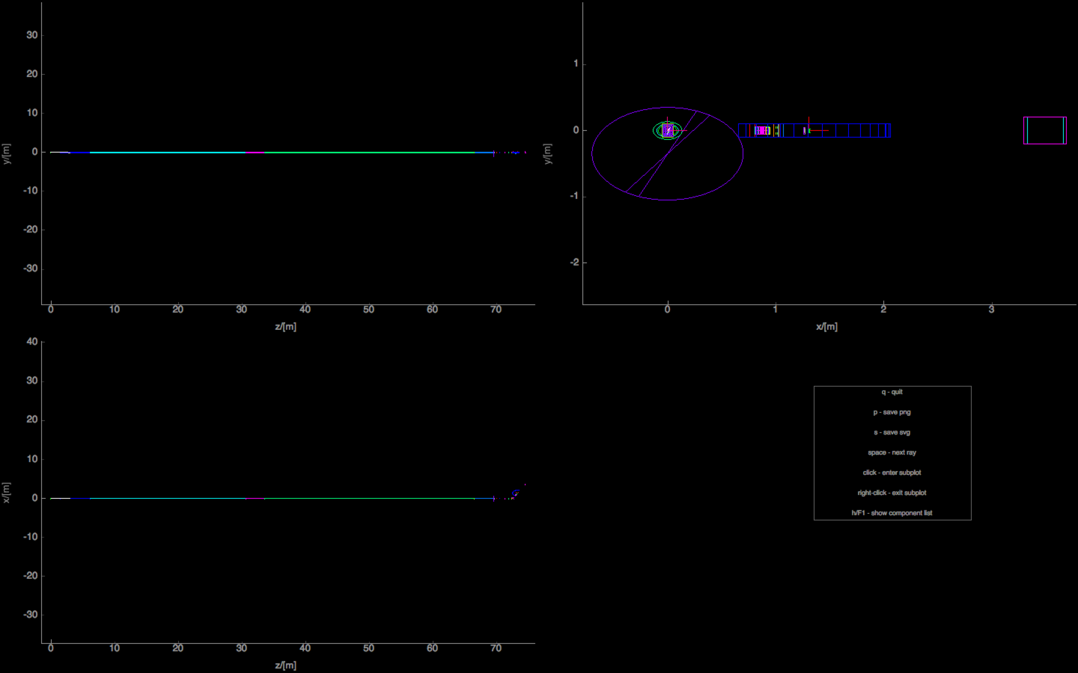
Python tool layer default from 2.4
mcdisplay Perl/PGPLOT -> PyQt + PyQtgraph

Slide 10
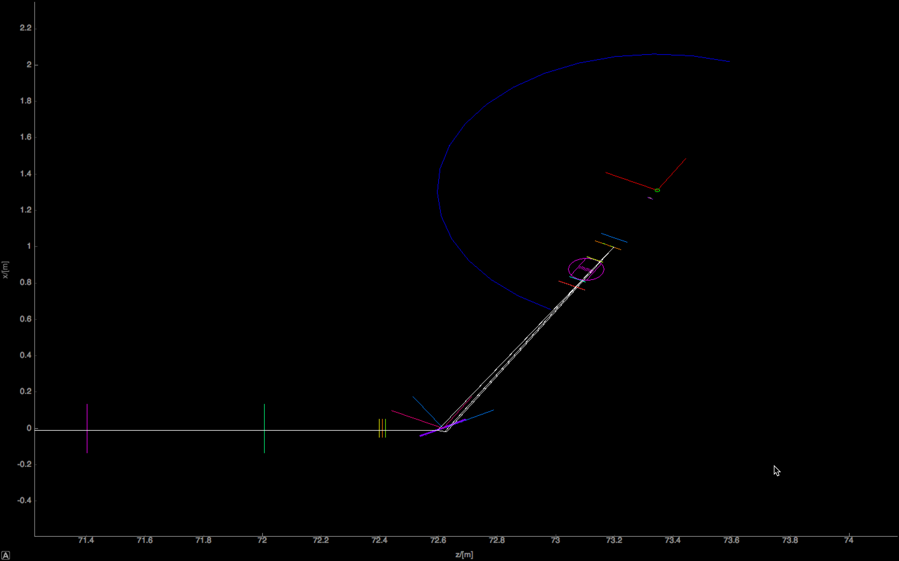
Python tool layer default from 2.4
mcdisplay Perl/PGPLOT -> PyQt + PyQtgraph

Slide 11
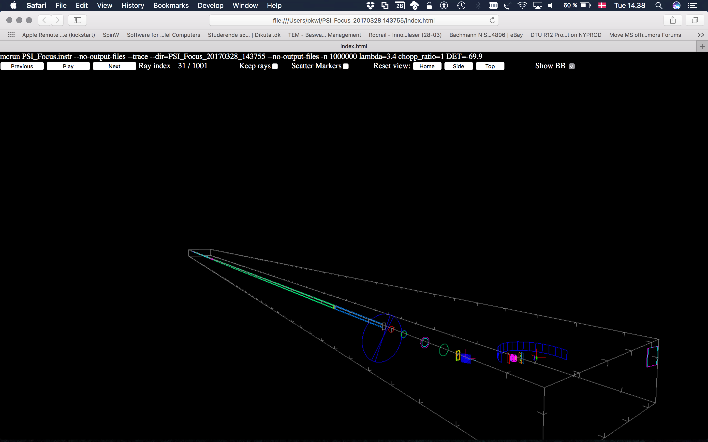
Python tool layer default from 2.4
mcdisplay Perl/PGPLOT -> Python + Webgl

Slide 12
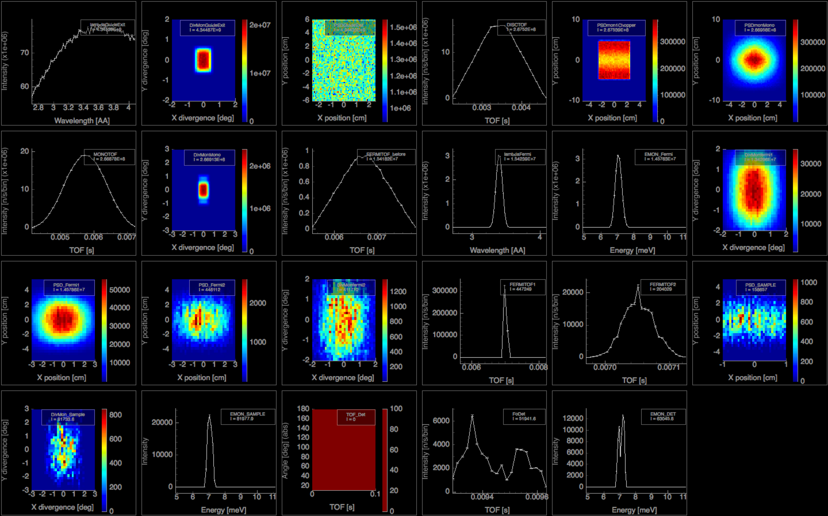
Python tool layer default from 2.4
mcplot Perl/PGPLOT -> PyQt + PyQtgraph

Slide 13
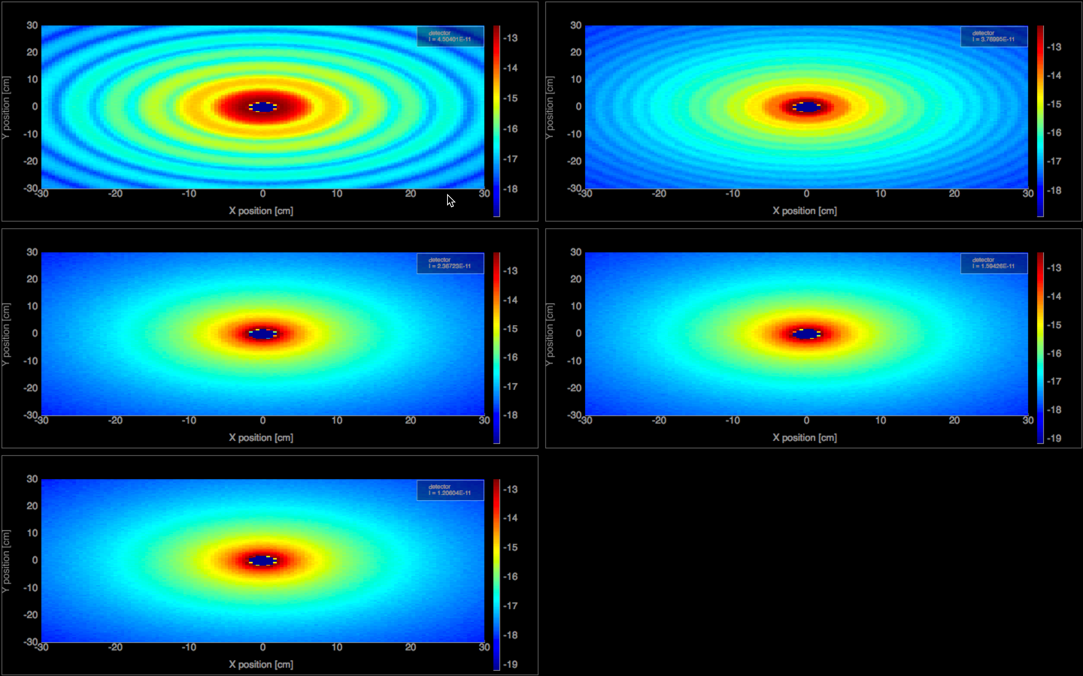
Python tool layer default from 2.4
mcplot Perl/PGPLOT -> PyQt + PyQtgraph

Slide 14
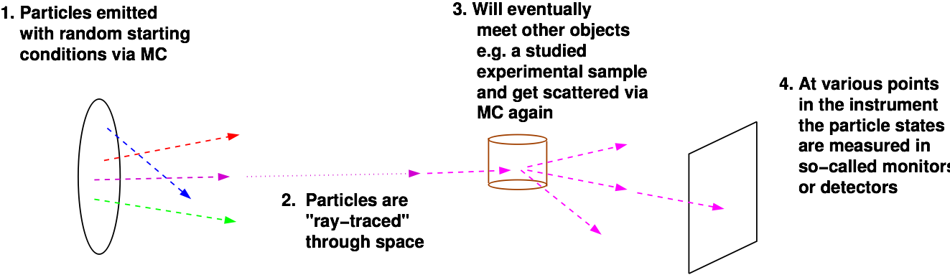
McStas overall picture
Important efficiency mechanisms:
“Focusing” - e.g. source to beamport only (4π vs. limited solid angle only)
Rather vs. single particle description, absorption handled though statistics and downscaling the ray weight

Slide 15

McStas overall picture
Algorithm limitations:
Linear comp seq. unless “hacks” are used - GROUP for comps in parallel - JUMP (a GOTO…) - EXTEND for further free-form C-code
Multiple scattering by default “within” component only - Some comps support “concentric” geometries e.g for sample inside sample env
Physics and geometry generally not separated - Both a strength and weakness, simple to write new comps < 200 LoC, one place.
The UNION concept by Mads Bertelsen, KU is an attempt to do something about the above points…
Important efficiency mechanisms:
“Focusing” - e.g. source to beamport only (4π vs. limited solid angle only)
Rather vs. single particle description, absorption handled though statistics and downscaling the ray weight

Slide 16

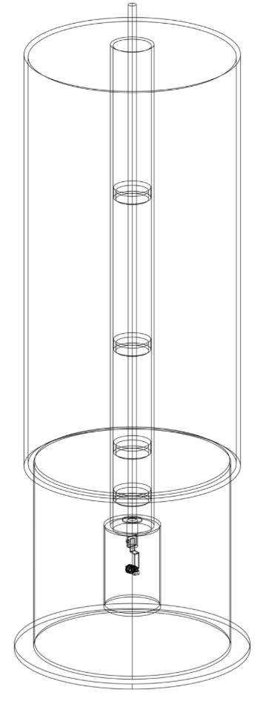
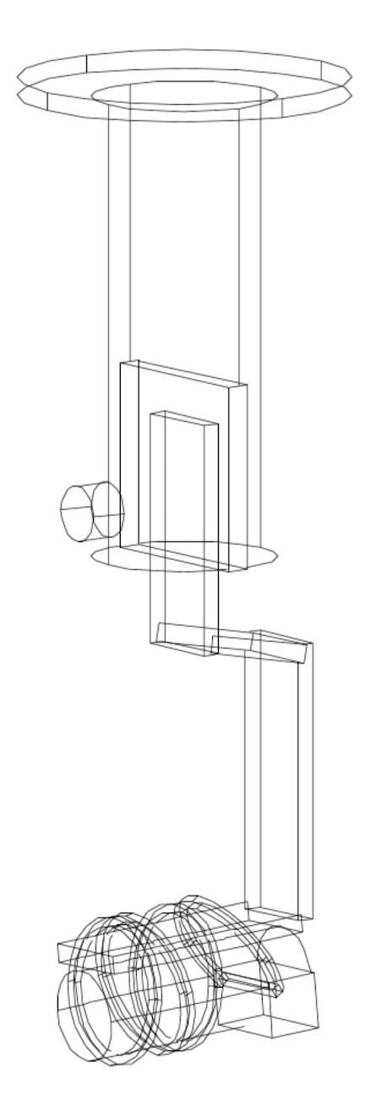
McStas overall picture
Algorithm limitations:
Linear comp seq. unless “hacks” are used - GROUP for comps in parallel - JUMP (a GOTO…) - EXTEND for further free-form C-code
Multiple scattering by default “within” component only - Some comps support “concentric” geometries e.g for sample inside sample env
Physics and geometry generally not separated - Both a strength and weakness, simple to write new comps < 200 LoC, one place.
The UNION concept by Mads Bertelsen, KU is an attempt to do something about the above points…
Important efficiency mechanisms:
“Focusing” - e.g. source to beamport only (4π vs. limited solid angle only)
Rather vs. single particle description, absorption handled though statistics and downscaling the ray weight

Slide 17
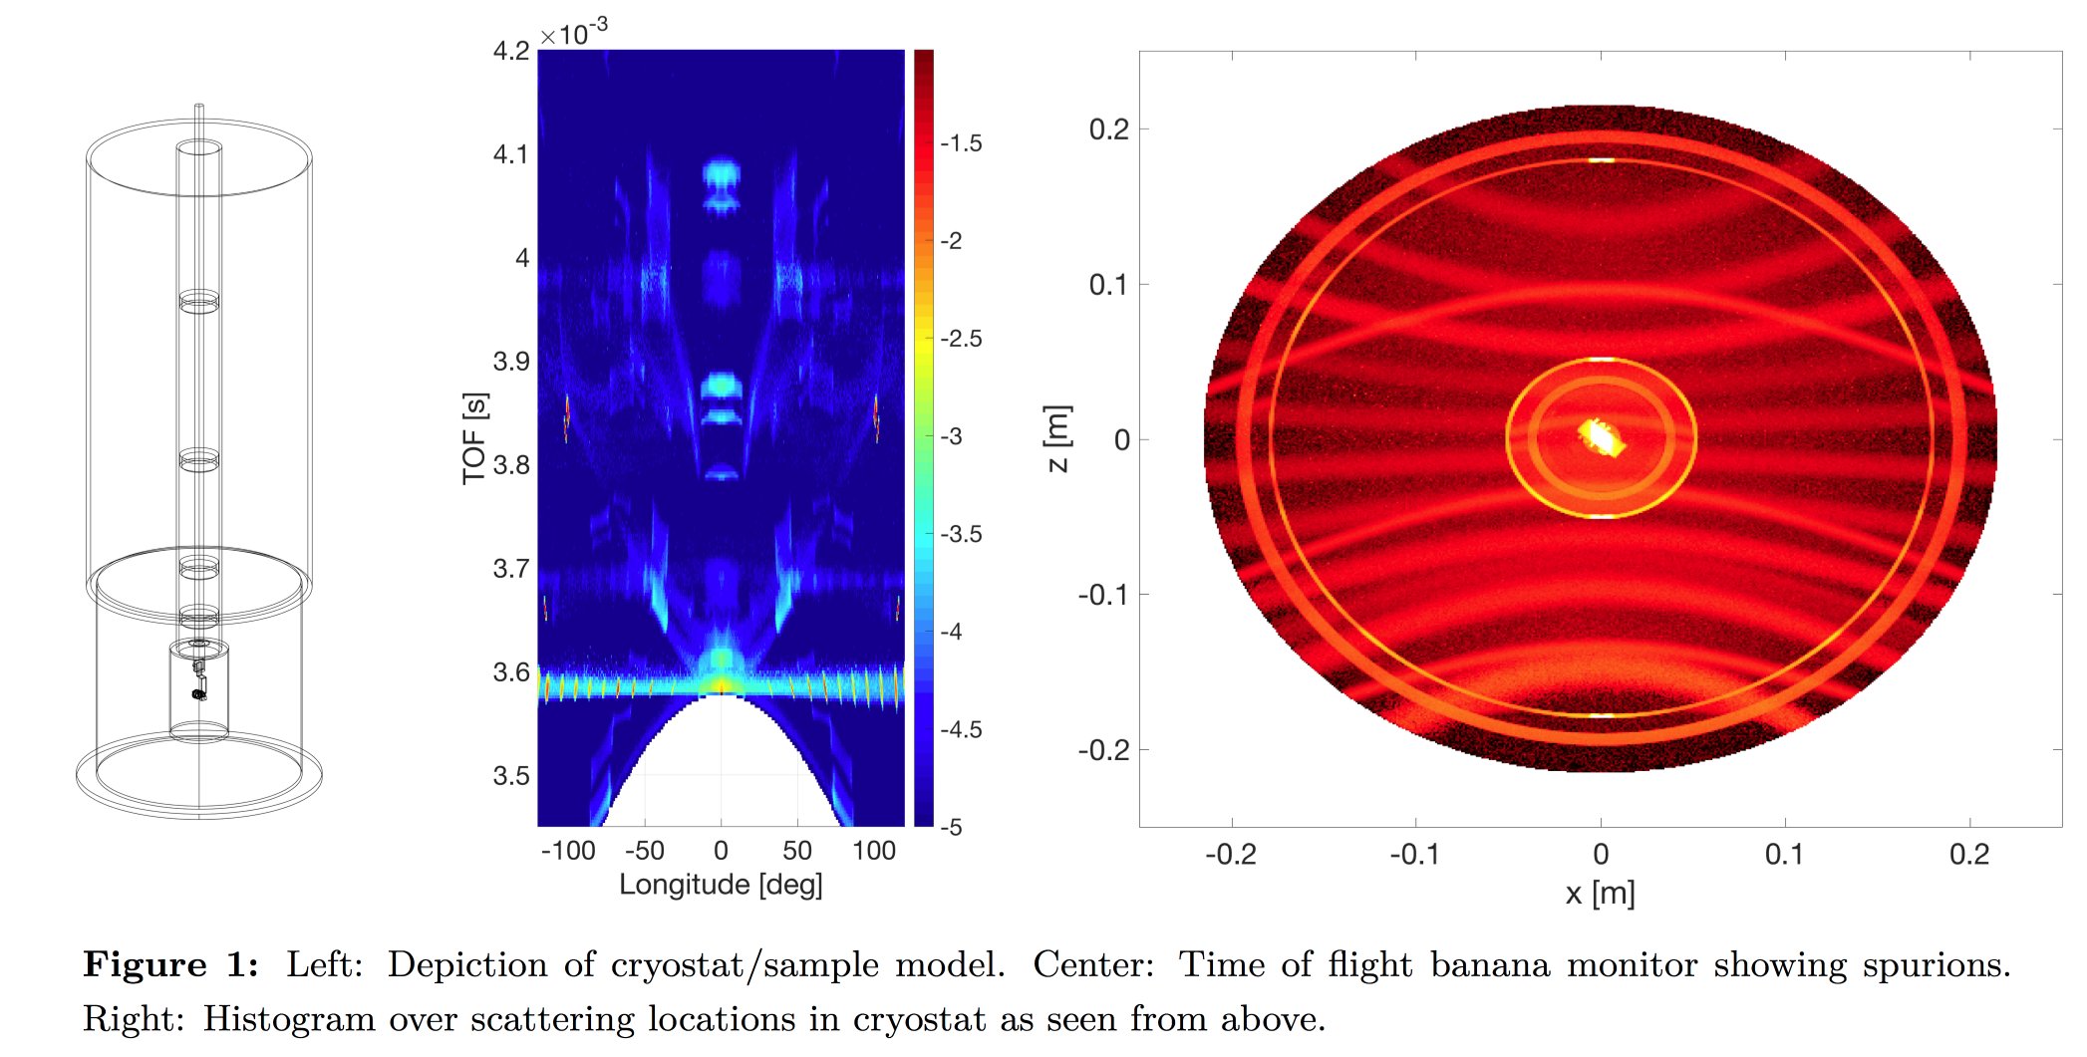
McStas Union concept
http://media.mcstas.org/ESS_DMSC_20161117/DMSC_talk_MBertelsen_McStas_Union.mp4
See online-video at http://media.mcstas.org/ESS_DMSC_20161117/DMSC_talk_MBertelsen_McStas_Union.mp4 + ICANS XXII proceedings

Slide 18
Next: Demo!

