Slide 1
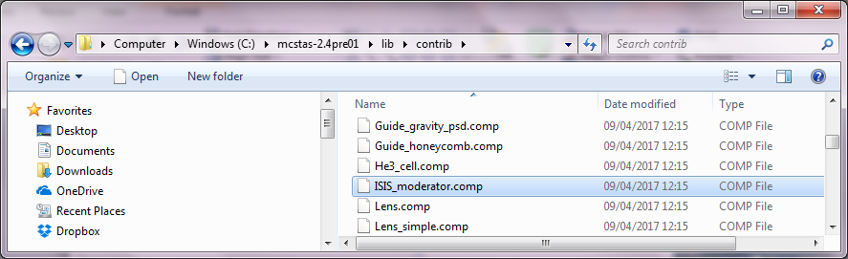
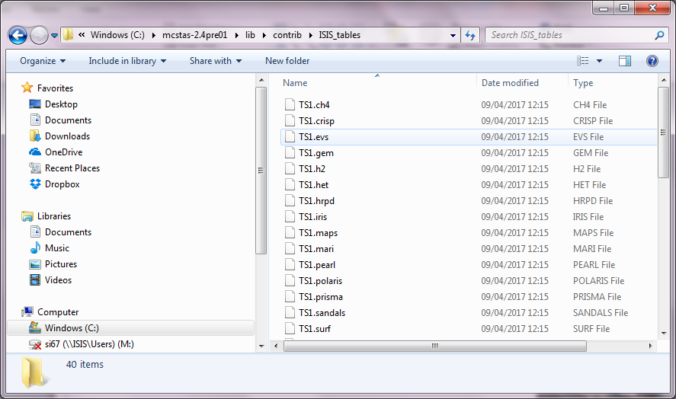
ISIS moderators

Slide 2
Component: ISIS_moderator
Written by: S. Ansell and D. Champion in August 2005
Release: McStas 1.9
Produces a TS1 or TS2 ISIS moderator distribution. The Face argument determines which moderator is to be sampled.
Neutrons are created having a range of energies determined by the Emin and Emax arguments.
Trajectories are produced such that they pass through the moderator face (defined by modXsize and modYsize) and a focusing rectangle (defined by focus_xh,focus_yh and dist).
The focusing rectangle could be, for example, your sample.

Slide 3
Component: ViewModISISver1
Modification of ViewModerator4 component written by S. Ansell in 2015
Written by: S. Ansell and Goran Škoro in Feb 2016
Release: McStas 2.4 (?), tested on 2.0 and 2.2
Please note that ViewModerator(1 to 4) are not supported anymore.
Please note that you need to use this component rather than ISIS_moderator.comp if you want to use the new moderator files produced by the neutronics group (see in the workshop folder). These are the most accurate model currently available.
It is still a beta version but so far no major complaints have been received.

Slide 4
Why a new moderator component?
The main difference with the previously distributed ISIS_moderator is that neutrons can be produced from the shutter front face rather than from the moderator face.
modPosition=1
The trajectories (and corresponding timings) are then projected backwards towards the moderator face, as well as forwards.
This option was necessary during the neutronics development phase of the TS1 project, when the moderator position, orientation and size and therefore the position of its front face was frequently changing. The shutter position was then the only stable reference point.
Running this option is non-trivial and requires further adjustments to your instrument file (details will be available for the record).

Slide 5
modPosition=1
m
sh
L1

Slide 6
So what do I do?
We have now reached the point where the moderators sizes are mostly fixed and therefore it is recommended that the moderator is used with the option modPosition=0
i.e. generating neutrons from the front face of the moderator as standard
With this option set to 0, the moderator component runs trivially like the previous ISIS_moderator, i.e. you only need to choose your energy interval (E0,E1), the size of your moderator face (modXsize, modZsize) and the size and distance for your focusing face(xw,yh,dist).
And of course you need to choose your instrument/face/port.

Slide 7
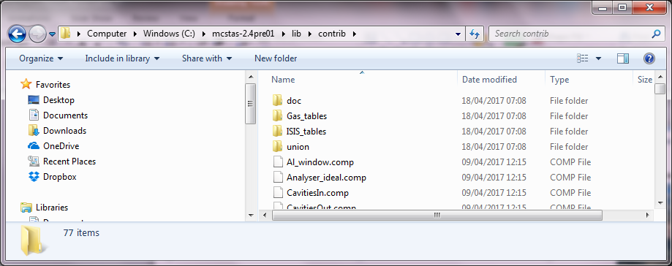
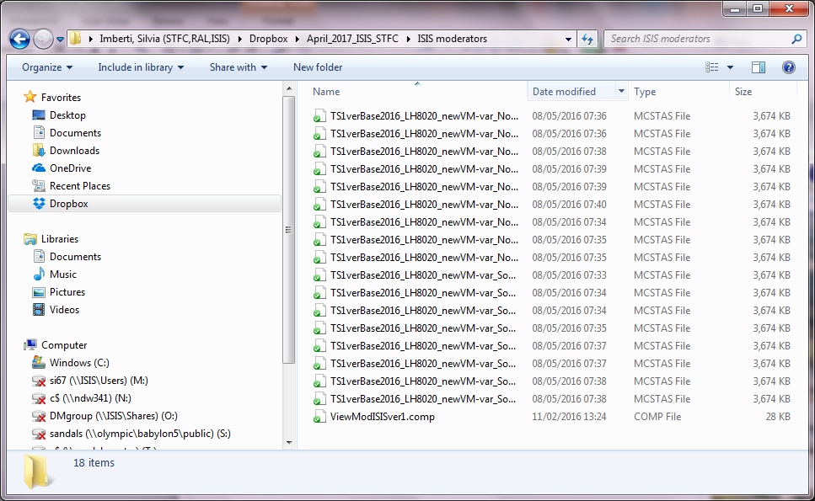
How to “install”
Since the new moderator component is not part of the beta release, you need to copy it from the USBdrive “ISIS moderator” and place it under C:\mcstas-2.4pre01\lib\contrib
Then the .mcstas file with your moderator should be placed in the folder with your instrument file

Slide 8
modPosition=0
m
L1

Slide 9
Using modPosition=1
Not recommended option, generating neutrons from the shutter face.
These instructions have been given to me by Goran Škoro some time ago but have not been revised by him in the current format.
Adjustments necessary to the instrument file:
1. Find out all the moderator to shutter position by looking into the actual moderator file. In the first few lines of the .mcstas file, look for TimeOffset=167 (for example). This means that the shutter is placed at 1.67m from the moderator face (Mod2Shut=1.67)
This distance can be different between you baseline and your upgrade models
2. Rescale all distances by this distance, i.e. the sample is now at L1-Mod2Shut
3. Remember that also the variable dist for the focusing window is now L1-Mod2Shut

Slide 10
modPosition=1
Mod2Shut
L1-Mod2Shut
m
sh
L1
Mod2Shut is called TimeOffset in the .mcstas file.
Mod2Shut [m]=TimeOffset/100

Slide 11
As a final warning, remember that in real life not all neutrons are created equally at the face of the moderator, and this becomes part of the accuracy of you experiment as well as of your simulation.

Slide 12
TODO
Suggestions for usage i.e. focus window into guide or onto sample

