Slide 1
Mantid – McStas Exercise
Torben Nielsen
Peter Willendrup
www.europeanspallationsource.se
28 April, 2017

Slide 2
Exercise I: From McStas to Mantid
Use templateSANS_Mantid.instr to make a Nexus file for Mantid
Compile McStas code
Make IDF file
Run simulation
Start Mantid
Load data into Mantid
Play with Mantid interface

Slide 3
Exercise II: Mantid Algorithms
Use templateSasView_Mantid.instr to make a NeXus file for Mantid
Compile McStas code
Make IDF file
Run simulation
Start Mantid
Load data into Mantid
Reduce event data in Mantid as described in the templateSasView_Mantid.instr file

Slide 4
Exercise III: Python Script
Write a python script in Mantid which will load and reduce the data
Use data from templateSasView_Mantid.instr
See link below about Mantid and Python
https://www.mantidproject.org/Running_Algorithms_With_Python
https://www.mantidproject.org/Python_In_Mantid
TIP: one can save the “history” of used algorithms operations on an data set into a python file

Slide 5
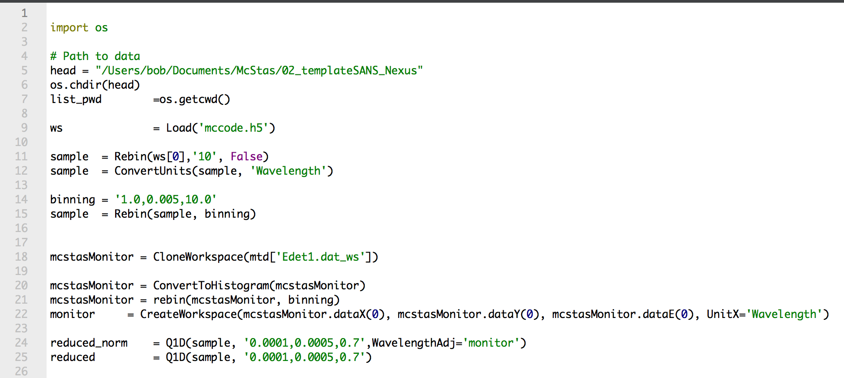
Exercise III: Mantid python Script
Use as template
Modify as needed

Slide 6
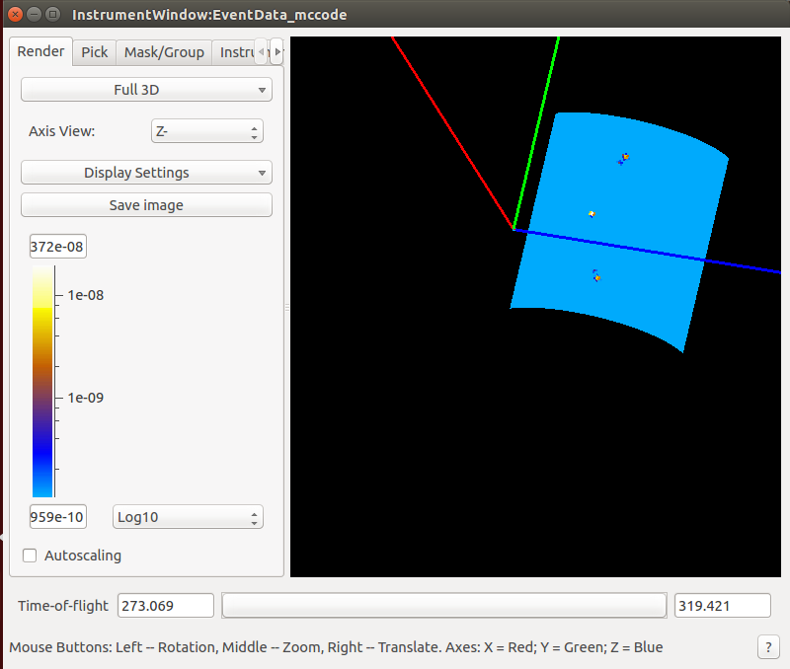
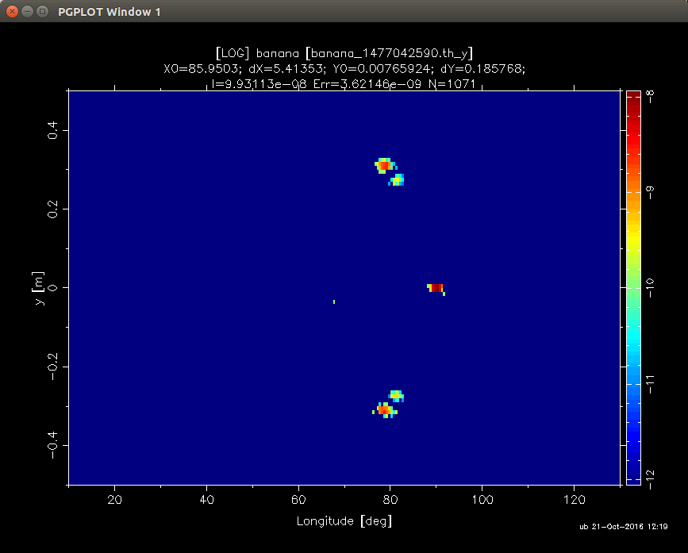
Exercise IV: Single_crystal
Use exercise “Single_crystal” to transform instrument file to be read from Mantid

