Slide 1
McStas - Mantid
Torben Nielsen
Anders Markvardsen
Peter Willendrup
www.europeanspallationsource.se
28 April, 2017

Slide 2
Outline
Motivation
Illustration of the Mantid-McStas interface
A simple toy model: templateSANS.instr
TOF, IDF, and NeXus files
How to use – a little more explanation
Demo time
A few other examples

Slide 3
Motivation: I - Highlevel
Mantid is well established software – long history
McStas is well established software – long history
Wanted to combine the reduction framework and the neutron transport framework
So users can seeming less do transport, reduction and “analysis” in one go

Slide 4
Motivation: II - Benefits for users
View McStas data in Mantid (simple – but nice to have)
Import McStas event data to Mantid
Use already developed and tested algorithms in Mantid to process McStas event data (no need to reinvent stuff!!!)
Advanced use: Use McStas to quantify (perhaps remove) “spurries” signal on detector (can scatt. – multi. scatt )

Slide 5
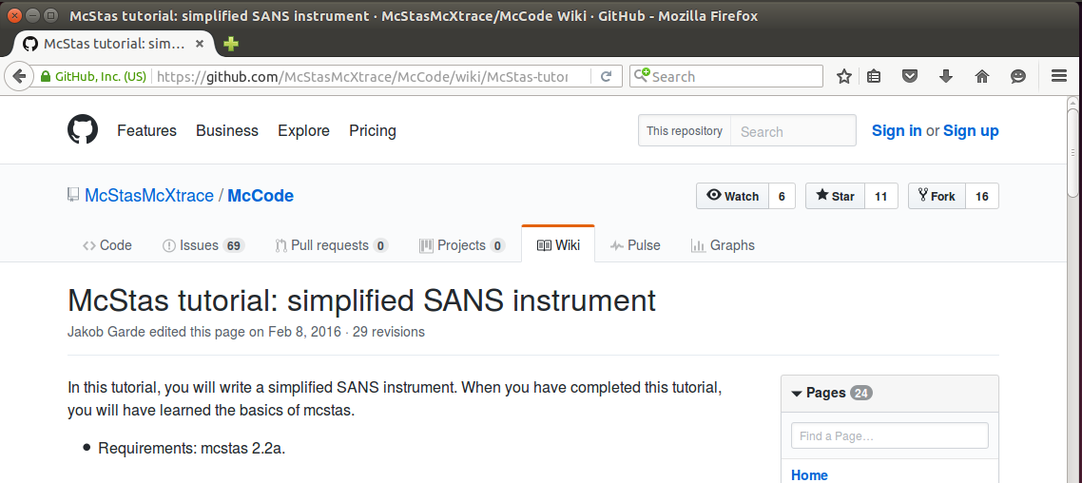
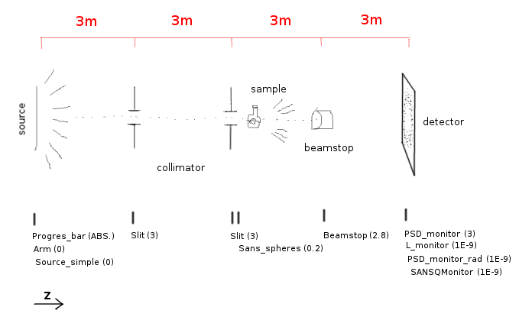
Illustration: simplified SANS instrument

Slide 6
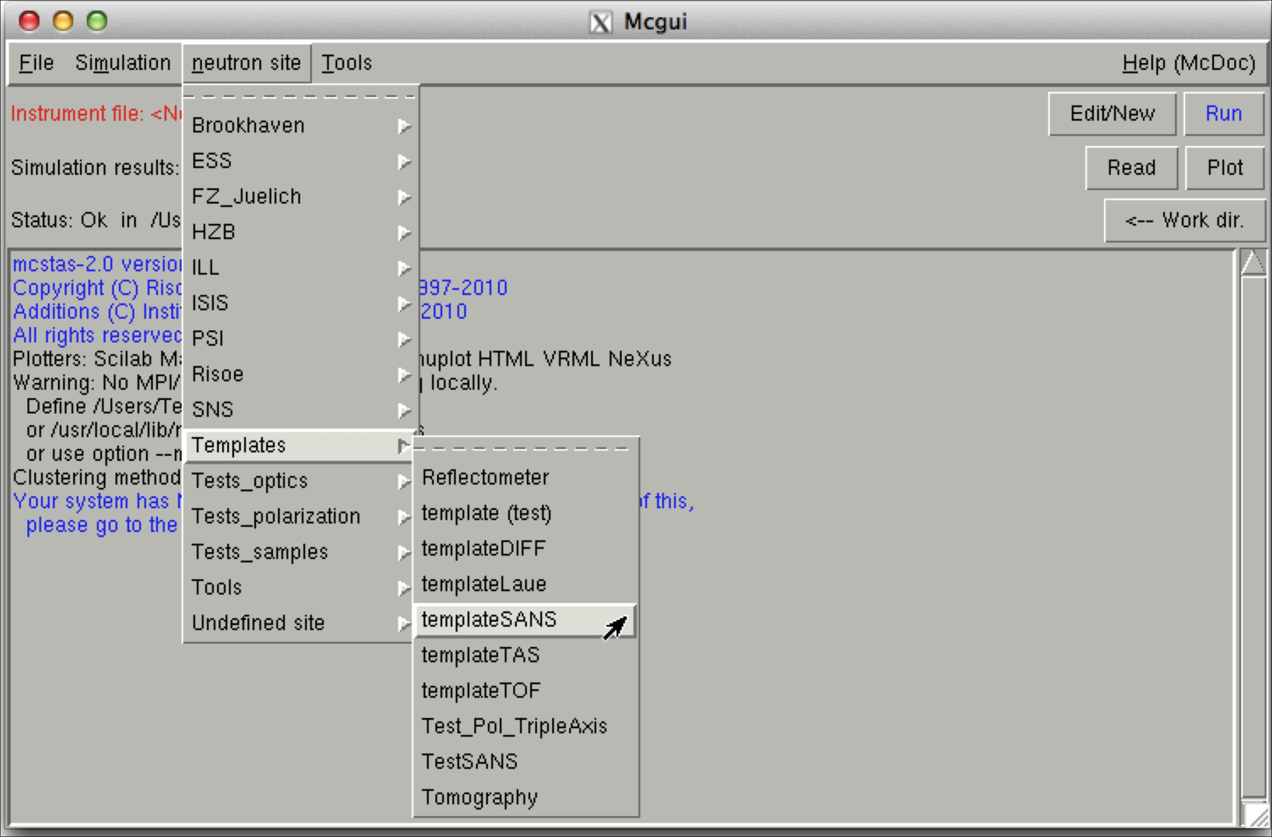
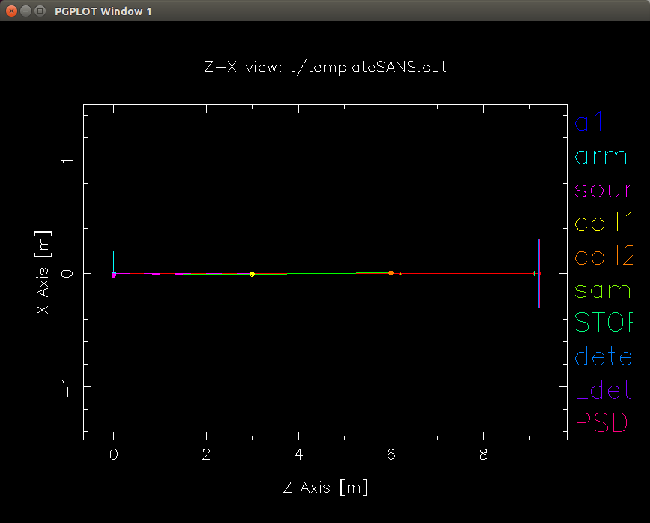
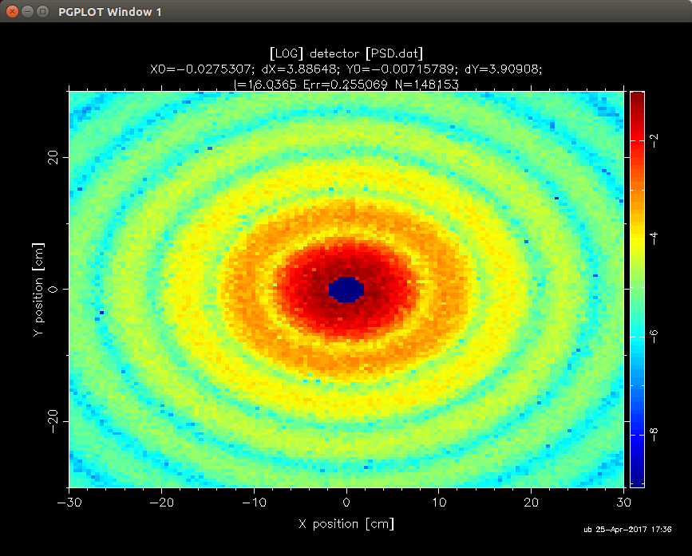
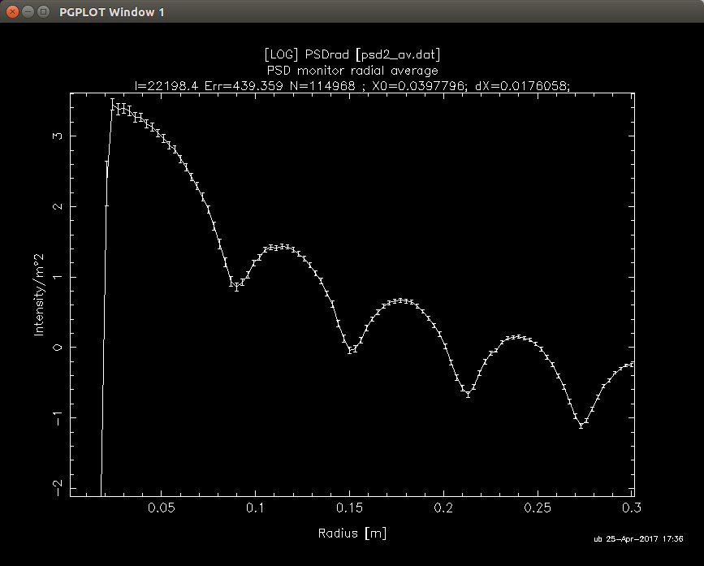
McStas GUI: templateSANS
R=150,phi=0.1, d=1,a=0

Slide 7
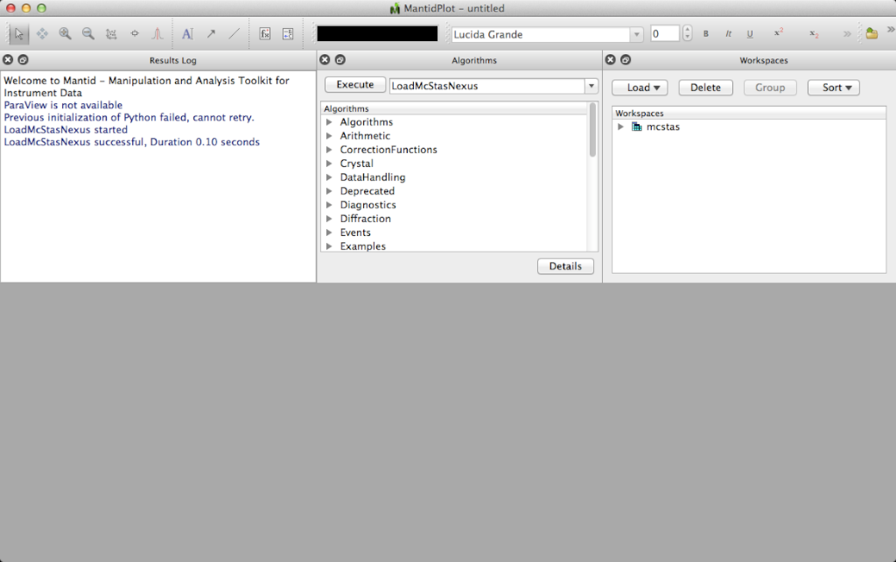
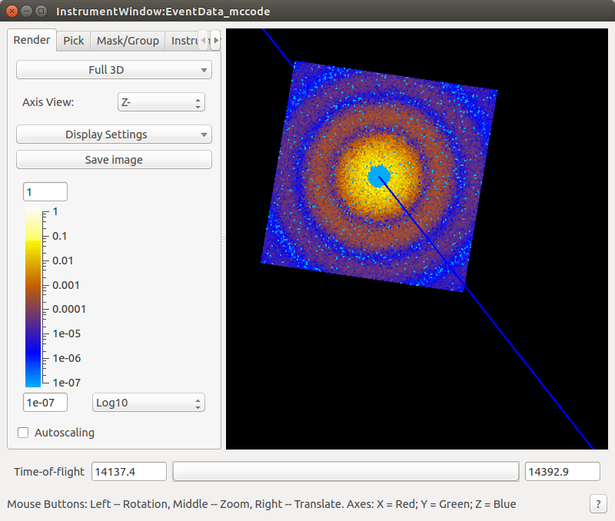
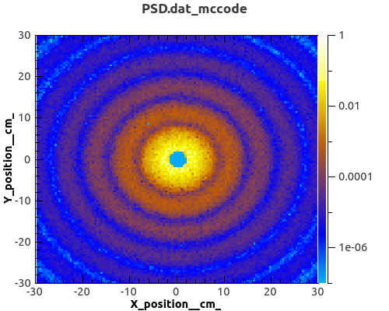
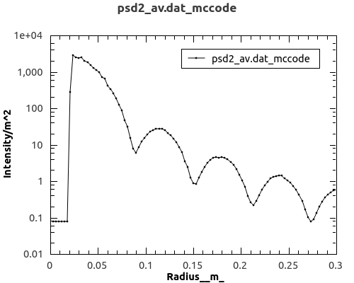
Mantid GUI: templateSANS McStas data

Slide 8
How to use: TOF and pixel ID’s
Mantid was designed for data reduction at TOF spallation neutron sources
Mantid’s IDF store geometry information use in TOF analysis
This implies parsing information about:
where the neutron source is located,
where the sample is located,
where each individual detector pixel is located.

Slide 9


How to use: NeXus file
NeXus file
Mantid
The McStas Nexus file must contain:
Event data, i.e each neutron has a pixel id and a time stamp
An IDF McStas monitor_nD gives pixle id & time for each event
mcdisplay can auto-generate an IDF

Slide 10
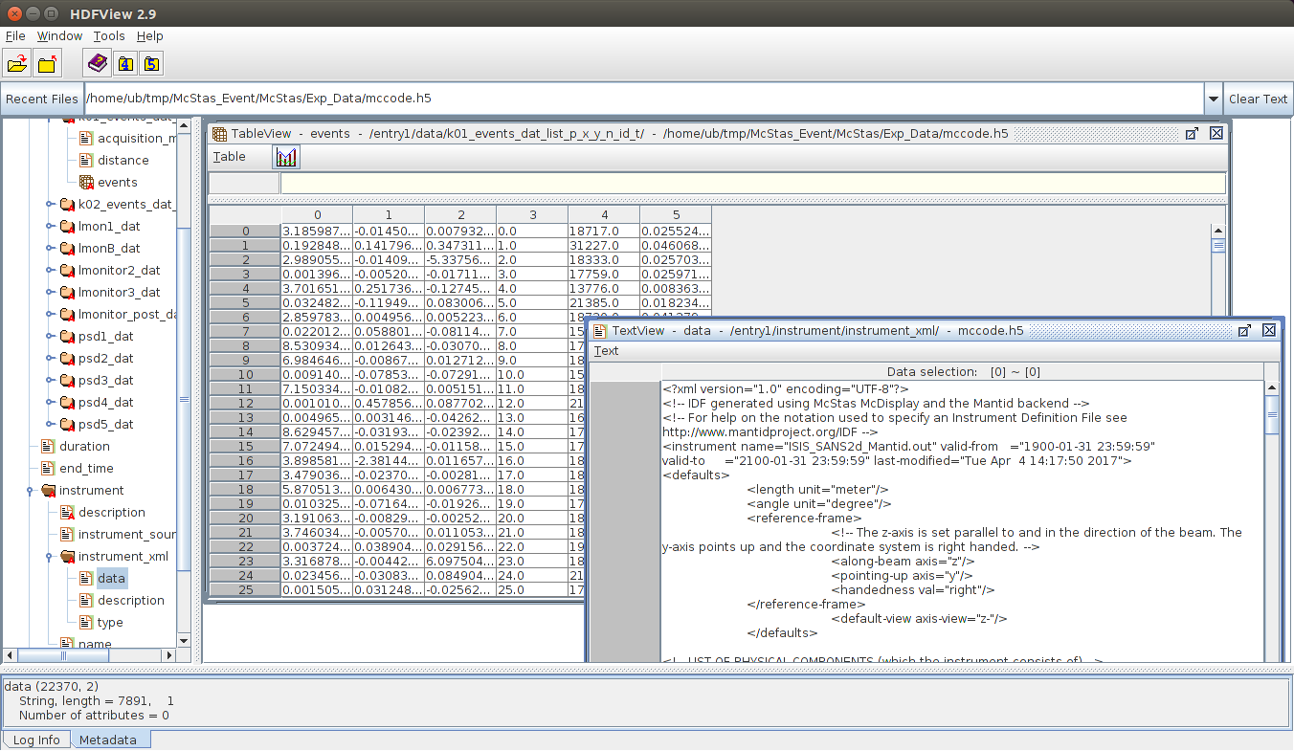
How to use: McStas NeXus file
Event data
IDF xml data

Slide 11
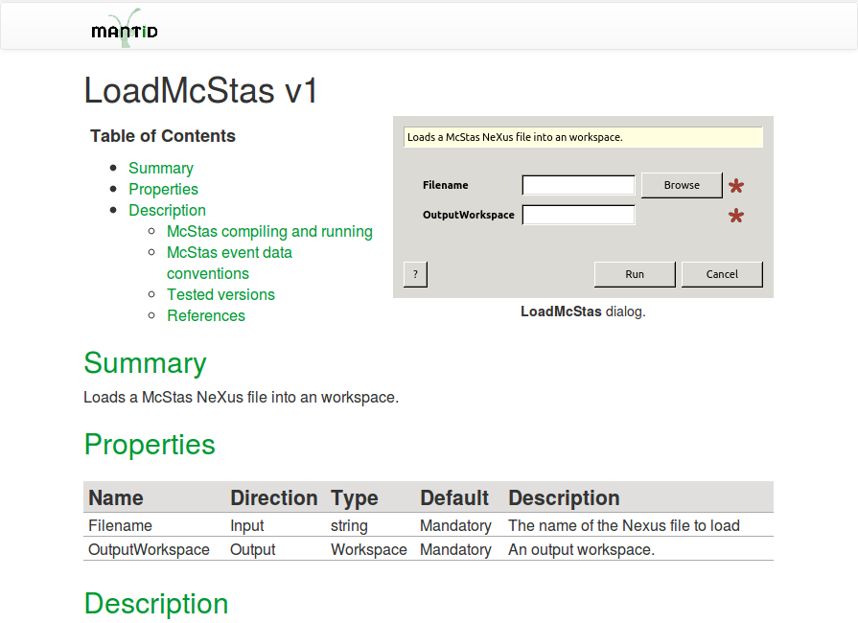
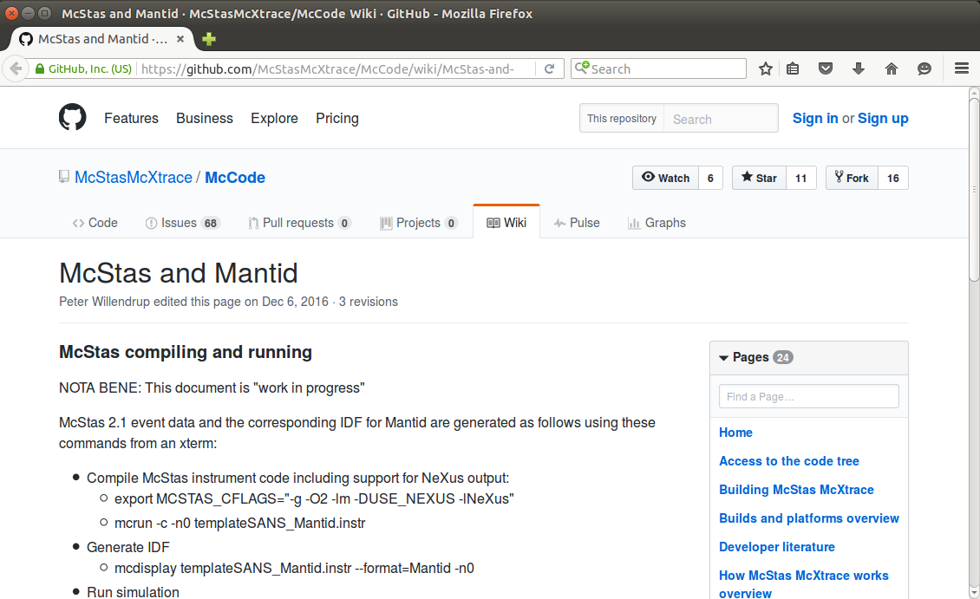
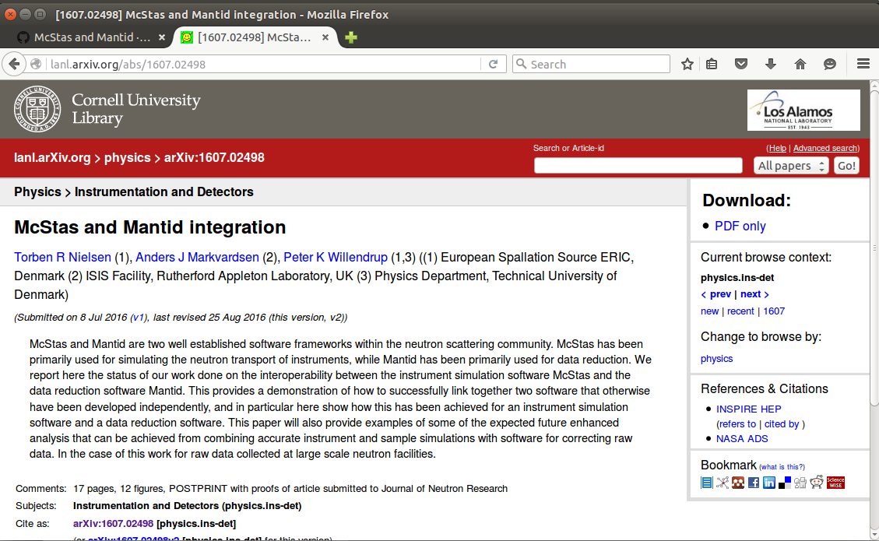
How to use: Online documentation
Buil-in Mantid
Github McStas
Archive - lanl.arXiv.org

Slide 12
How to use: McStas event conventions
McStas instrument file name and the McStas defined name of the instrument must be the same:
E.g. templateSANS_Mantid.instr and “DEFINE INSTRUMENT templateSANS_Mantid(…. )”
In the McStas instrument file the source must be named “sourceMantid”
E.g. "COMPONENT sourceMantid = Source_simple(…. )"
In the McStas instrument file the sample must be named “sampleMantid”
E.g. "COMPONENT sampleMantid = Sans_spheres(…. )"
In the McStas instrument file the event monitors must be named “nD_Mantid_#”
E.g. "COMPONENT nD_Mantid_1 = Monitor_nD(…. )"

Slide 13
How to use: Generate the IDF
How-to generate McStas event data for Mantid
Step 1. Generate IDF:
mcdisplay templateSANS_Mantid.instr --format=Mantid -n0
A new xml IDF file is then generated on disk

Slide 14
McStas – Mantid: Demo Time
See how to use Mantid – McStas interface

Slide 15
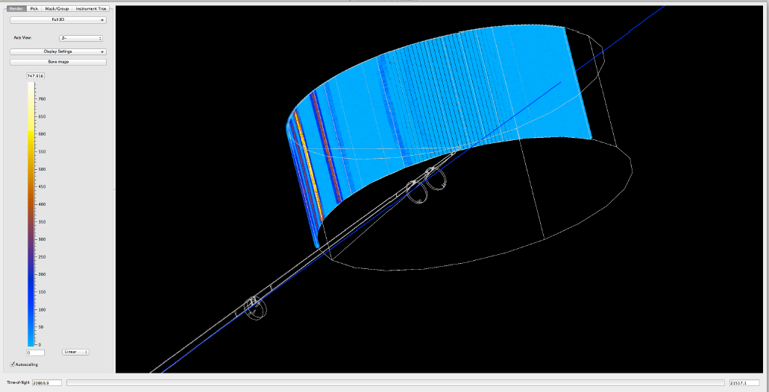
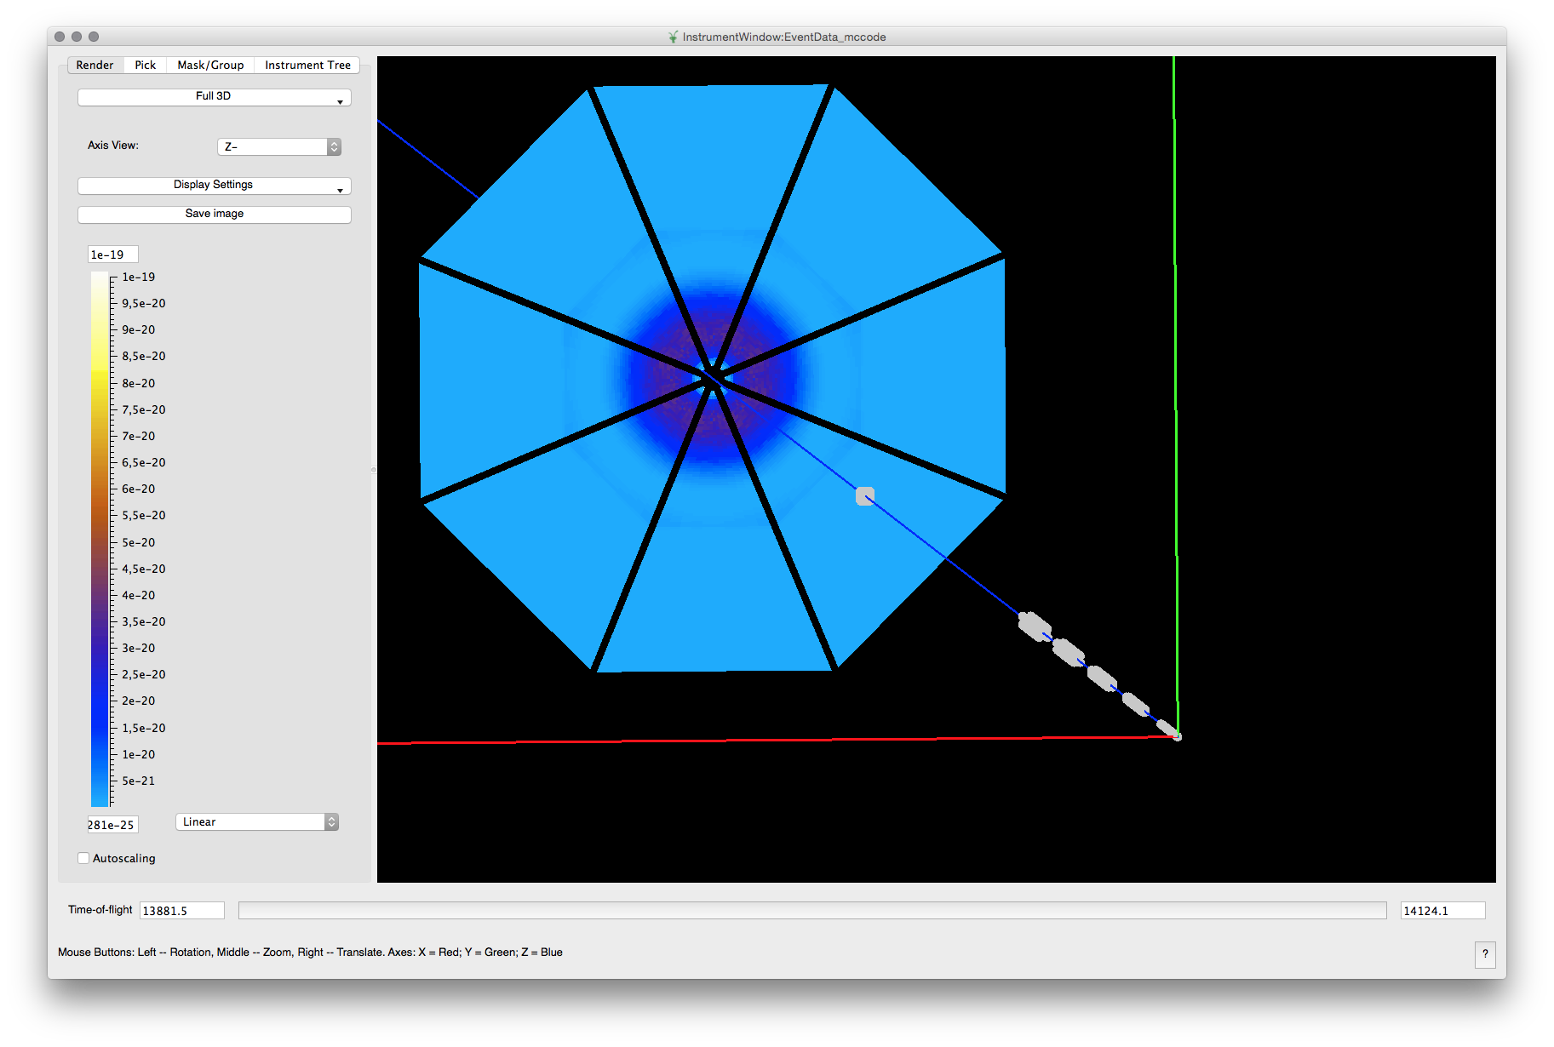
Examples of detectors: IN5 (ILL) and LoKI (ESS)

Slide 16
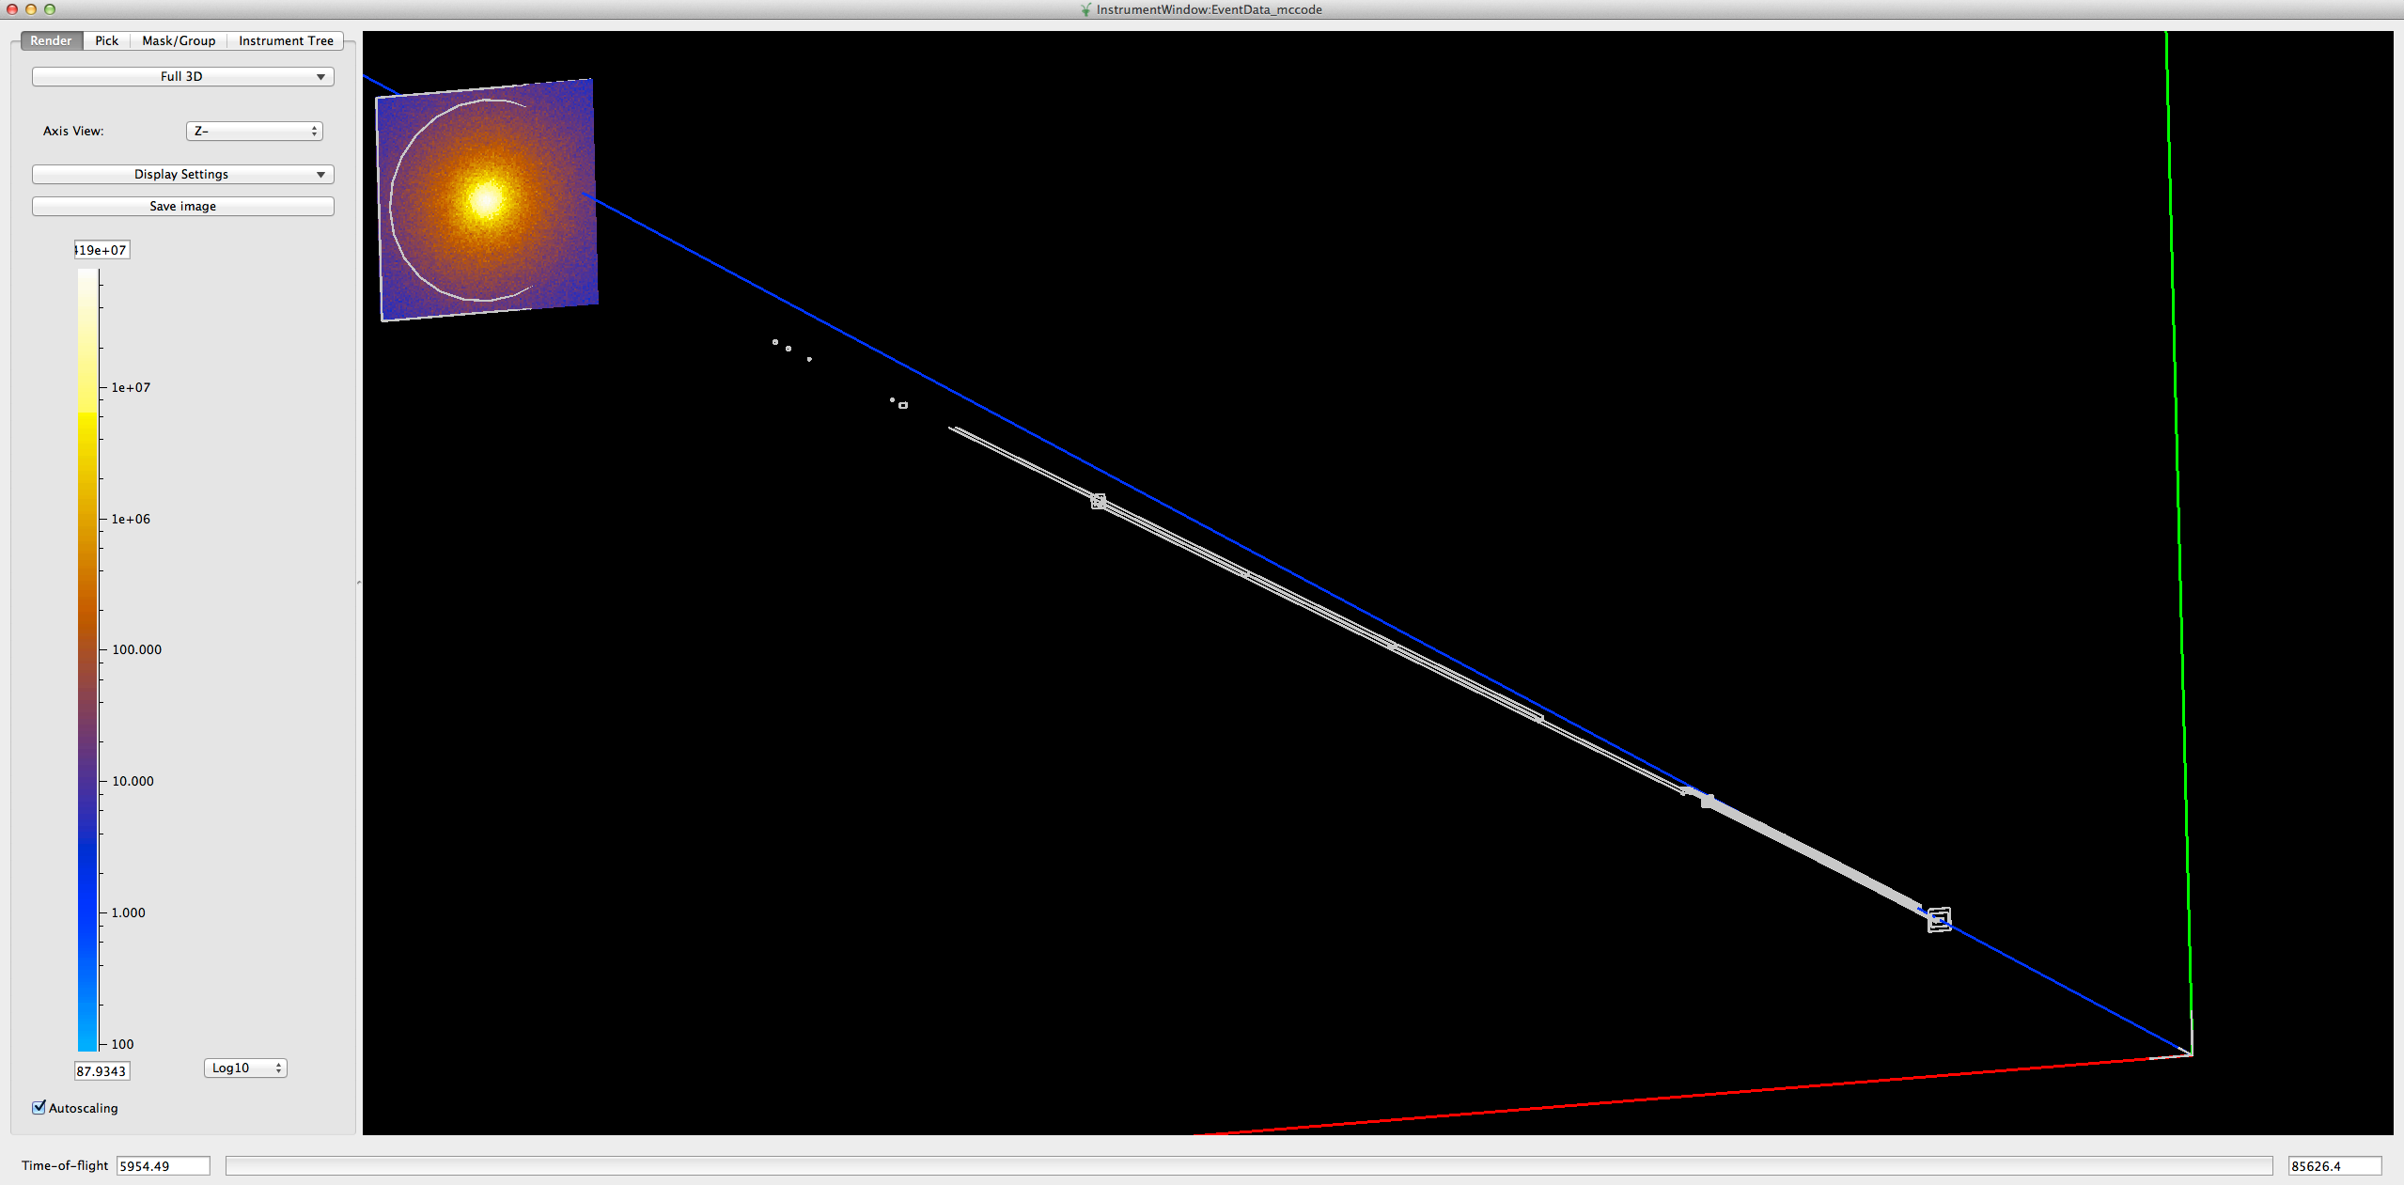
Example of real data: SANS2D
Mantid view of the McStas event data generated for the ISIS_SANS2d.instr file.
Comparison of rescaled scatting intensity I(q) derived from the experimental data and a McStas simulation. Nanospheres of radius 150 Å, polydispersion 0.2.

Slide 17
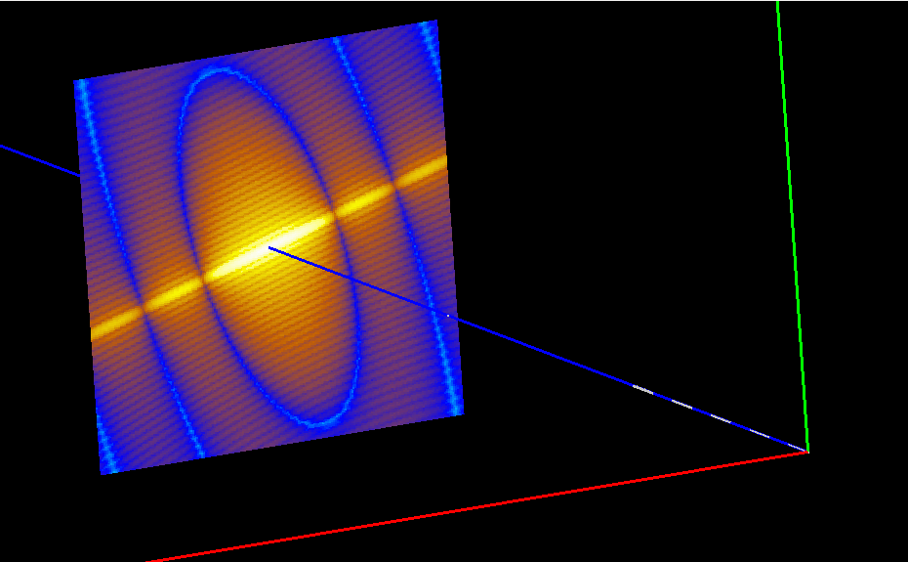
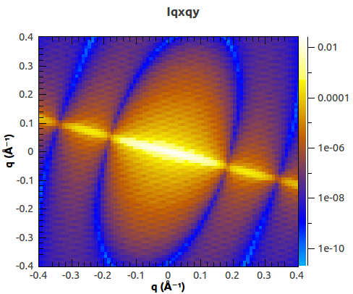
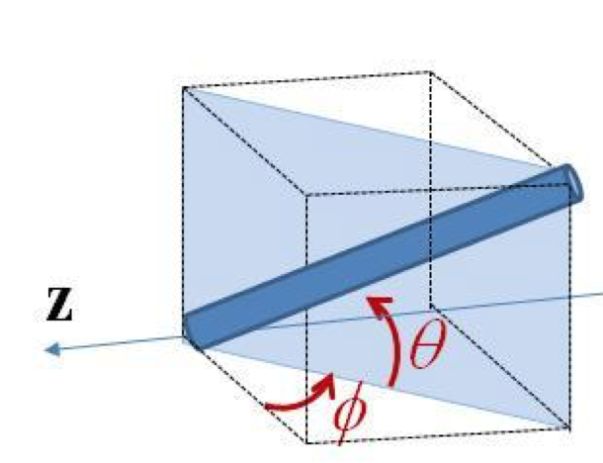
Example: Usage of Mantid algorithms
McStas – Mantid
2D scattering kernel from SasView
2D reduction in Mantid: Qxy
Can be send back to SasView fitting

Slide 18
The end …....

Slide 19
How to use: Make NeXus file for Mantid
How-to generate McStas event data for Mantid
Step 1. Compile c code:
gcc -o templateSANS_Mantid.out templateSANS_Mantid.c -DUSE_NEXUS –lNeXus –lm
Step 2. Run simulation:
templateSANS_Mantid.out --format=Nexus
Now IDF is embedded in the NeXus file to be read by Mantid

Slide 20
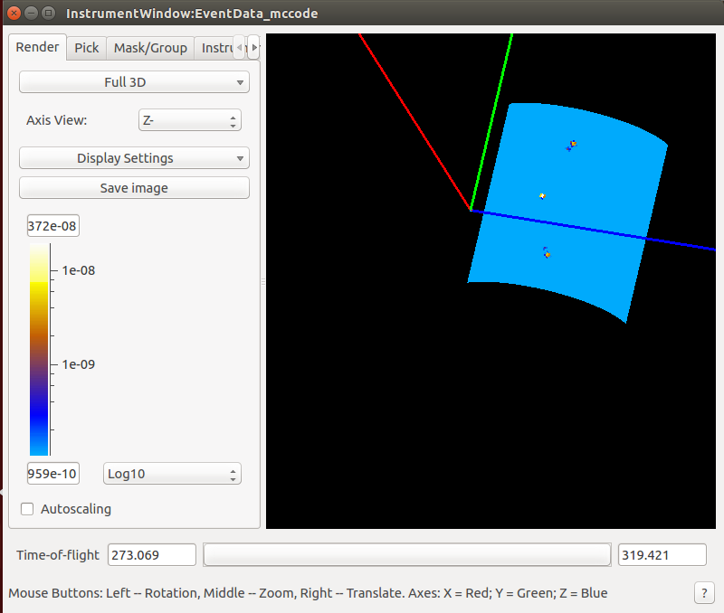
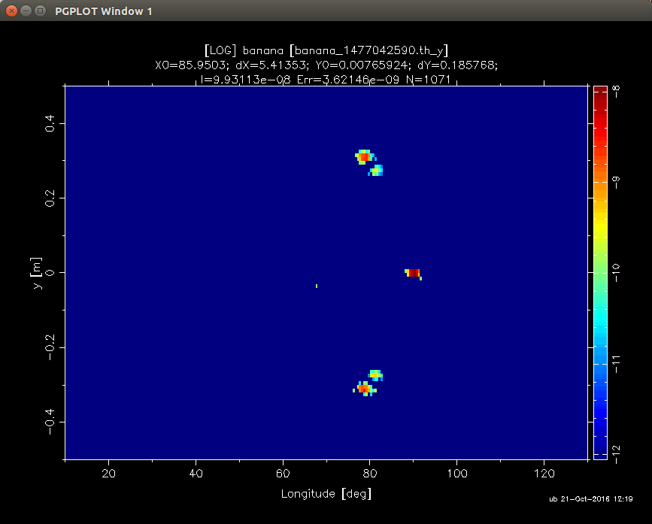
Example: Single_crystal
Use exercise “Single_crystal” to transform instrument file to be read from Mantid

